Slide 1
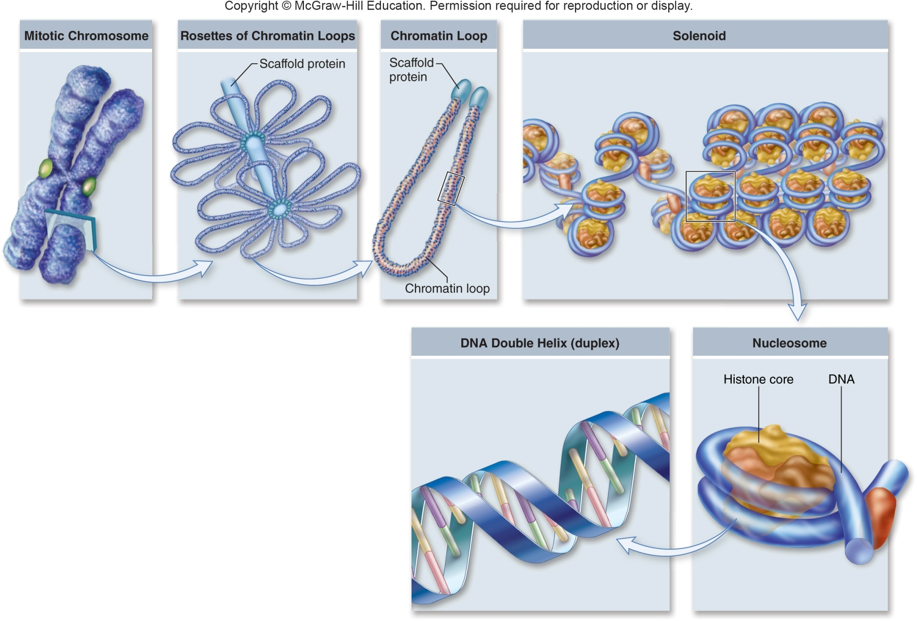
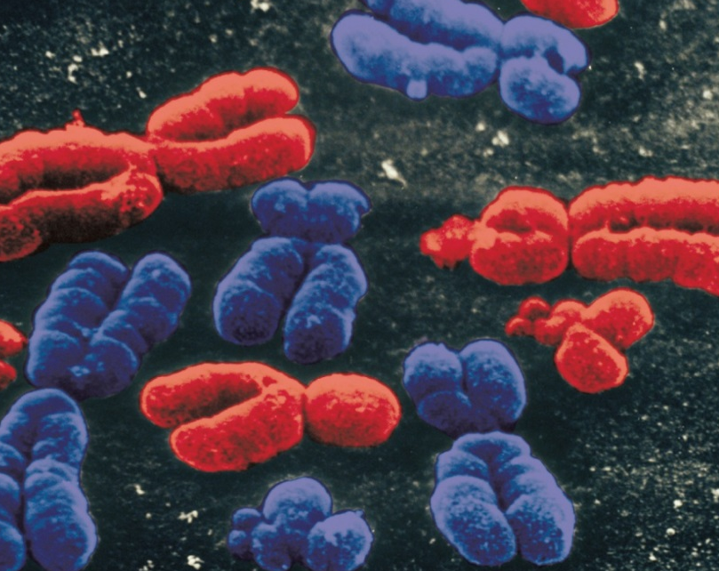
Chromosomes are made of protein and DNA
iClicker!
What is more complicated…
  Protein
  DNA
  Equally complex
Notes:
Can this DNA be used easily do you think?
Karyotype

Slide 2
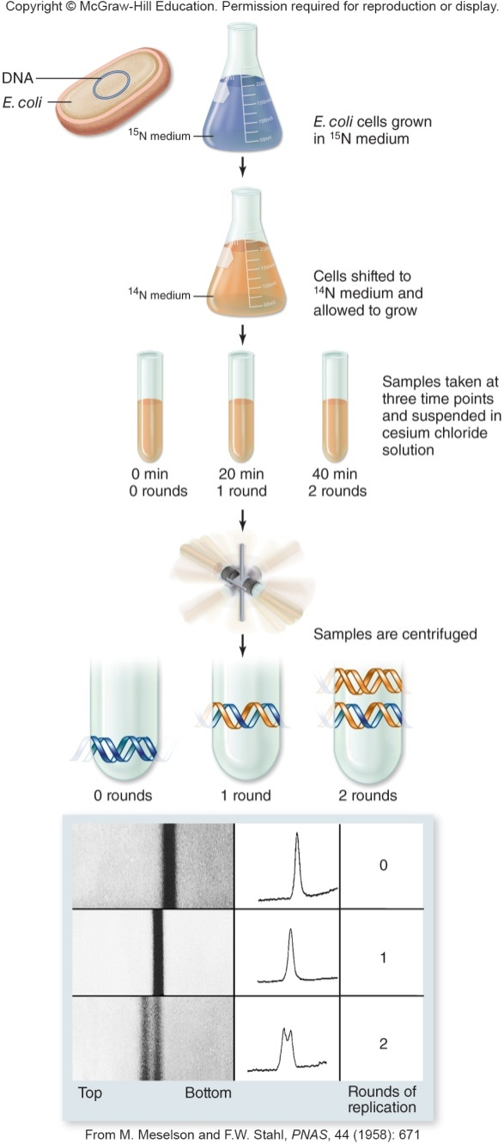
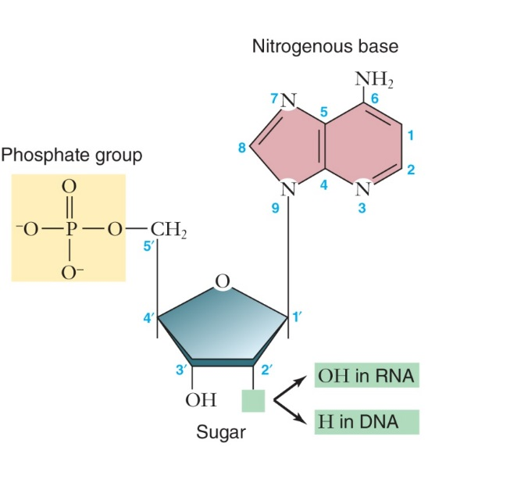
Meselson-Stahl Experiment
iClicker
What one does this experiment support?
Conservative
Semiconservative
Dispersive
Notes:
Bacterial cells were grown in a heavy isotope of nitrogen, $15N$
After several generations, the DNA of these bacteria was denser than normal DNA
Cells were switched to media containing lighter $14N$
DNA was extracted from the cells at various time intervals

Slide 3
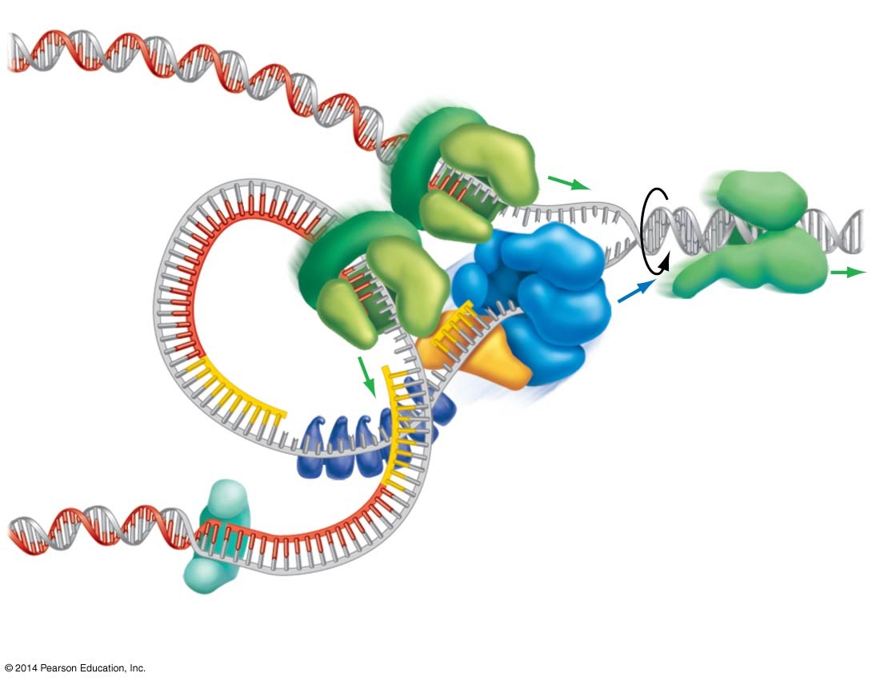
iClicker!
What is the purpose?
  Keep the strand looped
  Prevent the single strand from breaking apart
  Put RNA on the single strand
  They’re genomic parasites!
What is this doing?
  Putting RNA bases on
  Putting DNA bases on
  Breaking up the strands
  Recoiling the strands
This is?
  Recoiling the strands
  Proof reading
  Patching nicks
  Holding the strand steady
2
1
3
Notes:
Single Strand Binding Proteins
DNA polymerase III
DNA ligase

Slide 4
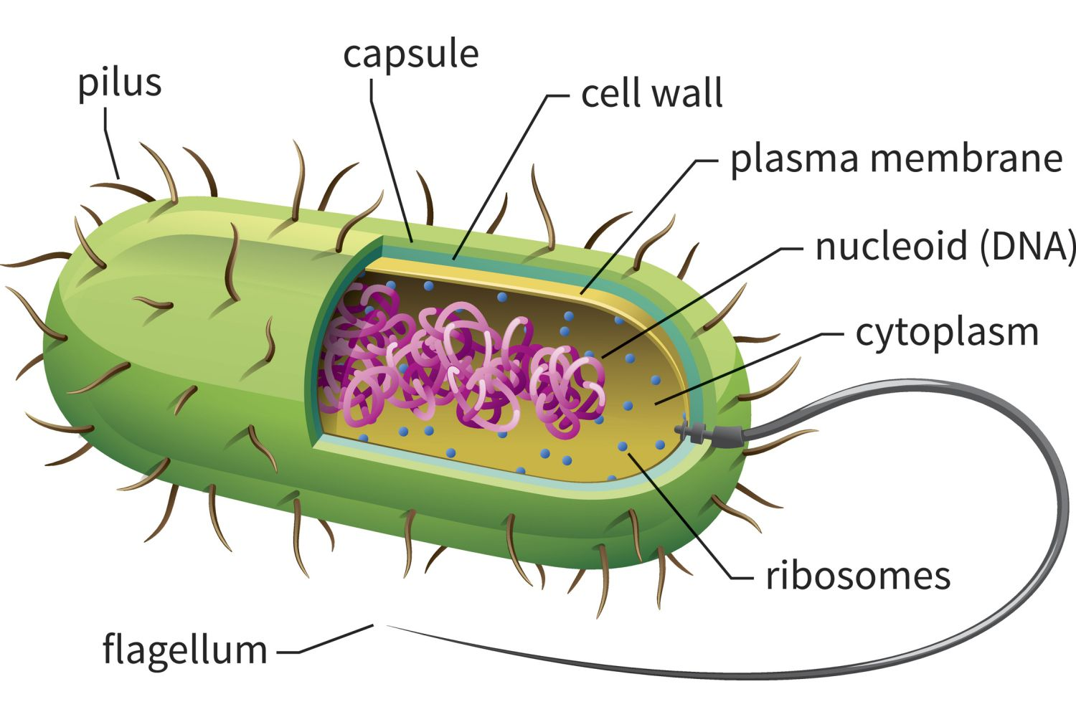
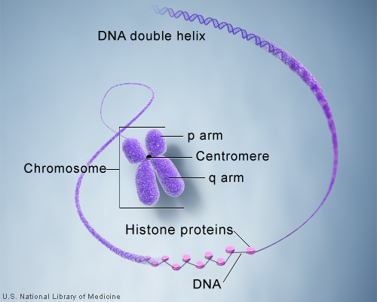
iClicker!
Which do you think is easier to replicate?
  Prokaryote
  Eukaryote
  Same amount of energy to replicate both

Slide 5
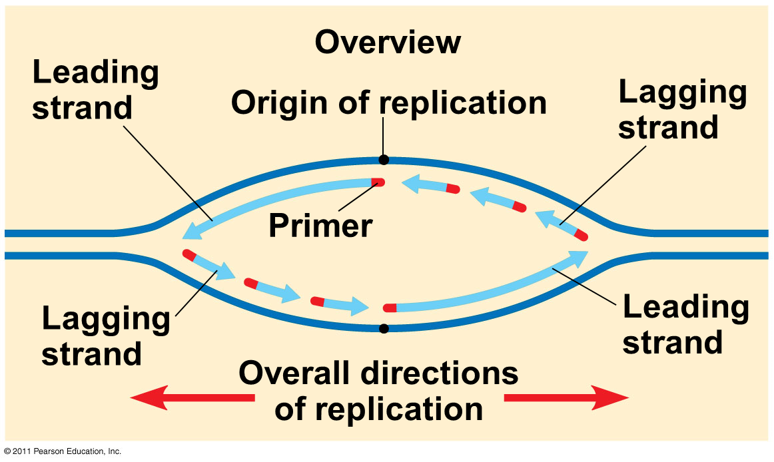
Linear nature of chromosomes
iClicker!
Why is linear nature a problem?
  Have to do it all at once
  More likely to tangle
  DNA replication only goes one way
  Easier to lose your place
  I like picking E.

Slide 6
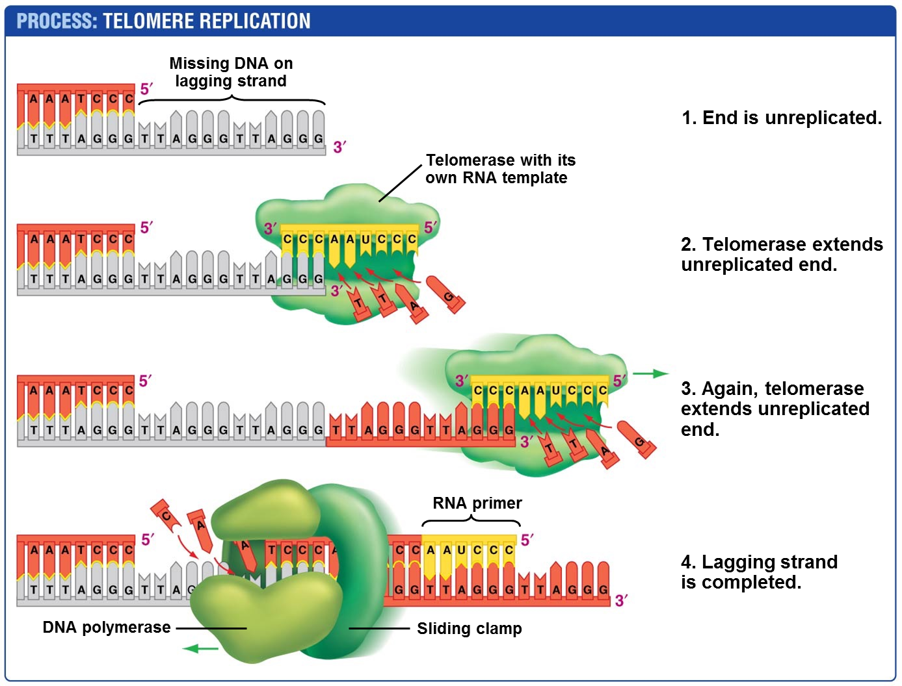
A company has introduced an “Eternal Life’ potion that is crammed full of telomerase! Should you take it?
Of course!
No!

Slide 7
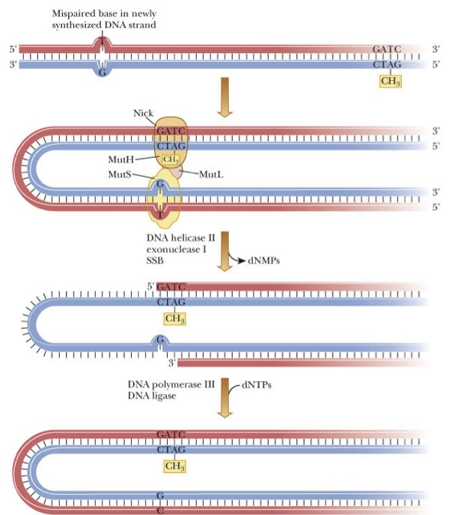
That’s still a lot of errors!
These errors are called Mutations.
What is a possible result of mutations?
Death
Illness
No effect on the organism
Beneficial effect
All of the above

Slide 8
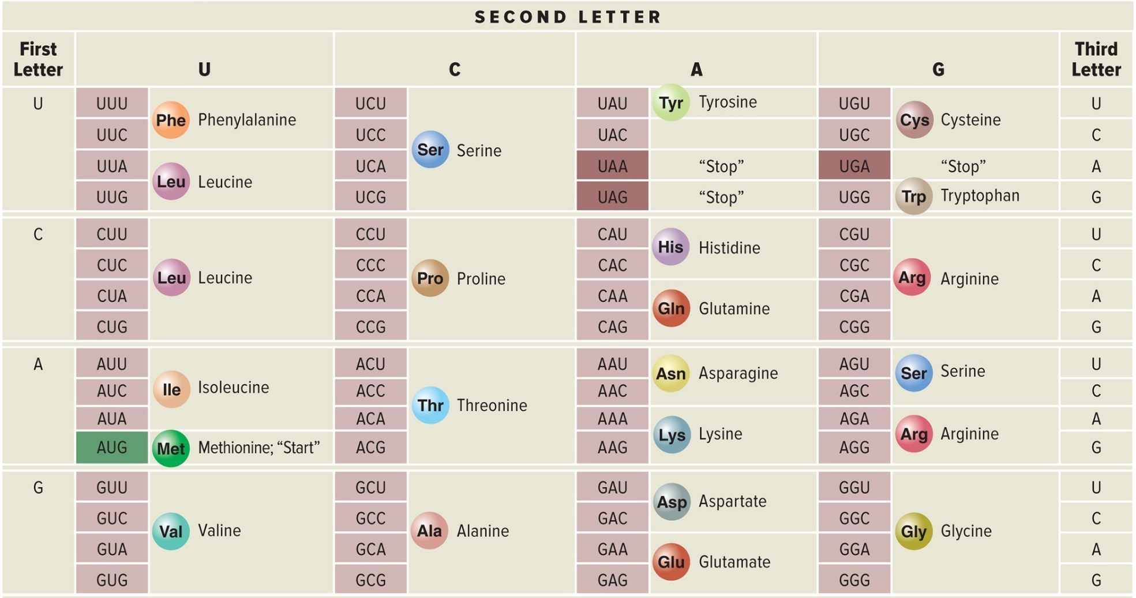
Based on this chart, which of the following would be cause a different protein to form?
Assume we started with ATT in the DNA
ATC
ATA
ATT
ATG
Notes:
Marshall Nirenberg identified the codons that specify each amino acid
Stop codons
3 codons (UAA, UGA, UAG) used to terminate translation
Start codon
Codon (AUG) used to signify the start of translation
Code is degenerate, meaning that some amino acids are specified by more than one codon

Slide 9
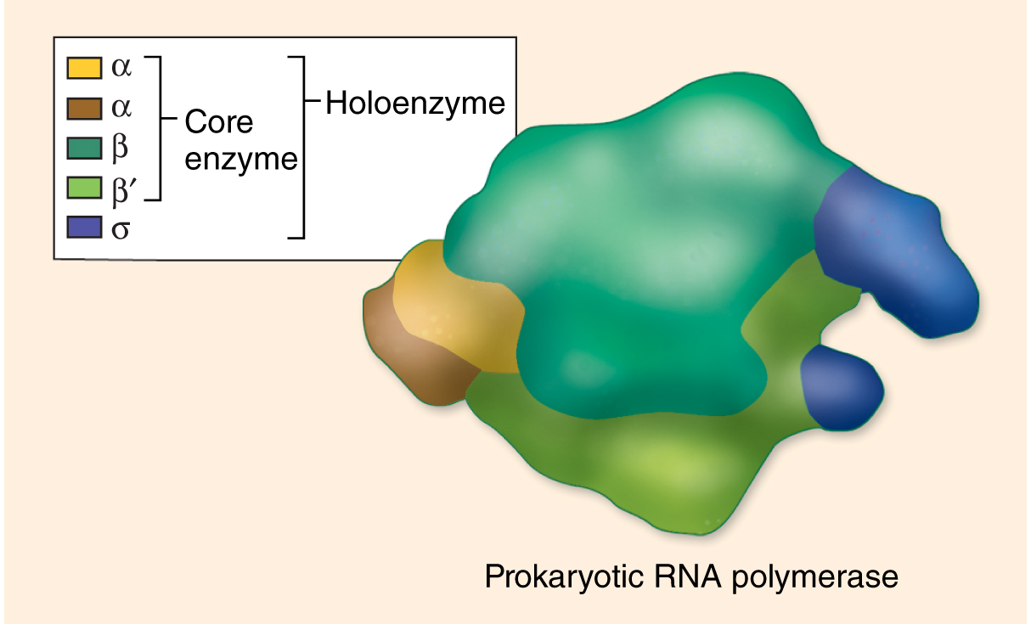
Prokaryotic Transcription
iClicker!
The blue bit
Proofreads the generated mRNA
Is needed throughout the entire transcription process
Disassociates after transcription has begun
Can bind anywhere on the DNA

Slide 10
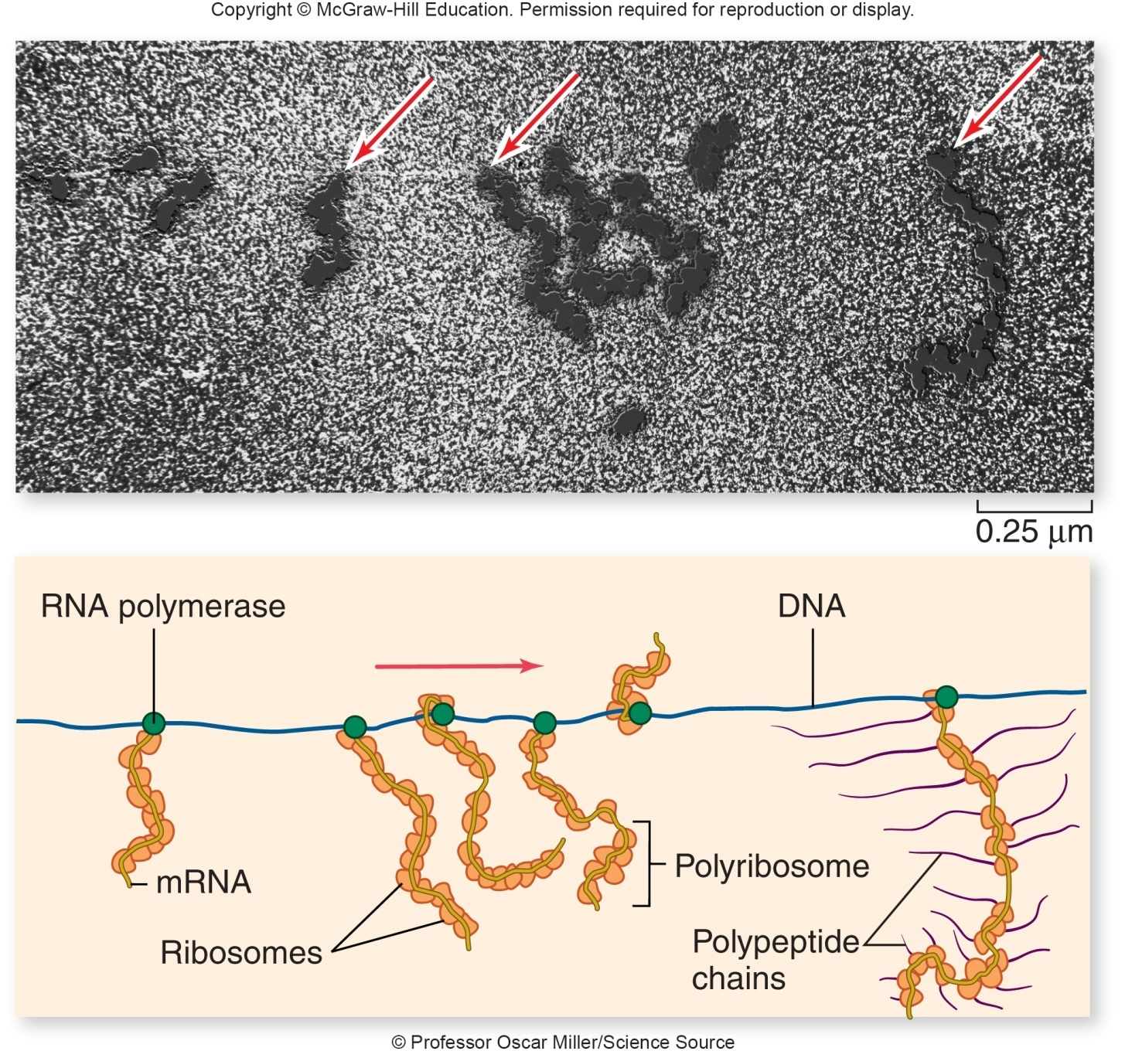
In prokaryotes transcription and translation are coupled
  mRNA begins to be translated before transcription is finished
Why can’t it work like this in Eukaryotes?
  Chromosomes are too large
  A little thing called the nucleus
  Eukaryotes modify the mRNA
  All of the above
  B&C, not A

Slide 11
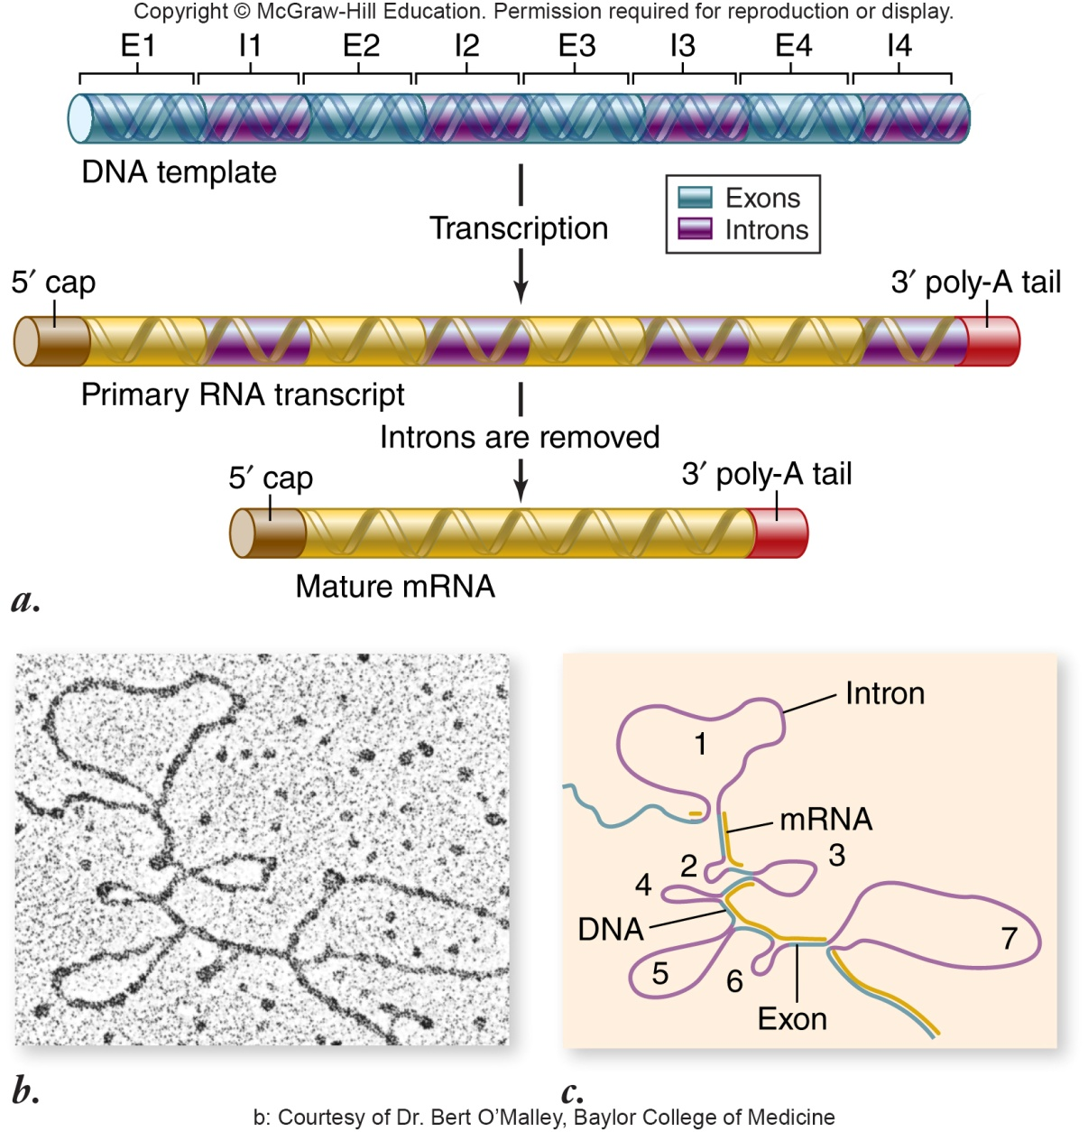
Intron Removal (pre-mRNA splicing)
Introns – non-coding sequences
Exons – sequences that will be translated
If a mutation occurs in an intron
will this have any impact on the
resulting protein?
  Yes, always
  No, never
  Sometimes, but if it does, the impact will always be very minor
  Sometimes, and the impact can be extreme
Notes:
Small ribonucleoprotein particles (snRNPs) recognize the intron–exon boundaries
snRNPs cluster with other proteins to form spliceosome
Responsible for removing introns

Slide 12
Translation and Transcription are?
Translation is the DNA being converted to an mRNA sequence and transcription is this sequence producing a protein
Transcription is the DNA being converted to an mRNA sequence and Translation is this sequence producing a protein
Translation is the DNA being converted to a protein and transcription is this sequence producing a mRNA sequence
Transcription is the DNA being converted to a protein and translation is this sequence producing a mRNA sequence

Slide 13
Which of the following types of mutation, resulting in an error in the mRNA just after the AUG start of translation, is likely to have the most serious effect on the polypeptide product?
a. deletion of a codon
b. deletion of a nucleotide
c. substitution of the third nucleotide of a codon
d. substitution of the first nucleotide of a codon
Notes:
B

Slide 14
RNA polymerase attaches to a promoter to initiation transcription in prokaryotes. Which of the following is true about this promoter region:
a. It is symmetrically on both DNA strands
b. It is not transcribed into mRNA
c. It costs ATP for the polymerase to attach
d. It must be regenerated between transcription events

Slide 15
What is consumed during translation?
a. Amino Acids
b. tRNA
c. Ribosomes
d. mRNA

Slide 16
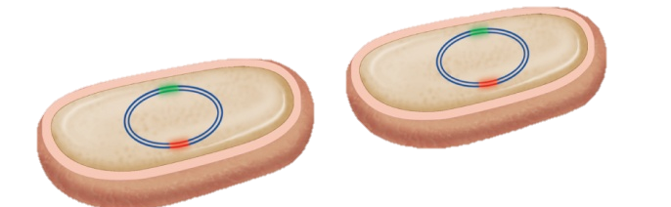
Result – Two daughter cells
These cells are:
  Always different from one another
  Always exactly the same as one another
  In theory identical, but there may have been a mutation when the DNA was copied
Notes:
Are these cells different at all from one another?

Slide 17
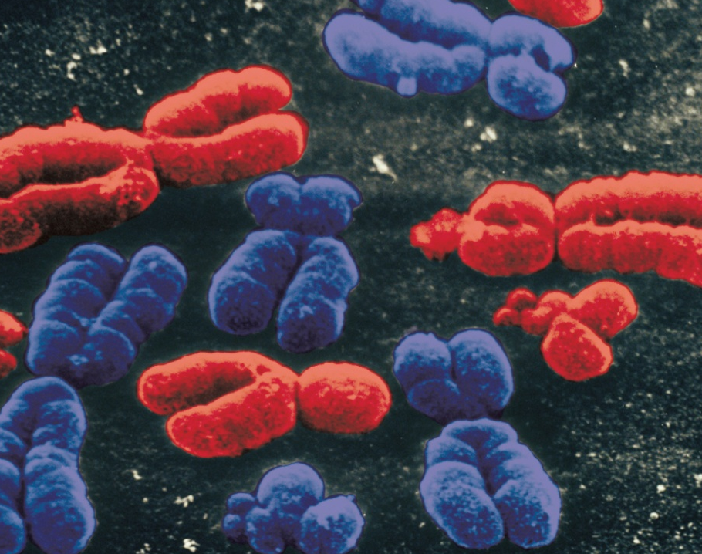
The DNA in a chromosome:
Can be easily replicated
Can be easily transcribed
Can be easily translated
Its hard to access in its stored state
Notes:
Can this DNA be used easily do you think?
Karyotype

Slide 18
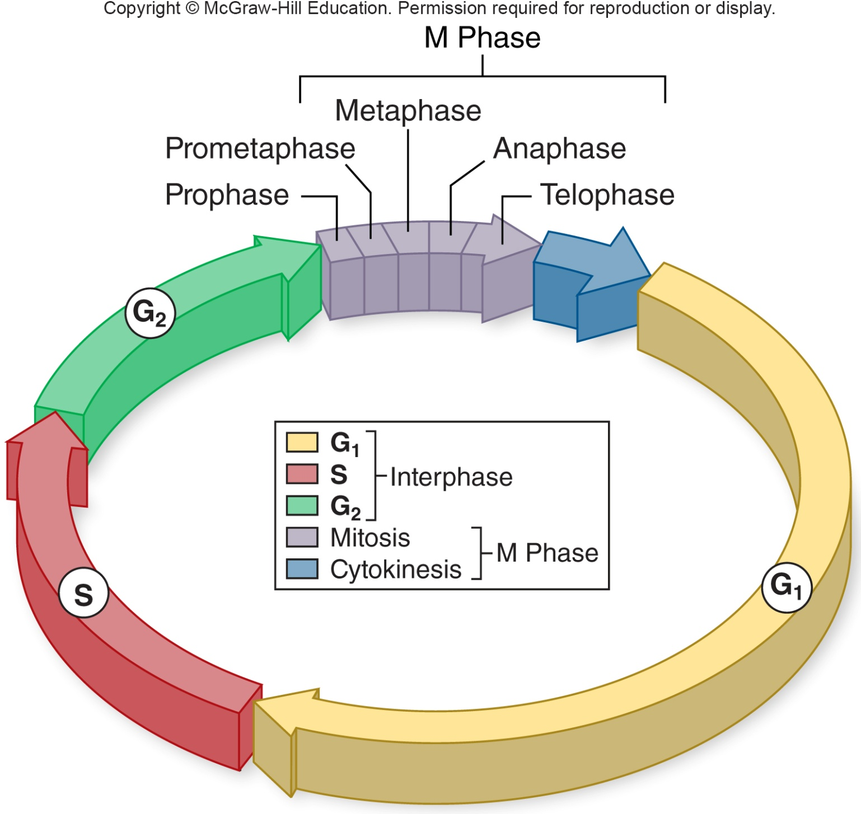
Which phase do you think is the quickest?
G2
M
S
G1
All equal
Notes:
Time it takes to complete a cell cycle varies greatly
Fruit fly embryos = 8 minutes
Mature cells take longer to grow
Typical mammalian cell takes 24 hours
Liver cell takes more than a year
Growth occurs during $G_{1}$, $G_{2}$, and S phases
M phase takes only about an hour
Most variation in length of $G_{1}$
Resting phase $G_{0}$ – cells spend more or less time here

Slide 19
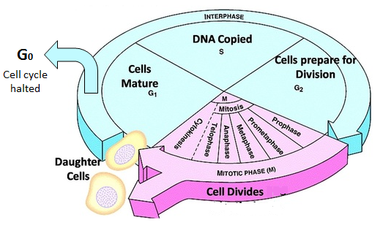
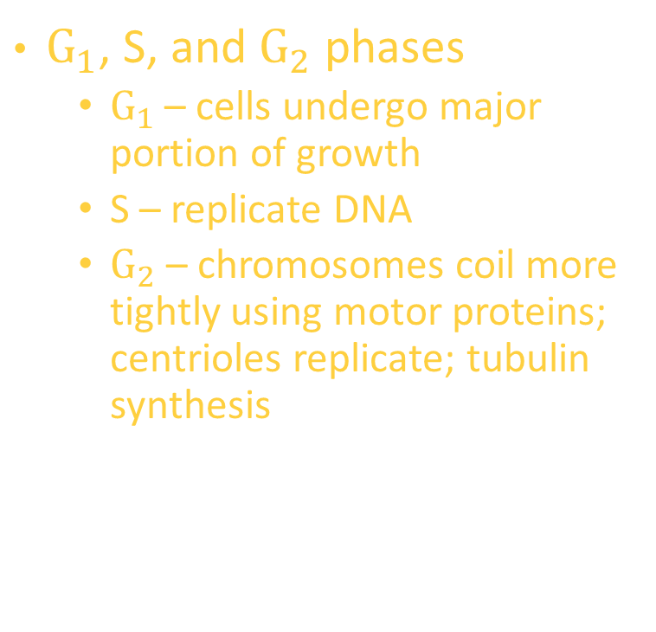
Interphase – preparing for mitosis
$G_{1}$, S, and $G_{2}$ phases
  $G_{1}$ – cells undergo major portion of growth
  S – replicate DNA
  $G_{2}$ – chromosomes coil more tightly using motor proteins; centrioles replicate; tubulin synthesis
When do we have sister chromatids appear?
  G1
  S
  G2
  They’re always there
Notes:
Important!!!!! DNA is always in chromosomes – they just COIL TIGHTER at times!! Go from hard to access to IMPOSSIBLE.

Slide 20
M phase – Cell Division
When are the chromosomes aligned in the middle of the cell?
Prophase
Prometaphase
Metaphase
Anaphase
Telophase

Slide 21
iclicker
What is the point of no return, where the
cell is COMMITTED to dividing?
G1
S
G2
M
Notes:
Its all about the DNA replication and processing
When is there a point of no return here do you think?

Slide 22
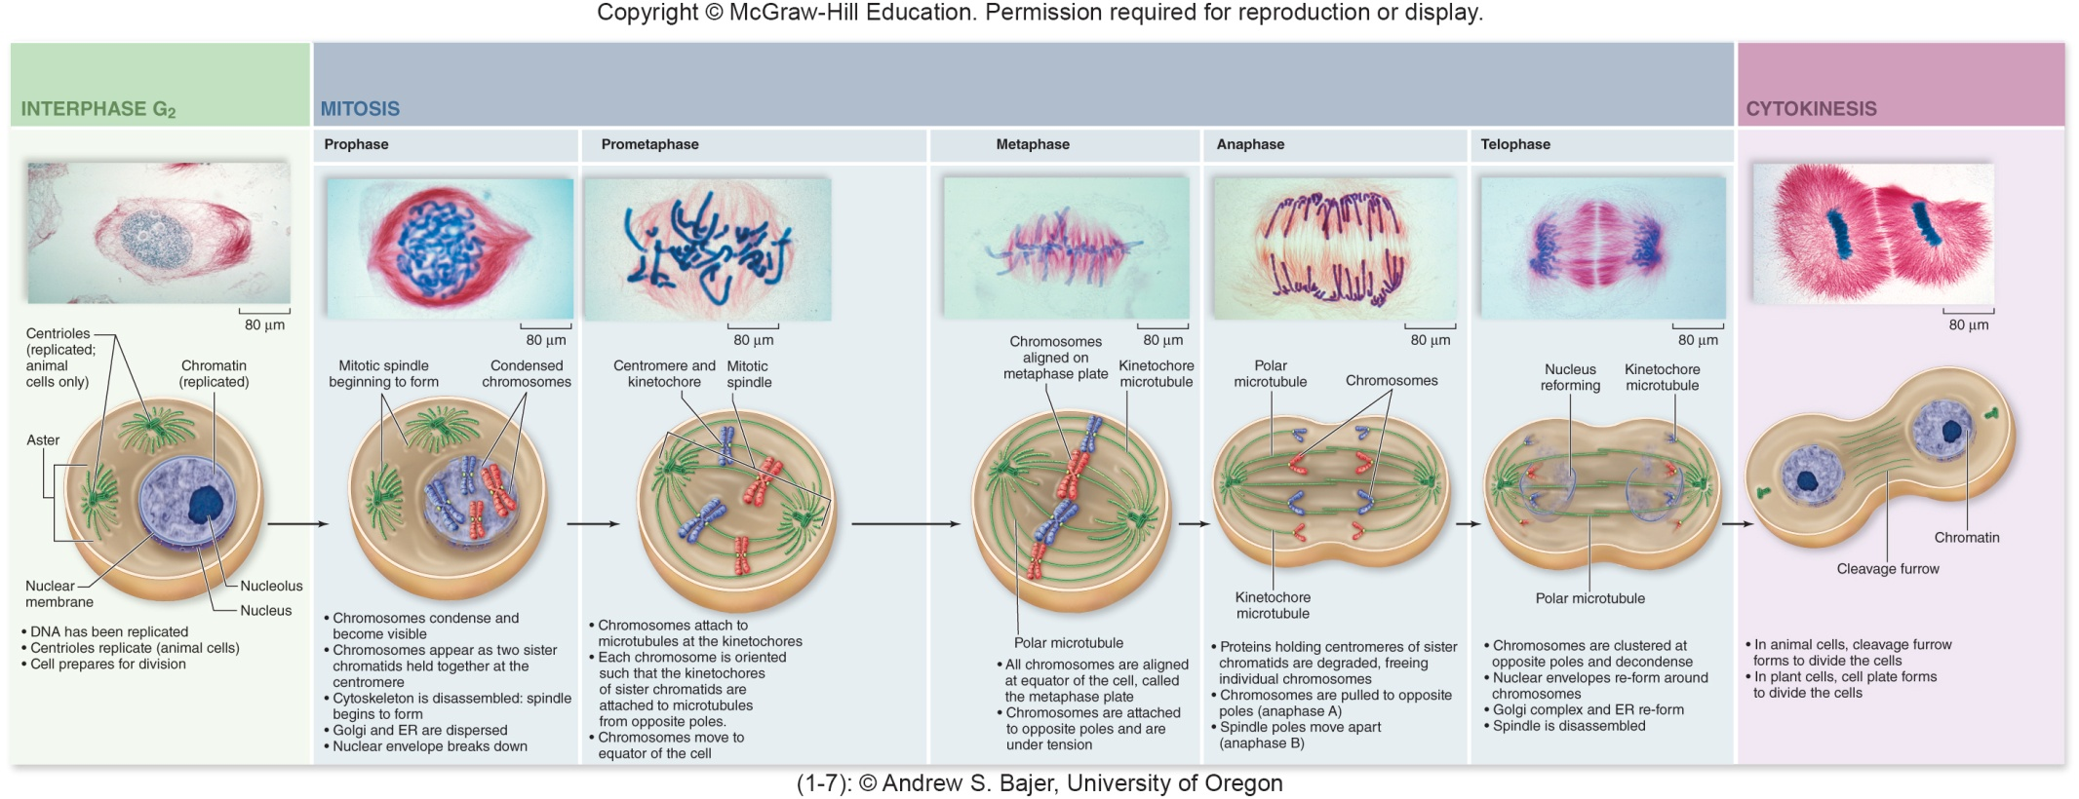
What is the most important phase of mitosis to get right? (with no do overs!)
Prophase
Metaphase
Anaphase
Telophase
Notes:
What about here? What is the most important part of mitosis to get right or its ALL ruined

Slide 23
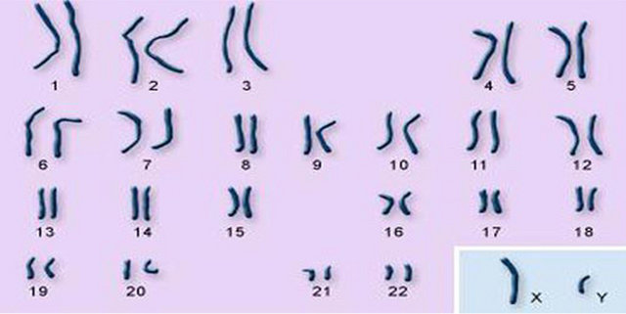
Sexual Reproduction requires reduction of genome
Are these chromosomes from a diploid cell?
  No!
  Yes!
  You can’t tell from this information

Slide 24
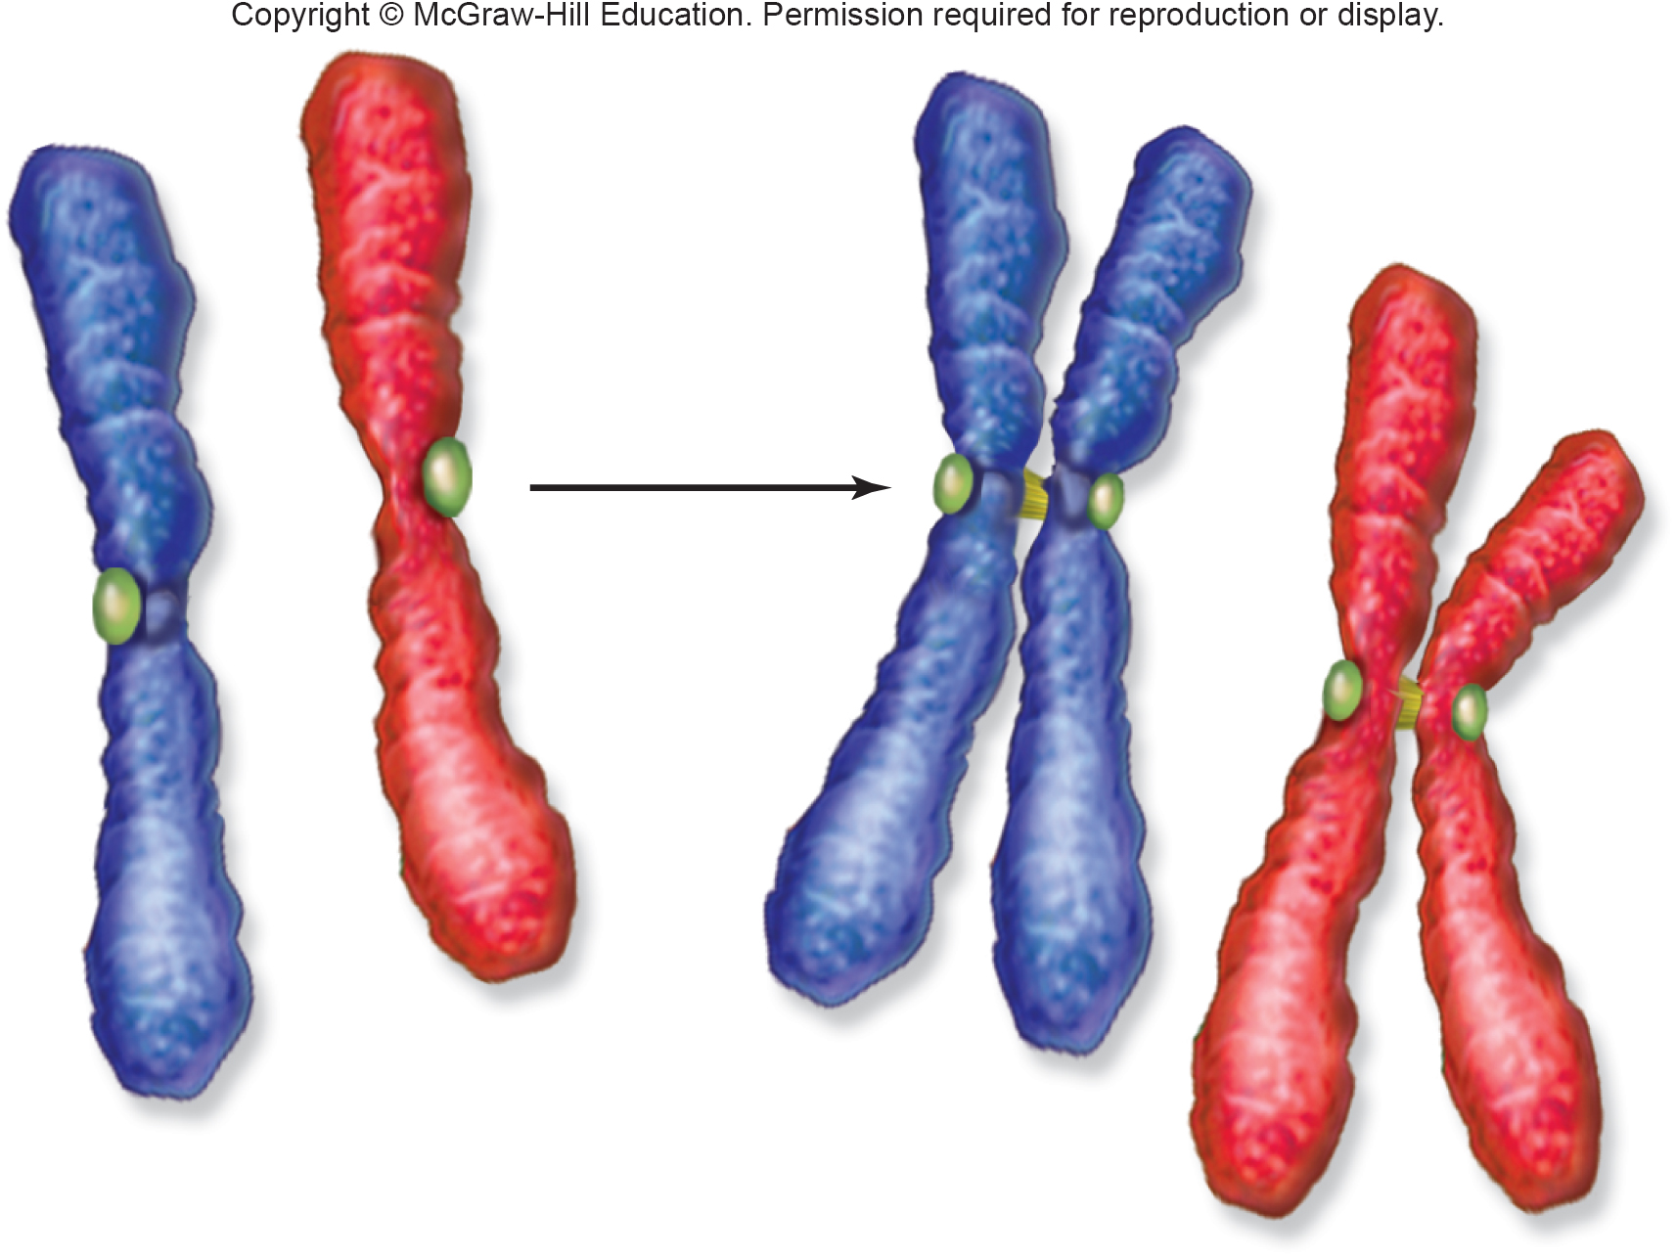
1 and 2 are:
  Sister Chromatids
  Homologous Chromosomes
  Both
  Neither
3 and 4 are:
  Sister Chromatids
  Homologous Chromosomes
  Both
  Neither
3 and 6 are:
  Sister Chromatids
  Homologous Chromosomes
  Both
  Neither
1 2 3 4 5 6
Notes:
B, A, B

Slide 25
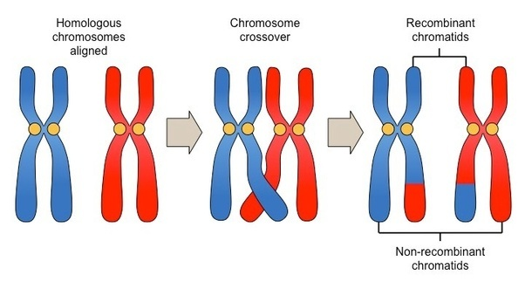
Result of crossing over
Do you have some of the exact same chromosomes as your great-great-grandparent?
  Yes
  No
  Yes for paternal
  Yes for maternal
Notes:
Novel combination of traits
Your chromosomes are not just your grandparents chromosomes shuffled around

Slide 26
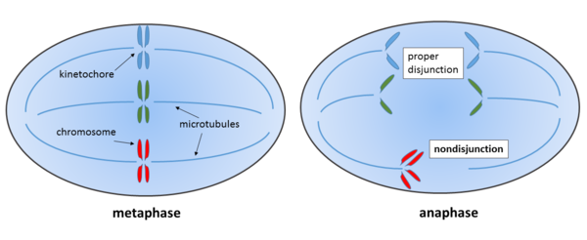
Result of Errors in Meiosis?
Nondisjunction – failure of chromosomes to move to opposite poles during either meiotic division
Aneuploid gametes – gametes with missing or extra chromosomes
Why is this a much bigger deal when it happens in meiosis?
  The cell won’t undergo Meiosis II properly
  It causes damage to surrounding somatic cells
  The resultant offspring will have an aberrant number of chromosomes
  Its not, its fine!

Slide 27
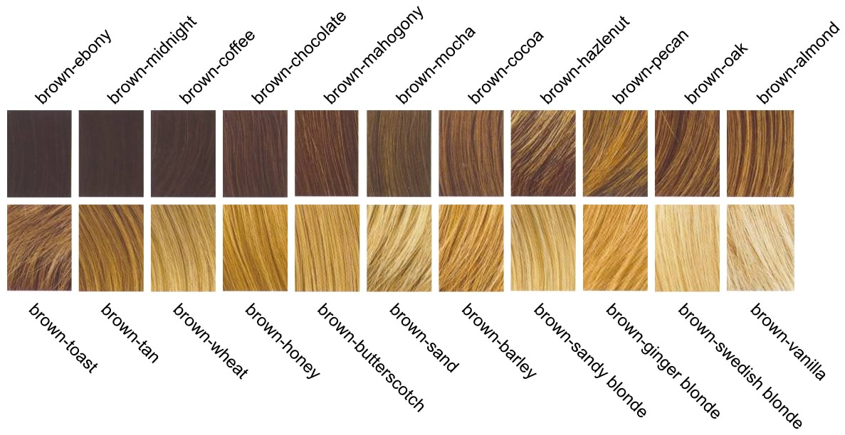
Genes vs Alleles
Which is accurate?
  There is a gene for brown-mocha hair specifically and an allele for hair color in general
  There is a gene for hair color in general and an allele for brown-mocha hair specifically
Alleles are variations of a gene
We may use them interchangeably in popular speech, but you need to know the definition

Slide 28
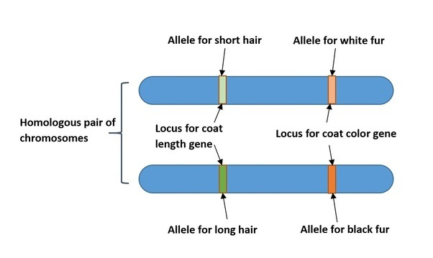
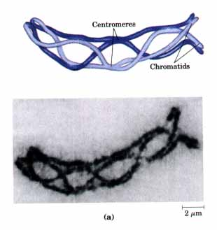
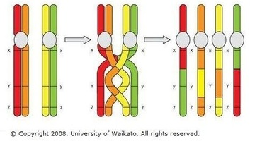
Genes vs Alleles
Are sister chromatids going to have the same alleles?
  Yes, always
  Yes, before crossing over – they may differ afterwards
  No, never
  No, before crossing over – they are sometimes the same afterwards

Slide 29
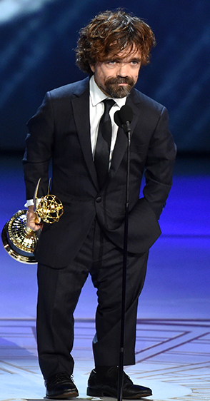
Dominate vs Recessive
Recessive traits:
  Are always harmful to the organism in some fashion
  Are always beneficial to the organism in some fashion
  Can be harmful, beneficial, or neutral – there is no pattern
  Are more often harmful, but they can be beneficial
Dominate traits ALWAYS are more common in the population?
  True
  False
Peter Dinklage ->
Achondroplastic Dwarfism
Dominate Allele

Slide 30
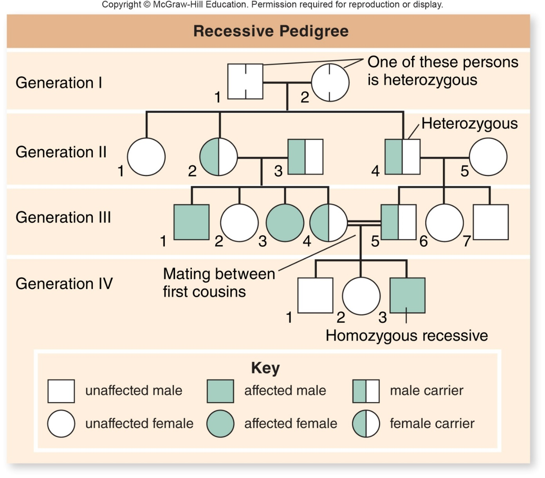
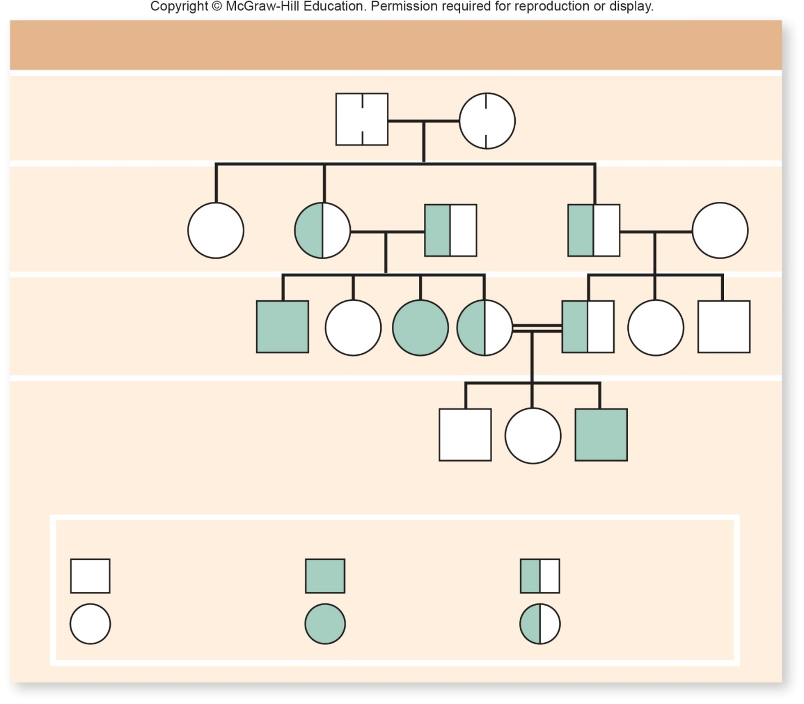
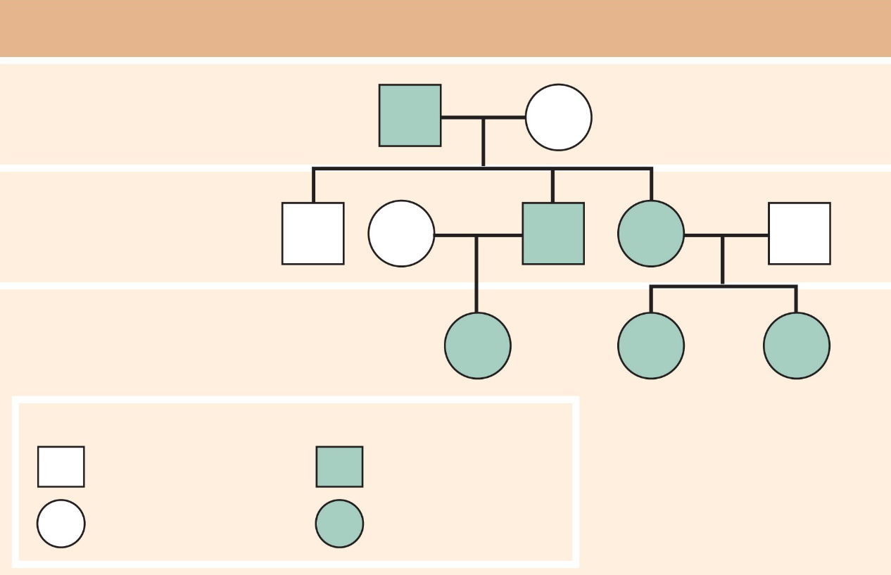
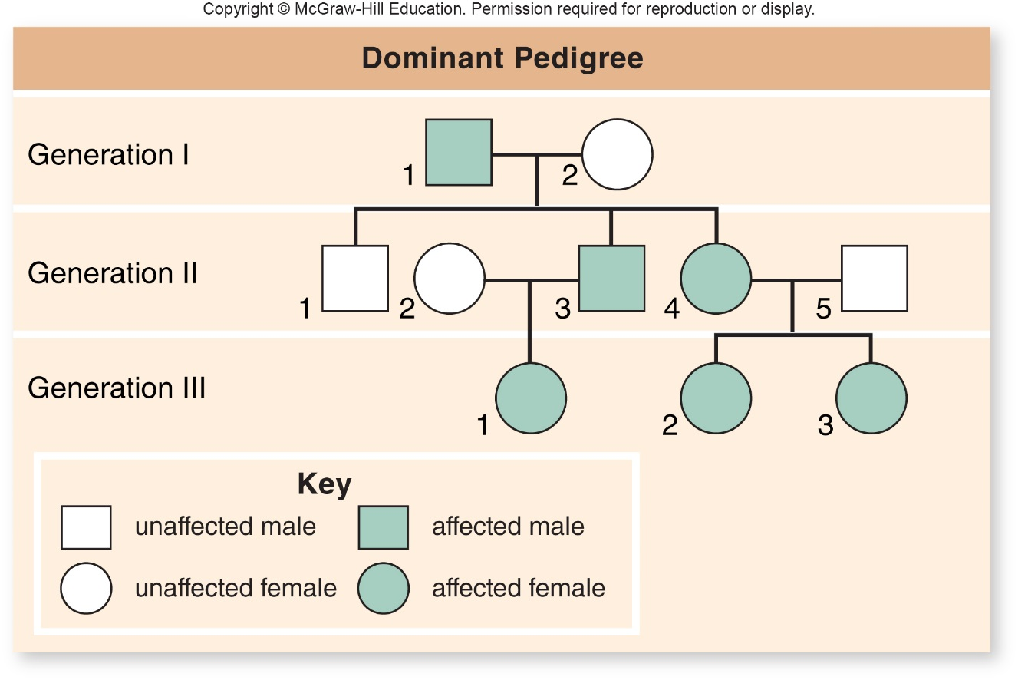
Which one is most likely a dominate trait?
A B
C – can’t tell!

Slide 31
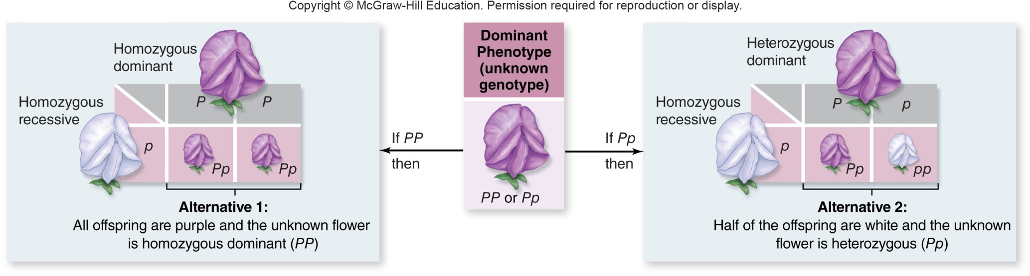
Testcrosses
You get 2 flowers in your f1, they are all purple.
What are the odds of this if you really had a Pp unknown?
  25%
  50%
  75%
  100%
  P from dominant phenotype flower given to both offspring
  ½ AND ½ = 25% chance to be wrong
Notes:
Cross used to determine the genotype of an individual with dominant phenotype
Cross the individual with unknown genotype (e.g. P_) with a homozygous recessive (pp)
Phenotypic ratios among offspring are different, depending on the genotype of the unknown parent

Slide 32
Testcrosses
You get 2 flowers in your f1, they are all purple. What are the odds of this if you really had a Pp unknown?
  P from dominant phenotype flower given to both offspring
  ½ AND ½ = 25% chance to be wrong
If 10 f1 and they were all purple? How likely is this if you really had a Pp?
  50%
  25%
  10%
  Less than 1%
50? Vanishingly small!
½ x ½ x ½ x ½ x ½ x ½ x ½ x ½ x ½ x ½
Notes:
Cross used to determine the genotype of an individual with dominant phenotype
Cross the individual with unknown genotype (e.g. P_) with a homozygous recessive (pp)
Phenotypic ratios among offspring are different, depending on the genotype of the unknown parent

Slide 33
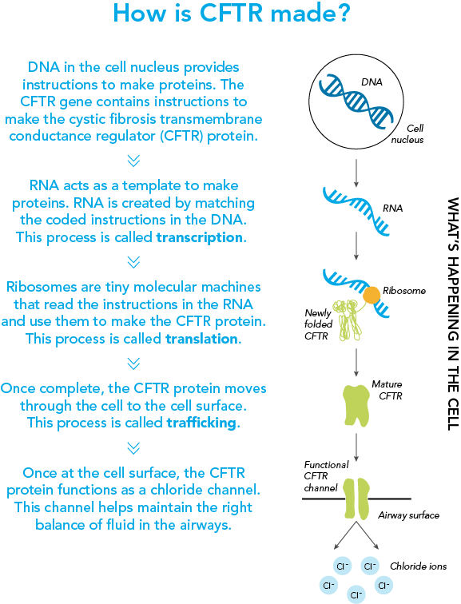
Cystic fibrosis affects the lungs, the pancreas, the digestive system, and other organs, resulting in symptoms ranging from breathing difficulties to recurrent infections. Which of the following terms best describes this?
  Pleiotropy
  Incomplete dominance
  Multiple alleles
  Codominance
Notes:
A

Slide 34
If a true breeding red starfish breeds with a true breeding blue starfish and the offspring are purple, what type of inheritance is this?
  Blending
  Codominance
  Incomplete Dominance
  Complete Dominance
Notes:
C

Slide 35
You are breeding Guinea Pigs. They have two coat textures spiky hair (S) and smooth hair (s) – this is a one gene/two allele system where you have already determined you will never produce a spiky haired Guinea pig from two smooth ones. Your breeding population comes in three colors: black, spotted, and white. Coat color is also controlled by one gene with two alleles (B and b).
What type of dominance is displaced for each trait?
  Texture – Incomplete, Color – Codominance
  Texture – Complete, Color – Incomplete
  Texture – Complete, Color – Complete
  Texture – Complete, Color – Codominance
  Texture – Codominance, Color – Codominance

Slide 36
In a diploid organism, there is a pair of homologous chromosomes. One of these chromosomes contains a sequence for blue eyes, at this same locus the other chromosome contains a sequence that would give rise to green eyes. What is the accurate statement?
  Each chromosome has a different gene, one gene for each eye color.
  Each chromosome has a different allele of the same gene – eye coloration.
  This is a two gene system.
  This is a one allele system.

Slide 37
Vocab Review!
Mendel studies seven different traits in the garden pea, such as pea color. What genetic term is used to describe an observable trait, such as those studied by Mendel?
  Genotype
  Appearance
  Phenotype
  Haplotype
A true-breeding line ALWAYS:
  Has the dominate phenotype
  Will give rise to offspring in a 1:2:1 genotypic ratio when self-crossed
  Is homozygous
  Has the recessive phenotype
A diploid individual that has two identical copies of a certain allele is said to be:
A. Homozygous
B. Heterozygous
C. Phenotype
D. Genotype
A carrier of a genetic disorder who does not show symptoms is most likely to be __________ to transmit it to offspring.
A. heterozygous for the trait and able
B. heterozygous for the trait and unable
C. homozygous for the trait and able
D. homozygous for the trait and unable

Slide 38
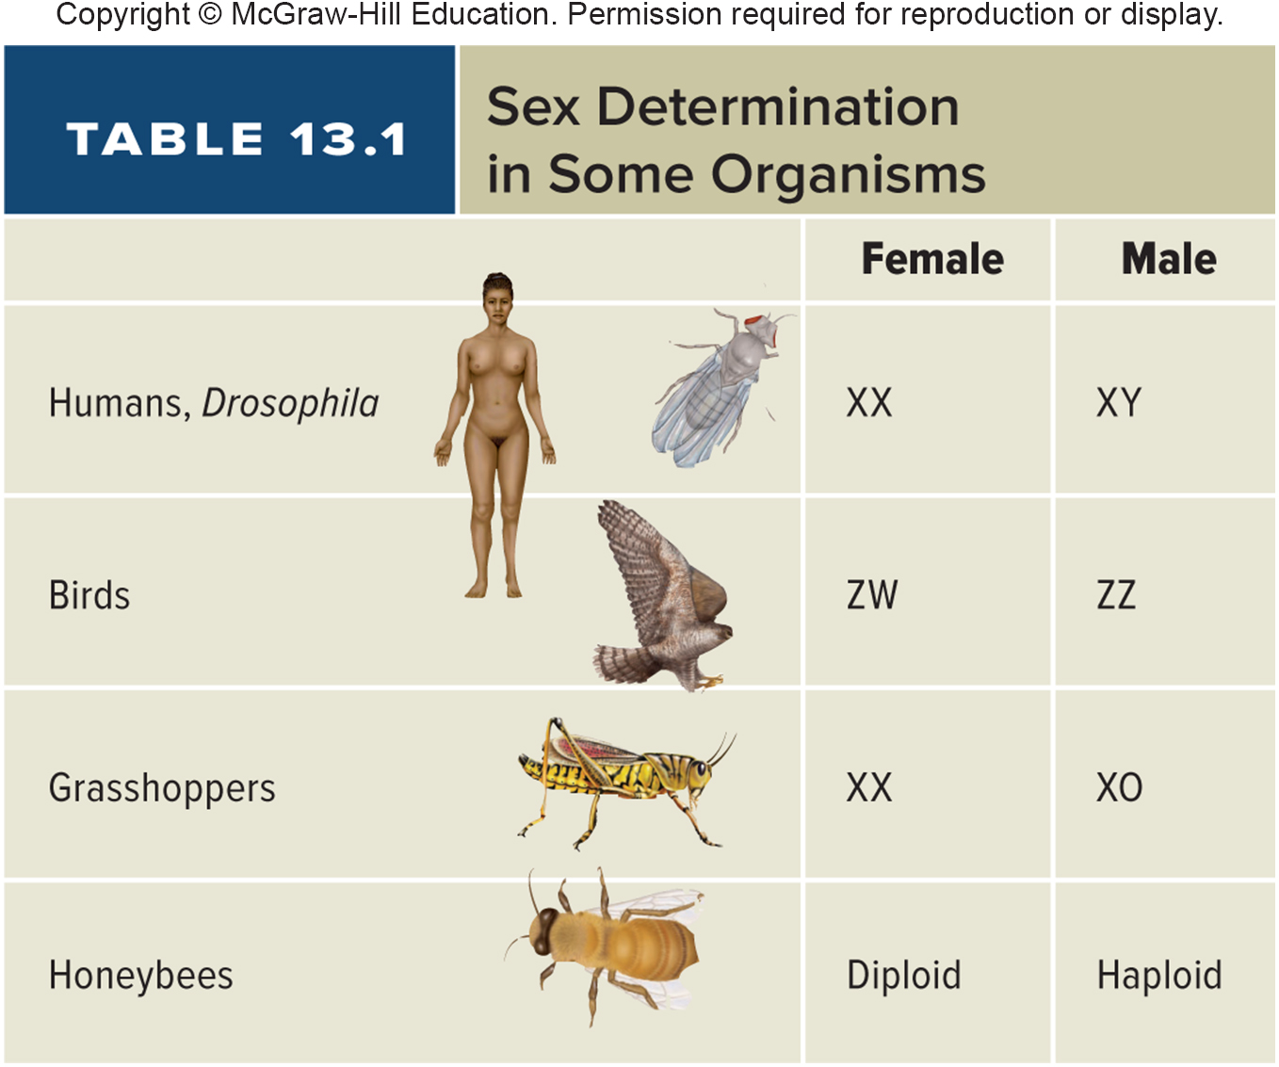
Sex Chromosomes and Inheritance
Certain genetic diseases affect XY individuals to a greater degree than those who are XX
Such as Color blindness & hemophilia
X-linked recessive alleles
For birds, what would you expect the distribution of these same types of disorders to be?
  More common in Males
  More Common in Females
  Equally common in both
Notes:
Of course this is for MAMMALS! And flies I guess
Birds?

Slide 39
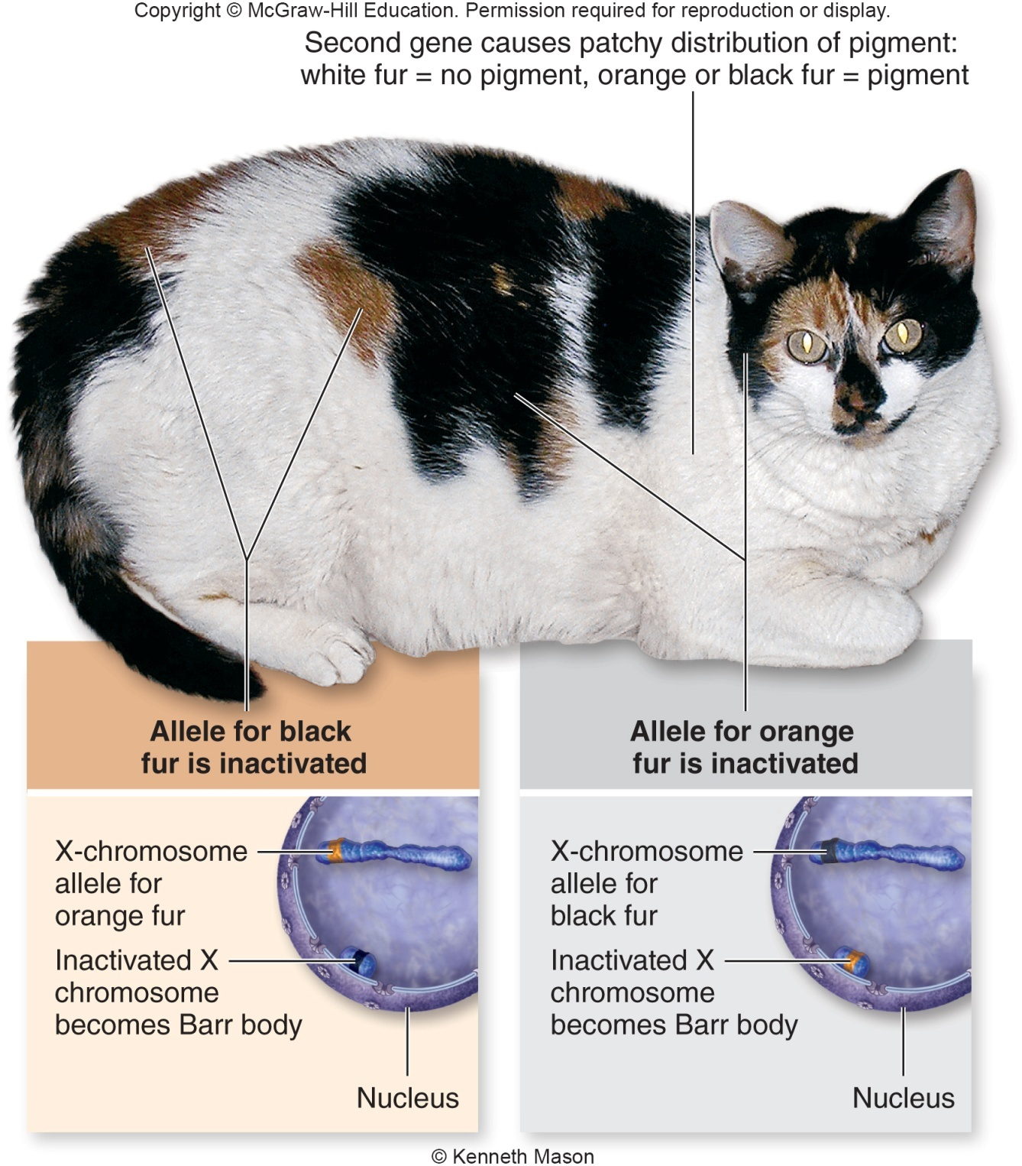
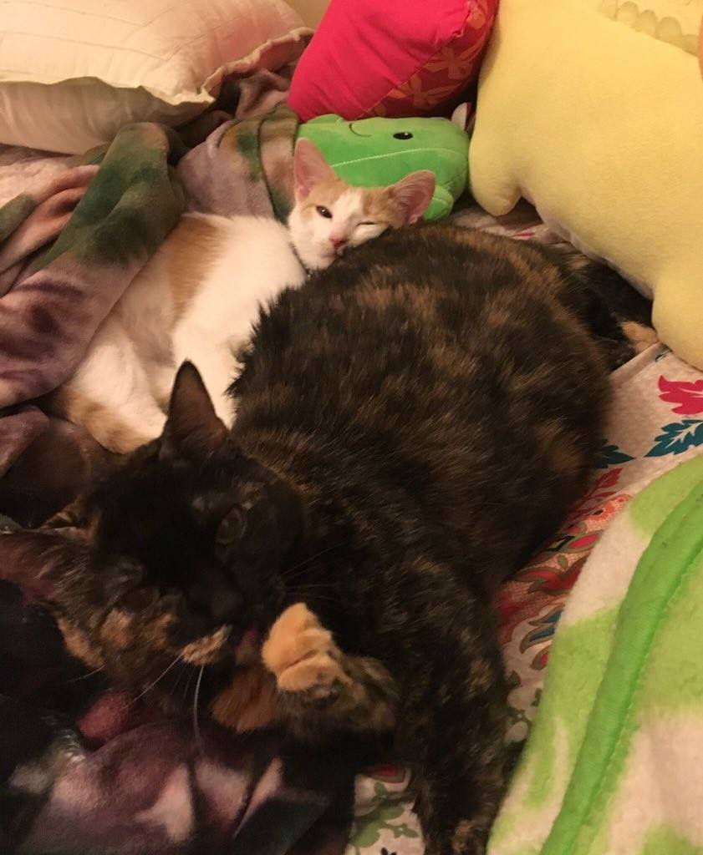
Examples? Calico and Tortoiseshell cats
Bigger splotches of color have the barr body form ______ in development compared to small areas.
  Later
  Earlier
  More often
  No pattern
You do occasional find male calicos, what must their genotype be?
  XY
  YY
  XXY
  XYY
Notes:
This is why you hardly ever find male calicos or torties (you can! XXY)
Also why its semirare to have an orange female
Size of spots – bar body inactivation timing

Slide 40
Distance matters
Independent assortment is impacted by distance between genetic loci on a chromosome. What do you think the pattern is?
  Closer loci have a lower level of independent assortment
  Farther away loci have a lower level of independent assortment
Notes:
If homologues undergo two crossovers between loci, then the parental combination is restored
Leads to an underestimate of the true genetic distance
Relationship between true distance on a chromosome and the recombination frequency is not linear

Slide 41
The central dogma:
Translation is DNA being converted to proteins
Transcription is DNA being converted to protein
Translation is RNA being converted to proteins
Transcription is RNA being converted to proteins

Slide 42
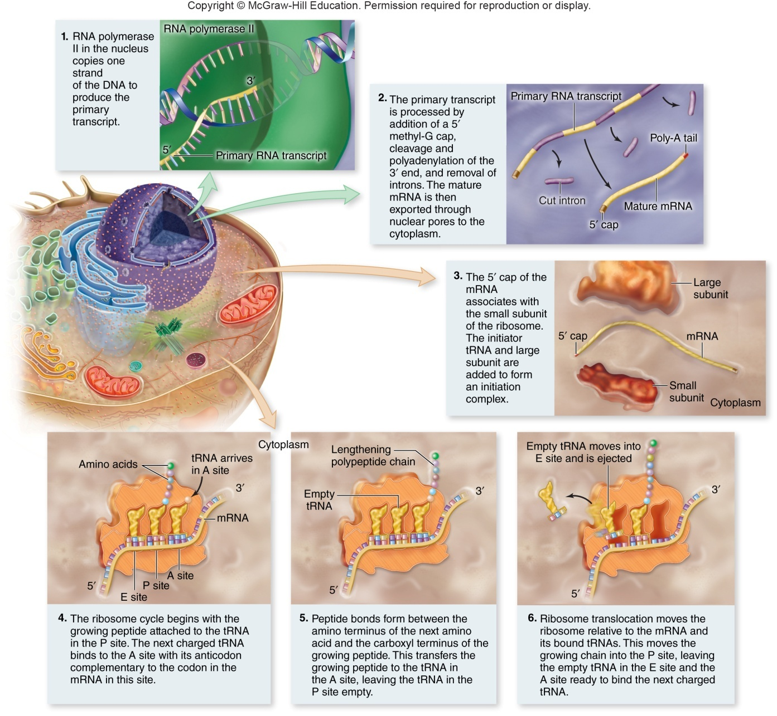
What stage do you think most protein regulation occurs at?
DNA replication
Transcription
Translation
At the protein level themselves

Slide 43
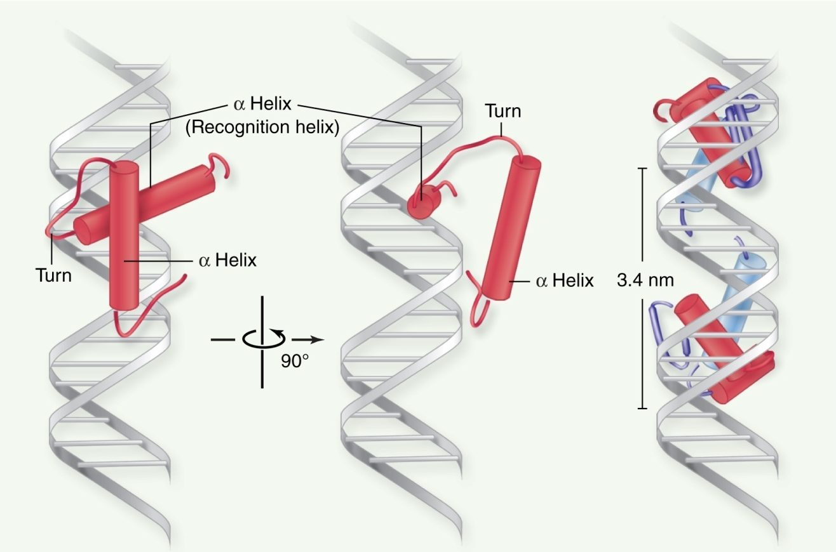
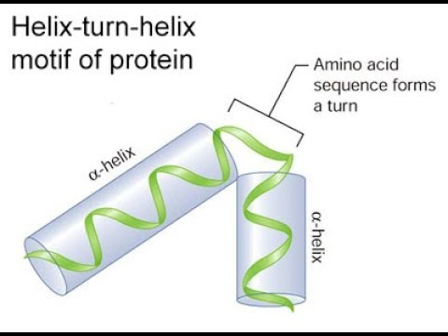
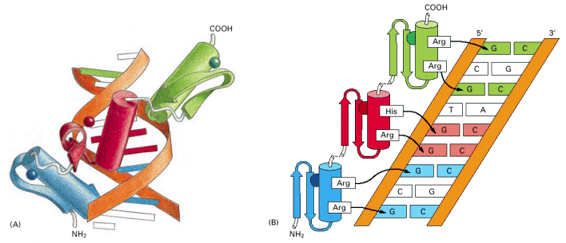
Types of DNA binders
Helix-turn-helix motif
  two α-helical segments linked by a nonhelical segment
    Homeodomain motif
Why can this result in less protein creation?
Denatures enzymes
Blocks binding sites
Destabilizes DNA
Destabilizes RNA
Notes:
Super common
Often in pairs

Slide 44
Positive control means?
MORE protein will be produced
LESS protein will be produced

Slide 45
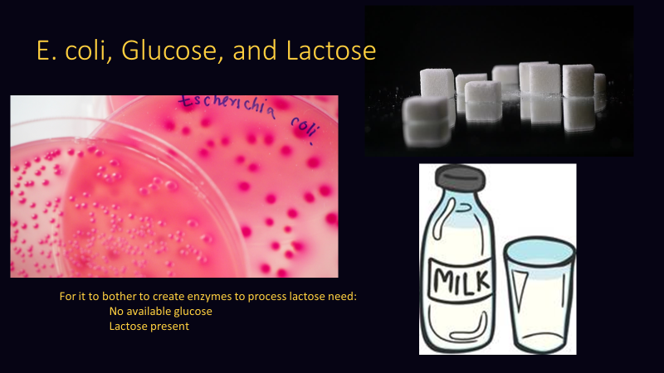
What do you think the absence of lactose in the surroundings will cause?
Induction of lactose digestive enzymes
Induction of glucose digestive enzymes
Repression of lactose digestive enzymes
Repression of glucose digestive enzymes
Induction – enzymes for a certain pathway are produced in response to a substrate
Repression – capable of making an enzyme but does not

Slide 46
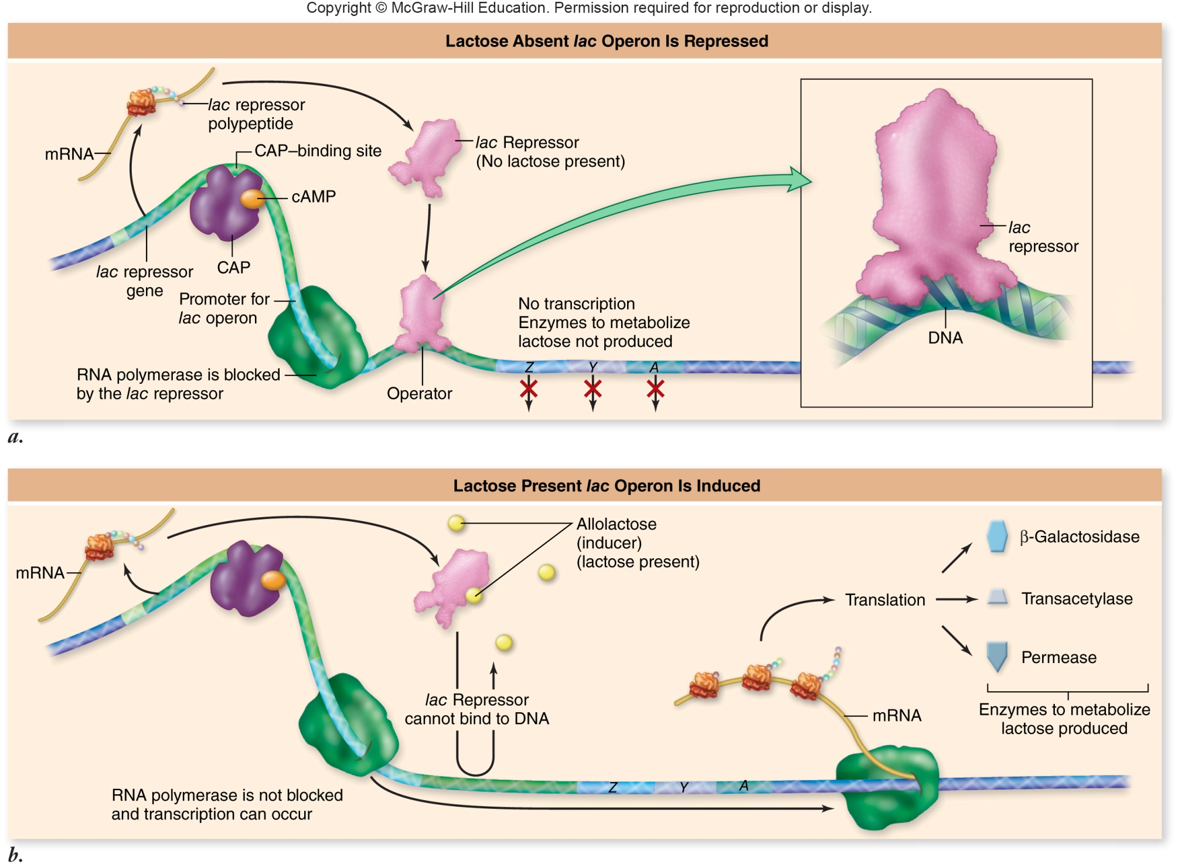
Negative Repression
Not all to the story
What if lactose AND glucose are present - what will the cell want to do?
Utilize both lactose and glucose
Only utilize glucose
Only utilize lactose

Slide 47
The DNA that is most readily transcribed is that:
In a mitotic chromosome
Pressed closely against the histone core
Located between histone cores

Slide 48
Control of Gene Expression
DNA binding motifs can most easily bind to bases:
A. at the end of DNA strands.
B. in the minor groove.
C. in the major groove.
D. anywhere along the sequence.
How do DNA-binding motifs regulate protein expression?
  They prevent translation
  They prevent transcription
  They increase translation rates
  They increase transcription rates

Slide 49
Once created proteins:
  are eternal
  are secreted from the cell once they are no longer useful
  naturally degrade and are recycled
  naturally build up in cells and trigger the next phase of cell division
In prokaryotes, most protein regulation occurs
A. during transcription.
B. after transcription.
C. before translation.
D. after translation.

Slide 50
Chromosomes are made of protein and DNA
iClicker!
What is more complicated…
  Protein
  DNA
  Equally complex
Notes:
Can this DNA be used easily do you think?
Karyotype

Slide 51
Meselson-Stahl Experiment
iClicker
What one does this experiment support?
Conservative
Semiconservative
Dispersive
Notes:
Bacterial cells were grown in a heavy isotope of nitrogen, $15N$
After several generations, the DNA of these bacteria was denser than normal DNA
Cells were switched to media containing lighter $14N$
DNA was extracted from the cells at various time intervals

Slide 52
iClicker!
What is the purpose?
  Keep the strand looped
  Prevent the single strand from breaking apart
  Put RNA on the single strand
  They’re genomic parasites!
What is this doing?
  Putting RNA bases on
  Putting DNA bases on
  Breaking up the strands
  Recoiling the strands
This is?
  Recoiling the strands
  Proof reading
  Patching nicks
  Holding the strand steady
2
1
3
Notes:
Single Strand Binding Proteins
DNA polymerase III
DNA ligase

Slide 53
iClicker!
Which do you think is easier to replicate?
  Prokaryote
  Eukaryote
  Same amount of energy to replicate both

Slide 54
Linear nature of chromosomes
iClicker!
Why is linear nature a problem?
  Have to do it all at once
  More likely to tangle
  DNA replication only goes one way
  Easier to lose your place
  I like picking E.

Slide 55
A company has introduced an “Eternal Life’ potion that is crammed full of telomerase! Should you take it?
Of course!
No!

Slide 56
That’s still a lot of errors!
These errors are called Mutations.
What is a possible result of mutations?
Death
Illness
No effect on the organism
Beneficial effect
All of the above

Slide 57
Based on this chart, which of the following would be cause a different protein to form?
Assume we started with ATT in the DNA
ATC
ATA
ATT
ATG
Notes:
Marshall Nirenberg identified the codons that specify each amino acid
Stop codons
3 codons (UAA, UGA, UAG) used to terminate translation
Start codon
Codon (AUG) used to signify the start of translation
Code is degenerate, meaning that some amino acids are specified by more than one codon

Slide 58
Prokaryotic Transcription
iClicker!
The blue bit
Proofreads the generated mRNA
Is needed throughout the entire transcription process
Disassociates after transcription has begun
Can bind anywhere on the DNA

Slide 59
In prokaryotes transcription and translation are coupled
  mRNA begins to be translated before transcription is finished
Why can’t it work like this in Eukaryotes?
  Chromosomes are too large
  A little thing called the nucleus
  Eukaryotes modify the mRNA
  All of the above
  B&C, not A

Slide 60
Intron Removal (pre-mRNA splicing)
Introns – non-coding sequences
Exons – sequences that will be translated
If a mutation occurs in an intron
will this have any impact on the
resulting protein?
  Yes, always
  No, never
  Sometimes, but if it does, the impact will always be very minor
  Sometimes, and the impact can be extreme
Notes:
Small ribonucleoprotein particles (snRNPs) recognize the intron–exon boundaries
snRNPs cluster with other proteins to form spliceosome
Responsible for removing introns

Slide 61
Translation and Transcription are?
Translation is the DNA being converted to an mRNA sequence and transcription is this sequence producing a protein
Transcription is the DNA being converted to an mRNA sequence and Translation is this sequence producing a protein
Translation is the DNA being converted to a protein and transcription is this sequence producing a mRNA sequence
Transcription is the DNA being converted to a protein and translation is this sequence producing a mRNA sequence

Slide 62
Which of the following types of mutation, resulting in an error in the mRNA just after the AUG start of translation, is likely to have the most serious effect on the polypeptide product?
a. deletion of a codon
b. deletion of a nucleotide
c. substitution of the third nucleotide of a codon
d. substitution of the first nucleotide of a codon
Notes:
B

Slide 63
RNA polymerase attaches to a promoter to initiation transcription in prokaryotes. Which of the following is true about this promoter region:
a. It is symmetrically on both DNA strands
b. It is not transcribed into mRNA
c. It costs ATP for the polymerase to attach
d. It must be regenerated between transcription events

Slide 64
What is consumed during translation?
a. Amino Acids
b. tRNA
c. Ribosomes
d. mRNA

Slide 65
Result – Two daughter cells
These cells are:
  Always different from one another
  Always exactly the same as one another
  In theory identical, but there may have been a mutation when the DNA was copied
Notes:
Are these cells different at all from one another?

Slide 66
The DNA in a chromosome:
Can be easily replicated
Can be easily transcribed
Can be easily translated
Its hard to access in its stored state
Notes:
Can this DNA be used easily do you think?
Karyotype

Slide 67
Which phase do you think is the quickest?
G2
M
S
G1
All equal
Notes:
Time it takes to complete a cell cycle varies greatly
Fruit fly embryos = 8 minutes
Mature cells take longer to grow
Typical mammalian cell takes 24 hours
Liver cell takes more than a year
Growth occurs during $G_{1}$, $G_{2}$, and S phases
M phase takes only about an hour
Most variation in length of $G_{1}$
Resting phase $G_{0}$ – cells spend more or less time here

Slide 68
Interphase – preparing for mitosis
$G_{1}$, S, and $G_{2}$ phases
  $G_{1}$ – cells undergo major portion of growth
  S – replicate DNA
  $G_{2}$ – chromosomes coil more tightly using motor proteins; centrioles replicate; tubulin synthesis
When do we have sister chromatids appear?
  G1
  S
  G2
  They’re always there
Notes:
Important!!!!! DNA is always in chromosomes – they just COIL TIGHTER at times!! Go from hard to access to IMPOSSIBLE.

Slide 69
M phase – Cell Division
When are the chromosomes aligned in the middle of the cell?
Prophase
Prometaphase
Metaphase
Anaphase
Telophase

Slide 70
iclicker
What is the point of no return, where the
cell is COMMITTED to dividing?
G1
S
G2
M
Notes:
Its all about the DNA replication and processing
When is there a point of no return here do you think?

Slide 71
What is the most important phase of mitosis to get right? (with no do overs!)
Prophase
Metaphase
Anaphase
Telophase
Notes:
What about here? What is the most important part of mitosis to get right or its ALL ruined

Slide 72
Sexual Reproduction requires reduction of genome
Are these chromosomes from a diploid cell?
  No!
  Yes!
  You can’t tell from this information

Slide 73
1 and 2 are:
  Sister Chromatids
  Homologous Chromosomes
  Both
  Neither
3 and 4 are:
  Sister Chromatids
  Homologous Chromosomes
  Both
  Neither
3 and 6 are:
  Sister Chromatids
  Homologous Chromosomes
  Both
  Neither
1 2 3 4 5 6
Notes:
B, A, B

Slide 74
Result of crossing over
Do you have some of the exact same chromosomes as your great-great-grandparent?
  Yes
  No
  Yes for paternal
  Yes for maternal
Notes:
Novel combination of traits
Your chromosomes are not just your grandparents chromosomes shuffled around

Slide 75
Result of Errors in Meiosis?
Nondisjunction – failure of chromosomes to move to opposite poles during either meiotic division
Aneuploid gametes – gametes with missing or extra chromosomes
Why is this a much bigger deal when it happens in meiosis?
  The cell won’t undergo Meiosis II properly
  It causes damage to surrounding somatic cells
  The resultant offspring will have an aberrant number of chromosomes
  Its not, its fine!

Slide 76
Genes vs Alleles
Which is accurate?
  There is a gene for brown-mocha hair specifically and an allele for hair color in general
  There is a gene for hair color in general and an allele for brown-mocha hair specifically
Alleles are variations of a gene
We may use them interchangeably in popular speech, but you need to know the definition

Slide 77
Genes vs Alleles
Are sister chromatids going to have the same alleles?
  Yes, always
  Yes, before crossing over – they may differ afterwards
  No, never
  No, before crossing over – they are sometimes the same afterwards

Slide 78
Dominate vs Recessive
Recessive traits:
  Are always harmful to the organism in some fashion
  Are always beneficial to the organism in some fashion
  Can be harmful, beneficial, or neutral – there is no pattern
  Are more often harmful, but they can be beneficial
Dominate traits ALWAYS are more common in the population?
  True
  False
Peter Dinklage ->
Achondroplastic Dwarfism
Dominate Allele

Slide 79
Which one is most likely a dominate trait?
A B
C – can’t tell!

Slide 80
Testcrosses
You get 2 flowers in your f1, they are all purple.
What are the odds of this if you really had a Pp unknown?
  25%
  50%
  75%
  100%
  P from dominant phenotype flower given to both offspring
  ½ AND ½ = 25% chance to be wrong
Notes:
Cross used to determine the genotype of an individual with dominant phenotype
Cross the individual with unknown genotype (e.g. P_) with a homozygous recessive (pp)
Phenotypic ratios among offspring are different, depending on the genotype of the unknown parent

Slide 81
Testcrosses
You get 2 flowers in your f1, they are all purple. What are the odds of this if you really had a Pp unknown?
  P from dominant phenotype flower given to both offspring
  ½ AND ½ = 25% chance to be wrong
If 10 f1 and they were all purple? How likely is this if you really had a Pp?
  50%
  25%
  10%
  Less than 1%
50? Vanishingly small!
½ x ½ x ½ x ½ x ½ x ½ x ½ x ½ x ½ x ½
Notes:
Cross used to determine the genotype of an individual with dominant phenotype
Cross the individual with unknown genotype (e.g. P_) with a homozygous recessive (pp)
Phenotypic ratios among offspring are different, depending on the genotype of the unknown parent

Slide 82
Cystic fibrosis affects the lungs, the pancreas, the digestive system, and other organs, resulting in symptoms ranging from breathing difficulties to recurrent infections. Which of the following terms best describes this?
  Pleiotropy
  Incomplete dominance
  Multiple alleles
  Codominance
Notes:
A

Slide 83
If a true breeding red starfish breeds with a true breeding blue starfish and the offspring are purple, what type of inheritance is this?
  Blending
  Codominance
  Incomplete Dominance
  Complete Dominance
Notes:
C

Slide 84
You are breeding Guinea Pigs. They have two coat textures spiky hair (S) and smooth hair (s) – this is a one gene/two allele system where you have already determined you will never produce a spiky haired Guinea pig from two smooth ones. Your breeding population comes in three colors: black, spotted, and white. Coat color is also controlled by one gene with two alleles (B and b).
What type of dominance is displaced for each trait?
  Texture – Incomplete, Color – Codominance
  Texture – Complete, Color – Incomplete
  Texture – Complete, Color – Complete
  Texture – Complete, Color – Codominance
  Texture – Codominance, Color – Codominance

Slide 85
In a diploid organism, there is a pair of homologous chromosomes. One of these chromosomes contains a sequence for blue eyes, at this same locus the other chromosome contains a sequence that would give rise to green eyes. What is the accurate statement?
  Each chromosome has a different gene, one gene for each eye color.
  Each chromosome has a different allele of the same gene – eye coloration.
  This is a two gene system.
  This is a one allele system.

Slide 86
Vocab Review!
Mendel studies seven different traits in the garden pea, such as pea color. What genetic term is used to describe an observable trait, such as those studied by Mendel?
  Genotype
  Appearance
  Phenotype
  Haplotype
A true-breeding line ALWAYS:
  Has the dominate phenotype
  Will give rise to offspring in a 1:2:1 genotypic ratio when self-crossed
  Is homozygous
  Has the recessive phenotype
A diploid individual that has two identical copies of a certain allele is said to be:
A. Homozygous
B. Heterozygous
C. Phenotype
D. Genotype
A carrier of a genetic disorder who does not show symptoms is most likely to be __________ to transmit it to offspring.
A. heterozygous for the trait and able
B. heterozygous for the trait and unable
C. homozygous for the trait and able
D. homozygous for the trait and unable

Slide 87
Sex Chromosomes and Inheritance
Certain genetic diseases affect XY individuals to a greater degree than those who are XX
Such as Color blindness & hemophilia
X-linked recessive alleles
For birds, what would you expect the distribution of these same types of disorders to be?
  More common in Males
  More Common in Females
  Equally common in both
Notes:
Of course this is for MAMMALS! And flies I guess
Birds?

Slide 88
Examples? Calico and Tortoiseshell cats
Bigger splotches of color have the barr body form ______ in development compared to small areas.
  Later
  Earlier
  More often
  No pattern
You do occasional find male calicos, what must their genotype be?
  XY
  YY
  XXY
  XYY
Notes:
This is why you hardly ever find male calicos or torties (you can! XXY)
Also why its semirare to have an orange female
Size of spots – bar body inactivation timing

Slide 89
Distance matters
Independent assortment is impacted by distance between genetic loci on a chromosome. What do you think the pattern is?
  Closer loci have a lower level of independent assortment
  Farther away loci have a lower level of independent assortment
Notes:
If homologues undergo two crossovers between loci, then the parental combination is restored
Leads to an underestimate of the true genetic distance
Relationship between true distance on a chromosome and the recombination frequency is not linear

Slide 90
The central dogma:
Translation is DNA being converted to proteins
Transcription is DNA being converted to protein
Translation is RNA being converted to proteins
Transcription is RNA being converted to proteins

Slide 91
What stage do you think most protein regulation occurs at?
DNA replication
Transcription
Translation
At the protein level themselves

Slide 92
Types of DNA binders
Helix-turn-helix motif
  two α-helical segments linked by a nonhelical segment
    Homeodomain motif
Why can this result in less protein creation?
Denatures enzymes
Blocks binding sites
Destabilizes DNA
Destabilizes RNA
Notes:
Super common
Often in pairs

Slide 93
Positive control means?
MORE protein will be produced
LESS protein will be produced

Slide 94
What do you think the absence of lactose in the surroundings will cause?
Induction of lactose digestive enzymes
Induction of glucose digestive enzymes
Repression of lactose digestive enzymes
Repression of glucose digestive enzymes
Induction – enzymes for a certain pathway are produced in response to a substrate
Repression – capable of making an enzyme but does not

Slide 95
Negative Repression
Not all to the story
What if lactose AND glucose are present - what will the cell want to do?
Utilize both lactose and glucose
Only utilize glucose
Only utilize lactose

Slide 96
The DNA that is most readily transcribed is that:
In a mitotic chromosome
Pressed closely against the histone core
Located between histone cores

Slide 97
Control of Gene Expression
DNA binding motifs can most easily bind to bases:
A. at the end of DNA strands.
B. in the minor groove.
C. in the major groove.
D. anywhere along the sequence.
How do DNA-binding motifs regulate protein expression?
  They prevent translation
  They prevent transcription (most common)
  They increase translation rates
  They increase transcription rates (but this can occur too!)

Slide 98
Once created proteins:
  are eternal
  are secreted from the cell once they are no longer useful
  naturally degrade and are recycled
  naturally build up in cells and trigger the next phase of cell division
In prokaryotes, most protein regulation occurs
A. during transcription.
B. after transcription.
C. before translation.
D. after translation.

