Slide 1
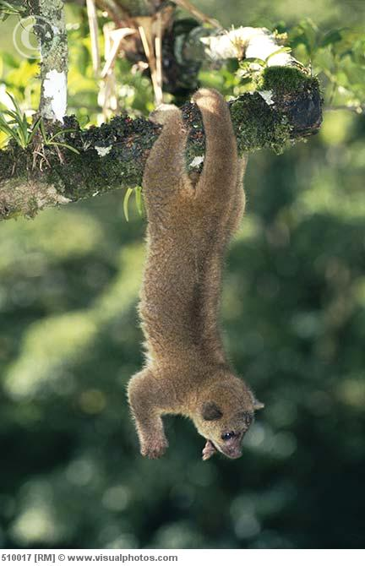
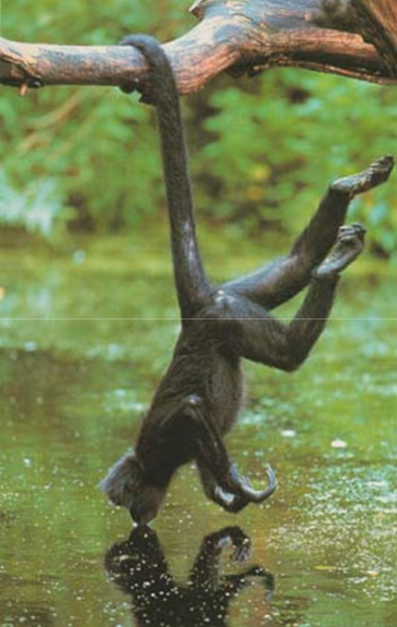

OSTEOLOGICAL INDICATORS OF PREHENSILITY IN THERIA AND THE IDENTIFICATION OF PREHENSILITY IN FOSSIL TAXA
M. Spaulding

Slide 2
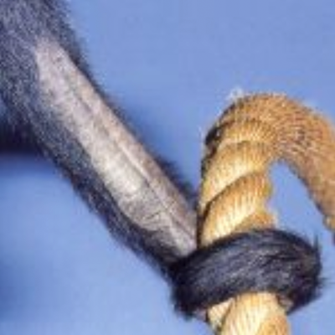
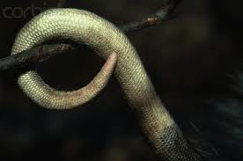
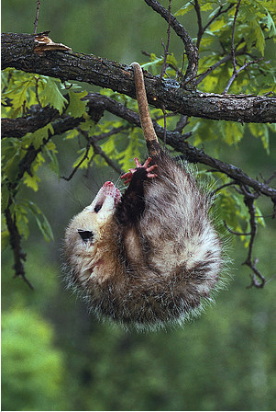
Prehensile
Semi-Prehensile
?

Slide 3
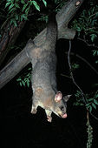
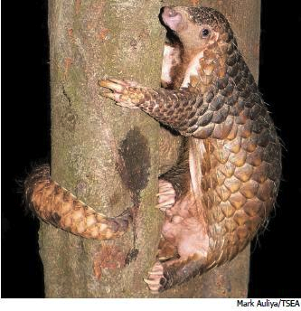
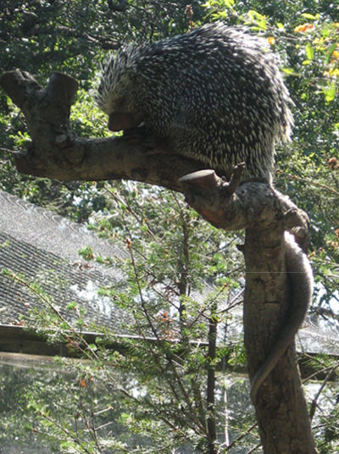
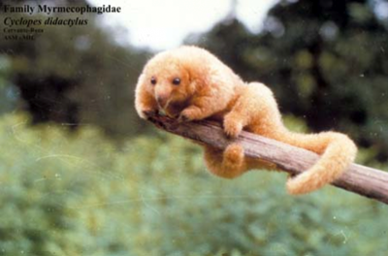
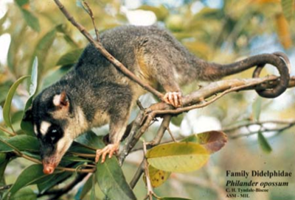
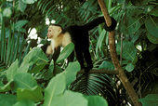
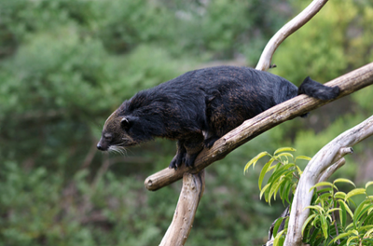
Multiple Origins of Prehensility
Notes:
Living orders with prehensile tails
Primates
Xenarthra
Philidota
Rodentia
marsupials

Slide 4
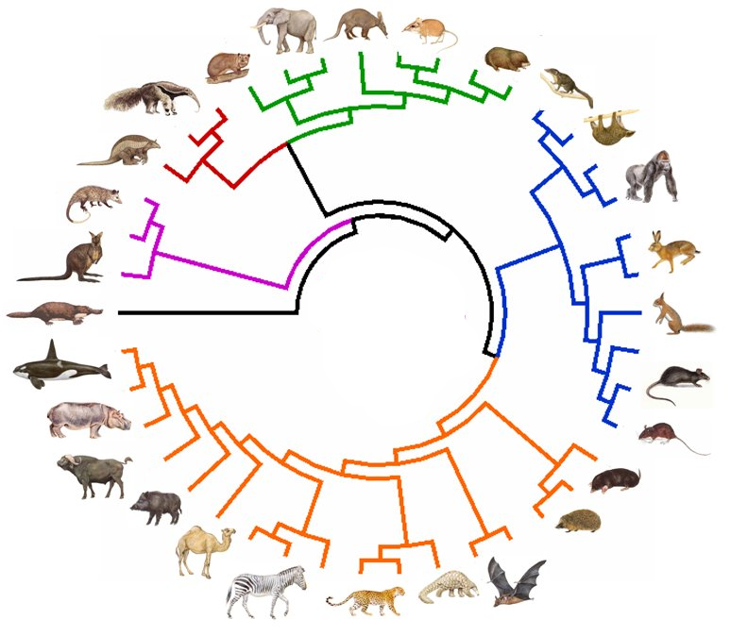
Minimum
8 events
In 6 orders

Slide 5
Prehensility in the fossil record?
?

Slide 6
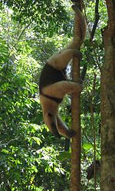
Convergence

Slide 7
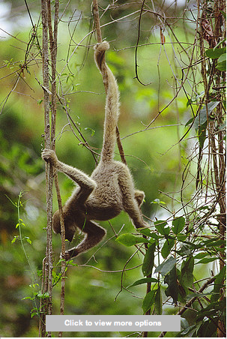
Previous Work
Primates
Carnivorans

Slide 8
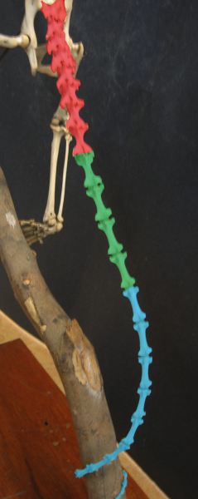
Tail Terminology
3 regions of the tail
Proximal region
From 1st caudal to transitional
Transitional region
After transitional to longest caudal
Distal region
After longest caudal
Notes:
Michelle- what marks the BEGINNING of the “transitional” vertebrae????? I presume it is the reduction or loss of transverse processes, or something similar-- whatever it is, list it on this slide

Slide 9

Transitional Vertebra
Proximal
Transitional

Slide 10
Tail Terminology
3 regions of the tail
Proximal region
From 1st caudal to transitional
Transitional region
After transitional to longest caudal
Distal region
After longest caudal
Notes:
Michelle- what marks the BEGINNING of the “transitional” vertebrae????? I presume it is the reduction or loss of transverse processes, or something similar-- whatever it is, list it on this slide

Slide 11
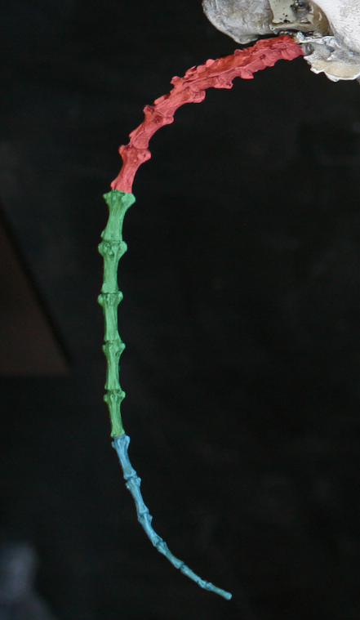
Phylogenetically Independent Osteological Indicators
Long tail compared to body
Long proximal section
Short transitional section
Well developed transverse processes
Increase in robusticity
Sacral features
  Number of vertebrae touching pelvis
  Size of sacral foramen
Notes:
Mention sacral stuff

Slide 12
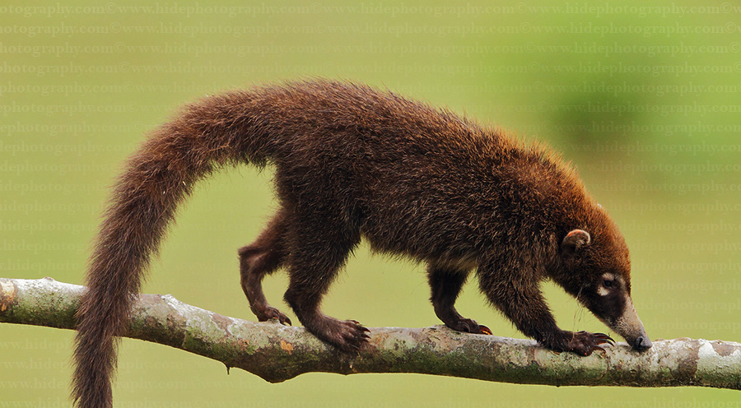
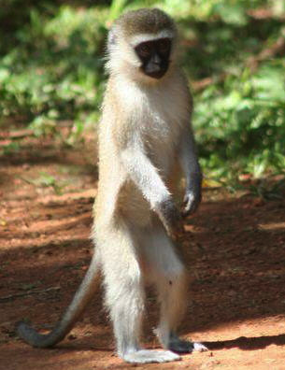
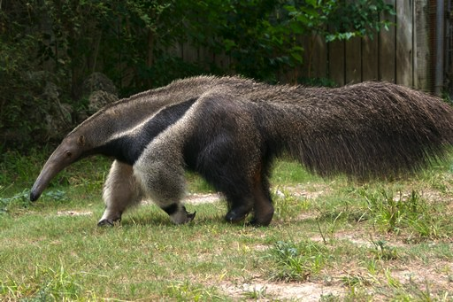
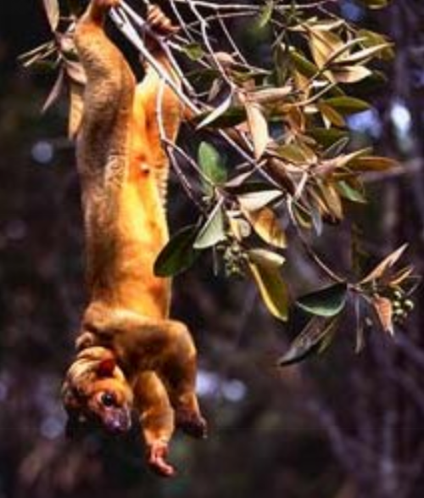
Testing

Slide 13
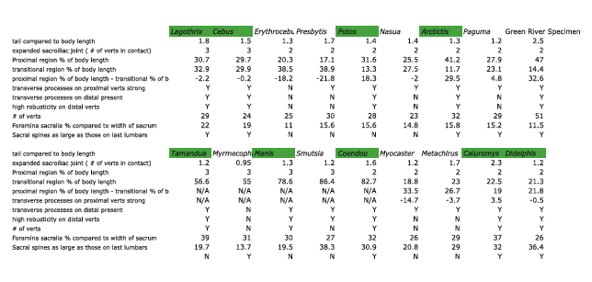
Results

Slide 14
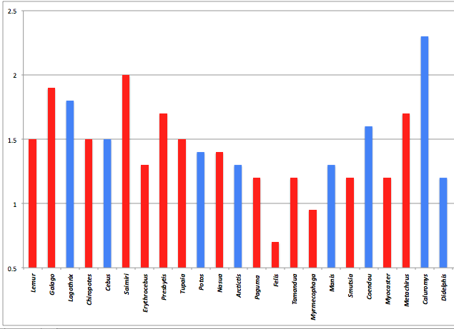
Tail Length
Percentage of body length

Slide 15
Relative Section Lengths
Proximal
Transitional
Notes:
same tail! Need to be able to compare.

Slide 16
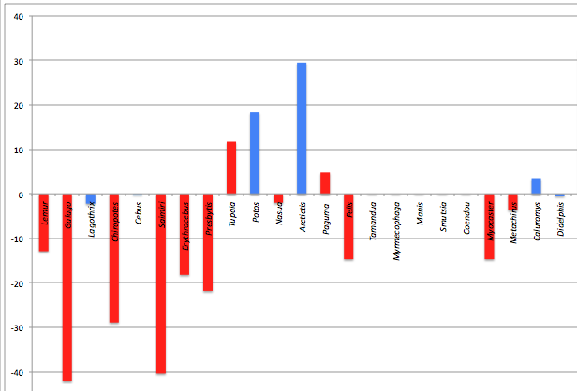
Proximal Section % minus Transitional Section % (% of body length)

Slide 17
Development of Transverse Processes

Slide 18
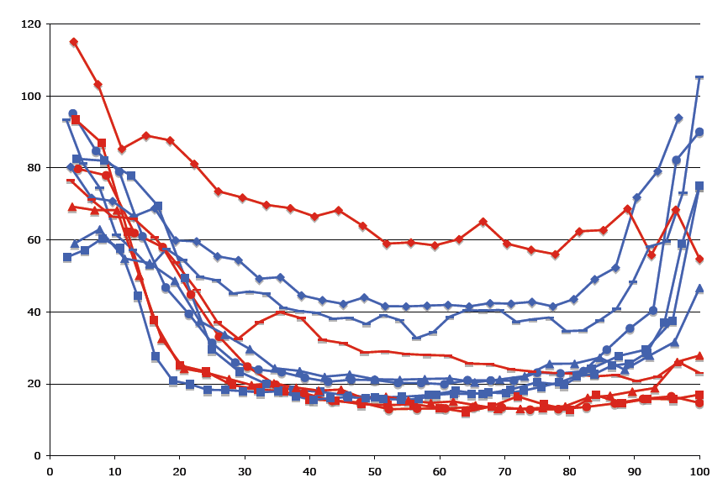
Robusticity of distal caudals
Robusticity
Percent of tail length

Slide 19
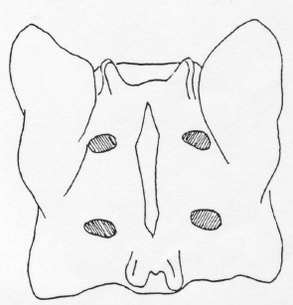
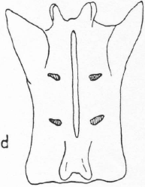
Sacral features

Slide 20
Phylogenetically Independent Osteological Indicators
Long tail compared to body
Long proximal section
Short transitional section
Well developed transverse processes
Increase in robusticity
Sacral features
  Number of vertebrae touching pelvis
  Size of sacral foramen

Slide 21
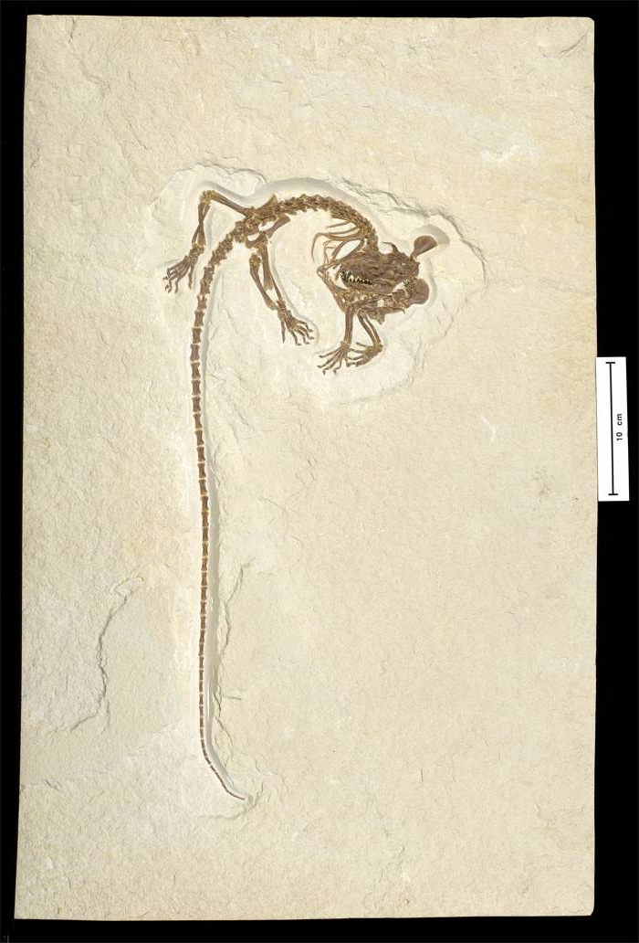
Green River Formation,
Wyoming
52.5 Ma
“cimolestid”
Spaulding et. al 2008
Spaulding, Flynn, and Grande. In prep.

Slide 22
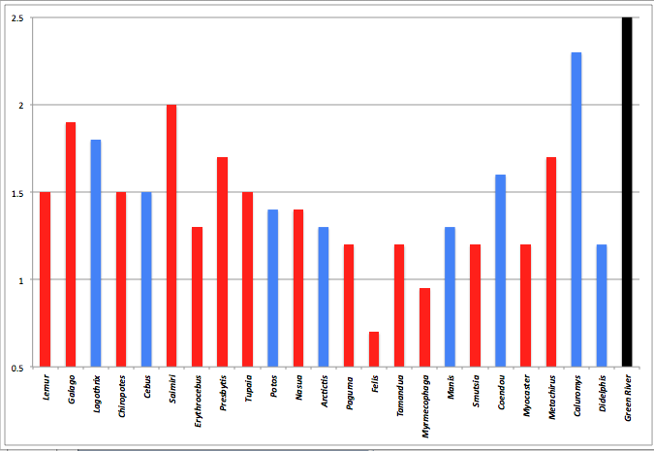
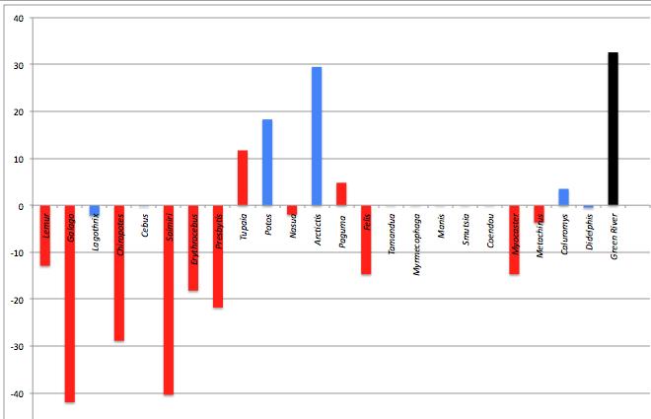
Tail Length
Section Lengths

Slide 23
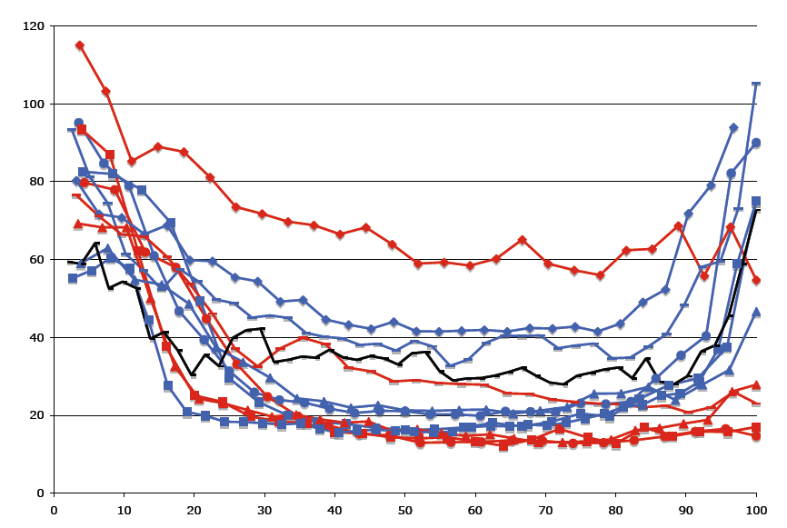
Robusticity of distal caduals
Robusticity
Percent of tail length

Slide 24
Its Prehensile!
51 caudal vertebrae!
Long proximal section compared to transitional
Well developed distal transverse processes
Increase in robusticity

Slide 25
Conclusions
Suite of features for identifying prehensility in fossils identified.
Features both applicable intra and inter ordinally
Identification of prehensility in fossil ‘cimolestid’

Slide 26

Acknowledgements
Access to collections and specimens: Carnegie Museum of Natural History - Dr. Zhe-xi Lou, Alan Tabrum, and Amy C. Henrici; The Field Museum of Natural History - Dr. Lance Grande and William F. Simpson; AMNH: Ivy Rutzky, Carl Mehling, Dr. Chris Norris, Ruth O’Leary, Judy Galkin, and Susan Bell. Eileen Westwig, Darrin Lunde, Neil Duncan, Catherine Doyle-Capitman, and Dr. Robert Voss, Ana Barcel, Jeanne Kelly, Amy Davidson, Dr. Robert Evander, Justy Alicea, Edward Pedersen, Lorraine Meeker, and Chester Tarka.
Funding: Columbia University and the National Science Foundation, NSF Graduate student fellowship and two awards to J. Flynn

