Slide 1
Chapter 11
Lecture Outline Part 2 of 2
Human Physiology Sixteenth Edition
Stuart Ira Fox
Krista Rompolski
Copyright 2022 © McGraw Hill LLC. All rights reserved. No reproduction or distribution without the prior written consent of McGraw Hill LLC.

Slide 2
11.5 Muscles of Respiration 1
The process of respiration involves inspiration and expiration
During inspiration (inhalation)
Several muscles contract to increase the size of the thoracic cavity, allowing lungs to fill with air
During expiration (exhalation)
Some respiratory muscles contract and others relax, decreasing the size of the thoracic cavity and forcing air out of lungs

Slide 3
11.5 Muscles of Respiration 2
Muscles of respiration
Found on posterior and anterior thorax
Serratus posterior superior
Elevates ribs during forced inspiration
Increases lateral dimensions of thorax
Serratus posterior inferior
Depresses ribs during forced expiration
Scalene muscles
Help elevate first and second ribs during forced inspiration

Slide 4
11.5 Muscles of Respiration 3
Muscles of respiration (continued )
External intercostals
Elevate ribs during inspiration, expanding cavity
Internal intercostals
Deep to external intercostals
Fibers at right angles to external intercostals
Depress ribs during forced expiration
Transversus thoracis
Depresses ribs during forced expiration

Slide 5
Muscles of Respiration, Anterior View
Figure 11.15
Access the text alternative for slide images.

Slide 6
11.5 Muscles of Respiration 4
Muscles of respiration (continued )
Diaphragm
Internally placed dome-shaped muscle that partitions thoracic and abdominal cavities
Most important muscle associated with breathing
Muscle fibers converge toward fibrous central tendon
Contracts during inspiration
Central tendon pulled inferiorly, increasing dimension of thoracic cavity

Slide 7
Intercostals and Diaphragm
Figure 11.15c-d
Access the text alternative for slide images.

Slide 8
Section 11.5 What did you learn?
Compare the actions of the external intercostals and the internal intercostals.
How is the diaphragm involved in respiration?

Slide 9
11.6 Muscles of the Abdominal Wall 1
Compress and hold abdominal organs in place
Involved in forced expiration
Flex vertebral column (except for transversus abdominis)
External oblique
Located superficially, fibers directed inferomedially
Forms aponeurosis anteriorly, that becomes inguinal ligament inferiorly
Internal oblique
Located deep to external oblique, fibers project superomedially
Forms aponeurosis anteriorly

Slide 10
11.6 Muscles of the Abdominal Wall 2
Transversus abdominis
Deepest abdominal muscle, fibers project transversely
Forms aponeurosis anteriorly
Rectus abdominis
Anteromedial location, fibers run vertically
Partitioned into four segments by fibrous tendinous intersections
Enclosed within fibrous sleeve, rectus sheath
Formed from aponeuroses of external and internal oblique, transversus abdominis
Rectus sheaths of two sides connected by fibrous strip, linea alba

Slide 11
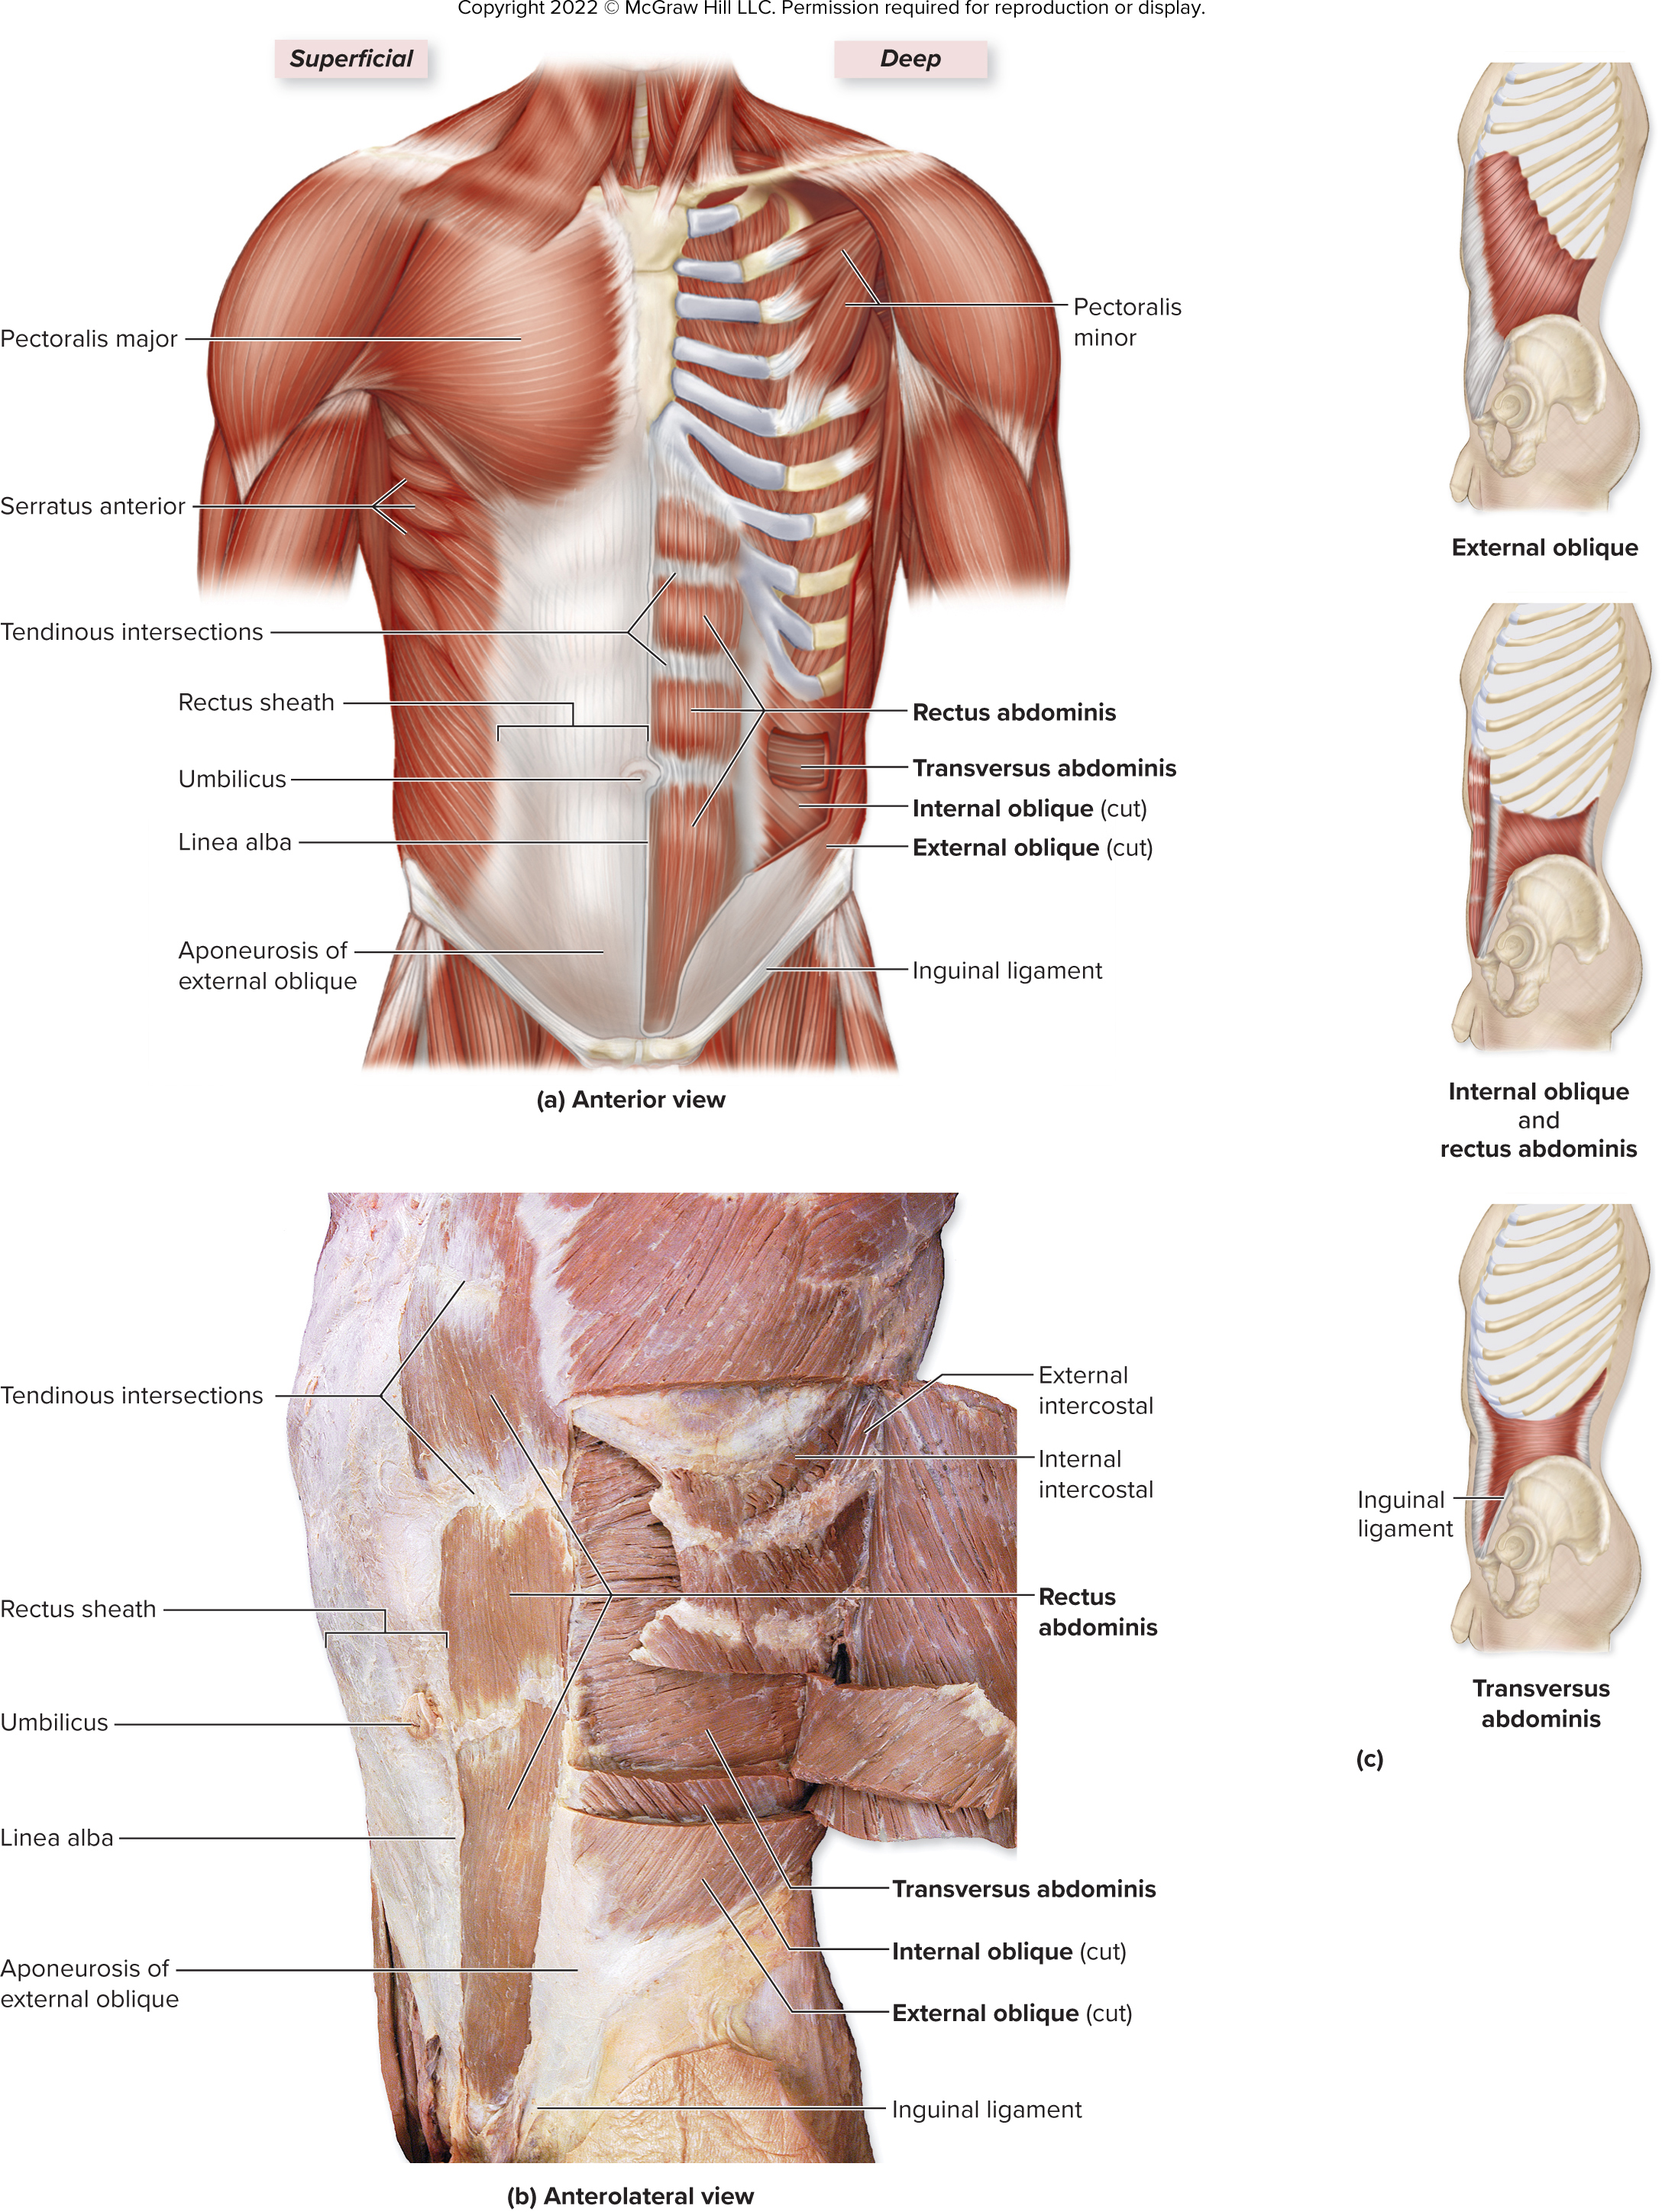
Muscles of the Abdominal Wall, Anterior View
Figure 11.16a,c
Access the text alternative for slide images.

Slide 12
Muscles of the Abdominal Wall, Anterolateral View
Unilateral contraction of oblique muscles and transversus abdominis helps laterally flex the vertebral column and rotate it toward the side opposite the contraction
©McGraw-Hill Education/Photo and Dissection by Christine Eckel
Figure 11.16b-c
Access the text alternative for slide images.

Slide 13
Clinical View: Hernias
Portion of viscera protrudes through weak point of abdominal wall
Inguinal hernia
Loop of small intestine protrudes through superficial inguinal ring
More likely to occur in males since their inguinal canals are larger to accommodate spermatic cord
High abdominal pressure (for example, straining to lift something heavy) can push intestine into canal
Physicians test for it by palpating inguinal ring while patient coughs (cough raises abdominal pressure)

Slide 14
Section 11.6 What did you learn?
What are the main actions of the abdominal muscles?

Slide 15
11.7 Muscles of the Pelvic Floor 1
Pelvic floor formed by three layers of muscles and fasciae
Collectively known as the pelvic diaphragm
Supports pelvic viscera
Figure 11.17a
Access the text alternative for slide images.

Slide 16
11.7 Muscles of the Pelvic Floor 2
Perineum
Diamond-shaped region between lower appendages
Bounded by pubic symphysis, coccyx, ischial tuberosities
Contains two triangles divided by transverse line between ischial tuberosities
Urogenital triangle contains external genitalia and urethra
Anal triangle contains anus

Slide 17
Muscles of the Pelvic Floor
Access the text alternative for slide images.

Slide 18
Section 11.7 What did you learn?
What are the main actions of the pelvic floor muscles?

Slide 19
11.8a Muscles That Move the Pectoral Girdle 1
Anterior thoracic muscles
Pectoralis minor
Deep to pectoralis major
Helps depress and protract scapula; hunches shoulders
Serratus anterior
Fan-shaped muscle between ribs and scapula
Protracts, stabilizes scapula
Subclavius
Extends from clavicle to first rib
Stabilizes and depresses scapula

Slide 20
Muscles That Move Pectoral Girdle and the Glenohumeral Joint/Arm, Anterior View
Figure 11.21a
Access the text alternative for slide images.

Slide 21
11.8a Muscles That Move the Pectoral Girdle 2
Posterior thoracic muscles
Levator scapulae
Attaches to cervical vertebrae and scapula
Elevates and inferiorly rotates the scapula
Rhomboid major and rhomboid minor
Runs inferolaterally from vertebrae to scapula, deep to trapezius
Helps elevate, retract, and inferiorly rotate the scapula
Trapezius
Diamond-shaped muscle extending from skull and vertebral column to pectoral girdle
Can elevate, depress, retract, or rotate scapula

Slide 22
Muscles That Move Pectoral Girdle and the Glenohumeral Joint/Arm, Posterior View
Figure 11.21b
Access the text alternative for slide images.

Slide 23
Retraction and Protraction of the Scapula
Figure 11.20a
Access the text alternative for slide images.

Slide 24
Elevation, Depression, and Rotation of the Scapula
Figure 11.20b-c
Access the text alternative for slide images.

Slide 25
11.8b Muscles That Move the Arm at the Glenohumeral Joint 1
Eleven muscles cross the glenohumeral joint and move the humerus
Agonists (prime movers) of the glenohumeral joint:
Latissimus dorsi
Broad triangular muscle on back
Agonist of arm extension; also adducts and medially rotates arm
Pectoralis major
Thick fan-shaped muscle on superior, anterior thorax
Agonist of arm flexion; also adducts and medially rotates arm

Slide 26
11.8b Muscles That Move the Arm at the Glenohumeral Joint 2
Triceps brachii
Long head originates on scapula, spans shoulder joint
Helps extend and adduct the arm
Biceps brachii
Both heads originate on scapula and span shoulder joint
Assists in flexing the arm
Deltoid
Prime abductor of the arm
Its anterior fibers flex and medially rotate arm
Its lateral fibers abduct the arm
Its posterior fibers extend and laterally rotate arm

Slide 27
11.8b Muscles That Move the Arm at the Glenohumeral Joint 3
Coracobrachialis
Flexes and adducts the arm
Teres major
Extends, adducts, medially rotates arm
Rotator cuff muscles:
Subscapularis
Medially rotates arm
Supraspinatus
Abducts the arm
Infraspinatus and teres minor
Adduct and laterally rotate arm

Slide 28
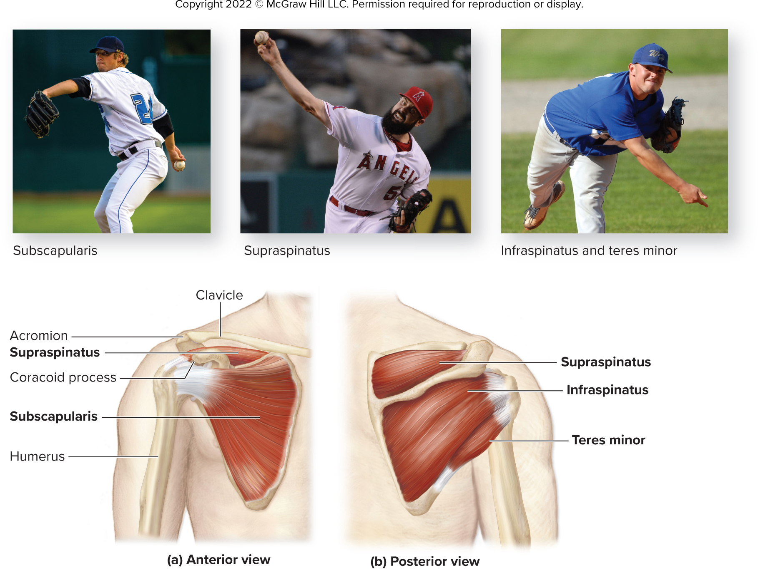
Rotator Cuff Muscles
Subscapularis helps in wind up for pitch
Supraspinatus helps in executing pitch delivery
Infraspinatus and teres minor slow the arm at end of pitch
(Top left) Richard Wear/Getty Images; (Top middle) ©Zuma Press Inc/Alamy Stock Photo; (Top right) ©Enigma/Alamy Stock Photo
Figure 11.22
Access the text alternative for slide images.

Slide 29
Clinical View: Rotator Cuff Injuries
Result of trauma or disease
Can be caused by repetitive use
Can be caused by falling on the shoulder or lifting too heavy of an object
Supraspinatus most commonly involved
Symptoms are swelling, tenderness, and pain with movement
Especially common in baseball players
May require physical therapy or surgical repair

Slide 30
11.8c Arm and Forearm Muscles That Move the Forearm at the Elbow Joint 1
Limbs are organized into compartments surrounded by deep fascia and subdivided by intermuscular septa
A compartment houses functionally related muscles
Anterior compartment of the arm has flexor muscles
Supplied blood by deep brachial artery
Innervated by musculocutaneous nerve
For example, biceps brachii, brachialis
Posterior compartment of the arm has extensor muscles
Supplied blood by deep brachial artery
Innervated by radial nerve
For example, triceps brachii

Slide 31
11.8c Arm and Forearm Muscles That Move the Forearm at the Elbow Joint 2
Muscles of the arm’s anterior compartment:
Biceps brachii
Two-headed muscle on anterior humerus
Flexes and supinates forearm; weak flexor of humerus
Brachialis
Deep to biceps brachii
Most powerful flexor of forearm
Brachioradialis
Located on anterolateral forearm
Involved in elbow flexion

Slide 32
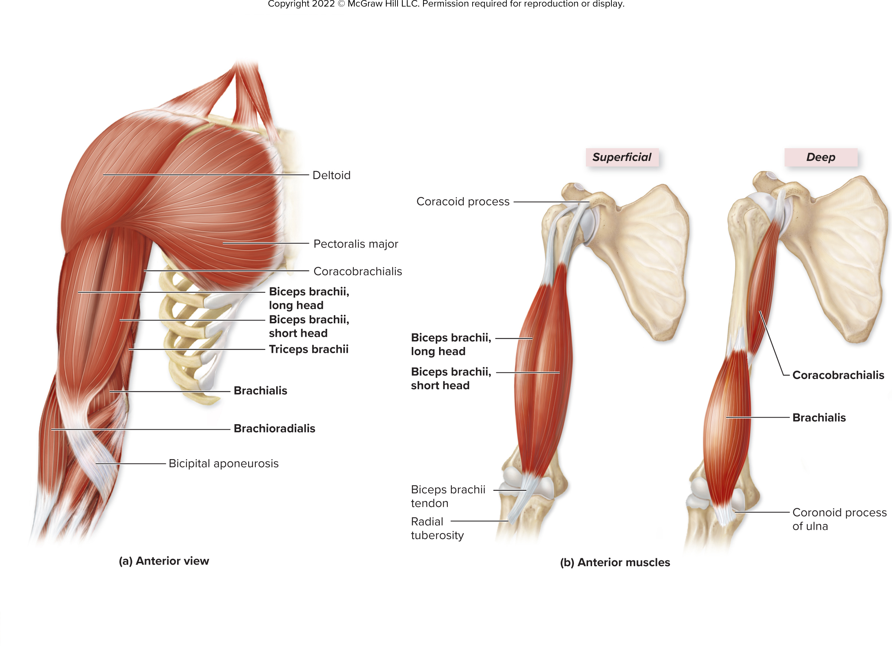
Anterior Muscles That Move the Elbow Joint/Forearm
Figure 11.24
Access the text alternative for slide images.

Slide 33
11.8c Arm and Forearm Muscles That Move the Forearm at the Elbow Joint 3
Muscles of the arm’s posterior compartment:
Triceps brachii
Large three-headed muscle on posterior arm
Major extensor of forearm; also helps extend humerus
Anconeus
Weak elbow extensor
Crosses posterolateral region of elbow

Slide 34
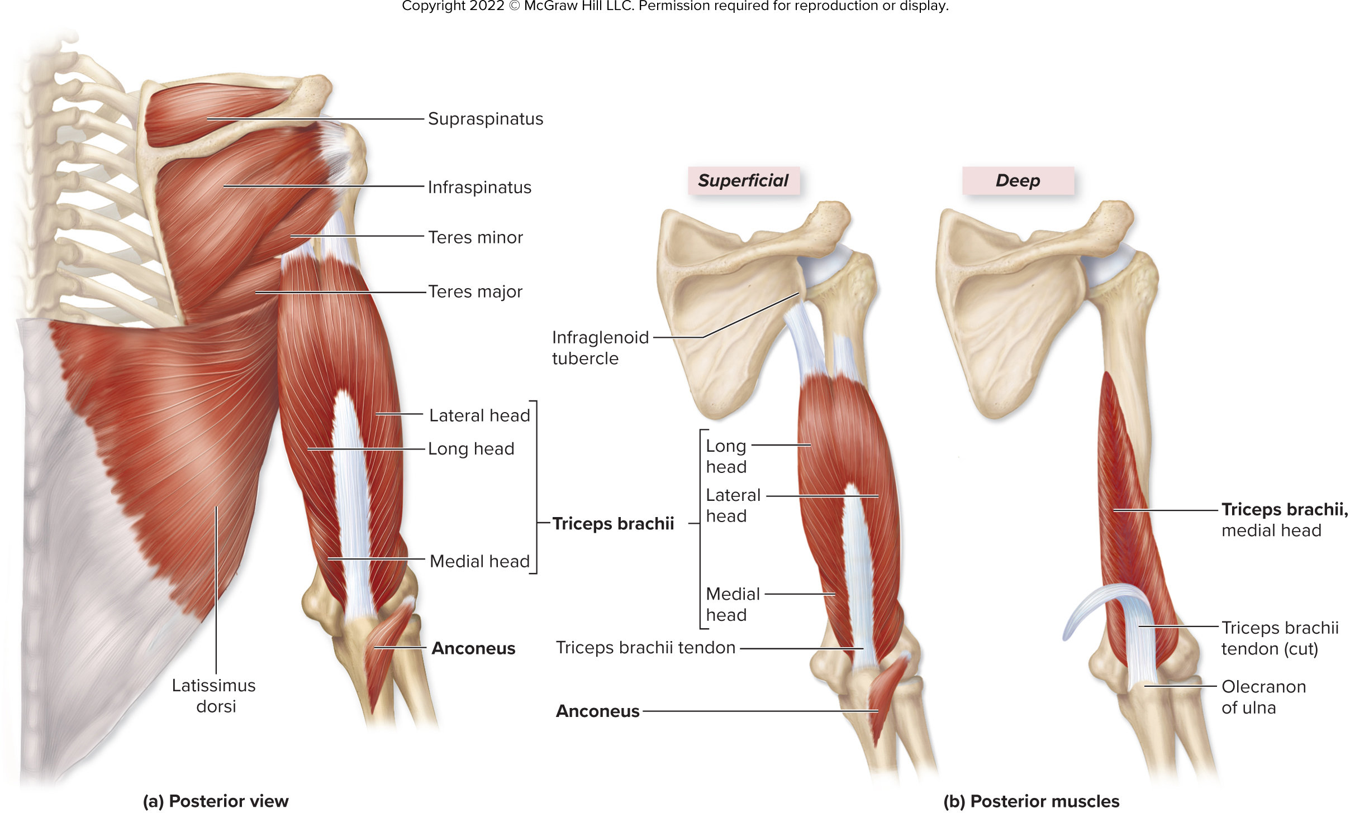
Posterior Muscles That Move the Elbow Joint/Forearm
Figure 11.25
Access the text alternative for slide images.

Slide 35
11.8c Arm and Forearm Muscles That Move the Forearm at the Elbow Joint 4
Muscles That Pronate or Supinate the Forearm:
Pronator teres and pronator quadratus
Rotate the radius across the ulna to pronate forearm
Located in anterior compartment of forearm
Supinator
Supinates forearm
Located in posterior compartment of forearm

Slide 36
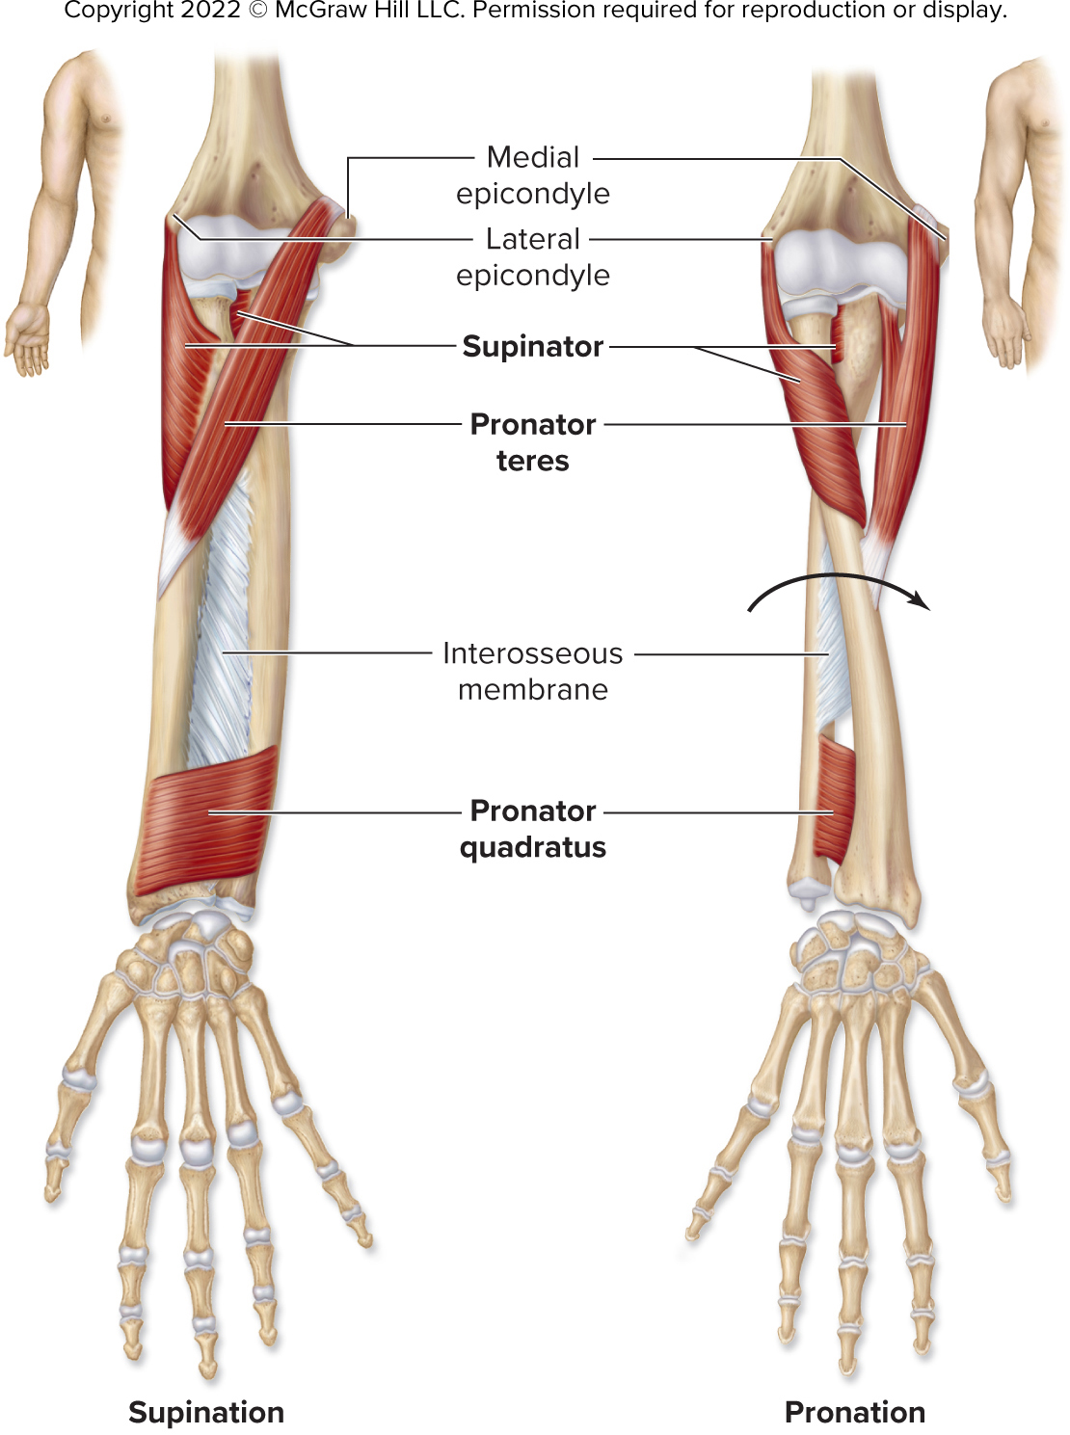
Forearm Muscles That Supinate and Pronate
Figure 11.26
Access the text alternative for slide images.

Slide 37
Clinical View: Lateral Epicondylitis
Also known as tennis elbow
From trauma or overuse of common extensor tendon of posterior forearm muscles
Pain at lateral epicondyle of humerus, tendon’s attachment site
Often results from repeated forceful contraction of forearm extensors

Slide 38
11.8d Forearm Muscles That Move the Wrist Joint, Hand, and Fingers 1
Forearm muscles are extrinsic to wrist and hand
Intermuscular septa partition muscles into anterior and posterior compartments
Anterior compartment muscles
Generally flex the wrist (some flex interphalangeal (IP) joint)
Most arise from medial epicondyle of humerus
Posterior compartment muscles
Generally extend the wrist (some extend metacarpophalangeal (MP) and interphalangeal (IP) joints)
Most arise from lateral epicondyle of humerus

Slide 39
11.8d Forearm Muscles That Move the Wrist Joint, Hand, and Fingers 2
Retinacula of the forearm
Fibrous bands at the wrist formed from deep fascia
Hold tendons close to bone
Flexor retinaculum covers palmar surface of carpal bones
Carpal tunnel: tight space between carpal bones and flexor retinaculum through which flexor tendons pass
Extensor retinaculum superficial to dorsal surface of carpal bones
Extensor tendons of wrist and digits pass under it

Slide 40
Clinical View: Carpal Tunnel Syndrome
Carpal tunnel
Space between carpal bones and flexor retinaculum
Flexor tendons extending through tunnel
Median nerve extending through tunnel
Syndrome caused by compression of nerve
Characterized by pain and “pins and needles” (paresthesia)

Slide 41
11.8d Forearm Muscles That Move the Wrist Joint, Hand, and Fingers 3
Muscles of the forearm’s anterior compartment:
Superficial layer
Medial epicondyle $=$ proximal attachment
Flexor carpi radialis
Prominent muscle on lateral forearm
Flexes wrist and abducts hand
Palmaris longus
Narrow muscle on anterior forearm
Weakly assists in wrist flexion
Flexor carpi ulnaris
Flexes wrist and adducts hand

Slide 42
11.8d Forearm Muscles That Move the Wrist Joint, Hand, and Fingers 4
Intermediate layer
Medial epicondyle $=$ proximal attachment
Flexor digitorum superficialis is only muscle of this layer
Its four tendons attach distally to middle phalanges of fingers 2 to 5
Flexes wrist, MP, and proximal interphalangeal (PIP) joints of fingers 2 to 5

Slide 43
11.8d Forearm Muscles That Move the Wrist Joint, Hand, and Fingers 5
Deep layer
Flexor pollicis longus
Attaches to distal phalanx of thumb
Flexes MP and IP joints of the thumb; weak flexor of wrist
Flexor digitorum profundus
Lies deep to flexor digitorum superficialis
Its four tendons attach distally to distal phalanges of fingers 2 to 5
Flexes wrist, MP joints, PIP joints, and distal interphalangeal (DIP) joints of fingers 2 to 5

Slide 44
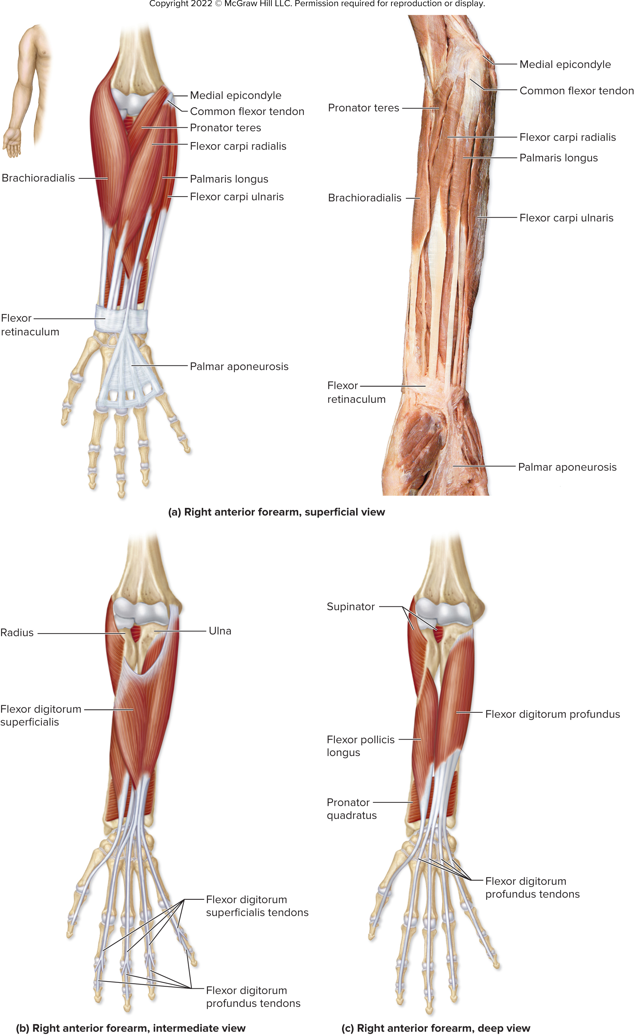
Right Anterior Forearm, Superficial View
Figure 11.27a
(a) ©McGraw-Hill Education/Photo and Dissection by Christine Eckel
Access the text alternative for slide images.

Slide 45
Right Anterior Forearm, Intermediate and Deep Views
Figure 11.27b-c
Access the text alternative for slide images.

Slide 46
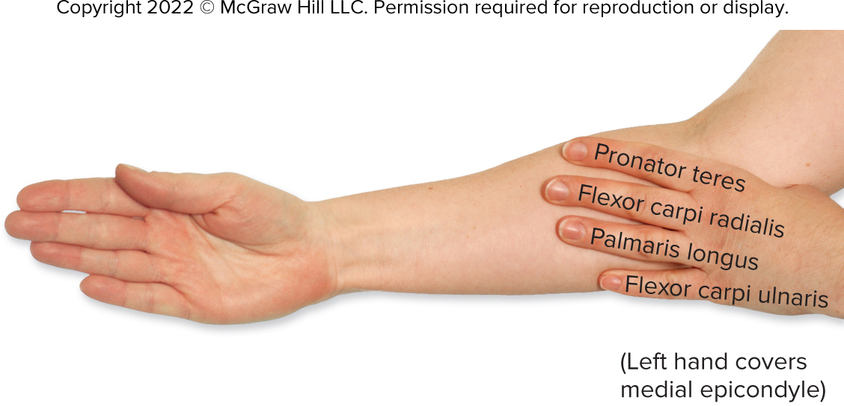
Positioning of the Superficial Anterior Forearm Muscles
©McGraw-Hill Education/Jw Ramsey
Figure 11.28

Slide 47
11.8d Forearm Muscles That Move the Wrist Joint, Hand, and Fingers 6
Muscles of forearm’s posterior compartment:
Superficial layer
Lateral epicondyle $=$ proximal attachment
Extensor carpi radialis longus
Extends wrist and abducts hand
Extensor carpi radialis brevis
Extends wrist and abducts hand
Extensor digitorum
Inserts on distal phalanges of fingers 2 to 5
Extends wrist, MP joints, PIP joints, and DIP joints of fingers 2 to 5

Slide 48
11.8d Forearm Muscles That Move the Wrist Joint, Hand, and Fingers 7
Superficial layer (continued )
Extensor digit minimi
Attaches to distal phalanx of finger 5 (pinky)
Extends the little finger
Extensor carpi ulnaris
Distal attachment on fifth metacarpal bone
Extends wrist and adducts hand

Slide 49
11.8d Forearm Muscles That Move the Wrist Joint, Hand, and Fingers 8
Muscles of forearm’s posterior compartment
Deep layer
Extensor pollicis brevis
Helps extend MP joint of the thumb
Extensor pollicis longus
Extends MP and IP joints of the thumb
Extensor indicis
Extends MP, PIP, and DIP joints of index finger

Slide 50
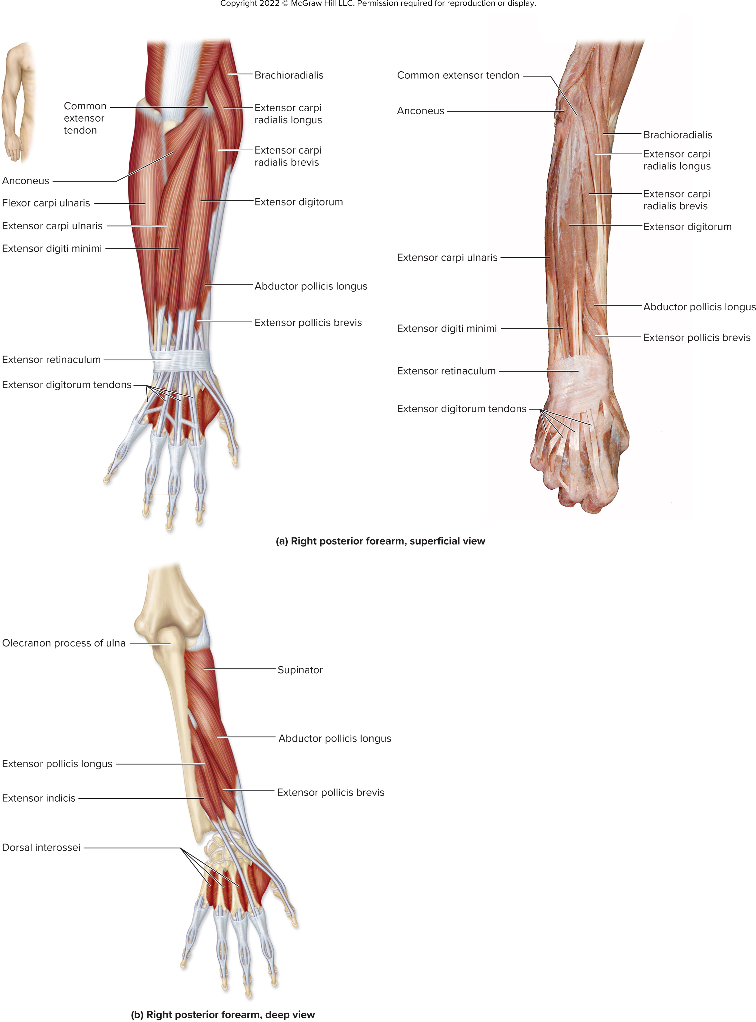
Right Posterior Forearm, Superficial View
Figure 11.29a
©McGraw-Hill Education/Photo and Dissection by Christine Eckel
Access the text alternative for slide images.

Slide 51
Right Posterior Forearm, Deep View
Figure 11.29b
Access the text alternative for slide images.

Slide 52
11.8e Intrinsic Muscles of the Hand 1
Intrinsic muscles of the hand: both proximal and distal attachments are in hand
Thenar group: form fleshy mass at base of thumb
Flexor pollicis brevis: flexes thumb
Abductor pollicis brevis: abducts thumb
Opponens pollicis: assists in opposition of thumb
Hypothenar group: fleshy mass at base of little finger
Flexor digiti minimi brevis: flexes little finger
Abductor digiti minimi: abducts little finger
Opponens digiti minimi: assists in opposition of little finger

Slide 53
11.8e Intrinsic Muscles of the Hand 2
Midpalmar group
Occupies space between thenar and hypothenar groups
Lumbricals (worm-shaped)
Flex the MP joints; extend PIP and DIP joints of fingers 2 to 5
Dorsal interossei (between metacarpals)
Flex MP joints and extend PIP and DIP joints of fingers 2 to 5; abduct fingers 2 to 5
Palmar interossei (between metacarpals)
Adduct the fingers; flex the MP joints and extend the PIP and DIP joints of fingers 2 to 5
Adductor Pollicis
Adducts thumb

Slide 54
Right Hand, Superficial Palmar View
Figure 11.30a
Access the text alternative for slide images.

Slide 55
Right Hand, Deep Palmar View
Figure 11.30b
Access the text alternative for slide images.

Slide 56
Right Hand, Posterior View
Figure 11.30c
Access the text alternative for slide images.

Slide 57
Section 11.8 What did you learn? 1
List the posterior thoracic muscles that move the pectoral girdle, and describe their common action(s).
Which muscles extend the arm at the glenohumeral (shoulder) joint?
List the rotator cuff muscles, and describe their actions.
What are the muscles in the anterior compartment of the arm, and what common action(s) do they perform?

Slide 58
Section 11.8 What did you learn? 2
What muscles pronate the forearm, and which supinate the forearm?
What are the common actions of muscles in the anterior compartment of the forearm?
What muscles in the posterior compartment move the thumb?
Which group of intrinsic hand muscles is primarily responsible for moving the thumb?

Slide 59
11.9a Muscles that Move the Thigh at the Hip Joint 1
Organization of thigh muscles
They are bound by the fascia lata, deep fascia that partitions them into compartments
Anterior compartment muscles
Extend the knee or flex the thigh
Medial compartment muscles
Adduct the thigh
Two gluteal muscles, as well as a muscle in the lateral thigh
Abduct the thigh
Posterior compartment muscles
Most flex knee and extend the thigh

Slide 60
11.9a Muscles that Move the Thigh at the Hip Joint 2
Muscles attaching to anterior thigh:
Psoas major and iliacus (collectively, iliopsoas)
Run from lumbar vertebrae and ilium to femur
Flex the hip joint
Muscle of lateral thigh:
Tensor fasciae latae
Attaches to iliotibial tract (lateral thickening of fascia lata)
Abducts and medially rotates the thigh

Slide 61
11.9a Muscles that Move the Thigh at the Hip Joint 3
Muscles of the medial compartment of thigh:
Adductor longus, adductor brevis, gracilis, pectineus
Adduct and flex the thigh
Adductor magnus
Adducts, extends, and laterally rotates the thigh
Obturator externus
Laterally rotates the thigh

Slide 62
Muscles That Act on the Hip and Thigh, Anterior View
Figure 11.31a
Access the text alternative for slide images.

Slide 63
11.9a Muscles that Move the Thigh at the Hip Joint 4
Muscles of the posterior thigh:
Gluteus maximus
Agonist of thigh extension; also laterally rotates the thigh
Gluteus medius and gluteus minimus
Deep to gluteus maximus
Abduct and medially rotate the thigh
Hamstrings: group of 3 muscles
Biceps femoris, semimembranosus, semitendinosus
Extend the thigh (also flex the knee)
Group of muscles deep to gluteal muscles
Piriformis, superior gemellus, obturator internus, inferior gemellus, and quadratus femoris
Laterally rotate the thigh

Slide 64
Muscles That Act on the Hip and Thigh, Lateral View
Figure 11.31b
Access the text alternative for slide images.

Slide 65
Muscles That Act on the Hip and Thigh, Deep Posterior View
Figure 11.31c
Access the text alternative for slide images.

Slide 66
Clinical View: Thigh Muscle Injuries
Groin strain (groin pull, pulled groin)
Tearing, stretching, straining proximal attachments of medial muscles of thigh (for example, adductor muscles, gracilis)
Typically occurs if muscles contract too suddenly, forcefully
For example, jumping, kicking, change direction while running
Strained or pulled hamstring
Hamstring tendons avulsed (torn away) during quick starts/stops, fast running, sudden lateral/medial stress to knee joint
Prevention by doing dynamic warm-up prior to exercise, static stretching after exercise

Slide 67
11.9b Thigh Muscles That Move the Leg at the Knee Joint 1
Muscles of the thigh’s anterior compartment:
Quadriceps femoris: composite muscle with four heads
Consists of: rectus femoris, vastus lateralis, vastus medialis, vastus intermedius
Agonist of knee extension
Pulls on quadriceps tendon, which becomes patellar ligament to tibia
Sartorius
Flexes and laterally rotates thigh; also flexes and medially rotates leg

Slide 68
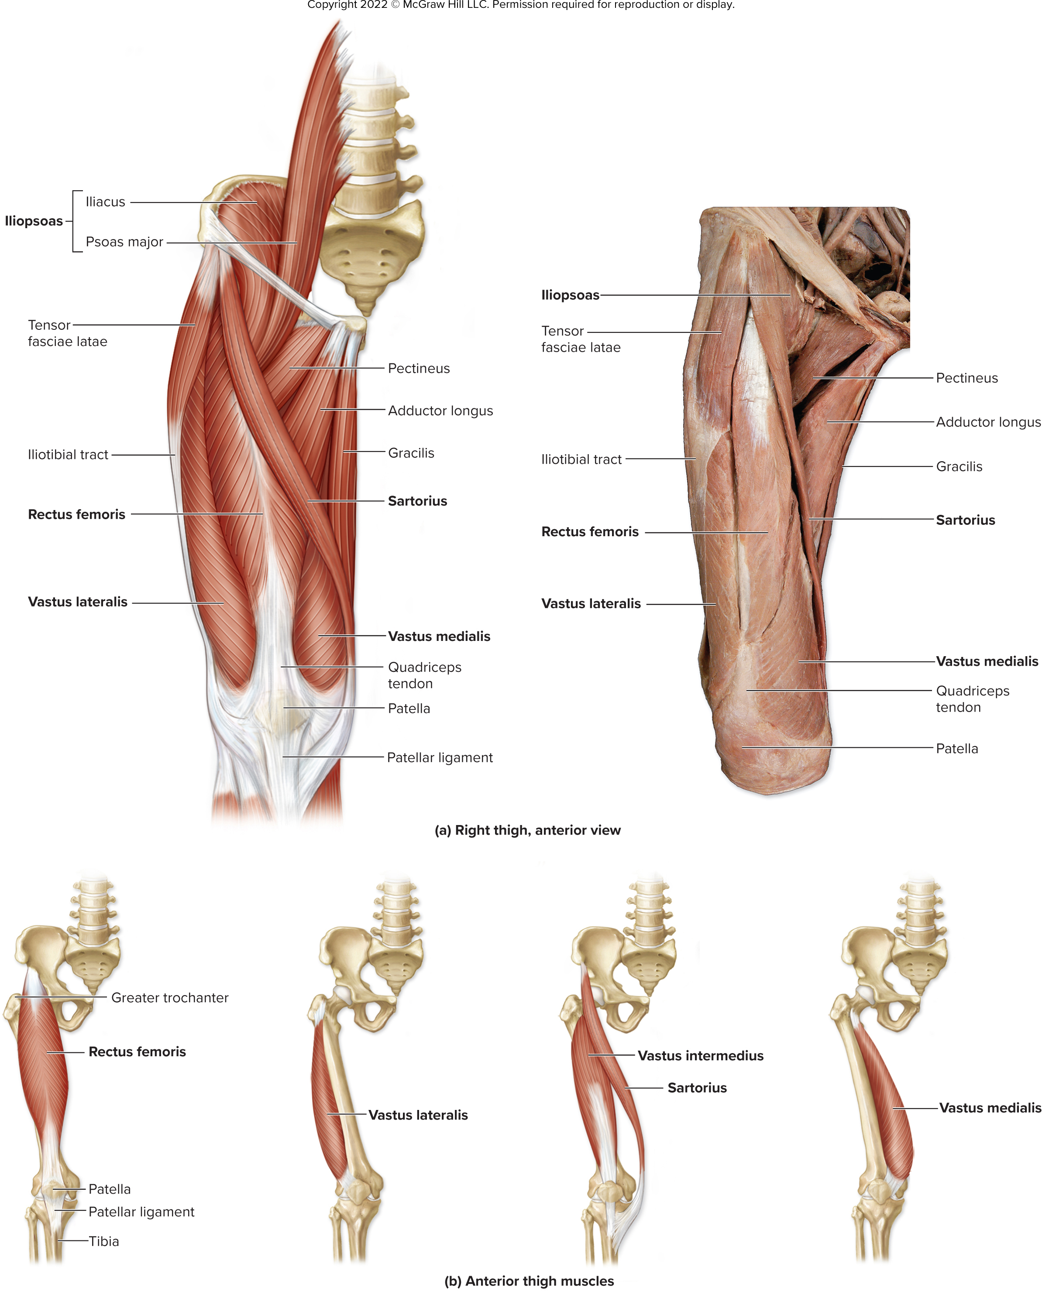
Right Thigh, Anterior View
Figure 11.32a
©McGraw-Hill Education/Photo and Dissection by Christine Eckel
Access the text alternative for slide images.

Slide 69
Anterior Thigh Muscles
Figure 11.32b
Access the text alternative for slide images.

Slide 70
11.9b Thigh Muscles That Move the Leg at the Knee Joint 2
Muscle of the thigh’s medial compartment:
Gracilis
Flexes the leg (as well as adducting the thigh)
Muscles of the thigh’s posterior compartment:
Hamstring muscles: composite of three muscles
Biceps femoris (has two heads)
Flexes leg; also laterally rotates leg when leg is flexed
Semimembranosus and semitendinosus
Medially rotate leg when leg is flexed
Several leg muscles (more distally located) span the knee and flex the leg (to be discussed in next section)

Slide 71
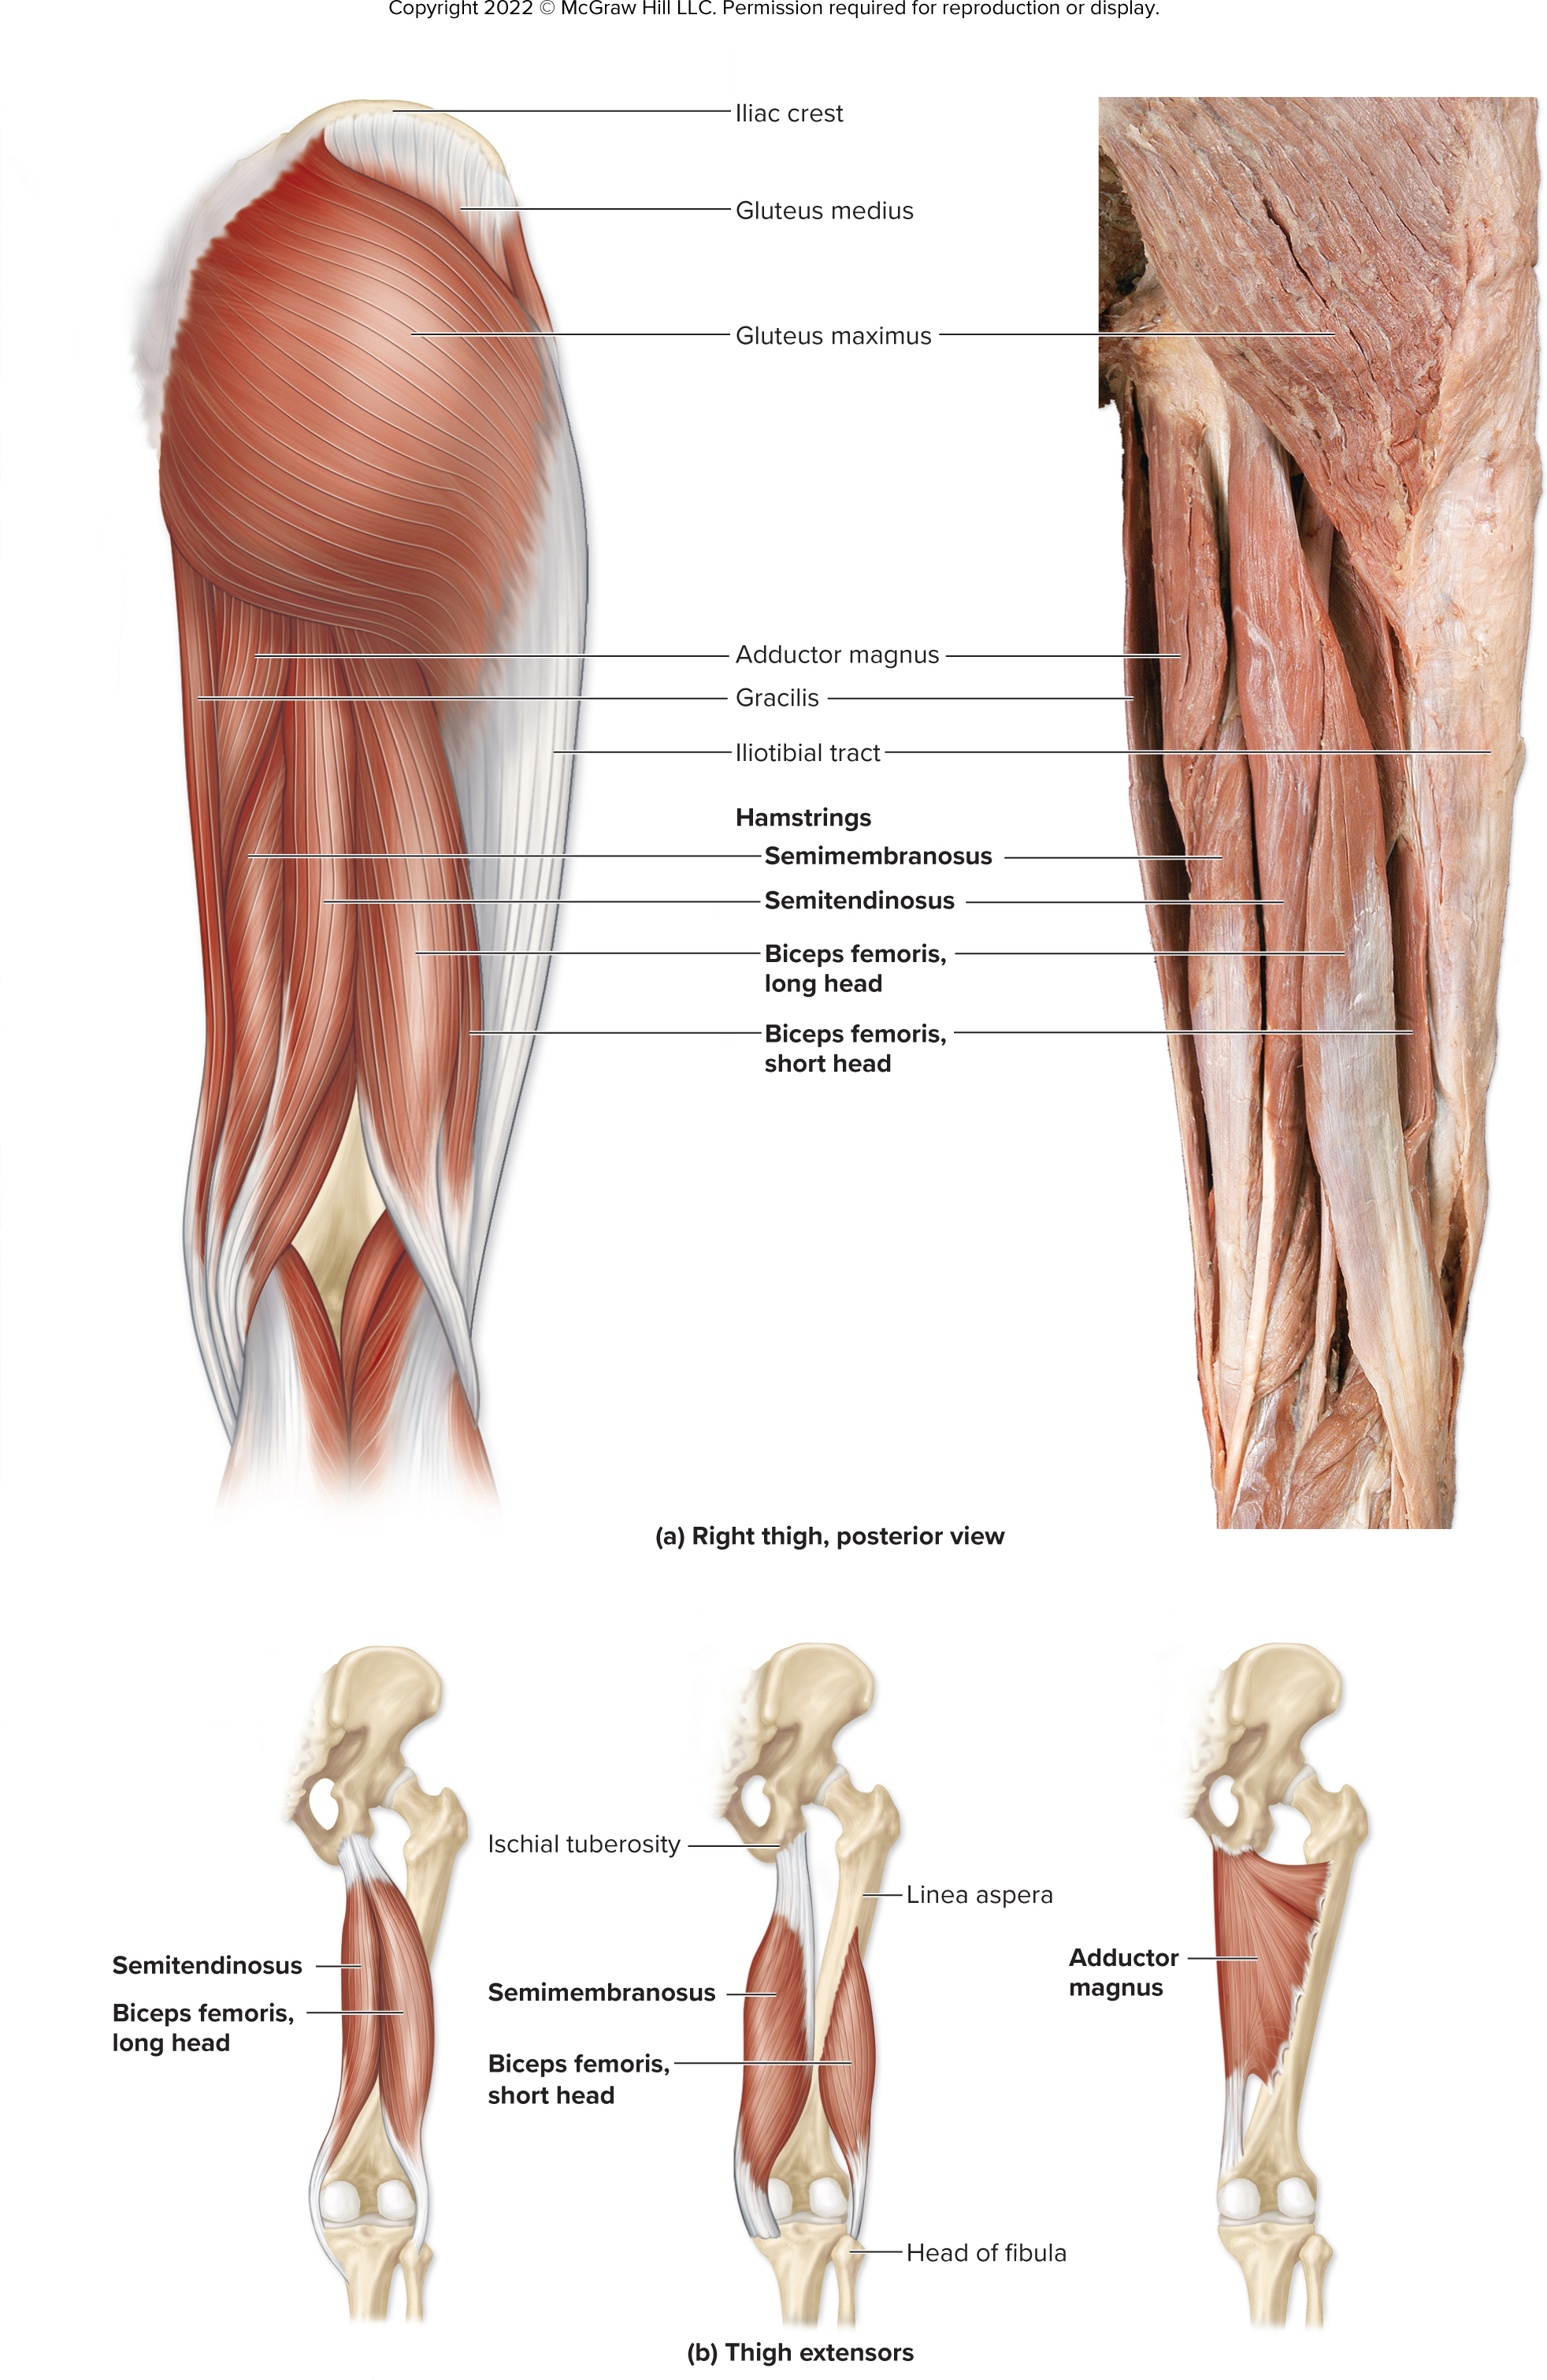
Right Thigh, Posterior View
©McGraw-Hill Education/Photo and Dissection by Christine Eckel LH
Figure 11.33a
Access the text alternative for slide images.

Slide 72
Thigh Extensors
Figure 11.33b
Access the text alternative for slide images.

Slide 73
11.9c Leg Muscles That Move the Ankle, Foot, and Toes 1
Crural muscles: muscles located in leg that move ankle, foot, toes
Partitioned into anterior, lateral, and posterior compartments

Slide 74
11.9c Leg Muscles That Move the Ankle, Foot, and Toes 2
Muscles of the leg’s anterior compartment:
Extensor digitorum longus
Dorsiflexes the foot and extends toes 2 to 5
Extensor hallucis longus
Dorsiflexes the foot and extends the great toe
Fibularis tertius
Dorsiflexes and weakly everts the foot
Tibialis anterior
Primary dorsiflexor of the foot; also inverts the foot
Extensor retinaculum
Thickening of fascia at ankle that holds tendons close to bones

Slide 75
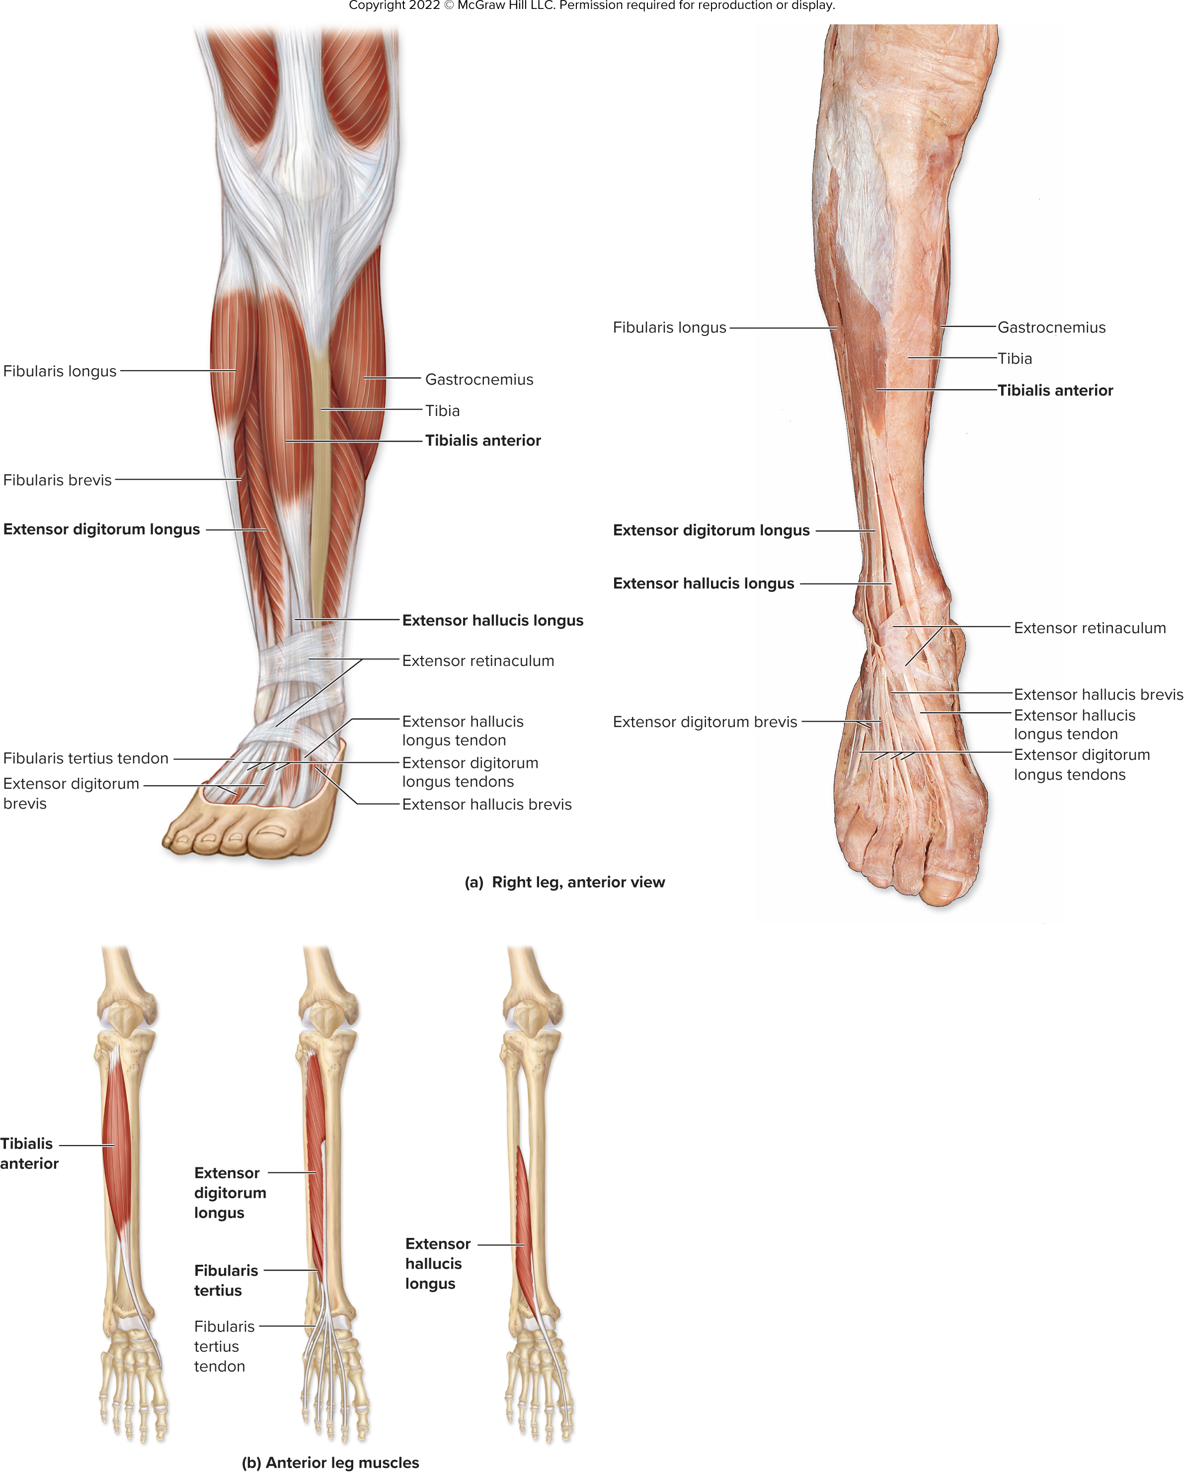
Right Leg, Anterior View
Figure 11.34a
©McGraw-Hill Education/Christine Eckel
Access the text alternative for slide images.

Slide 76
Anterior Leg Muscles
Figure 11.34b
Access the text alternative for slide images.

Slide 77
11.9c Leg Muscles That Move the Ankle, Foot, and Toes 3
Muscles of the leg’s lateral compartment:
Both are powerful foot evertors, weak plantar flexors
Fibularis longus: attaches to plantar side of foot
Fibularis brevis: lies deep to fibularis longus, attaches to base of 5th metatarsal

Slide 78
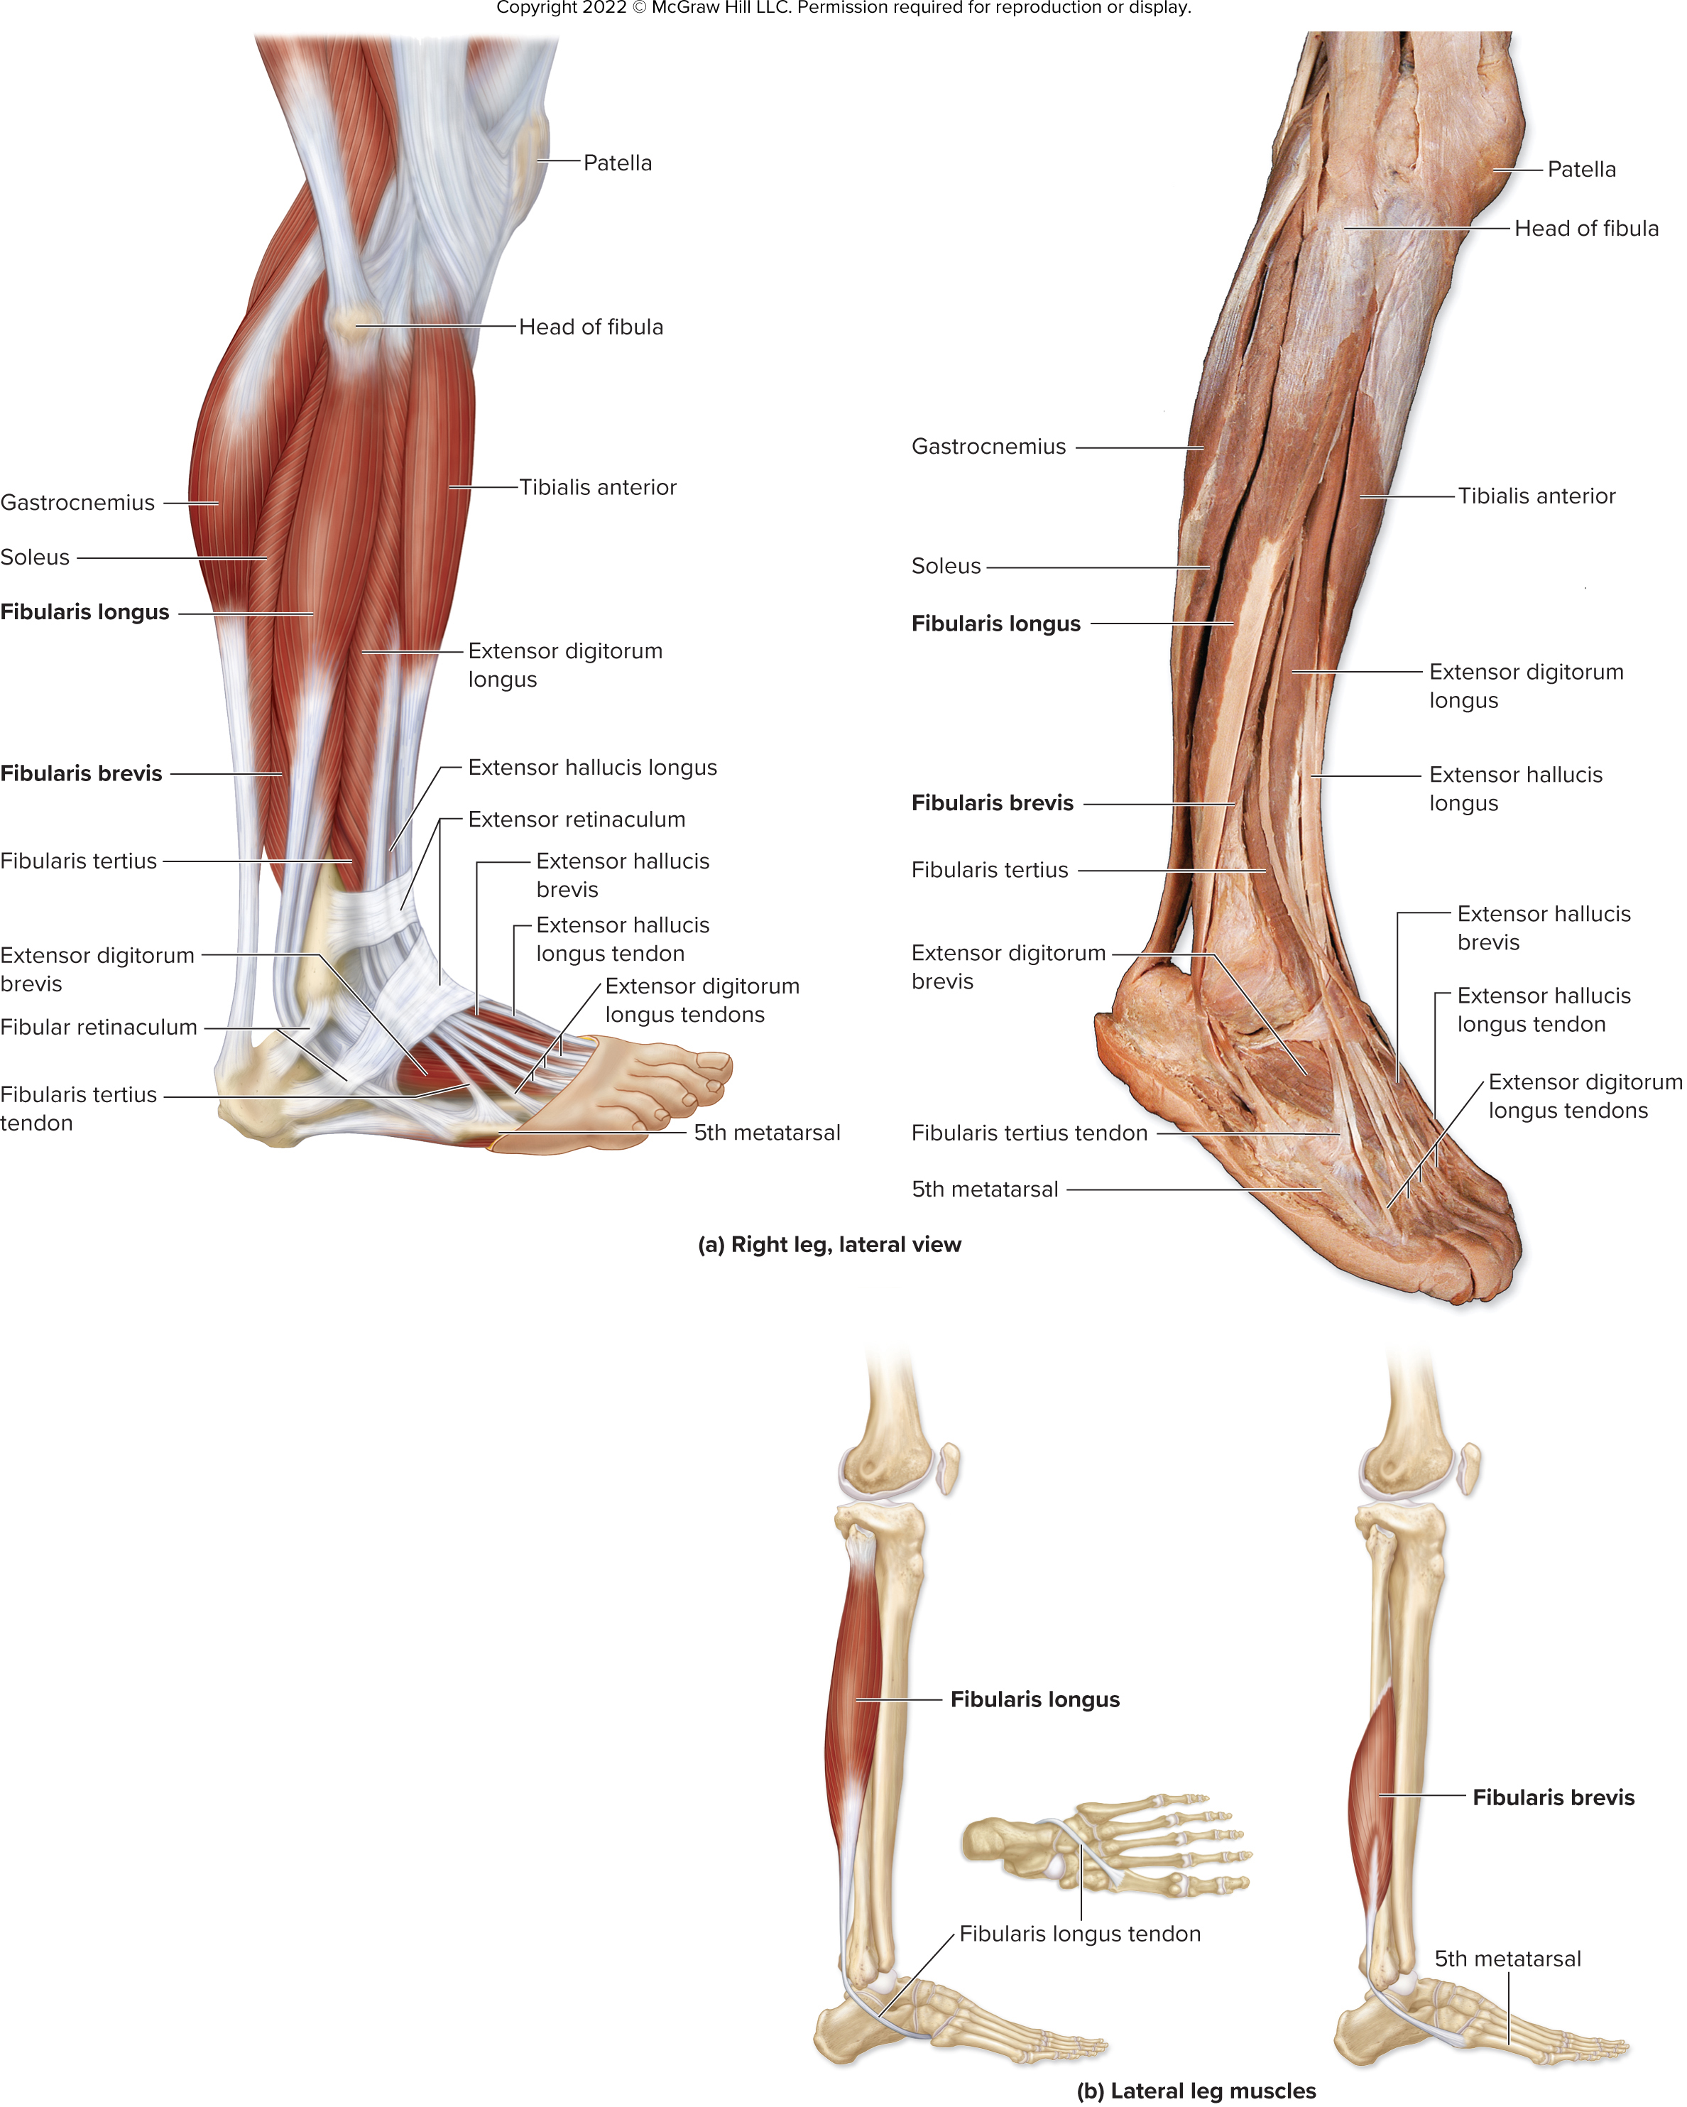
Right Leg, Lateral View
Figure 11.35a
©McGraw-Hill Education/Christine Eckel
Access the text alternative for slide images.

Slide 79
Lateral Leg Muscles
Figure 11.35b
Access the text alternative for slide images.

Slide 80
11.9c Leg Muscles That Move the Ankle, Foot, and Toes 4
Muscles of the leg’s posterior compartment:
Superficial layer
Gastrocnemius
Has two bellies; forms calf
Flexes the leg and plantar flexes the foot
Soleus
Broad muscle deep to gastrocnemius
Plantar flexes the foot
Triceps surae $=$ gastrocnemius + soleus
Attach to heel (calcaneus) with calcaneal tendon
Plantaris
Weak leg flexor and plantar flexor of the foot

Slide 81
11.9c Leg Muscles That Move the Ankle, Foot, and Toes 5
Muscles of the leg’s posterior compartment (continued)
Deep layer
Flexor digitorum longus
Flexes the foot and the MP, PIP and DIP of joints 2 to 5
Flexor hallucis longus
Flexes the foot and great toe
Tibialis posterior
Plantar flexes and inverts the foot
Popliteus
Flexes the leg and medially rotates the tibia (no action at ankle or foot)

Slide 82
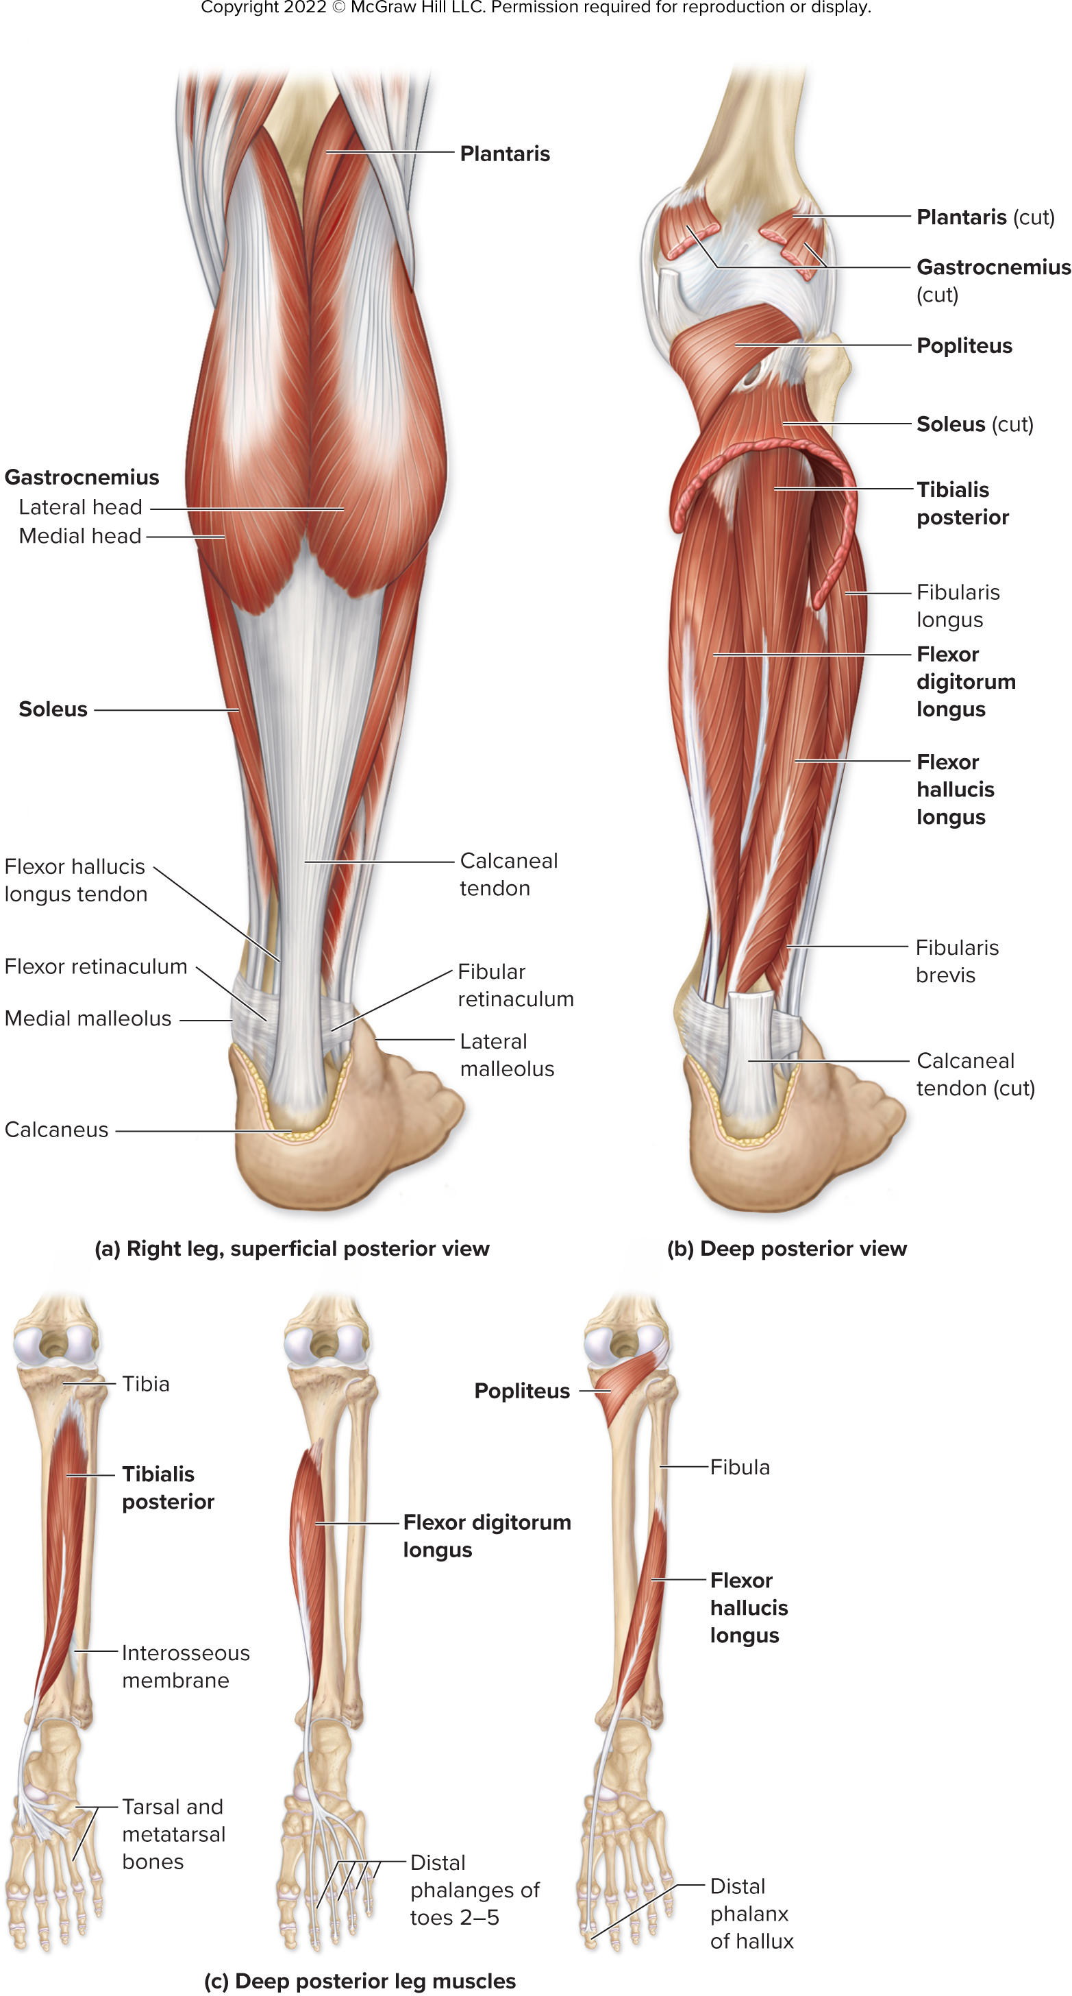
Right Leg, Superficial and Deep Posterior Views
Figure 11.36a-b
Access the text alternative for slide images.

Slide 83
Deep Posterior Leg Muscles
Figure 11.36c
Access the text alternative for slide images.

Slide 84
Clinical View: Shin Splints and Compartment Syndrome
Shin splints
Soreness along length of tibia
Often occur in new poorly conditioned runners
May be considered a type of compartment syndrome
Compartment syndrome
Compression of blood vessels within a limb compartment
Due to inflammation and swelling secondary to strain or trauma
Increased pressure in compartment since deep fascia cannot stretch
In severe cases, fascia cut to relieve pressure

Slide 85
11.9d Intrinsic Muscles of the Foot 1
Intrinsic muscles of the foot have both proximal and distal attachments within the foot
Support the arches, move the toes
Dorsal group:
Extensor hallucis brevis
Extends the MP joint of the great toe
Extensor digitorum brevis
Extends the MP and PIP joints of toes 2 to 4

Slide 86
11.9d Intrinsic Muscles of the Foot 2
Plantar group:
Supported by aponeurosis formed from deep fascia
Extends between phalanges of toes and calcaneus
Muscles grouped into four layers from superficial to deep
Flexor digitorum brevis, abductor hallucis, abductor digiti minimi
Quadratus plantae, lumbricals
Adductor hallucis, flexor hallucis brevis, flexor digiti minimi brevis
Dorsal interossei, plantar interossei

Slide 87
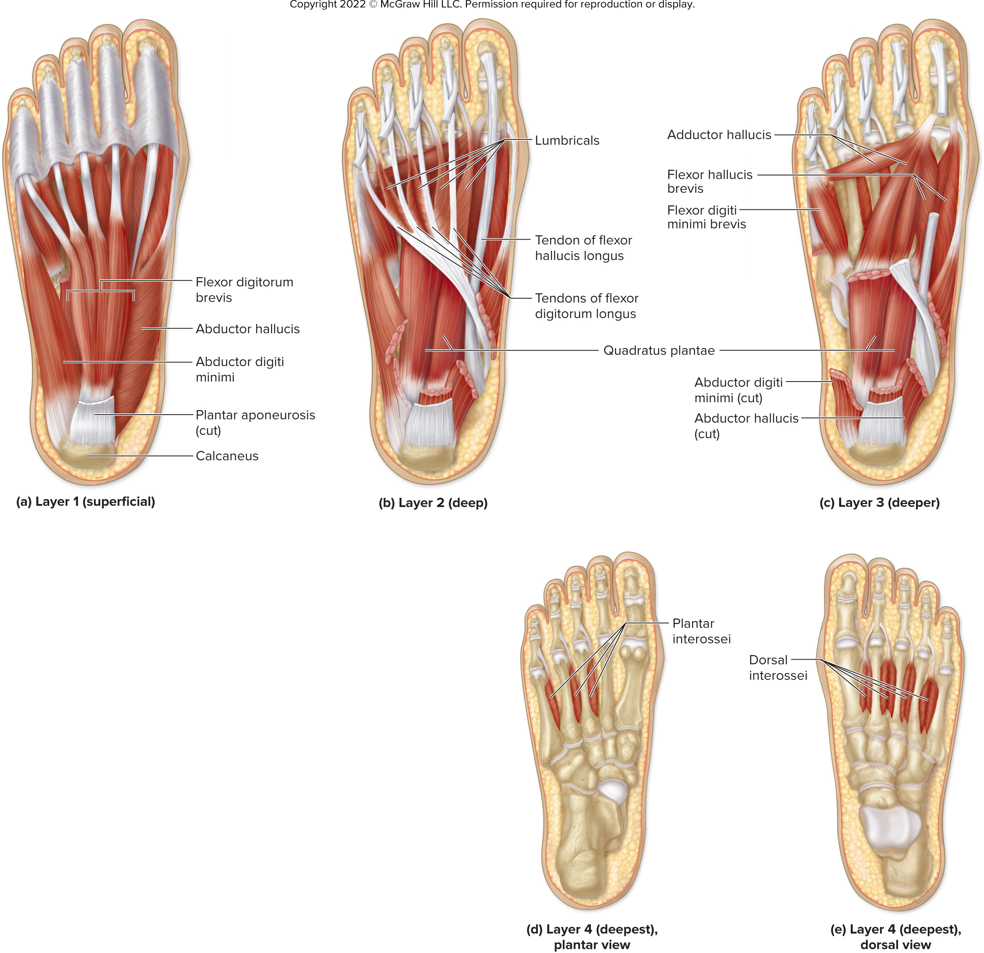
Plantar Intrinsic Muscles of the Foot 1
Figure 11.37a-c
Access the text alternative for slide images.

Slide 88
Plantar Intrinsic Muscles of the Foot 2
Figure 11.37d-e
Access the text alternative for slide images.

Slide 89
Clinical View: Plantar Fasciitis
Inflammation of the plantar aponeurosis
Associated with overexertion that stresses the fascia
For example, weight bearing activities, excessive body weight, poor shoes, poor biomechanics

Slide 90
Section 11.9 What did you learn?
List the compartments of the thigh, and describe the common action of the muscles in each.
List the thigh muscles that flex the leg at the knee joint.
What are the common actions of each of the compartments of the leg?
Identify the intrinsic muscles of the foot that extend the toes.

Slide 91
End of Main Content
Copyright 2022 © McGraw Hill LLC. All rights reserved. No reproduction or distribution without the prior written consent of McGraw Hill LLC.

Slide 92
Accessibility Content: Text Alternatives for Images

Slide 93
Muscles of Respiration, Anterior View - Text Alternative
Return to parent-slide containing images.
The scalene muscle from the vertebral column join the rib followed by external intercostals, internal intercostals, transversus thoracis, and diaphragm.
Return to parent-slide containing images.

Slide 94
Intercostals and Diaphragm - Text Alternative
Return to parent-slide containing images.
A lateral view shows external intercostals and internal intercostals. The diaphragm has sternum at the top followed by xiphoid process with costal cartilage on either side. Below the xiphoid process lies the central tendon of diaphragm followed by esophageal opening and caval opening. Below the esophageal opening lies the aortic opening (hiatus) followed by left crus and right crus. The twelfth rib is identified in this view along with quadratus lumborum muscle and psoas major muscle.
Return to parent-slide containing images.

Slide 95
Muscles of the Abdominal Wall, Anterior View – Text Alternative
Return to parent-slide containing images.
The illustration A shows anterior view of the upper body. The superficial muscles are pectoralis major, serratus anterior, tendinous intersections, rectus sheath, umbilicus, linea alba, and aponeurosis of external oblique. The deep muscles are pectoralis minor, rectus abdominis, transversus abdominis, internal oblique, external oblique, and inguinal ligament. The external oblique, internal oblique and rectus abdominis are shown.
Return to parent-slide containing images.

Slide 96
Muscles of the Abdominal Wall, Anterolateral View – Text Alternative
Return to parent-slide containing images.
It shows anterolateral view of the upper body that has tendinous intersections, rectus sheath, umbilicus, linea alba, aponeurosis of external oblique, external intercostal, internal intercostal, rectus abdominis, transversus abdominis, internal oblique, external oblique, and inguinal ligament.
Return to parent-slide containing images.

Slide 97
11.7 Muscles of the Pelvic Floor 1 – Text Alternative
Return to parent-slide containing images.
The illustration shows superior view of female pelvic floor. The bones of the pelvis are ilium, coccyx, sacrum, sacroiliac articulation, and obturator canal. The muscles of the pelvic floor are coccygeus, levator ani (iliococcygeus and pubococcygeus), deep transverse perineal, external urethral sphincter, and obturator internus. Piriformis, pubic symphysis, urethra, vagina, anal canal, and ischial spine are also identified.
Return to parent-slide containing images.

Slide 98
Muscles of the Pelvic Floor – Text Alternative
Return to parent-slide containing images.
The first one shows inferior view of male pelvic floor with urogenital triangle and anal triangle. The superficial muscles of the pelvic floor are bulbospongiosus, ischiocavernosus, superficial transverse perineal muscle, and levator ani. Raphe, gluteus maximus, and perineal body are also identified. The deep muscles of the pelvic floor are external urethral sphincter, deep transverse perineal muscle, and external anal sphincter. Pubic symphysis, pubic ramus, urethra, and anus are also identified. The second one shows inferior view of female pelvic floor with urogenital triangle and anal triangle. The superficial muscles of the pelvic floor are bulbospongiosus, ischiocavernosus, superficial transverse perineal muscle, and levator ani. Urethra, vagina, gluteus maximus, and perineal body are also identified. The deep muscles of the pelvic floor are external urethral sphincter, deep transverse perineal muscle, and external anal sphincter. Pubic symphysis, pubic ramus, urethra, vagina, and anus are also identified.
Return to parent-slide containing images.

Slide 99
Muscles That Move Pectoral Girdle and the Glenohumeral Joint/Arm, Anterior View – Text Alternative
Return to parent-slide containing images.
The superficial muscles are deltoid, pectoralis major, biceps brachii, and long head. The deep muscles are sternocleidomastoid, Subclavius, Subscapularis, Coracobrachialis, Pectoralis minor, and Serratus anterior. Subclavius, Pectoralis minor, and Serratus anterior are the muscles whose primary action is to move the scapula or clavicle.
Return to parent-slide containing images.

Slide 100
Muscles That Move Pectoral Girdle and the Glenohumeral Joint/Arm, Posterior View – Text Alternative
Return to parent-slide containing images.
The superficial muscles are trapezius, rhomboid minor, rhomboid major, deltoid, deep fascia covering infraspinatus, and latissimus dorsi. The deep muscles are levator scapulae, supraspinatus, infraspinatus, teres minor, and teres major. trapezius, rhomboid minor, rhomboid major, and levator scapulae are the muscles whose primary action is to move the scapula or clavicle.
Return to parent-slide containing images.

Slide 101
Retraction and Protraction of the Scapula – Text Alternative
Return to parent-slide containing images.
It shows a man standing with good posture and retracted scapulae. A man lying on the floor with his one hand raised (Protractors: Pectoralis minor and Serratus anterior) and one hand resting on his elbow (Retractors: Trapezius and Rhomboids). A man is standing with poor posture and protracted scapulae.
Return to parent-slide containing images.

Slide 102
Elevation, Depression, and Rotation of the Scapula – Text Alternative
Return to parent-slide containing images.
The muscles that elevate the scapula are Rhomboid major, Rhomboid minor, Levator scapulae, and Trapezius (superior part). The muscle that depress the scapula are Trapezius (inferior part) and Pectoralis minor (not shown). The superior muscles that rotate scapula are Serratus anterior and Trapezius (superior part). The inferior muscles of that rotate scapula are Rhomboid major, Rhomboid minor, and Levator scapulae.
Return to parent-slide containing images.

Slide 103
Rotator Cuff Muscles – Text Alternative
Return to parent-slide containing images.
The illustration A shows anterior view of the scapula and humerus along with acromion, clavicle, supraspinatus, coracoid process, and subscapularis. The illustration B shows the posterior view of supraspinatus, infraspinatus, and teres minor. A photo shows a bowler winding up for a pitch where subscapularis is employed. The second photo shows a bowler executing the pitch where supraspinatus is employed. The third photo shows a bowler completing the pitch and slowing down the pitching arm where Infraspinatus and teres minor are unemployed.
Return to parent-slide containing images.

Slide 104
Anterior Muscles That Move the Elbow Joint/Forearm – Text Alternative
Return to parent-slide containing images.
The illustration A shows the anterior view of the right arm and shoulder. The anterior muscles that move the elbow joint are long head of biceps brachii, short head of biceps brachii, triceps brachii, brachialis, and brachioradialis. Deltoid, pectoralis major, coracobrachialis, and bicipital aponeurosis are also identified. The illustration B shows superficial anterior muscles that arises from the coracoid process, long head of biceps brachii, short head of biceps brachii, biceps brachii tendon, and radial tuberosity. The deep anterior muscles are Coracobrachialis, brachialis, and coronoid process of ulna.
Return to parent-slide containing images.

Slide 105
Posterior Muscles That Move the Elbow Joint/Forearm – Text Alternative
Return to parent-slide containing images.
The illustration A shows the posterior view of the right arm and shoulder. The posterior muscles that move the elbow joint are triceps brachii (lateral head, long head, and medial head) and anconeus. Supraspinatus, infraspinatus, teres minor, teres minor, and latissimus dorsi are also identified. The illustration B shows superficial posterior muscle is triceps brachii (lateral head, long head, and medial head). Infraglenoid tubercle, triceps brachii tendon, and anconeus are also identified. The deeper posterior muscle is medial head of triceps brachii. Triceps brachii tendon, and olecranon of ulna are also identified.
Return to parent-slide containing images.

Slide 106
Forearm Muscles That Supinate and Pronate – Text Alternative
Return to parent-slide containing images.
The illustration on the left shows a hand in supination and identifies medial epicondyle on the right, lateral epicondyle on the left, supinator, pronator teres, interosseous, and pronator quadratus. The illustration on the left shows medial epicondyle on the left, lateral epicondyle on the right, supinator curled over the bone, and pronator quadrantus between the bones.
Return to parent-slide containing images.

Slide 107
Right Anterior Forearm, Superficial View – Text Alternative
Return to parent-slide containing images.
The forearm has medial epicondyle, common flexor tendon, flexor carpi radialis, pronator teres, palmaris longus, flexor carpi ulnaris, brachioradialis, flexor retinaculum, and palmar aponeurosis.
Return to parent-slide containing images.

Slide 108
Right Anterior Forearm, Intermediate and Deep Views – Text Alternative
Return to parent-slide containing images.
The intermediate view of right anterior forearm has ulna, radius, flexor digitorum superficialis, flexor digitorum superficialis tendon, and flexor digitorum profundus tendons. The deep view of right anterior forearm has supinator, flexor pollicis longus, flexor digitorum profundus, pronator quadratus, flexor digitorum profundus tendons.
Return to parent-slide containing images.

Slide 109
Right Posterior Forearm, Superficial View – Text Alternative
Return to parent-slide containing images.
The first one shows superficial view of the right posterior forearm that has brachioradialis, extensor carpi radialis longus, extensor car radialis brevis, extensor digitorum, anconeus, flexor carpi ulnaris, extensor digiti minimi, abductor pollicis longus, extensor pollicis brevis, extensor retinaculum, and extensor digitorum tendons.
Return to parent-slide containing images.

Slide 110
Right Posterior Forearm, Deep View – Text Alternative
Return to parent-slide containing images.
It shows deep view of right posterior forearm that has olecranon process of ulna, supinator, abductor pollicis longus, extensor pollicis brevis, extensor pollicis longus, extensor indicis, and dorsal interossei.
Return to parent-slide containing images.

Slide 111
Right Hand, Superficial Palmar View – Text Alternative
Return to parent-slide containing images.
It has tendon sheaths inside which lies the flexor digitorum profundus tendon, first dorsal interosseous, flexor pollicis longus tenson, adductor pollicis, flexor pollicis brevis, abductor pollicis brevis, palmaris longus tendon, flexor retinaculum, abductor digiti minimi, flexor digiti minimi brevis, lumbricals, and flexor digitorum superficialis tendon.
Return to parent-slide containing images.

Slide 112
Right Hand, Deep Palmar View – Text Alternative
Return to parent-slide containing images.
It has palmar interossei, adductor pollicis (transverse head and oblique head), opponens pollicis, flexor carpi radialis tendon, flexor carpi ulnaris tendon, carpal tunnel, flexor retinaculum, and opponens digiti minimi.
Return to parent-slide containing images.

Slide 113
Right Hand, Posterior View – Text Alternative
Return to parent-slide containing images.
It has second dorsal interosseous, extensor indicis tendon, first dorsal interosseous, extensor pollicis longus tendon, extensor pollicis brevis tendon, third dorsal interosseous, fourth dorsal interosseous, extensor digiti minimi tendon, extensor digitorum tendons, and extensor retinaculum.
Return to parent-slide containing images.

Slide 114
Muscles That Act on the Hip and Thigh, Anterior View – Text Alternative
Return to parent-slide containing images.
The illustration shows anterior view of right thigh that has psoas minor, psoas major, Iliacus, Iliopsoas, pectineus, adductor brevis, adductor longus, gracilis, and adductor magnus.
Return to parent-slide containing images.

Slide 115
Muscles That Act on the Hip and Thigh, Lateral View – Text Alternative
Return to parent-slide containing images.
It shows lateral view of right thigh that has iliac crest, gluteus medius, tensor fasciae latae, sartoris, gluteus maximus, rectus femoris, vastus lateralis, iliotibial tract, long head of biceps femoris, semimembranosus, short head of biceps femoris, patella, and gastrocnemius.
Return to parent-slide containing images.

Slide 116
Muscles That Act on the Hip and Thigh, Deep Posterior View – Text Alternative
Return to parent-slide containing images.
The illustration shows deep posterior view of right thigh that has sacrum, gluteus maximus, piriformis, superior gemellus, obturator internus, inferior gemellus, ischial tuberosity, gracilis, long head of biceps femoris, semitendinosus, iliotibial tract, quadratus femoris, gluteus maximus, gluteus medius, gluteus minimus, gluteus medius and iliac crest.
Return to parent-slide containing images.

Slide 117
Right Thigh, Anterior View – Text Alternative
Return to parent-slide containing images.
It shows anterior view of right thigh that has Iliopsoas (iliacus and psoas major), tensor fasciae latae, pectineus, adductor longus, gracilis, iliotibial tract, rectus femoris, sartorius, vastus lateralis, vastus medialis, quadriceps tendon, patella, and patellar ligament.
Return to parent-slide containing images.

Slide 118
Anterior Thigh Muscles – Text Alternative
Return to parent-slide containing images.
It shows anterior thigh muscles that has greater trochanter, rectus femoris, patella, patellar ligament, tibia, vastus lateralis, vastus intermedius, sartorius, and vastus medialis.
Return to parent-slide containing images.

Slide 119
Right Thigh, Posterior View – Text Alternative
Return to parent-slide containing images.
It has iliac crest, gluteus medius, gluteus maximus, adductor magnus, gracilis, iliotibial tract, and hamstrings (semimembranosus, semitendinosus, long head of biceps femoris, and short head of biceps femoris).
Return to parent-slide containing images.

Slide 120
Thigh Extensors – Text Alternative
Return to parent-slide containing images.
The muscles that extend the thigh are semitendinosus, long head of biceps femoris, semimembranosus, and adductor magnus. Ischial tuberosity, short head of biceps femoris, linea aspera, and head of fibula are also identified.
Return to parent-slide containing images.

Slide 121
Right Leg, Anterior View – Text Alternative
Return to parent-slide containing images.
It shows posterior view of right leg that has fibularis longus, gastrocnemius, tibia, tibialis anterior, fibularis brevis, extensor digitorum longus, extensor hallucis longus, extensor retinaculum, fibularis tertius tendon, extensor digitorum brevis, extensor hallucis longus tendon, extensor digitorum longus tendon, and extensor hallucis brevis.
Return to parent-slide containing images.

Slide 122
Anterior Leg Muscles – Text Alternative
Return to parent-slide containing images.
The illustration shows anterior leg muscles, tibialis anterior, extensor digitorum longus, fibularis tertius, fibularis tertius tendon, and extensor hallucis longus.
Return to parent-slide containing images.

Slide 123
Right Leg, Lateral View – Text Alternative
Return to parent-slide containing images.
The lateral view of right leg has patella, head of fibula, tibialis anterior, gastrocnemius, soleus, fibularis longus, extensor digitorum longus, fibularis brevis, fibularis tertius, Extensor hallucis longus, Extensor hallucis brevis, Extensor hallucis longus tendon, Extensor digitorum longus tendons, fifth metatarsal, Extensor digitorum brevis, fibularis retinaculum, and fibularis tertius tendon.
Return to parent-slide containing images.

Slide 124
Lateral Leg Muscles – Text Alternative
Return to parent-slide containing images.
The illustration shows lateral leg muscles, fibularis longus and fibularis brevis along with fibularis longus tendon and fifth metatarsal.
Return to parent-slide containing images.

Slide 125
Right Leg, Superficial and Deep Posterior Views – Text Alternative
Return to parent-slide containing images.
The illustrations show superficial posterior view of the right leg that has plantaris, lateral head and medial head of gastrocnemius, soleus, calcaneal tendon, flexor hallucis longus tendon, flexor retinaculum, medial malleolus, calcaneus, lateral malleolus, fibular retinaculum, and calcaneus tendon.
Return to parent-slide containing images.

Slide 126
Deep Posterior Leg Muscles – Text Alternative
Return to parent-slide containing images.
The illustration shows deep posterior view of the right leg that has plantaris, gastrocnemius, popliteus, soleus, tibialis posterior, fibularis longus, flexor digitorum longus, flexor hallucis longus, fibularis brevis, and calcaneal tendon. The illustration C shows deep posterior leg muscles, tibialis posterior, flexor digitorum longus, popliteus, and flexor hallucis longus along with tibia, interosseous membrane, tarsal and metatarsal bones, distal phalanges of toes 2 to 5, distal phalanx of hallux, and fibula.
Return to parent-slide containing images.

Slide 127
Plantar Intrinsic Muscles of the Foot 1 – Text Alternative
Return to parent-slide containing images.
The illustrations show: layer 1 (superficial) that has flexor digitorum brevis, abductor hallucis, abductor digiti minimi, planter aponeurosis, and calcaneus, layer 2: (deep) that has lumbricals, tendon of flexor hallucis longus, tendons of flexor digitorum longus, and quadratus plantae, layer 3 (deeper): that has addcutor hallucis, flexor hallucis brevis, flexor digiti minimi brevis, quadratus plantae, abductor digiti minimi, and abductor hallucis.
Return to parent-slide containing images.

Slide 128
Plantar Intrinsic Muscles of the Foot 2 – Text Alternative
Return to parent-slide containing images.
The illustrations show plantar view of layer 4 (deepest) that has plantar interossei and the dorsal view of layer 4 (deep) that has dorsal interossei.
Return to parent-slide containing images.

