Slide 1

Chapter 11
Lecture Outline Part 1 of 2
Anatomy & Physiology
AN INTEGRATIVE APPROACH
Fourth Edition
Michael P. McKinley
Valerie Dean O’Loughlin
Theresa Stouter Bidle
Copyright 2022 © McGraw Hill LLC. All rights reserved. No reproduction or distribution without the prior written consent of McGraw Hill LLC.

Slide 2
Introduction: Axial and Appendicular Muscles
Axial muscles
  Have both origins and insertions on axial skeleton
  Support and move the head and vertebral column
  Function in facial expression, breathing, chewing and swallowing
  Support and protect abdominal and pelvic organs
Appendicular muscles
  Control movements of upper and lower limbs
  Control movements of pectoral and pelvic girdles
  Organized into groups based on locations

Slide 3
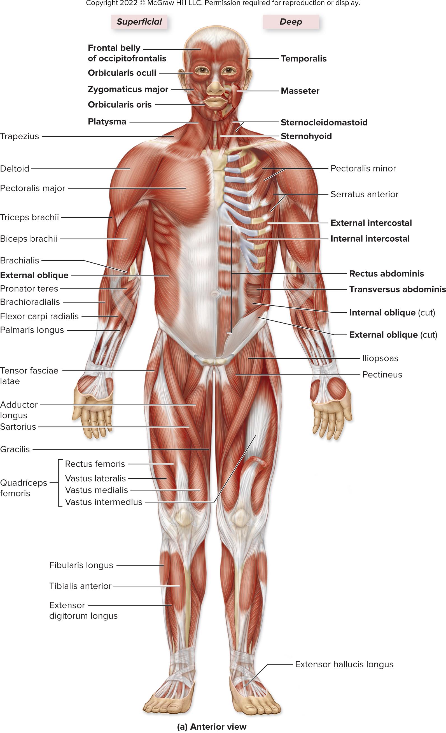
Body Musculature: Anterior View
Figure 11.1a
Access the text alternative for slide images.

Slide 4
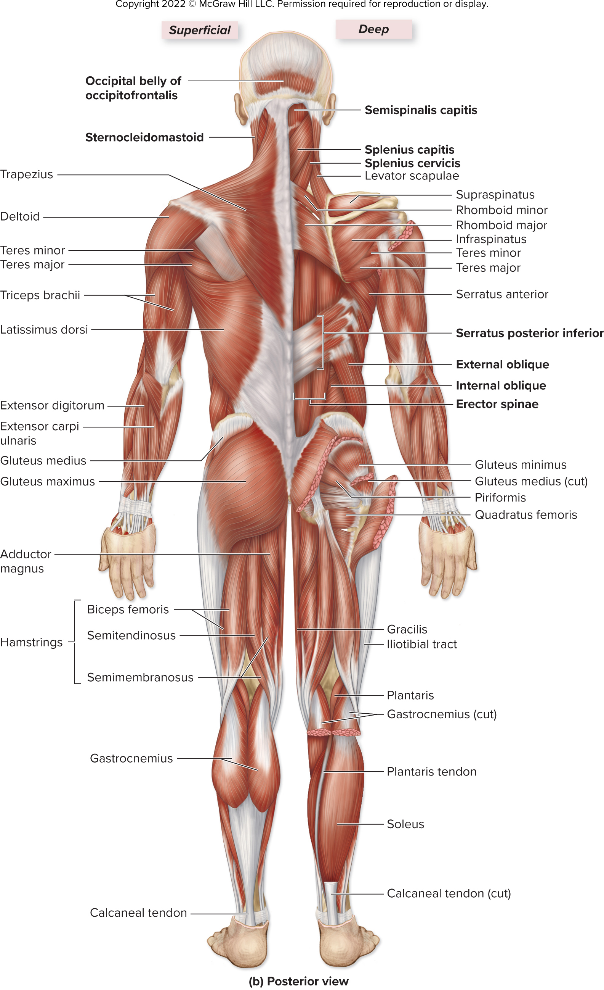
Body Musculature: Posterior View
Figure 11.1b
Access the text alternative for slide images.

Slide 5
11.1a Skeletal Muscle Attachments
Tendon – attaches muscle to bone, skin, or another muscle
  Aponeurosis – thin, flattened sheetlike tendon
Most muscle cross at least one mobile joint
  Upon contraction, one bone moves while other is fixed
Attachments for axial muscles:
  Superior attachment (usually more moveable)
  Inferior attachment (usually less moveable)
Attachments for appendicular muscles:
  Proximal attachment (usually less moveable)
  Distal attachment (usually more moveable)

Slide 6
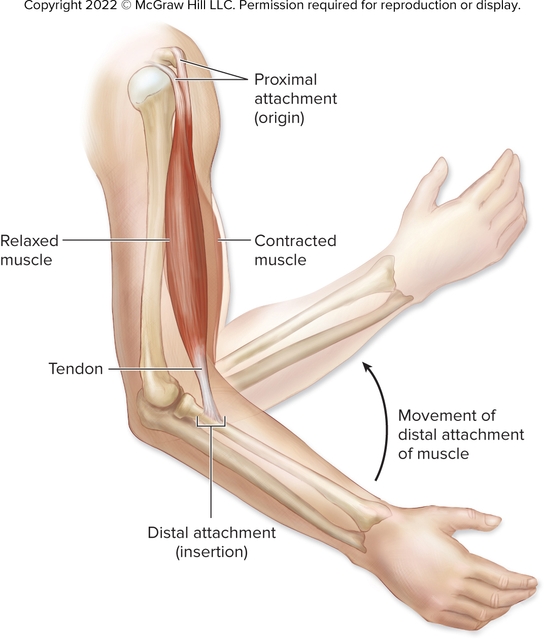
Muscle Attachments
Proximal attachments of biceps brachii are on scapula
Distal attachment of biceps brachii is on radius
Contraction pulls radius toward scapula, flexing the elbow
Figure 11.2
Access the text alternative for slide images.

Slide 7
11.1b Organizational Patterns of Skeletal Muscle Fibers 1
Varied organization of fascicles (bundles of muscle fibers)
  Circular muscles: concentrically arranged fascicles
    Create a sphincter; control material passage through an opening
  Parallel muscles: fascicles run parallel to muscle’s long axis
    Sometimes have an expanded central belly; high endurance
  Convergent muscles: fascicles merge toward a common attachment site
    Can pull in varying directions, but not as hard as parallel muscles

Slide 8
11.1b Organizational Patterns of Skeletal Muscle Fibers 2
Organization of fascicles (continued)
  Pennate muscles: fascicles organized as if part of a large feather
    Fibers pull at an angle to the tendon
    Generate more tension but don’t pull their tendons as far as parallel muscles
    Three subtypes:
      Unipennate – fascicles on same side of tendon
      Bipennate – fascicles on both sides of tendon; most common
      Multipennate – branches of tendon within muscle, and fascicles arranged around both sides of each tendon branch

Slide 9
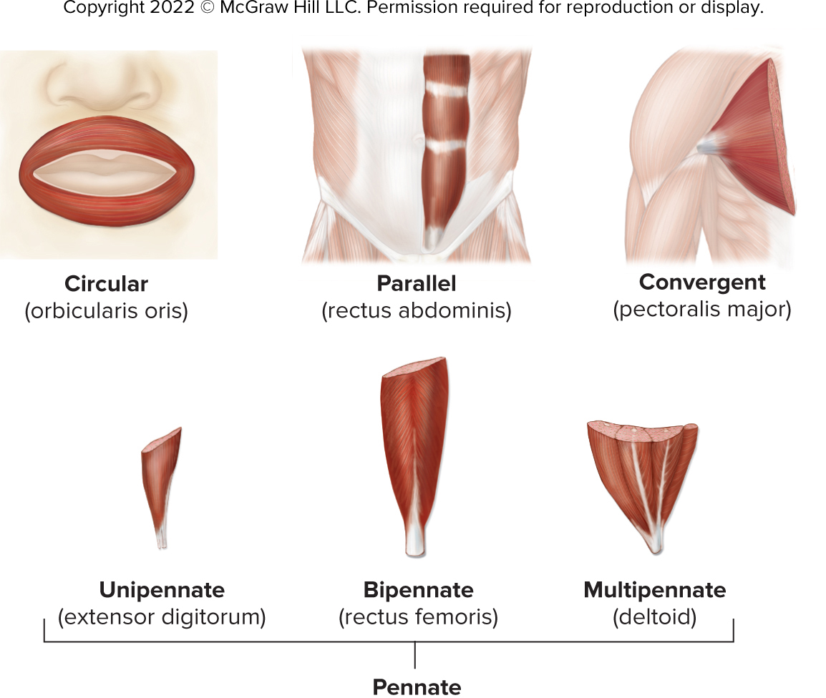
Organization of Muscle Fibers
Figure 11.3
Access the text alternative for slide images.

Slide 10
11.1c Actions of Skeletal Muscles
Muscles grouped by primary actions:
  Agonist
    Prime mover; muscle that contracts to produce a movement
    E.g., triceps brachii is agonist for forearm extension
  Antagonist
    Muscle whose contraction opposes that of the agonist
      This allows for smooth movement of controlled speed
    E.g., biceps brachii, is antagonist for forearm extension
  Synergist
    Muscle that assists agonist by contributing tension or stabilizing point of origin (acting as fixators)
    E.g., biceps brachii and brachialis muscle work synergistically to flex elbow joint

Slide 11
Section 11.1 What did you learn?
What is the difference between the proximal and distal attachment of a skeletal muscle?
Which muscle is stronger—a pennate muscle or a parallel muscle?
What is the difference between an agonist and a synergist?

Slide 12
11.2 Skeletal Muscle Naming 1
Muscles named according to several criteria
  Muscle action: indicates muscle’s primary action
    E.g., flexor digitorum longus flexes digits
  Specific body regions: indicates muscle location
    E.g., rectus femoris is near the femur
  Muscle attachments: indicates origins and/or insertions
    E.g., sternocleidomastoid originates on the sternum and clavicle and inserts on the mastoid process
  Orientation of muscle fibers: indicates organization of muscle fascicles
    E.g., rectus abdominis is composed of fibers running in vertically straight (“rectus”) orientation

Slide 13
11.2 Skeletal Muscle Naming 2
Muscles named according to several criteria (continued)
  Muscle shape
    E.g., deltoid is shaped like a triangular delta symbol
    E.g., abductor pollicis longus is a long muscle
  Muscle size
    E.g., gluteus maximus is the largest of the buttocks muscles
  Number of muscle heads at an attachment site: indicates number of muscle bellies or heads each contains at the superior or proximal attachment site
    E.g., triceps brachii has three heads

Slide 14
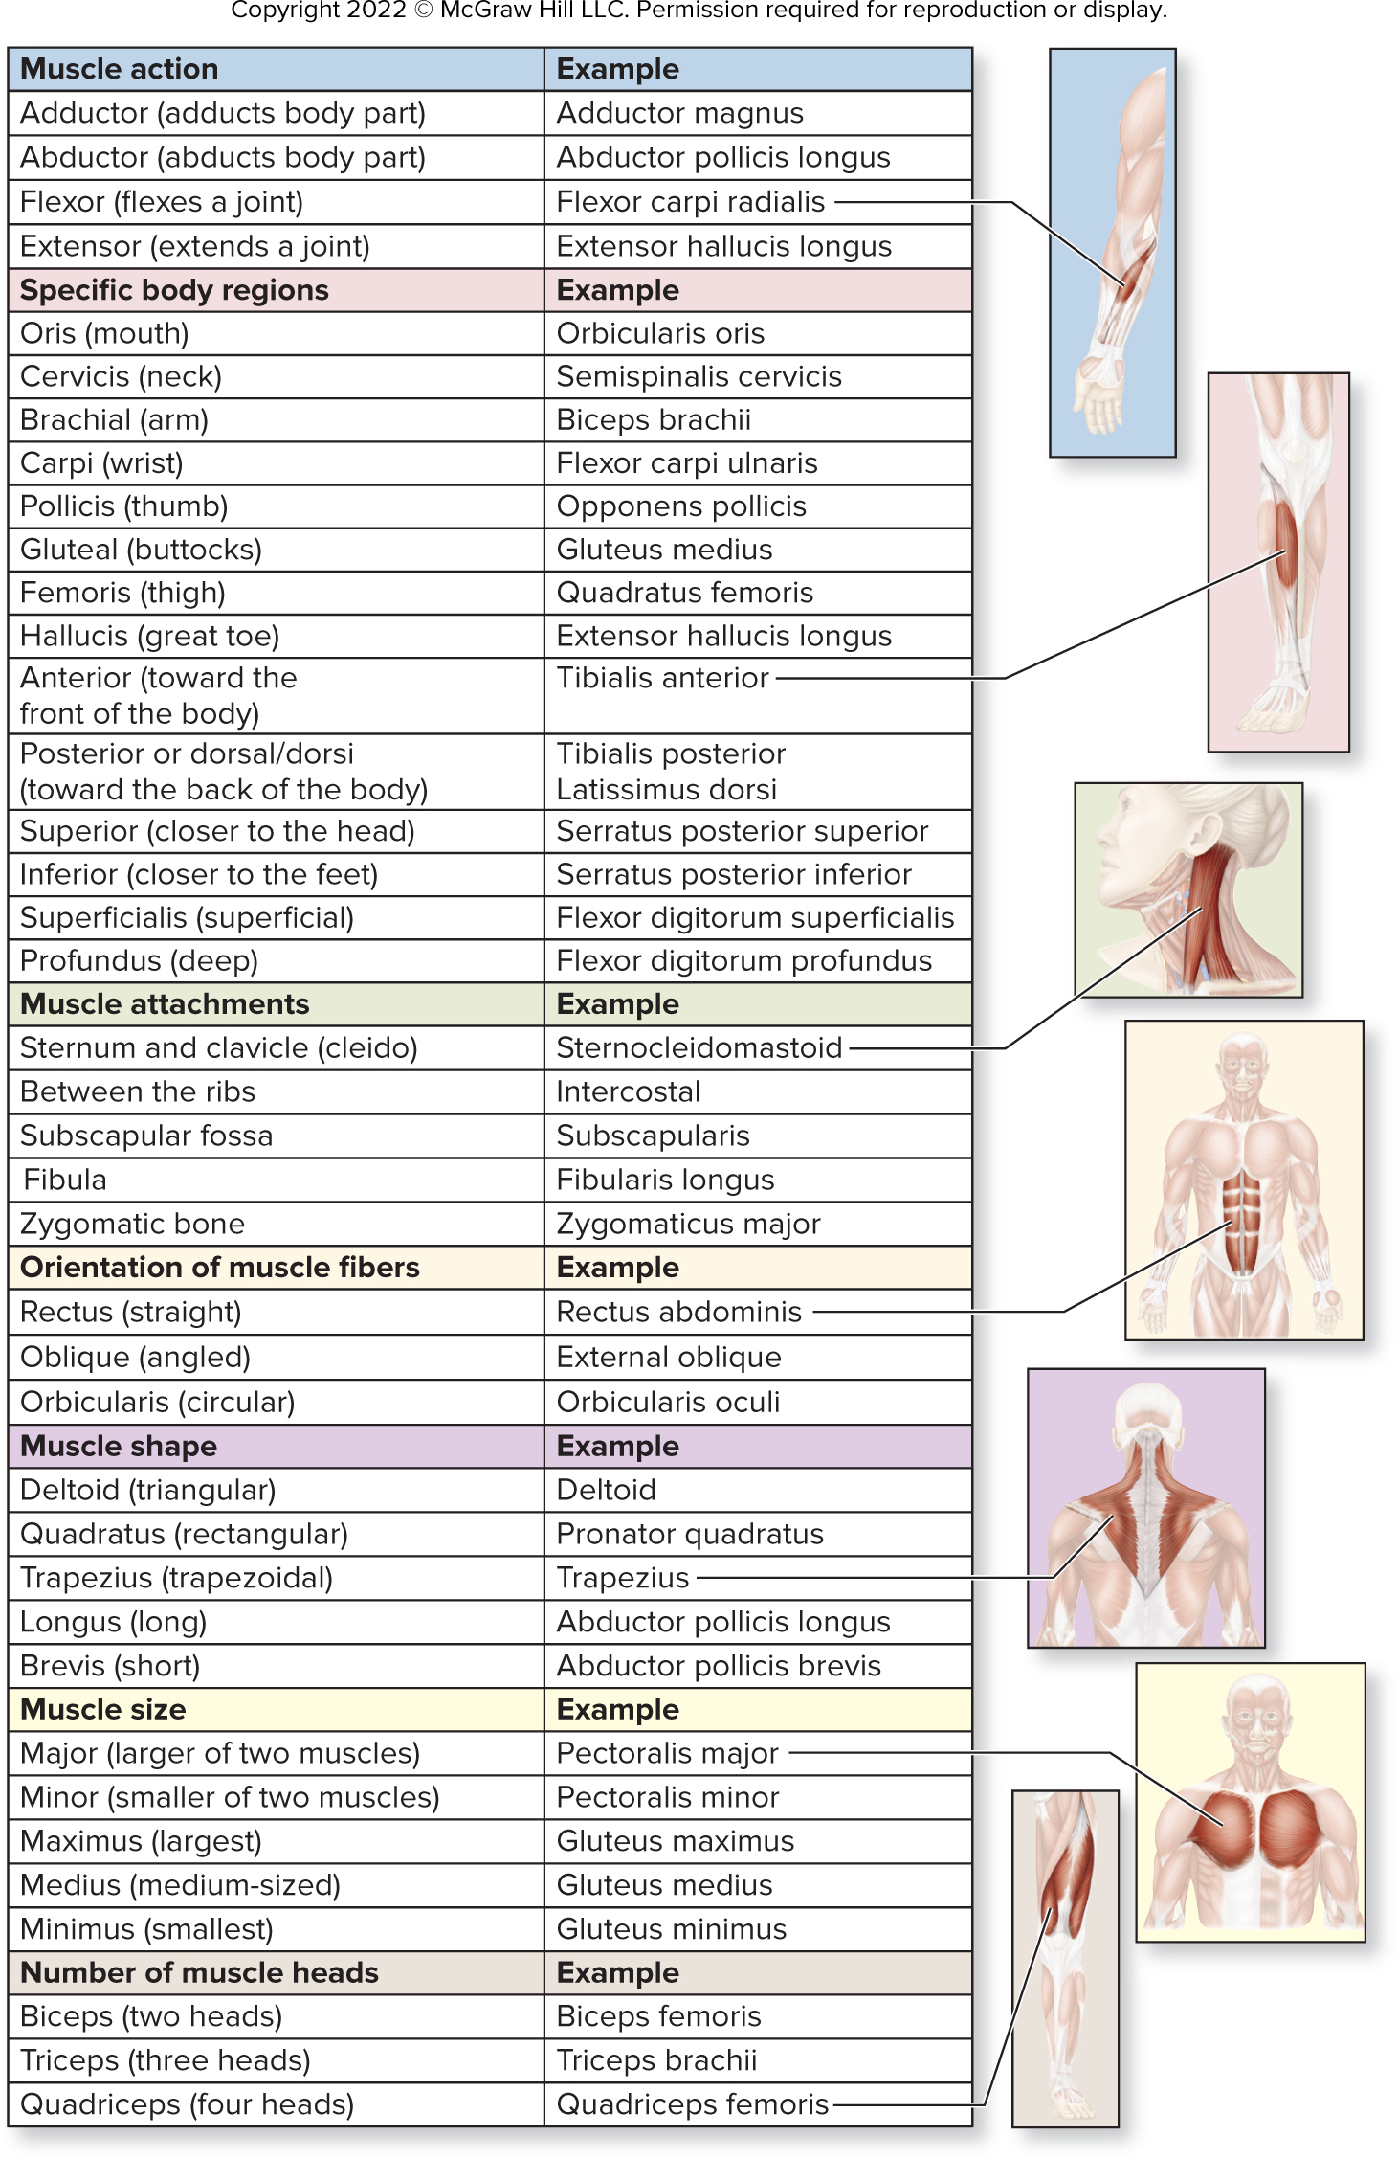
Muscle Naming
Figure 11.4
Access the text alternative for slide images.

Slide 15
Clinical View: Intramuscular Injections
One route of medication administration
May be inserted into muscle with a syringe
Medication to cardiovascular system through muscle’s blood vessels
Allows large amount of medication given at once
Ensures slower and more uniform delivery than orally or intravenously
E.g., vaccines, some contraceptive medications, some antibiotics
Common sites: deltoid, gluteal, quadriceps

Slide 16
Section 11.2 What did you learn?
What are some words used in muscle names that refer to muscle shape?
The gluteus maximus muscle gets its name from which categories for naming muscles?

Slide 17
11.3a Muscles of Facial Expression 1
General characteristics
  Generally attach to subcutaneous layer deep to skin
  Cause skin to move (facial expression) during contraction
  Most are innervated by facial nerve (CN VII)
Muscles of forehead, scalp, and eyebrows
  Occipitofrontalis muscle
    Connects with epicranial aponeurosis (galea aponeurotica) to form epicranius
    Frontal belly raises eyebrows
    Occipital belly retracts scalp slightly
  Corrugator supercilii muscle
    Draws eyebrows together

Slide 18
11.3a Muscles of Facial Expression 2
Muscles of the eyelids
  Orbicularis oculi
    Circular muscle fibers surround orbit
    Closes eye
  Levator palpebrae superioris
    Elevates upper eyelid
Muscles associated with the nose
  Nasalis
    Elevates corners of the nostrils for “flared” nostrils
  Procerus
    Wrinkles nose in distaste
    Continuous with frontal belly of occipitofrontalis muscle

Slide 19
11.3a Muscles of Facial Expression 3
Muscles associated with the mouth
  Orbicularis oris
    Closes mouth, puckers lips
  Depressor labii inferioris
    Pulls lower lip inferiorly
  Depressor anguli oris
    Pulls corners of the mouth inferiorly to frown
  Levator labii superioris
    Pulls upper lip superiorly
  Levator anguli oris
    Pulls corners of mouth superiorly and laterally
    Works with zygomaticus major and minor in smiling

Slide 20
11.3a Muscles of Facial Expression 4
Muscles associated with the mouth (continued)
  Risorius
    Pulls corner of the lips laterally
  Mentalis
    Protrudes lower lip
  Platysma
    Tenses skin of neck and pulls lower lip inferiorly
  Buccinator
    Compresses cheek against the teeth when chewing

Slide 21
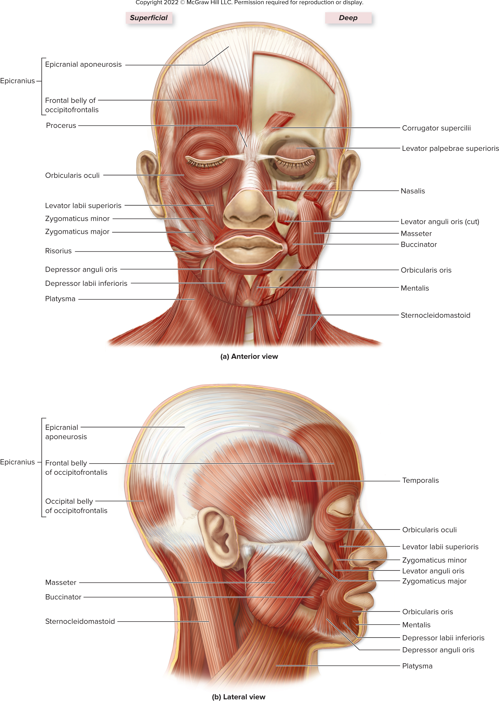
Muscles of Facial Expression, Anterior View
Figure 11.5a
Access the text alternative for slide images.

Slide 22
Muscles of Facial Expression, Lateral View
Figure 11.5b
Access the text alternative for slide images.

Slide 23
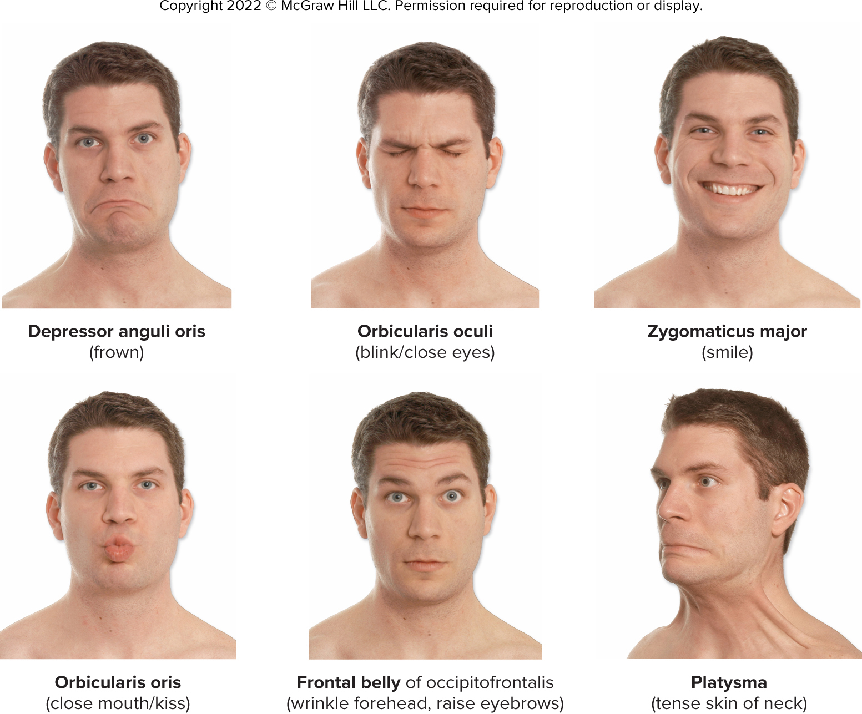
Surface Anatomy of Some Muscles of Facial Expression
Figure 11.6
©McGraw-Hill Education/Jw Ramsey
Access the text alternative for slide images.

Slide 24
Clinical View: Idiopathic Facial Nerve Paralysis (Bell Palsy)
May be without known cause (idiopathic)
Also known as Bell palsy
Facial nerve inflamed and compressed
  Muscles on same side paralyzed
Prednisone often used to reduce swelling
Level and timing of recovery varies

Slide 25
11.3b Extrinsic Eye Muscles 1
Extrinsic eye muscles are extraocular
  Insert onto outer surface of the eye and move it
  Six muscles: four rectus and two oblique
Rectus eye muscles originate from common tendinous ring
  Medial rectus pulls eye medially
    Innervated by CN III (oculomotor)
  Lateral rectus pulls eye laterally
    Innervated by CN VI (abducens)
  Inferior rectus pulls eye inferiorly and medially
    Innervated by CN III (oculomotor)
  Superior rectus pulls eye superiorly and medially
    Innervated by CN III (oculomotor)

Slide 26
11.3b Extrinsic Eye Muscles 2
Oblique eye muscles
  Inferior oblique ealevates and turns eye laterally
    Innervated by CN III (oculomotor)
  Superior oblique depresses and turns the eye laterally
    Passes through pulleylike loop, trochlea
    Innervated by CN IV (trochlear)

Slide 27
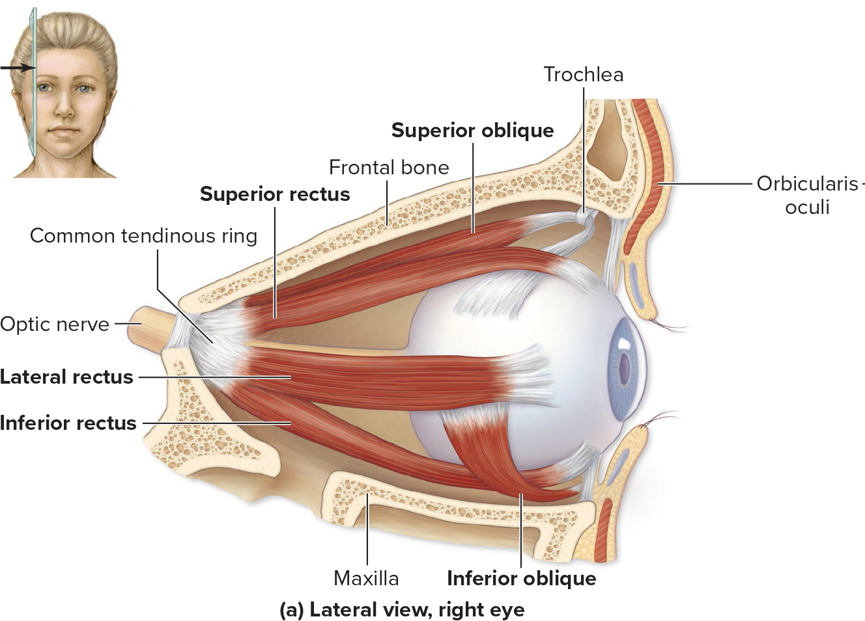
Lateral View of Right Eye
Figure 11.7a
Access the text alternative for slide images.

Slide 28
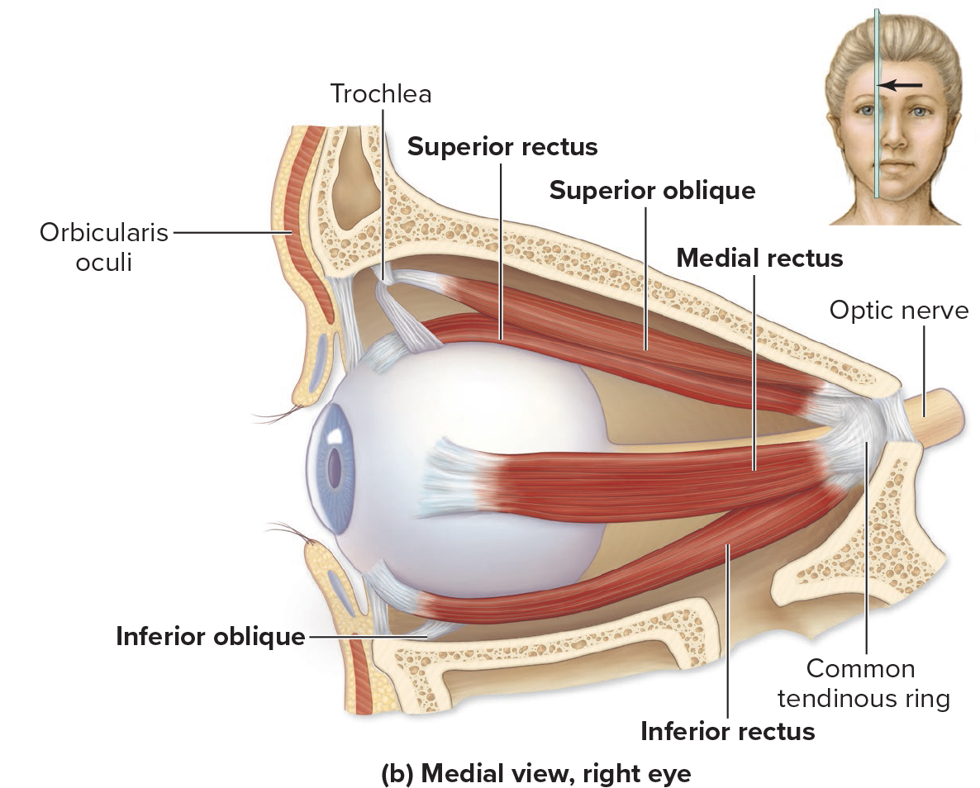
Medial View of Right Eye
Figure 11.7b
Access the text alternative for slide images.

Slide 29
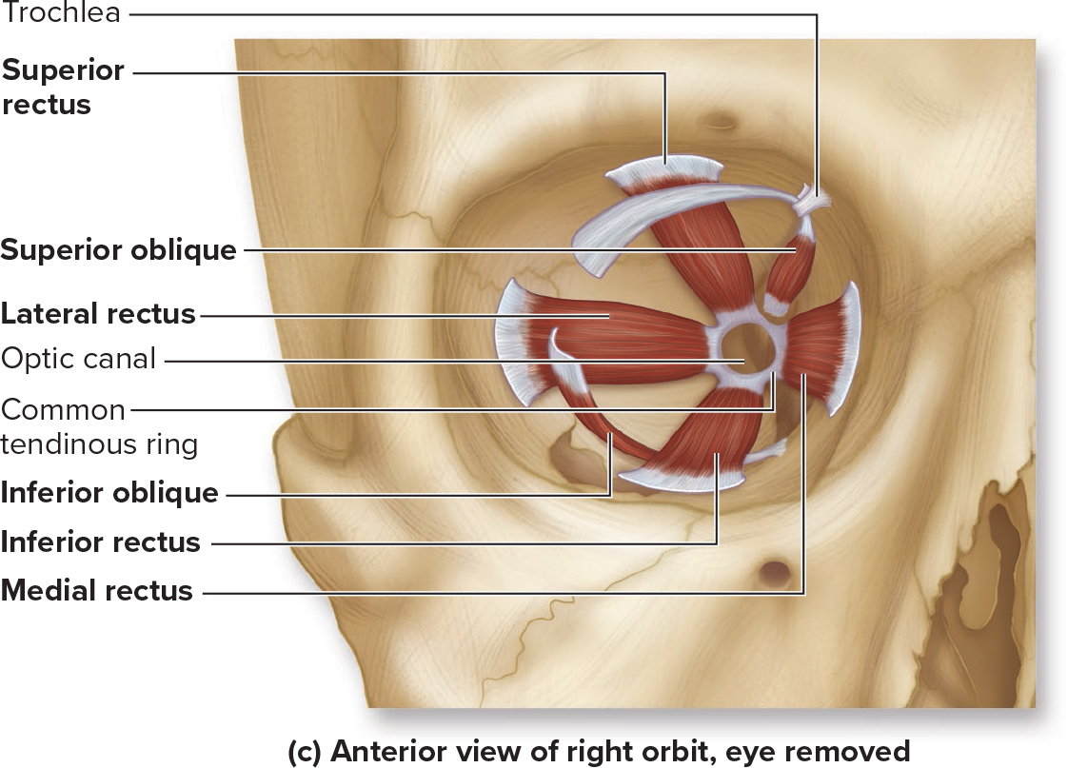
Anterior View of Right Orbit
Figure 11.7c
Access the text alternative for slide images.

Slide 30
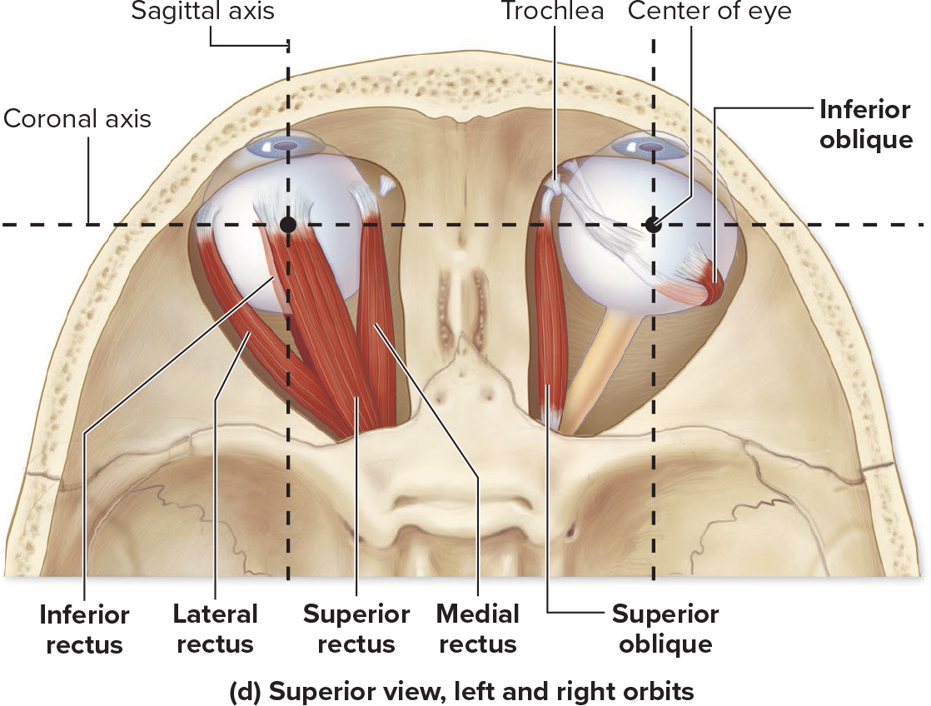
Superior View of Left and Right Orbits
Figure 11.7d
Access the text alternative for slide images.

Slide 31
11.3c Muscles of the Oral Cavity and Pharynx 1
Muscles of mastication (chewing)
  Four paired muscles move mandible at temporomandibular joint (TMJ)
  All four are innervated by CN V (trigeminal)
  Temporalis
    Elevates and pulls the mandible posteriorly (retracts)
    Broad, fan-shaped muscle
  Masseter
    Elevates and pulls the mandible anteriorly (protracts)
    Most powerful and important masticatory muscle
  Medial and lateral pterygoid
    Protraction and side to side movement of mandible
    Medial pterygoid also helps with elevation of mandible

Slide 32
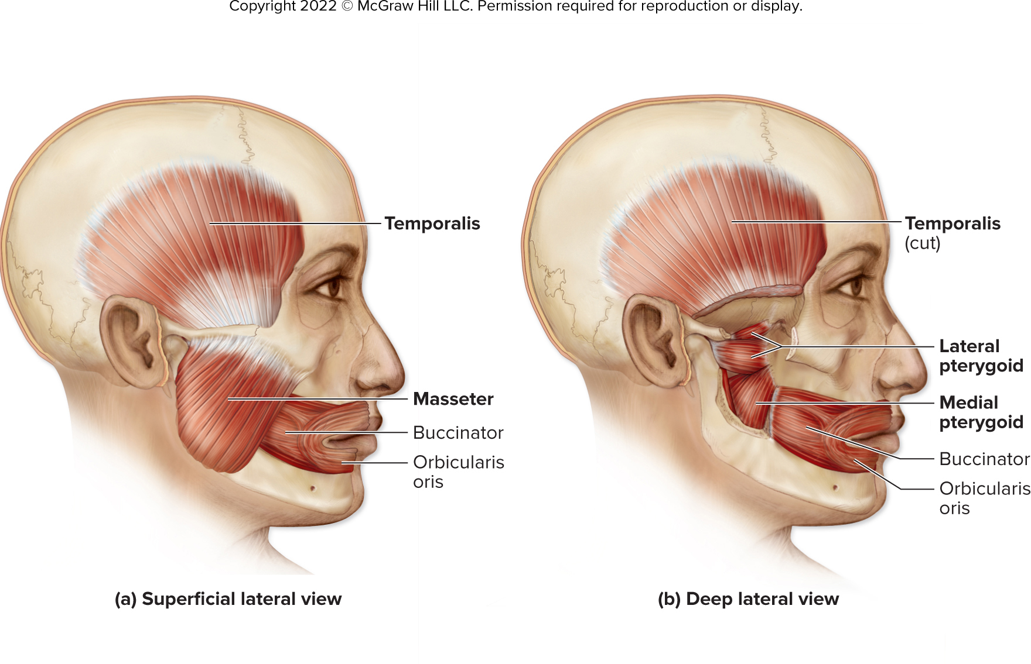
Muscles of Mastication
Figure 11.8
Access the text alternative for slide images.

Slide 33
11.3c Muscles of the Oral Cavity and Pharynx 2
Muscles that move the tongue
  Tongue consists of intrinsic muscles that change shape during chewing and speaking
  Extrinsic muscles arise in head and neck and attach to tongue
    Names end in suffix –glossus
    Produce movements for manipulating food and speaking
    Most are innervated by CN XII, hypoglossal nerve
    Extrinsic muscles are paired, and they include:
      Genioglossus – protract tongue
      Styloglossus – elevate and retract tongue
      Hyoglossus – depress and retract tongue
      Palatoglossus – elevate posterior part of tongue

Slide 34
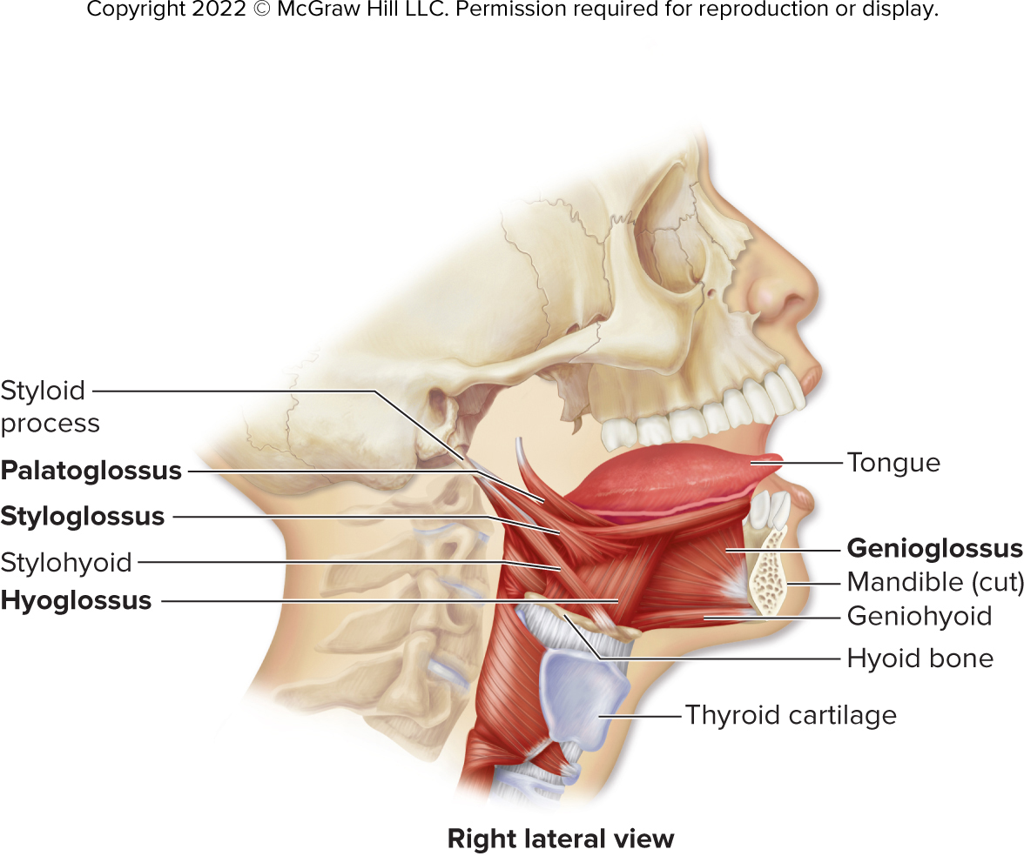
Muscles That Move the Tongue
Figure 11.9
Access the text alternative for slide images.

Slide 35
11.3c Muscles of the Oral Cavity and Pharynx 3
Pharynx muscles
  The pharynx is a funnel-shaped tube (throat) located posterior to oral and nasal cavities
  Includes several muscles that aid in swallowing, including: superior, middle, and inferior pharyngeal constrictor muscles
    Innervated by CN X (vagus)
  Contract sequentially to push food into esophagus

Slide 36
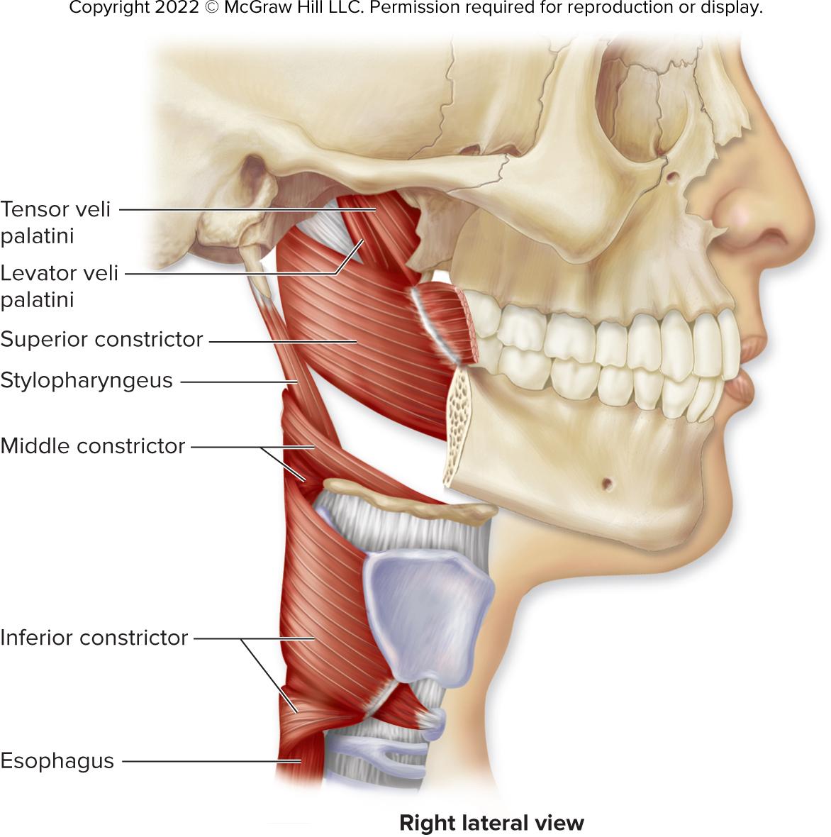
Pharyngeal Constrictors, Palate Muscles, and Laryngeal Elevators
Figure 11.10
Access the text alternative for slide images.

Slide 37
11.3d Muscles of the Anterior Neck: The Hyoid Muscles 1
Suprahyoid muscles: superior to hyoid bone
  Elevate hyoid bone during swallowing or speaking
  Digastric: has two bellies, anterior and posterior
    Also helps depress mandible
  Geniohyoid
    Elevates the hyoid bone
  Mylohyoid
    Provides muscular floor of mouth; also raises it up
  Stylohyoid: attaches to styloid process of temporal bone
    Elongates oral cavity during swallowing

Slide 38
11.3d Muscles of the Anterior Neck: The Hyoid Muscles 2
Infrahyoid muscles: inferior to hyoid bone
  Depress hyoid bone or thyroid cartilage of larynx as swallowing finishes
  Omohyoid
    Depresses hyoid by pulling it toward scapula
  Sternohyoid
    Depresses hyoid by pulling it toward sternum
  Sternothyroid
    Depresses thyroid cartilage by pulling it toward sternum
  Thyrohyoid: extends from thyroid cartilage to hyoid
    Depresses hyoid bone and elevates thyroid cartilage
    Closes off larynx during swallowing

Slide 39
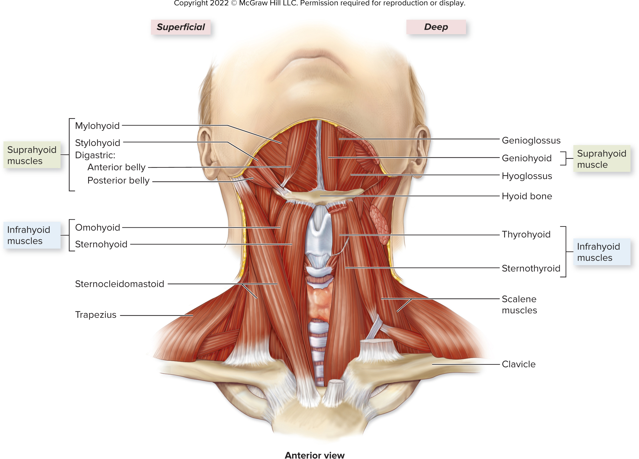
Muscles of the Anterior Neck
Figure 11.11
Access the text alternative for slide images.

Slide 40
11.3e Muscles That Move the Head and Neck 1
Anterolateral neck muscles
  Generally act to flex neck
  Sternocleidomastoid: extends from sternum and clavicle to mastoid
    Bilateral (both sides) contraction flexes neck
    Unilateral (one side) contraction causes lateral flexion of head to contracting muscle’s side and rotation of head to opposite side
  Anterior, middle, and posterior scalene muscles
    Work with sternocleidomastoid to flex neck
    Pull cervical vertebrae toward 1st and 2nd ribs (lateral flexion of neck)
    Elevate 1st and 2nd ribs during forced inhalation

Slide 41
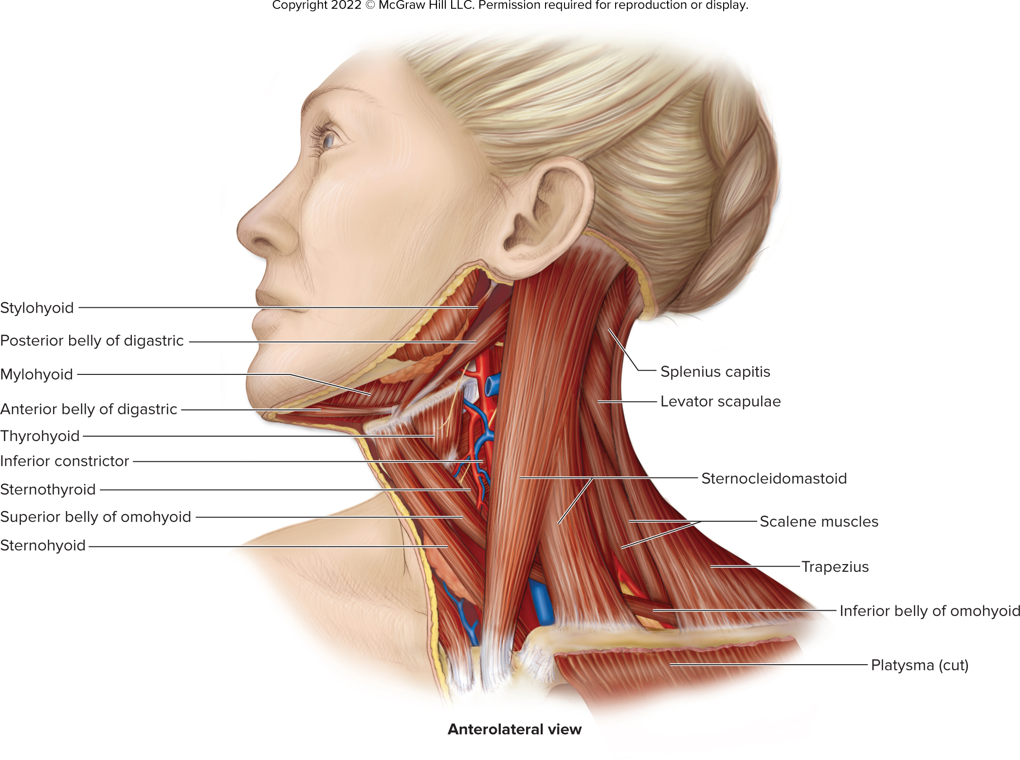
Muscles That Move the Head and Neck
Figure 11.12
Access the text alternative for slide images.

Slide 42
11.3e Muscles That Move the Head and Neck 2
Posterior neck muscles
  Generally act to extend the neck
  Trapezius
    Primary function is to help move pectoral girdle, but also helps extend neck
  Splenius capitis, splenius cervicis, semispinalis capitis, longissimus capitis
    When contracted bilaterally, extend neck
    When contracted unilaterally, turn head to same side
  Suboccipital muscles
    Obliquus capitis superior, obliquus capitis inferior turn head to same side
    Rectus capitis posterior major, rectus capitis posterior minor extend neck

Slide 43
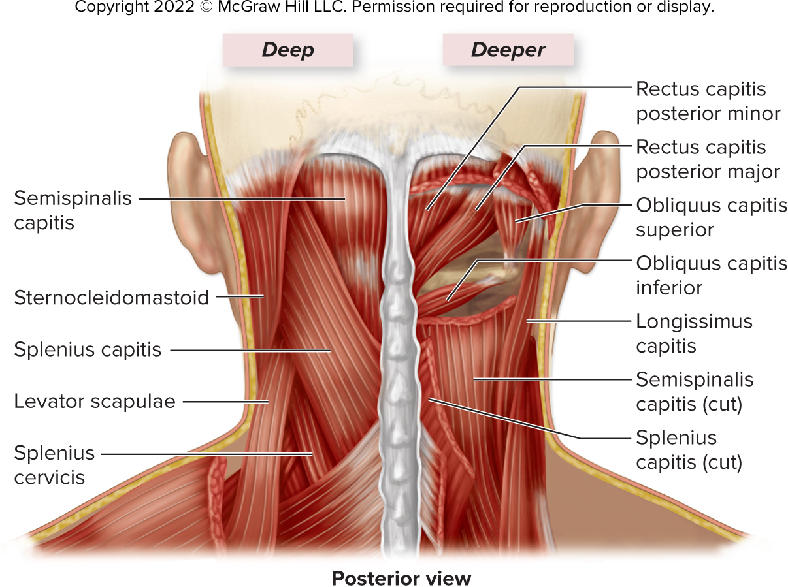
Posterior Neck Muscles
Figure 11.13
Access the text alternative for slide images.

Slide 44
Clinical View: Congenital Muscular Torticollis
Newborn with shortened sternocleidomastoid
May persist into childhood
From birth trauma or prenatal position
Head tilts to affected side and chin to unaffected side
Treatments include
  Physical therapy
  Botulinum toxin, which impairs contraction of affected muscle

Slide 45
Section 11.3 What did you learn? 1
Stand in front of a mirror and demonstrate the actions of the following muscles: zygomaticus major, orbicularis oris, platysma, orbicularis oculi, and depressor anguli oris. Then list what these muscles do.
What are the common general attachments for the muscles of facial expression?
Which extrinsic eye muscles abduct the eye (move the eye laterally)?
What movements do the medial and lateral pterygoid muscles perform?

Slide 46
Section 11.3 What did you learn? 2
What is the general action of the extrinsic muscles of the tongue?
Draw the suprahyoid and infrahyoid muscles. What is the common action of the suprahyoid muscles? Of the infrahyoid muscles?
Which neck muscles extend the neck? Which neck muscles flex the neck?

Slide 47
11.4 Muscles of the Vertebral Column 1
Erector spinae
  Maintain upright posture; if bilaterally contracted, vertebral column extends
  If unilaterally contracted, lateral flexion toward that side
  Three groups of erector spinae muscles, listed lateral to medial:
    Iliocostalis group
    Longissimus group
    Spinalis group

Slide 48
11.4 Muscles of the Vertebral Column 2
Other muscles of vertebral column
  Transversospinalis muscles
    Connect and stabilize the vertebrae
    Deep to erector spinae
  Quadratus lumborum muscles
    Extends vertebral column when bilaterally contracted
    Laterally flexes column when unilaterally contracted
    Located primarily in the lumbar region

Slide 49
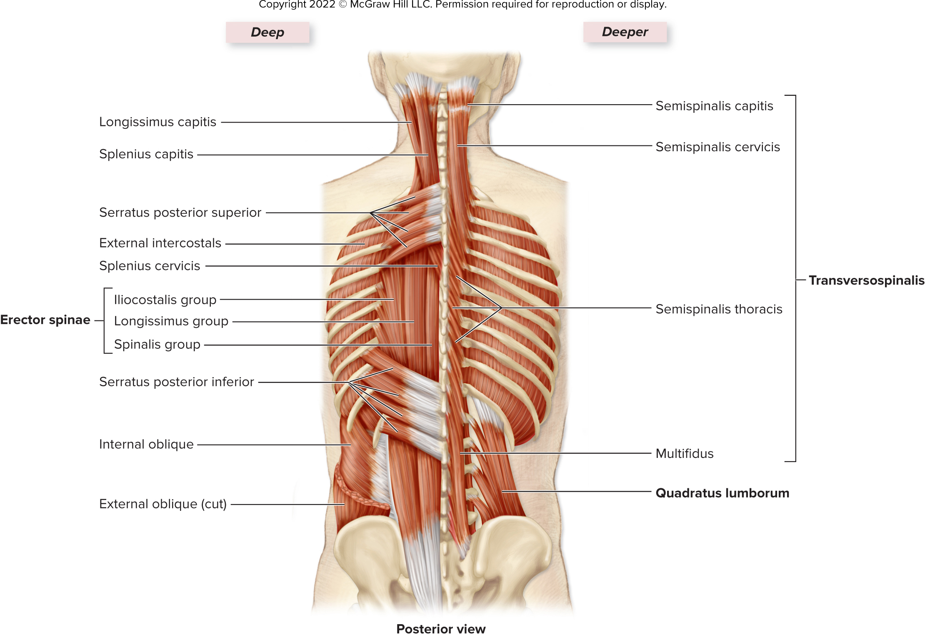
Deep Muscles of the Vertebral Column
Figure 11.14
Access the text alternative for slide images.

Slide 50
Section 11.4 What did you learn?
Draw and label the muscles that form the erector spinae, and briefly explain their common actions.

Slide 51
End of Main Content
Copyright 2022 © McGraw Hill LLC. All rights reserved. No reproduction or distribution without the prior written consent of McGraw Hill LLC.

Slide 52
Accessibility Content: Text Alternatives for Images

Slide 53
Body Musculature: Anterior View - Text Alternative
Return to parent-slide containing images.
The anterior view of human body shows the following superficial axial muscles, frontal belly of Occipitofrontalis, orbicularis oculi, zygomaticus major, orbicularis oris, platysma, and external oblique. The other superficial muscles are trapezius, deltoid, pectoralis major, triceps brachii, biceps brachii, brachialis, pronator teres, brachioradialis, flexor carpi radialis, palmaris longus, tensor fasciae latae, adductor longus, Sartorius, gracilis, quadriceps femoris (rectus femoralis, vastus lateralis, vastus medialis, and vastus intermedius), fibularis longus, tibialis anterior, and extensor digitorum longus. The deep axial muscles are temporalis, masseter, sternocleidomastoid, sternohyoid, external intercoastal, internal intercostal, rectus abdominis, transversus abdominis, internal oblique, and external oblique. The other deep muscles are pectoralis minor, serratus anterior, iliopsoas, pectineus, and extensor hallucis longus.
Return to parent-slide containing images.

Slide 54
Body Musculature: Posterior View - Text Alternative
Return to parent-slide containing images.
The posterior view of human body shows the following superficial axial muscles occipital belly of Occipitofrontalis and sternocleidomastoid. The other superficial muscles are trapezius, deltoid, tees minor, teres major, triceps brachii, latissimus dorsi, extensor digitorum, extensor carpi ulnaris, gluteus medius, gluteus maximus, adductor magnus, hamstrings (biceps femoris, semitendinosus, and semimembranosus), gastrocnemius, and calcaneal tendon. The deep axial muscles are semispinalis capitis, splenius capitis, splenius cervicis, serratus posterior inferior, external oblique, internal oblique, and erector spinae. The other deep muscles are supraspinatus, rhomboid minor, rhomboid major, infraspinatus, teres minor, teres major, serratus anterior, gluteus minimus, gluteus medius, piriformis, quadratus femoris, gracilis, iliotibial tract, plantaris, gastrocnemius, plantaris tendon, soleus, and calcaneal tendon.
Return to parent-slide containing images.

Slide 55
Muscle Attachments - Text Alternative
Return to parent-slide containing images.
The illustration shows a hand that is pulled up from the elbow that leads to contraction of the relaxed muscle in the upper arm. The muscle has two proximal attachment (origin) and a tendon that is connected to the distal attachment (insertion). The movement of distal attachment of muscle allows the hand to be folded at the elbow.
Return to parent-slide containing images.

Slide 56
Organization of Muscle Fibers - Text Alternative
Return to parent-slide containing images.
The illustration shows circular muscle (orbicularis oris) around the mouth, parallel muscle (rectus abdominis) of the abdomen, and convergent muscle (pectoralis muscle) of the chest. Pennate muscles are of three types, unipennate (extensor digitorum), bipennate (rectus femoris), and multipennate (deltoid).
Return to parent-slide containing images.

Slide 57
Muscle Naming - Text Alternative
Return to parent-slide containing images.
The table shows naming based on muscle action: Adductor (adducts body parts): adductor magnus; Abductor (abducts body part): Abductor pollicis longus; Flexor (flexes a joint): Flexor carpi radialis; Extensor (extends a joint): Extensor hallucis longus. Naming based on specific body regions: Oris (mouth): Orbicularis oris; Cervicis (neck): Semispinalis cervicis; Brachial (arm): Biceps brachii; Carpi (wrist): Flexor carpi ulnaris; Pollicis (thumb): Opponens pollicis; Gluteal (buttocks): Gluteus medius; Femoris (thigh): Quadratus femoris; Hallucis (great toe): Extensor hallucis longus; Anterior (toward the front of the body): Tibialis anterior; Posterior or dorsal/dorsi (toward the back of the body): Tibialis posterior Latissimus dorsi; Superior (closer to the head): Serratus posterior superior; Inferior (closer to the feet): Serratus posterior inferior; Superficialis (superficial): Flexor digitorum superficialis; Profundus (deep): Flexor digitorum profundus. Naming based on muscle attachments: Sternum and clavicle (cleido): Sternocleidomastoid; Between the ribs: Intercostal; Subscapular fossa: Subscapularis; Fibula: Fibularis longus; Zygomatic bone: Zygomaticus major. Naming based on orientation of muscle fibers: Rectus (straight): Rectus abdominis; Oblique (angled): External oblique; Orbicularis (circular): Orbicularis oculi. Naming based on muscle shape: Deltoid (triangular): Deltoid; Quadratus (rectangular): Pronator quadratus; Trapezius (trapezoidal): Trapezius; Longus (long): Abductor pollicis longus; Brevis (short): Abductor pollicis brevis. Naming based on muscle size: Major (larger of two muscles): Pectoralis major; Minor (smaller of two muscles): Pectoralis minor; Maximus (largest): Gluteus maximus; Medius (medium-sized): Gluteus medius; Minimus (smallest): Gluteus minimus. Naming based on number of muscle heads: Biceps (two heads): Biceps femoris; Triceps (three heads): Triceps brachii; Quadriceps (four heads): Quadriceps femoris.
Return to parent-slide containing images.

Slide 58
Muscles of Facial Expression, Anterior View –
Text Alternative
Return to parent-slide containing images.
The illustration shows anterior view of facial muscles. The superficial muscles are epicranius (epicranial aponeurosis and frontal belly of Occipitofrontalis), procerus, orbicularis oculi, levator labii superioris, zygomaticus major, zygomaticus minor, risorius, depressor anguli oris, depressor labii Inferioris, and platysma. The deep muscles are corrugator supercilli, levator palpebrae superioris, nasalis, levator anguli oris, masseter, buccinator, orbicularis oris, mentalis, and sternocleidomastoid.
Return to parent-slide containing images.

Slide 59
Muscles of Facial Expression, Lateral View –
Text Alternative
Return to parent-slide containing images.
The illustration shows lateral view of facial muscles. The superficial muscles are epicranius (epicranial aponeurosis, frontal belly of Occipitofrontalis, from occipital belly of Occipitofrontalis), masseter, buccinator, and sternocleidomastoid. The deep muscles are temporalis, orbicularis oculi, levator labii superioris, zygomaticus minor, levator anguli oris, zygomaticus major, orbicularis oris, mentalis, depressor labii Inferioris, depressor anguli oris, and platysma.
Return to parent-slide containing images.

Slide 60
Surface Anatomy of Some Muscles of Facial Expression – Text Alternative
Return to parent-slide containing images.
The photos shows Depressor anguli oris for frown, Orbicularis oculi for blink or close eyes, Zygomaticus major for smile, Orbicularis oris for close mouth or kiss, Frontal belly of Occipitofrontalis for wrinkle forehead and raise eyebrows, and Platysma for tense skin of neck.
Return to parent-slide containing images.

Slide 61
Lateral View of Right Eye – Text Alternative
Return to parent-slide containing images.
The illustration shows the following: upper eyelid has orbicularis oculi muscle followed by trochlea above the eyeball from which superior oblique arises and joins the common tendinous ring below the frontal bone. Superior rectus arises from the common tendinous ring which connects to the upper portion of the eyeball and lateral rectus and inferior rectus join the lower portion of the eyeball. A muscle below the eyeball is identified as inferior oblique that lies above maxilla. Behind the common tendinous ring lie the optic nerve.
Return to parent-slide containing images.

Slide 62
Medial View of Right Eye – Text Alternative
Return to parent-slide containing images.
The upper eyelid has orbicularis oculi muscle followed by trochlea above the eyeball from which superior oblique arises and joins the common tendinous ring below the frontal bone. Superior rectus arises from the common tendinous ring which connects to the upper portion of the eyeball and lateral medial and inferior rectus join the central and lower portion of the eyeball. A muscle below the eyeball is identified as inferior oblique. Behind the common tendinous ring lie the optic nerve.
Return to parent-slide containing images.

Slide 63
Anterior View of Right Orbit – Text Alternative
Return to parent-slide containing images.
The illustration shows anterior view of right orbit with eye removed has trochlea on the top followed by optic canal, superior oblique, and common tendinous ring from which lateral rectus, superior rectus, inferior rectus, and medial rectus arise.
Return to parent-slide containing images.

Slide 64
Superior View of Left and Right Orbits – Text Alternative
Return to parent-slide containing images.
Below the coronal axis lies the inferior oblique. Below the trochlea lies superior oblique and below the coronal axis and to the right of sagittal axis lies the inferior rectus and lateral rectus. below the coronal axis and to the left of sagittal axis lies the superior rectus and medial rectus.
Return to parent-slide containing images.

Slide 65
Muscles of Mastication – Text Alternative
Return to parent-slide containing images.
The illustration A shows lateral view of superficial muscles that has temporalis, masseter, buccinator, and orbicularis oris. The illustration B shows lateral view of deep muscles that has temporalis, lateral pterygoid, medial pterygoid, buccinator, and orbicularis oris.
Return to parent-slide containing images.

Slide 66
Muscles That Move the Tongue – Text Alternative
Return to parent-slide containing images.
The illustration shows right lateral view of the face that has tongue, mandible, geniohyoid, hyoid bone, thyroid cartilage, stylohyoid, and styloid process. The extrinsic tongue muscles are genioglossus, palatoglossus, styloglossus, and hyoglossus.
Return to parent-slide containing images.

Slide 67
Pharyngeal Constrictors, Palate Muscles, and Laryngeal Elevators – Text Alternative
Return to parent-slide containing images.
The right lateral view shows tensor veli palatini at the top followed by levator veli palatini, superior constrictor, stylopharyngeus, middle constrictor, inferior constrictor, and esophagus.
Return to parent-slide containing images.

Slide 68
Muscles of the Anterior Neck – Text Alternative
Return to parent-slide containing images.
The anterior view of neck shows both superficial and deep muscle of the neck. The superficial muscles are suprahyoid muscle (mylohyoid, stylohyoid, digastric: anterior belly and posterior belly), infrahyoid muscle (omohyoid and sternohyoid), sternocleidomastoid, and trapezius. The deep muscles are Genioglossus, Geniohyoid (suprahyoid muscle), Hyoglossus, infrahyoid muscles (thyrohyoid and sternothyroid), scalene muscles.
Return to parent-slide containing images.

Slide 69
Muscles That Move the Head and Neck – Text Alternative
Return to parent-slide containing images.
The illustration shows anterolateral view of the head and neck. The muscles identified on the left are Stylohyoid, Posterior belly of digastric, Mylohyoid, Anterior belly of digastric, thyrohyoid, inferior constrictor, sternothyroid, superior belly of omohyoid and sternohyoid. The muscles identified in the right are splenius capitis, levator scapulae, sternocleidomastoid, scalene muscles, trapezius, inferior belly of omohyoid, and platysma.
Return to parent-slide containing images.

Slide 70
Posterior Neck Muscles – Text Alternative
Return to parent-slide containing images.
The posterior view of neck shows deep muscles such as semispinalis capitis, sternocleidomastoid, splenius capitis, levator scapulae, and splenius cervicis. The deeper muscles of the neck are rectus capitis posterior minor, rectus capitis posterior major, obliquus capitis superior, obliquus capitis inferior, longissimus capitis, semispinalis capitis, and splenius capitis.
Return to parent-slide containing images.

Slide 71
Deep Muscles of the Vertebral Column – Text Alternative
Return to parent-slide containing images.
The illustration shows posterior view of the vertebral column. The deep muscles are longissimus capitis, splenius capitis, serratus posterior superior, splenius cervicis, external intercostals, erector spinae (iliocostalis group, longissimus group, and spinalis group), serratus posterior inferior, internal oblique, and external oblique. The deeper muscles are transversospinalis (semispinalis capitis, semispinalis cervicis, and semispinalis thoracis) and quadratus lumborum.
Return to parent-slide containing images.

