Slide 1
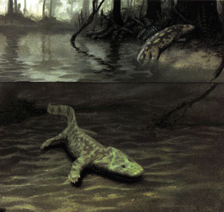
The Vertebrate Story, Part Two
BIOL 495 – Chapter Three

Slide 2
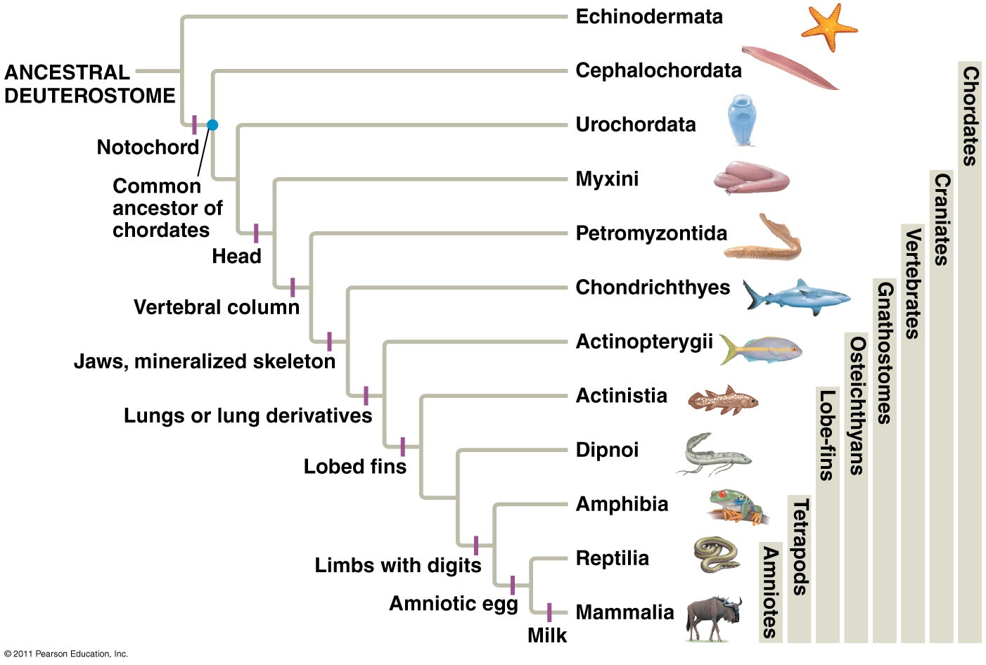

Slide 3
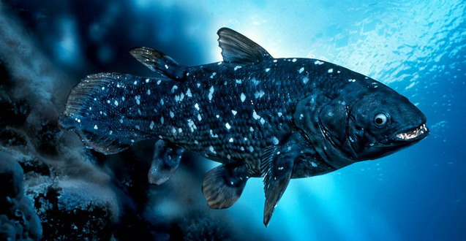
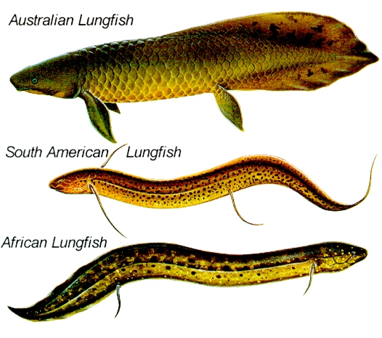
Sarcopterygii – Lobe Finned Fish

Slide 4
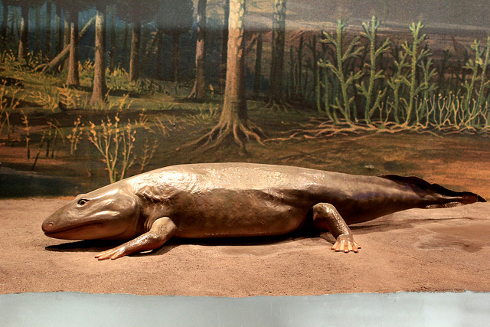
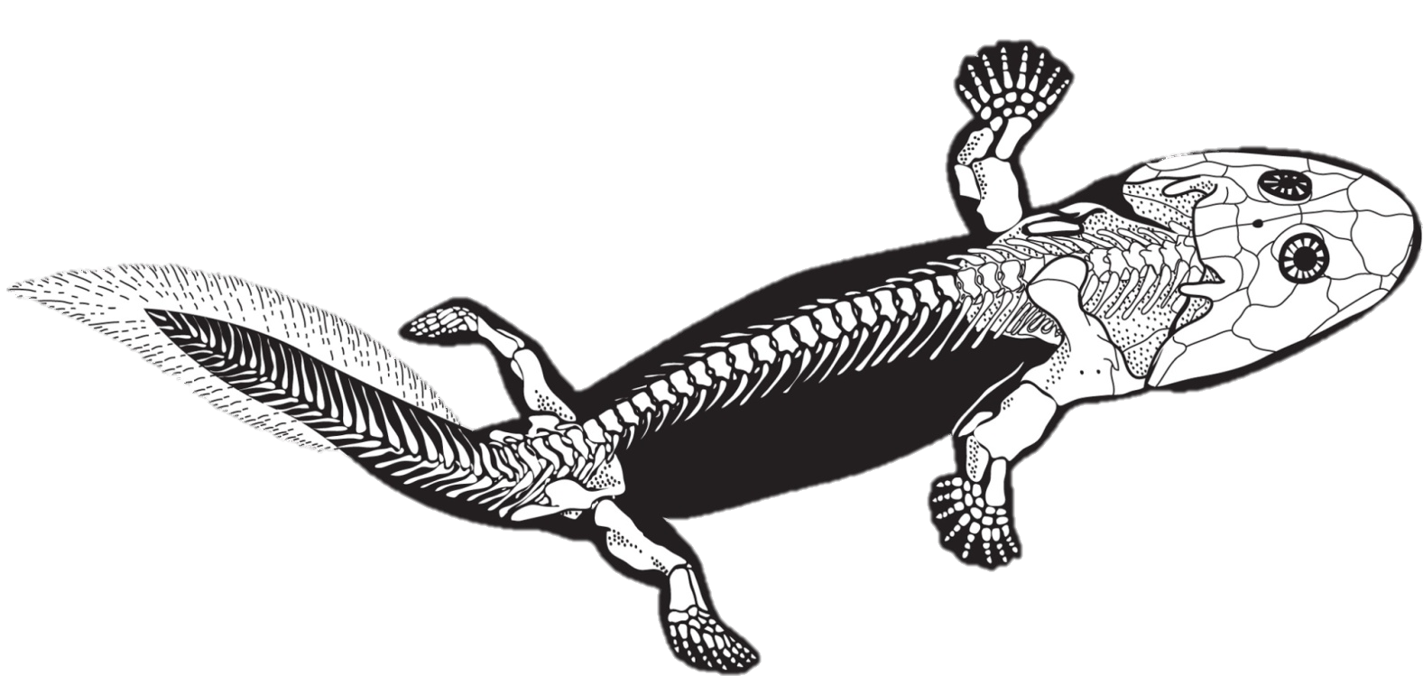
Tetrapods – Leaving the water
Lateral Line System
Tail Fins
Aquatic Hearing
Opercular Bones (Internal Gills)
Limbs with Digits
Weight Bearing Separated Girdles
Acanthostega and Ichthyostega ~ 360 MA (Greenland)

Slide 5
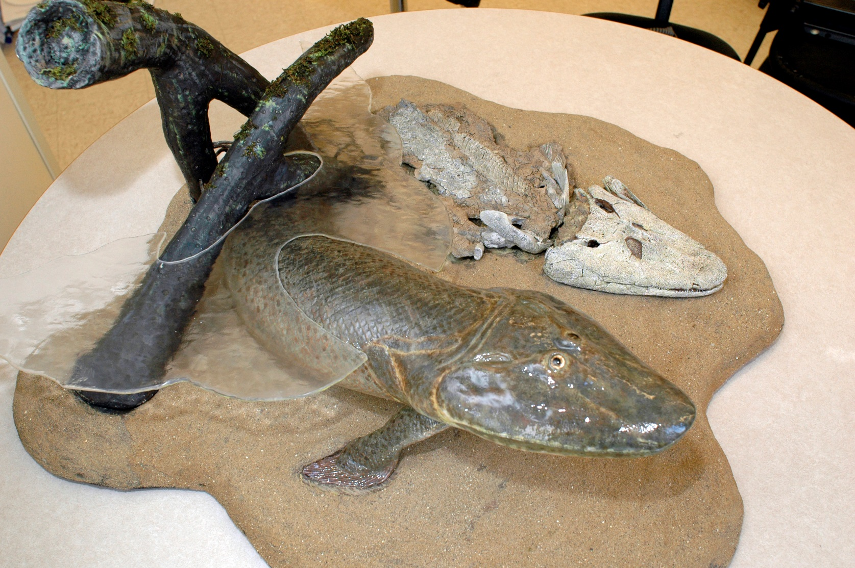
Transition to land
Lateral Line System
Tail Fins
Aquatic Hearing
Opercular Bones (Internal Gills)
Limbs with Digits
Weight Bearing Separated Girdles
Northern Canada ~ 360 MA

Slide 6
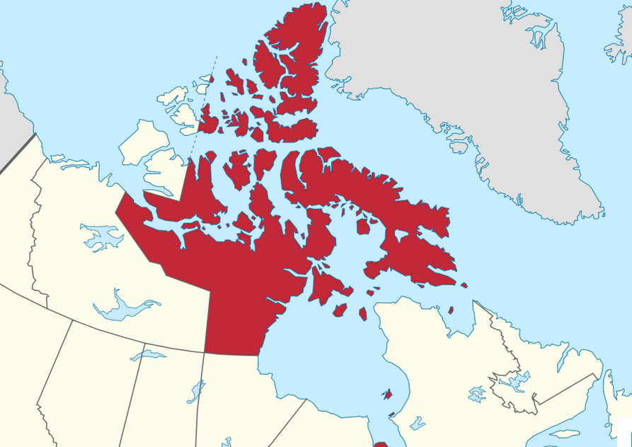
Window in time, amazing transition

Slide 7
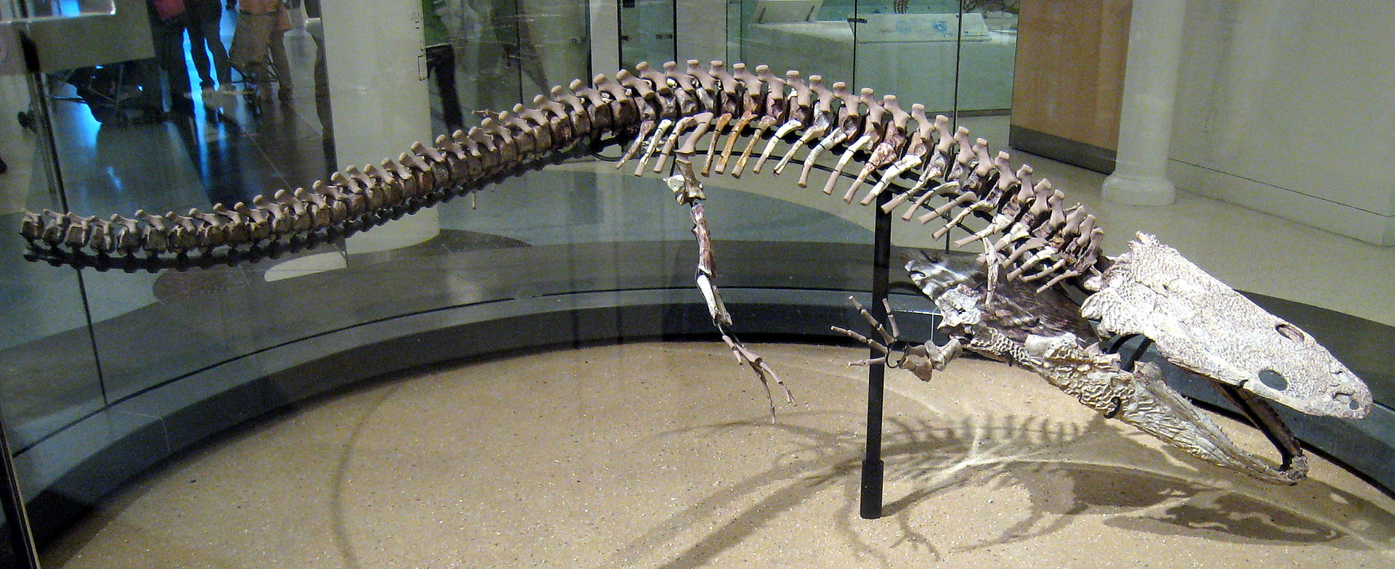
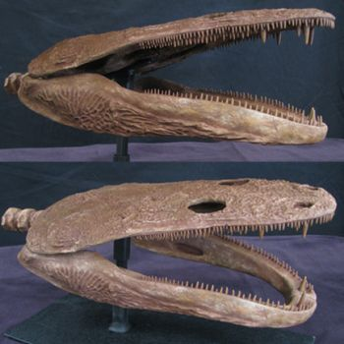
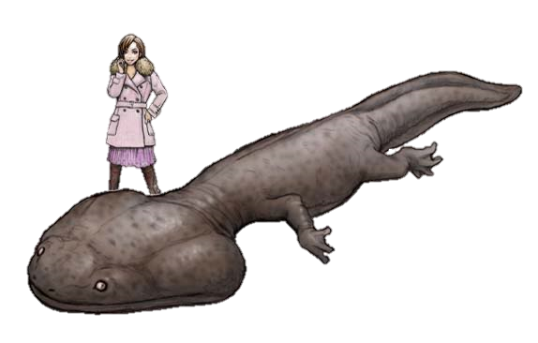
Temnospondyli (‘amphibians’)
Koskinonodon American Southwest ~ 220 MA
Koolasuchus Australia – 120 MA

Slide 8
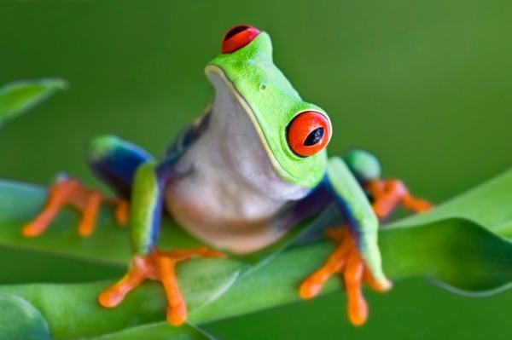
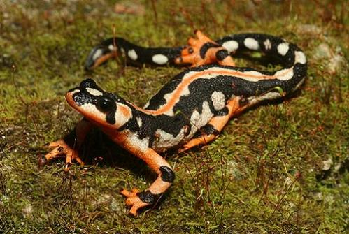
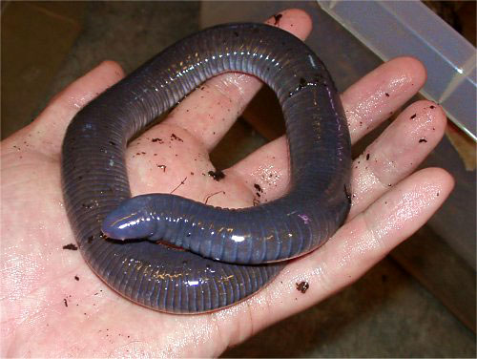
Modern Amphibians - Lissamphibians
Earliest fossils are Jurassic (200 MA) Frogs
4,000 Living species

Slide 9
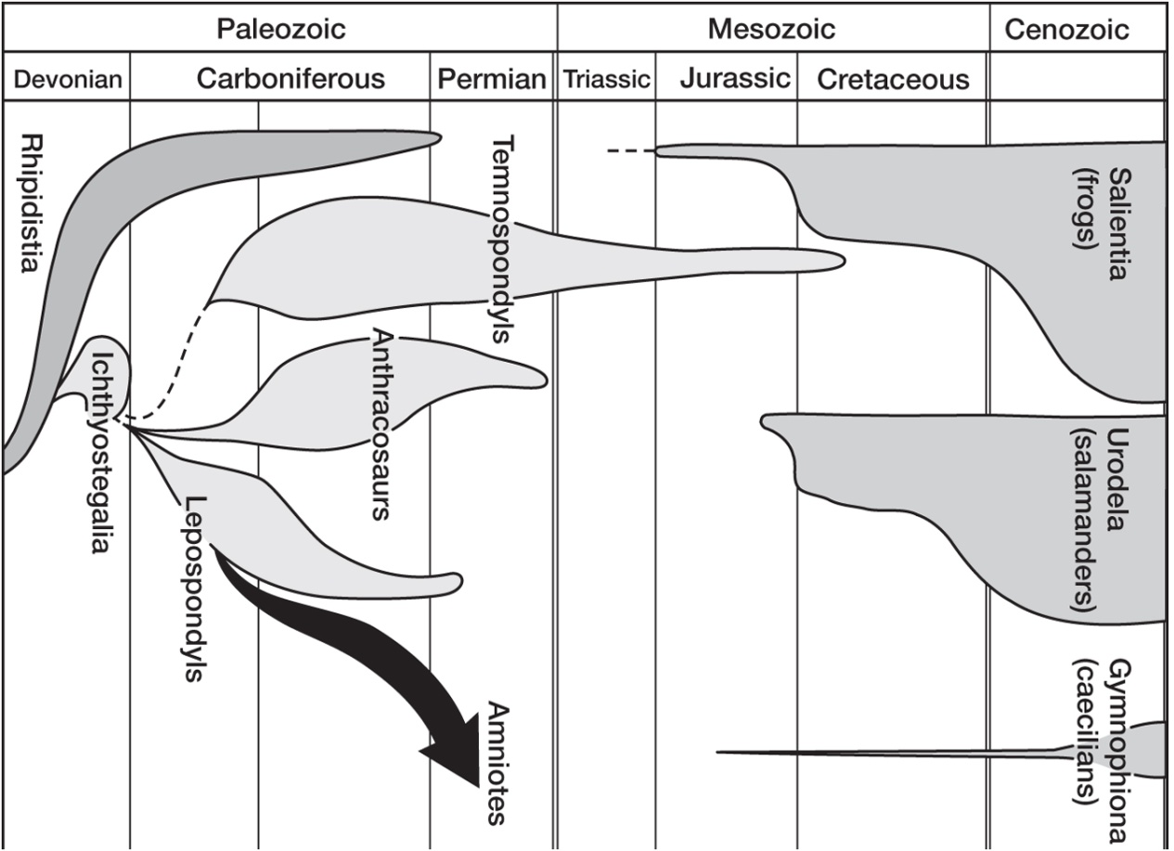
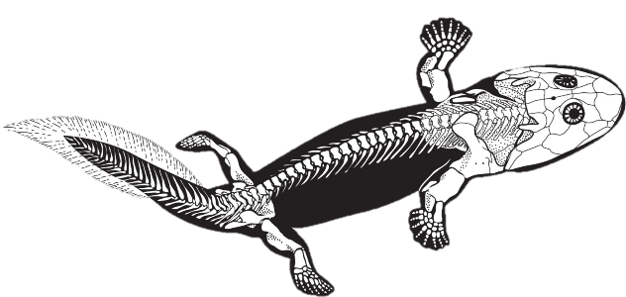

Slide 10
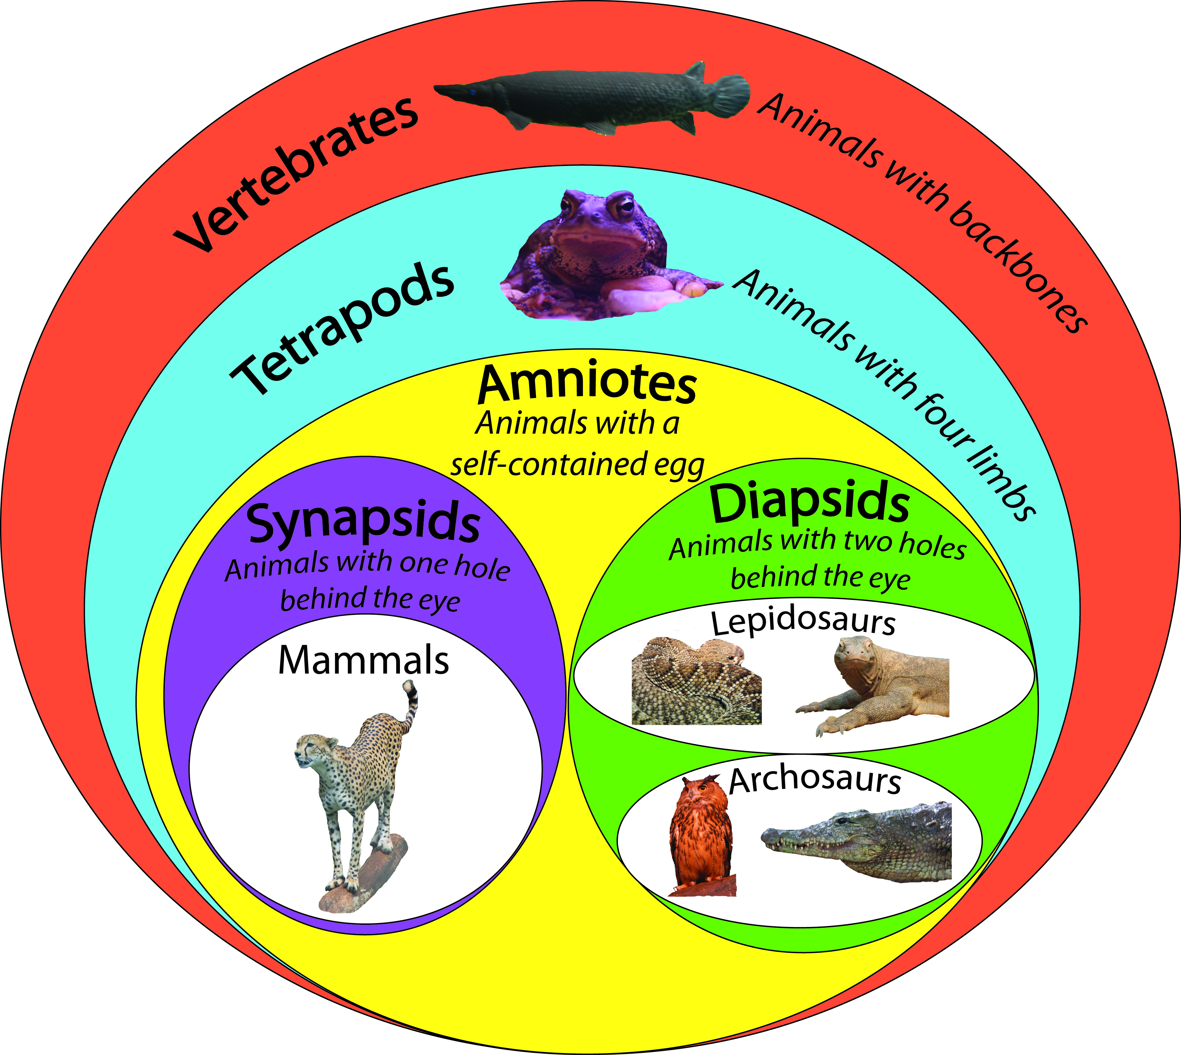

Slide 11
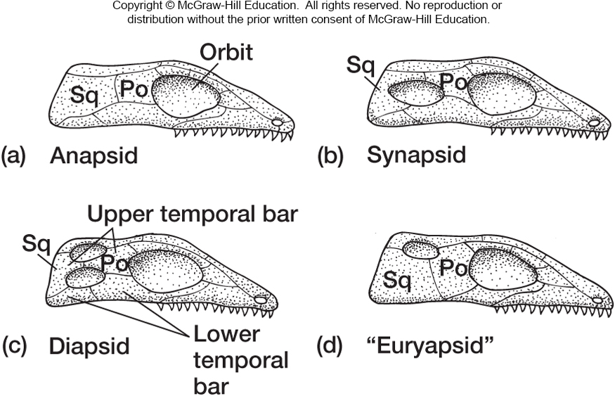
Amniotes – Skull types

Slide 12
Stem Amniotes – Diadectes ~ 300 MA

Slide 13
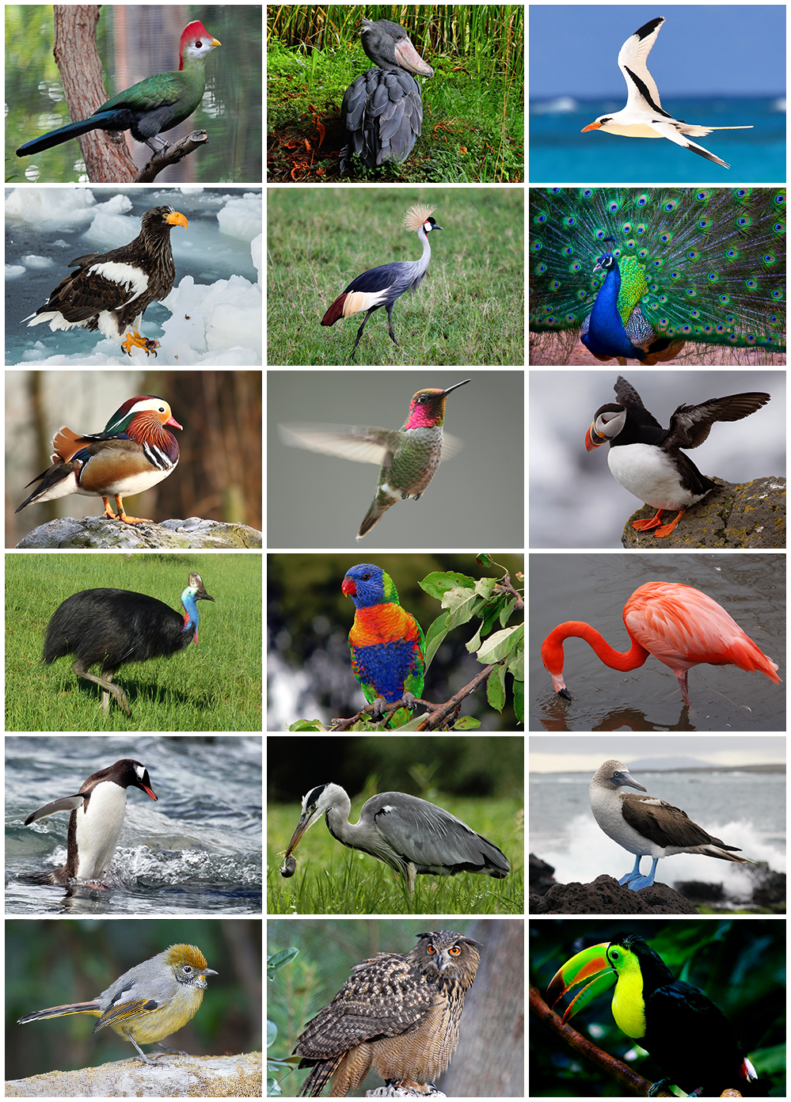
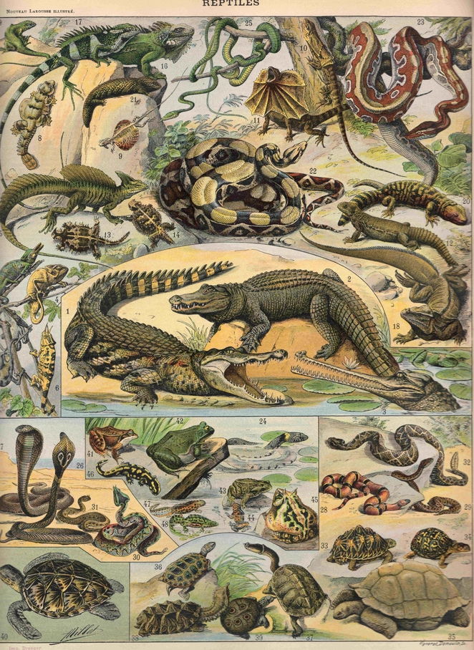
Reptilia

Slide 14
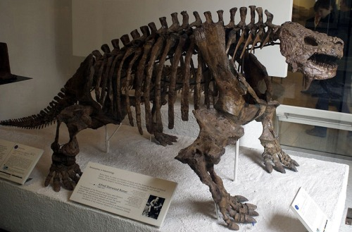
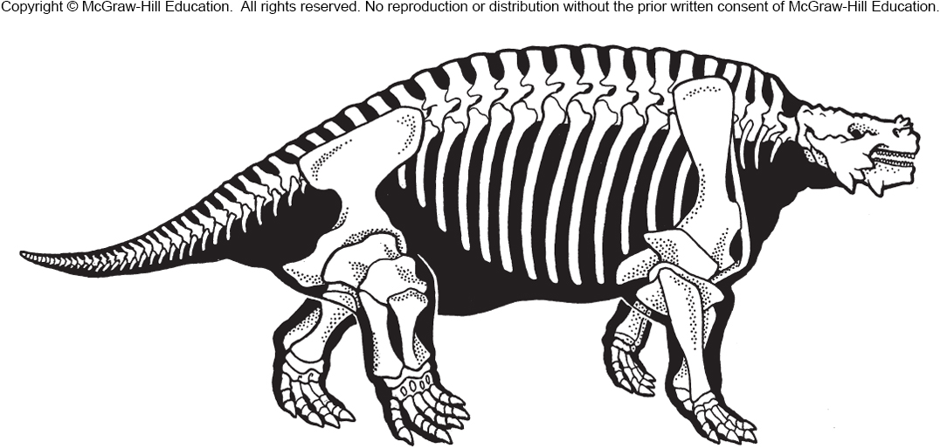
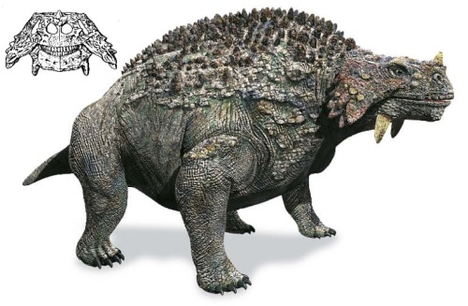
Parareptilia
Russia ~ 250 Ma

Slide 15
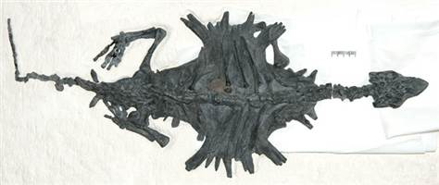
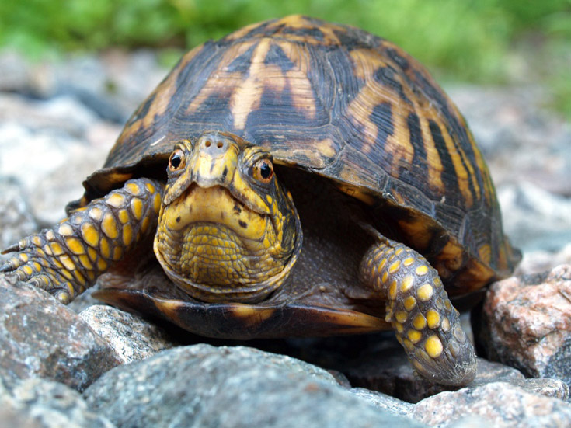
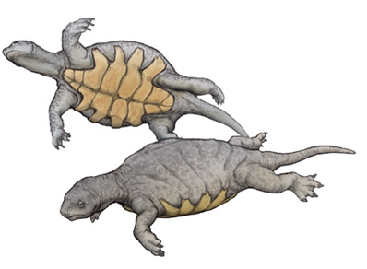
Turtles – anapsids
China – 220 Ma

Slide 16
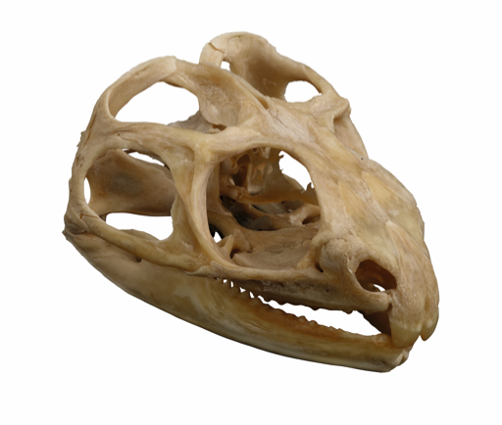
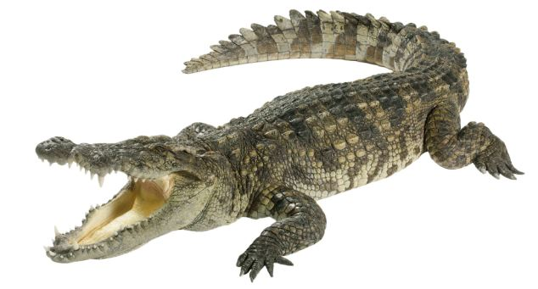
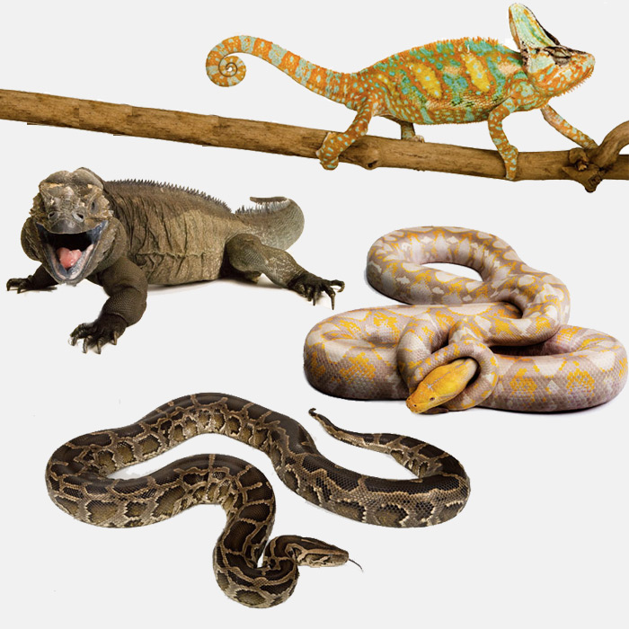
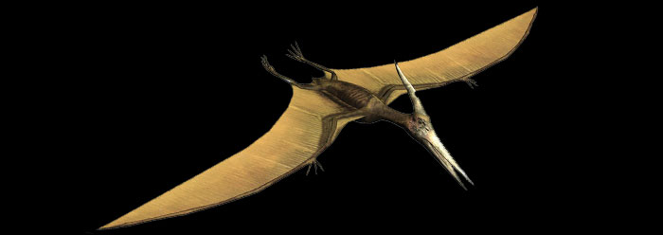
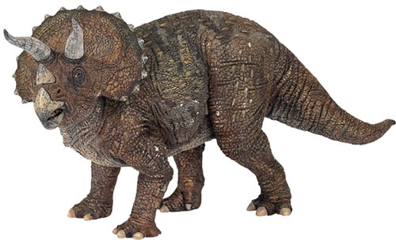
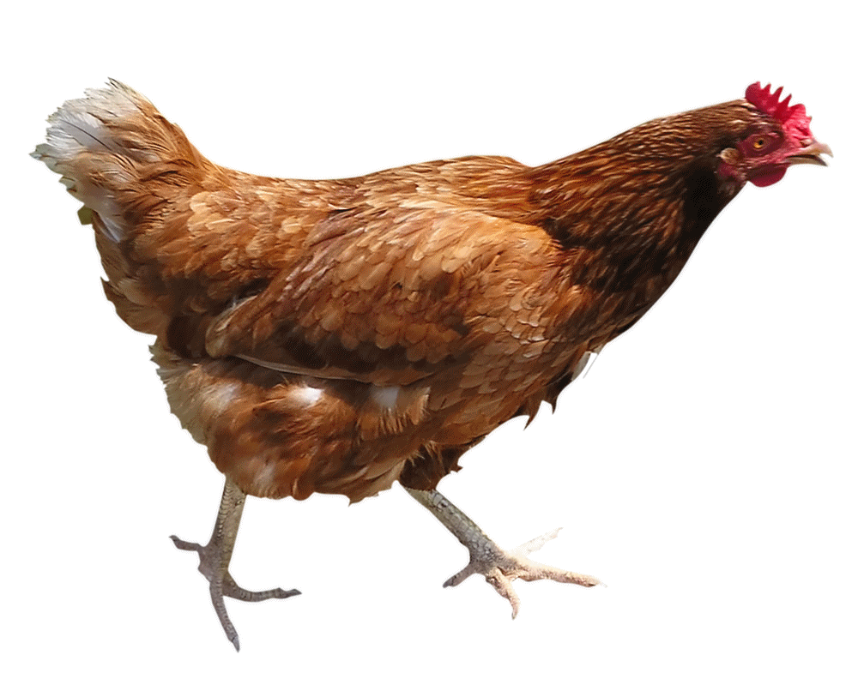
Diapsida
Archosauria
Squamata

Slide 17
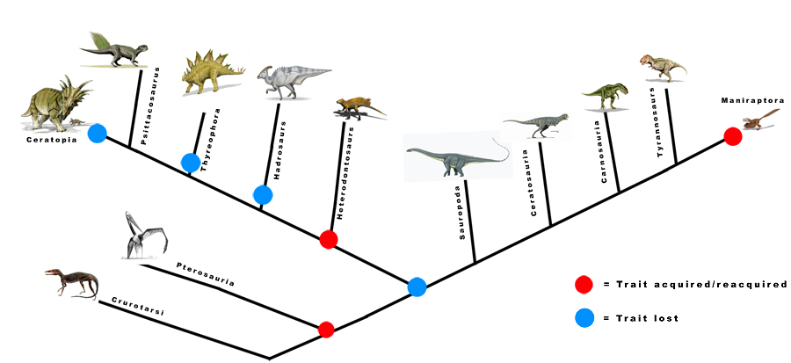
Dinosauria – Dominate Terrestrial Vert for 135 Ma

Slide 18
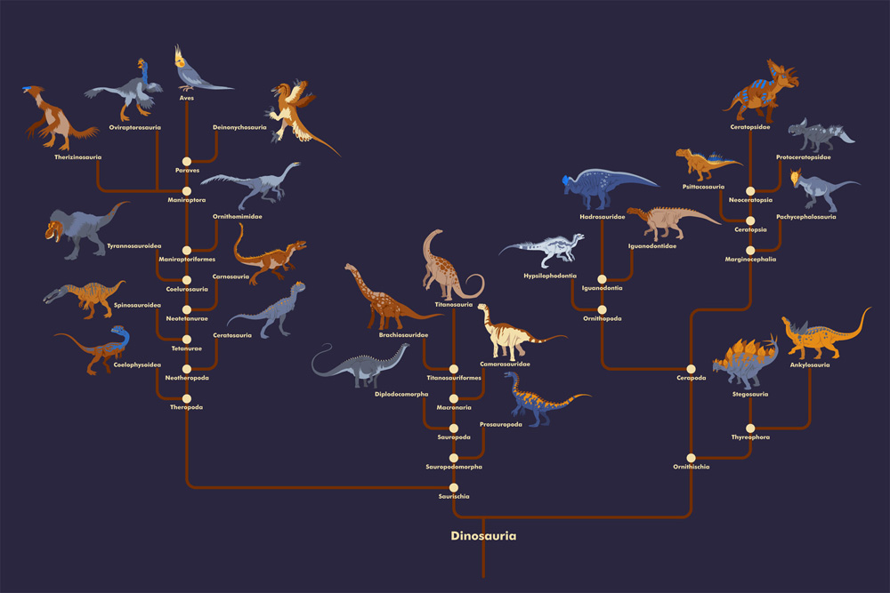

Slide 19
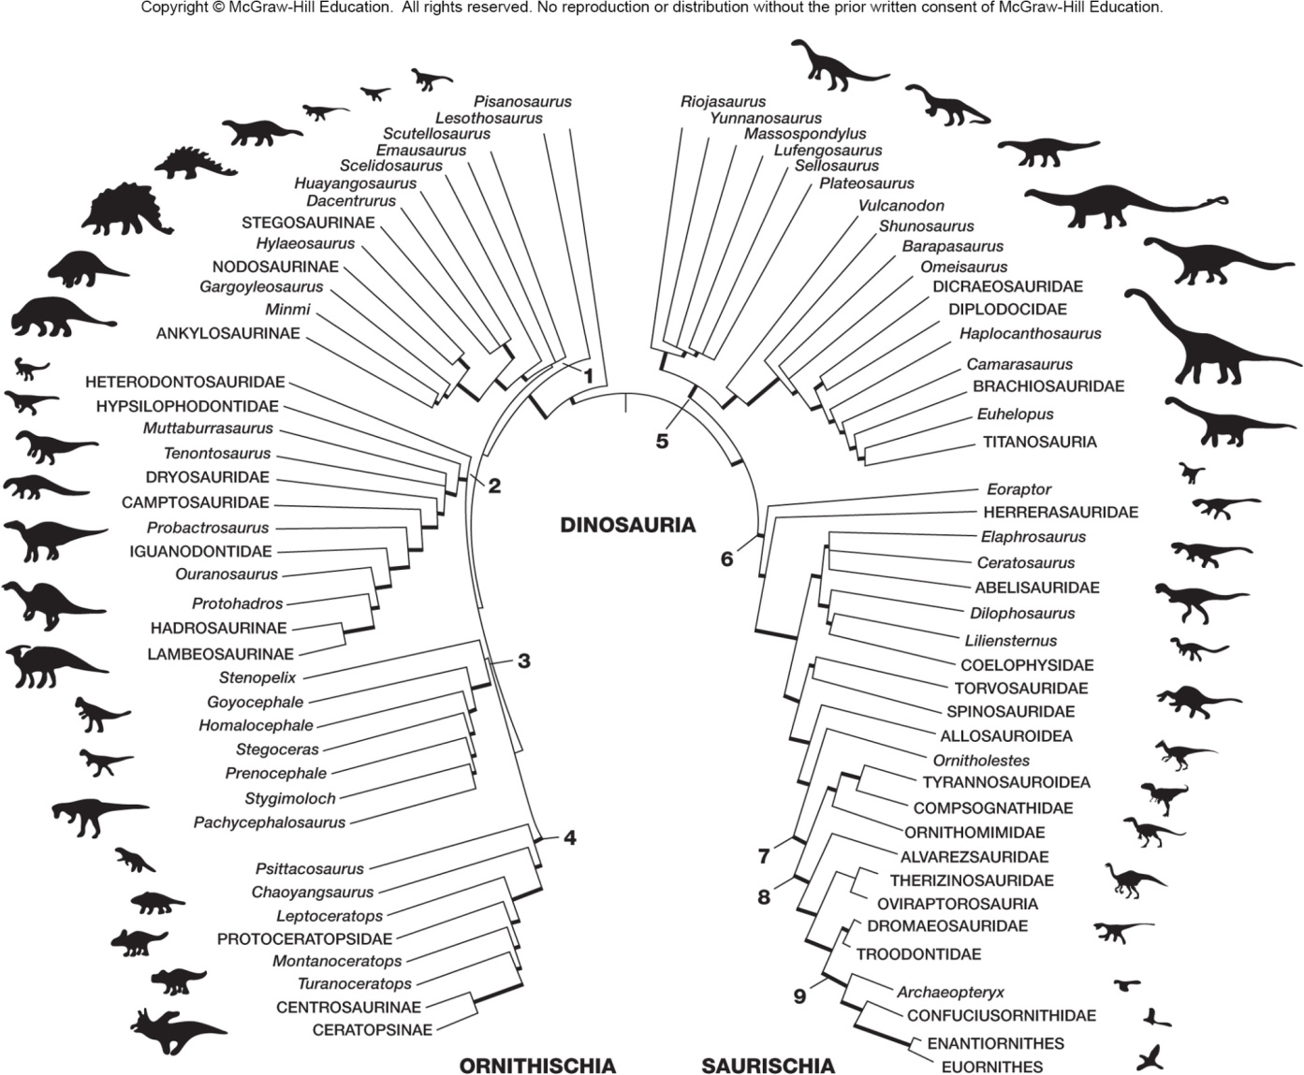

Slide 20
Saurischia Ornithischia

Slide 21
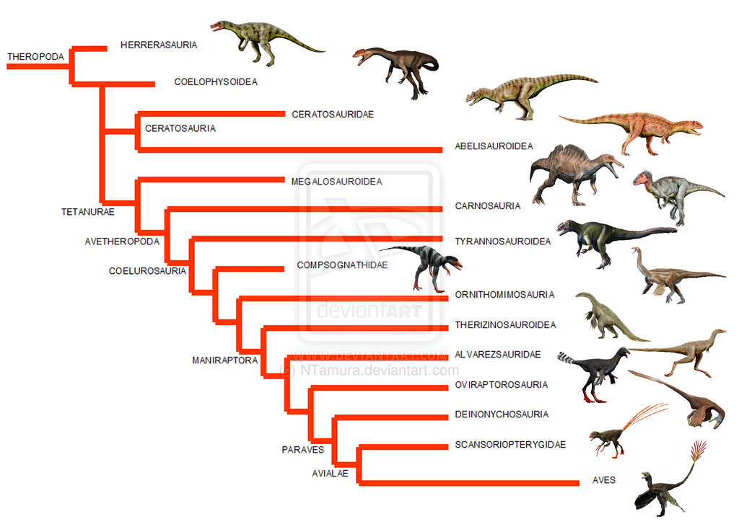
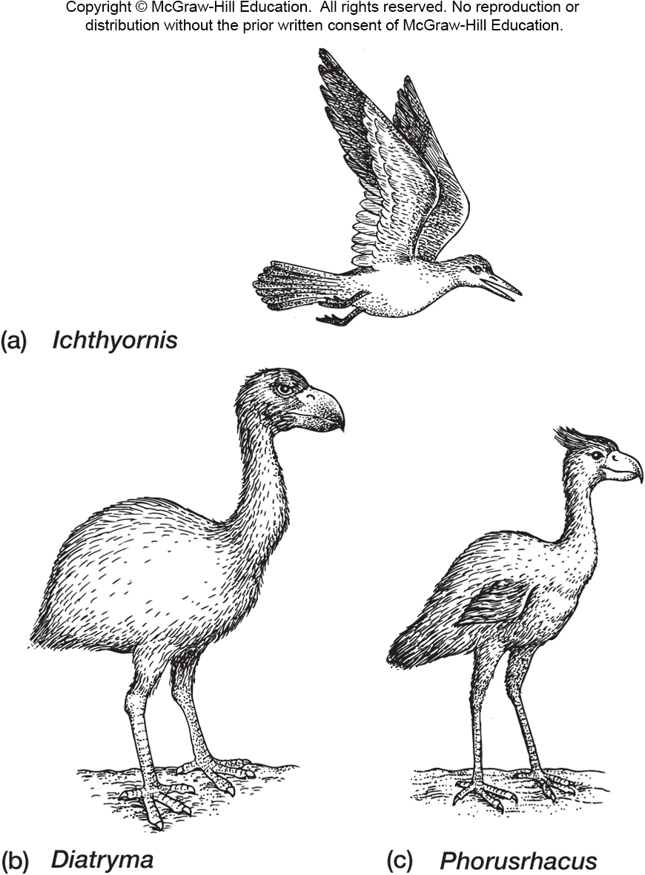
Theropoda

Slide 22
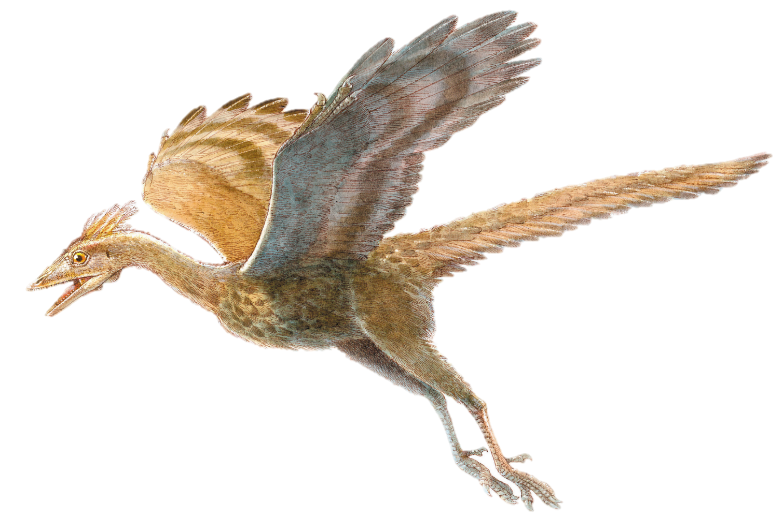
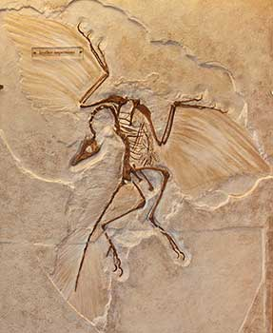
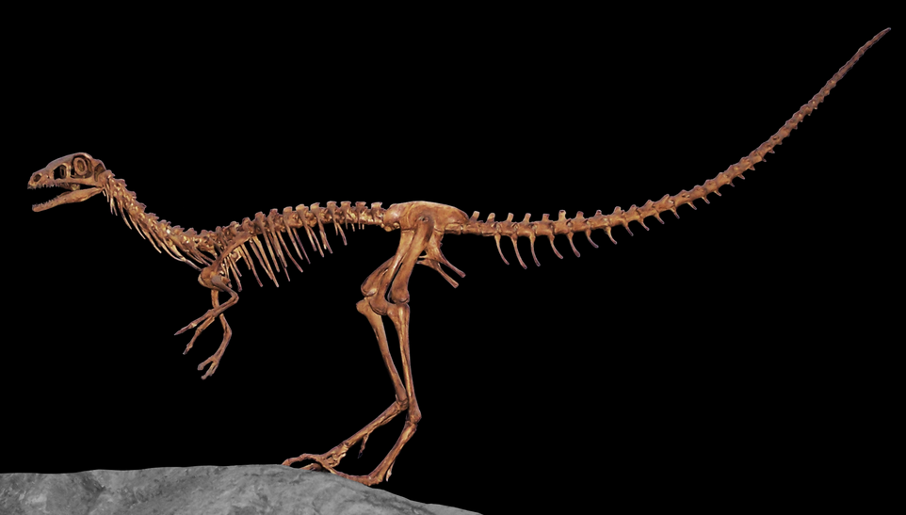
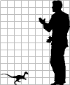
The Origin of Birds – The Great Transition
Compsognathus – 150 Ma – Europe
Archaeopteryx – 150 Ma – Europe

Slide 23
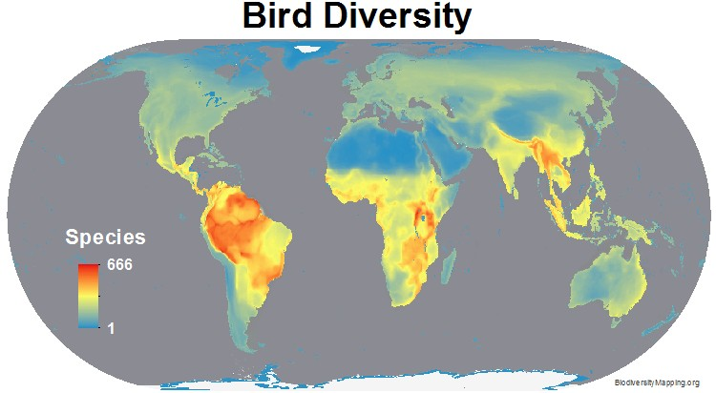
Modern Birds – roughly 10,000 living species
Distribution
Notes:
FEATHERS
AAAAAAAAAAAAAAAAAAAAH
Other
Stuff.
Big important transitional.

Slide 24
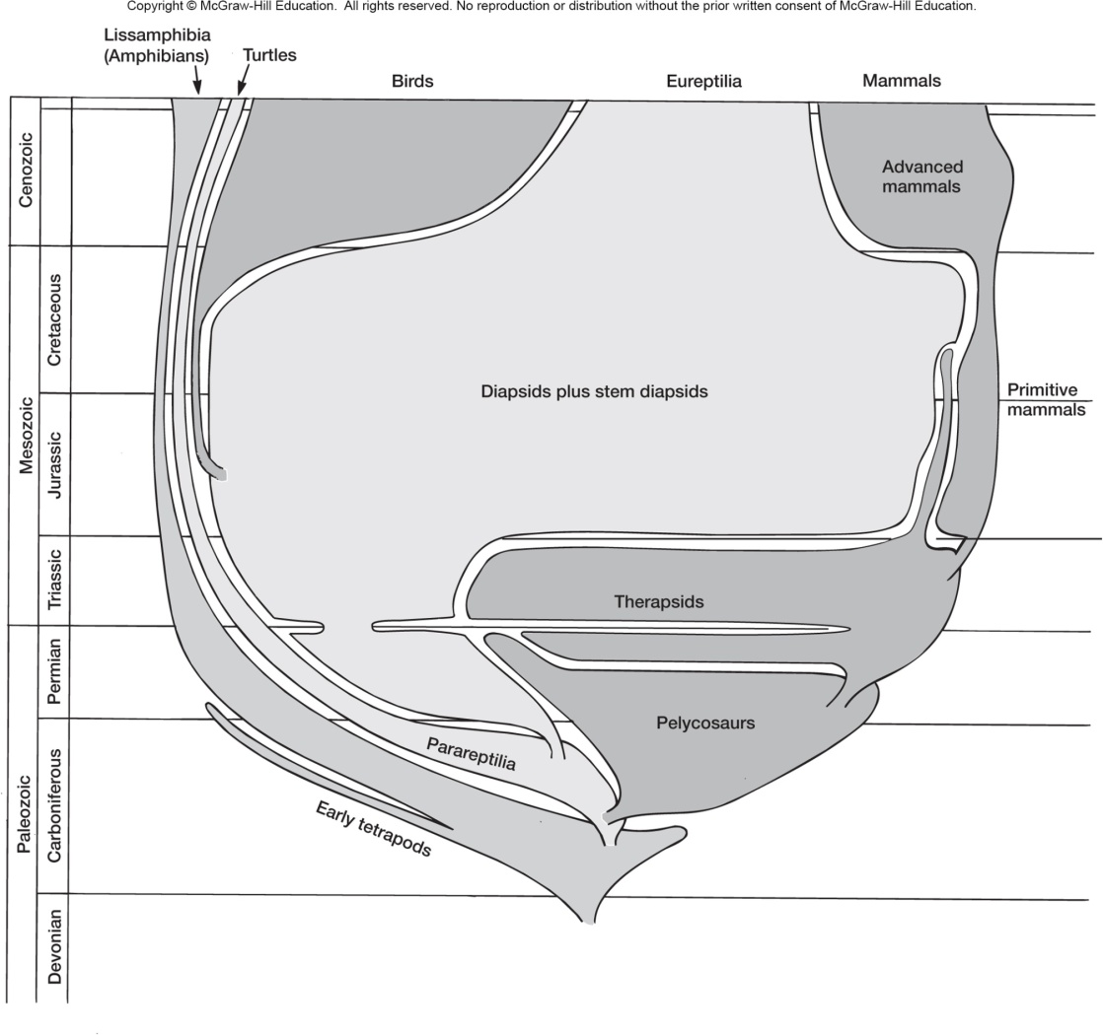
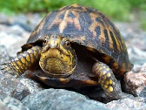

Slide 25
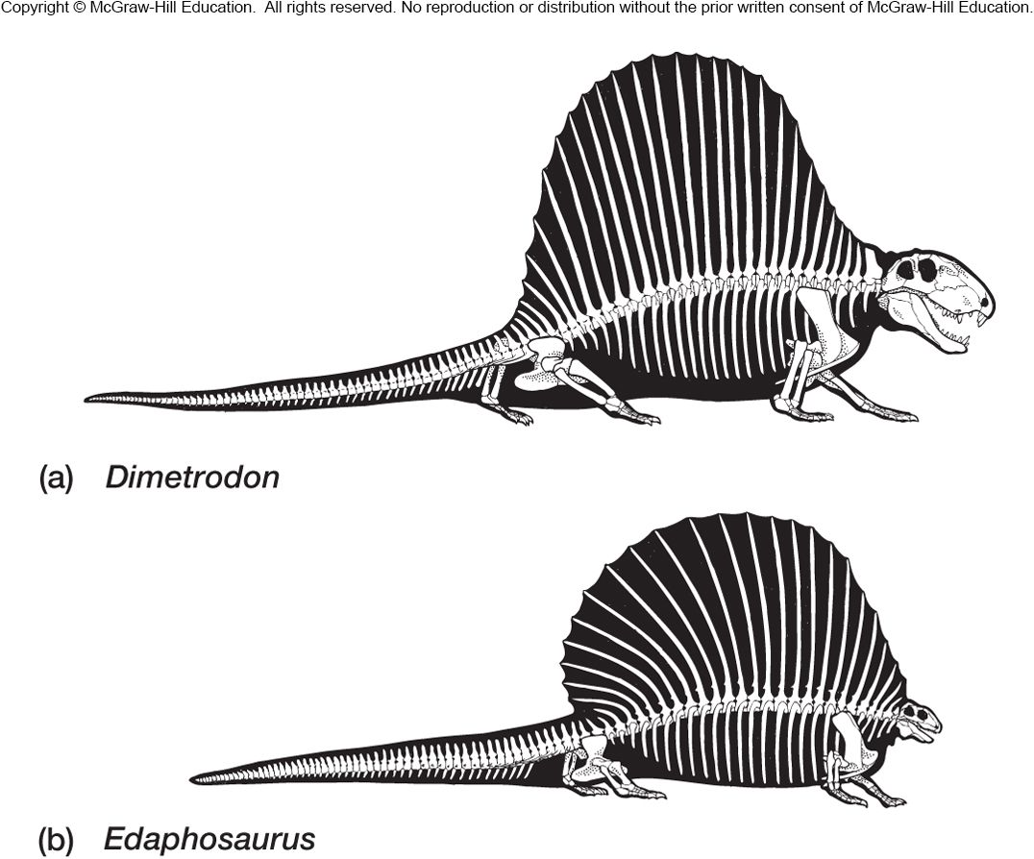
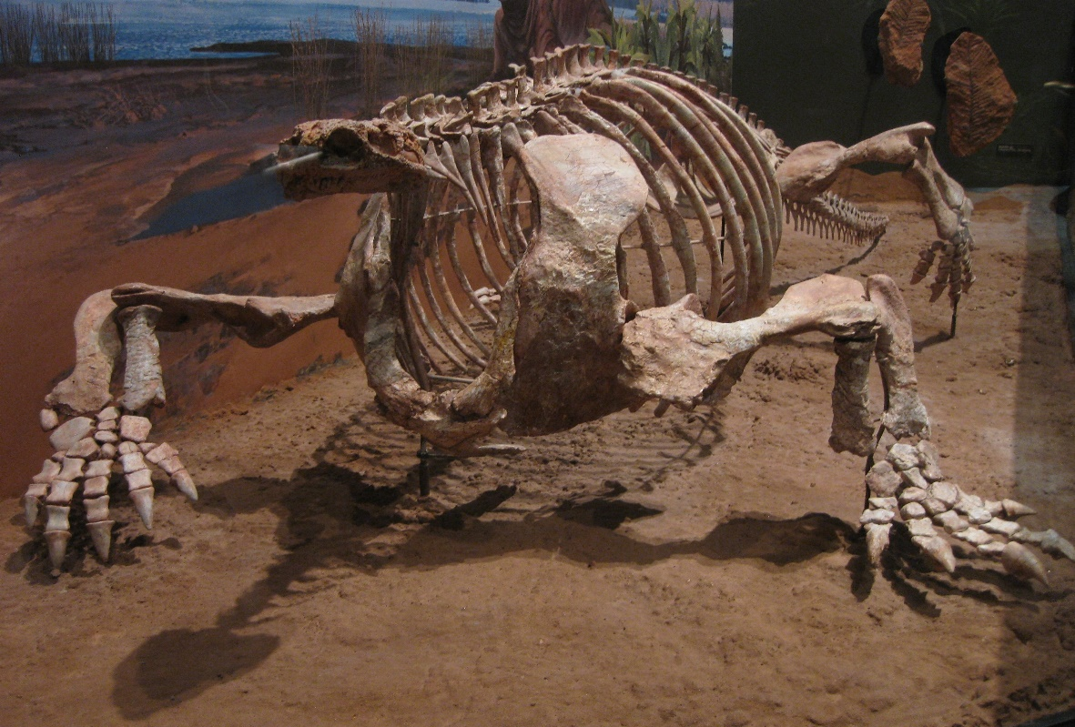
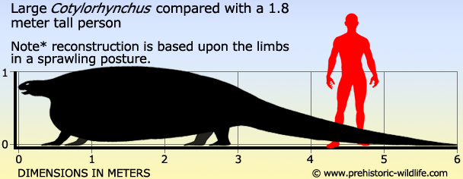
Permian Synapsids

Slide 27
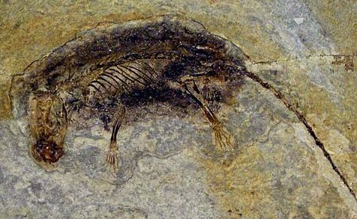
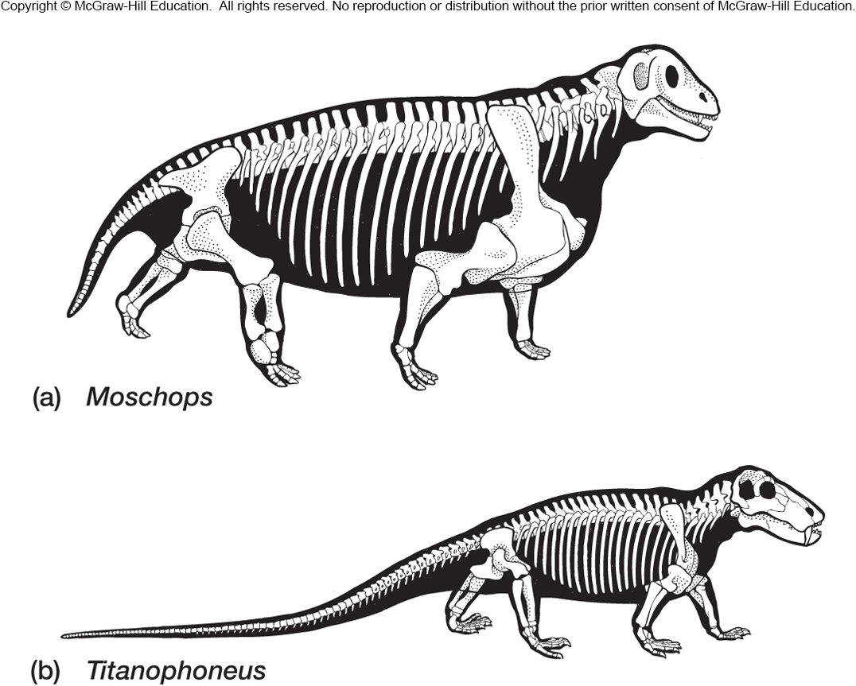
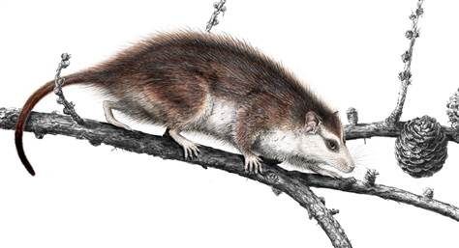
Mammals in the Mesozoic
Eomaia – 125 Ma – China
Triassic forms

Slide 28
Modern Mammals
Monotremes ~ 5 Species
Marsupials ~ 330 species

Slide 29
Placental Mammals, over 5,000 species

