Slide 1
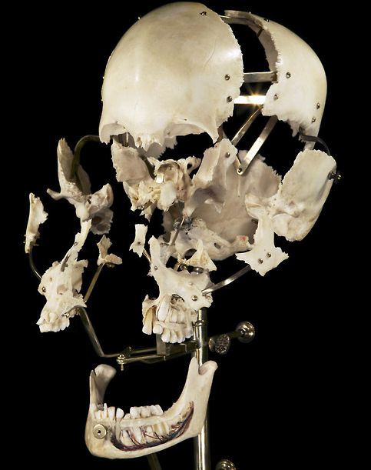
The Skull, Part one
BIOL 495 – Chapter Seven

Slide 2
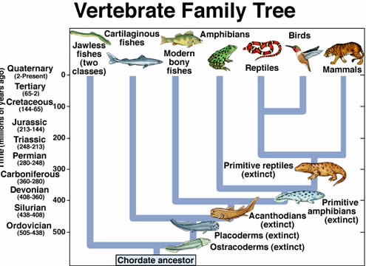

Slide 4
Parts of the Skull/Cranium
Dermatocranium

Slide 5
Parts of the Skull/Cranium
Chondrocranium
Splanchnocranium

Slide 6
Parts of the Skull/Cranium
Chondrocranium

Slide 7
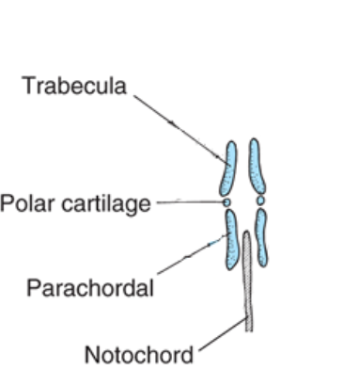
Chondrocranium
Ossifies in most vertebrates
Neural Crest Cells – Nasal capsule, trabeculae
Rest are condensations of head MESENCHYME*
*isolated areas of Mesoderm

Slide 8
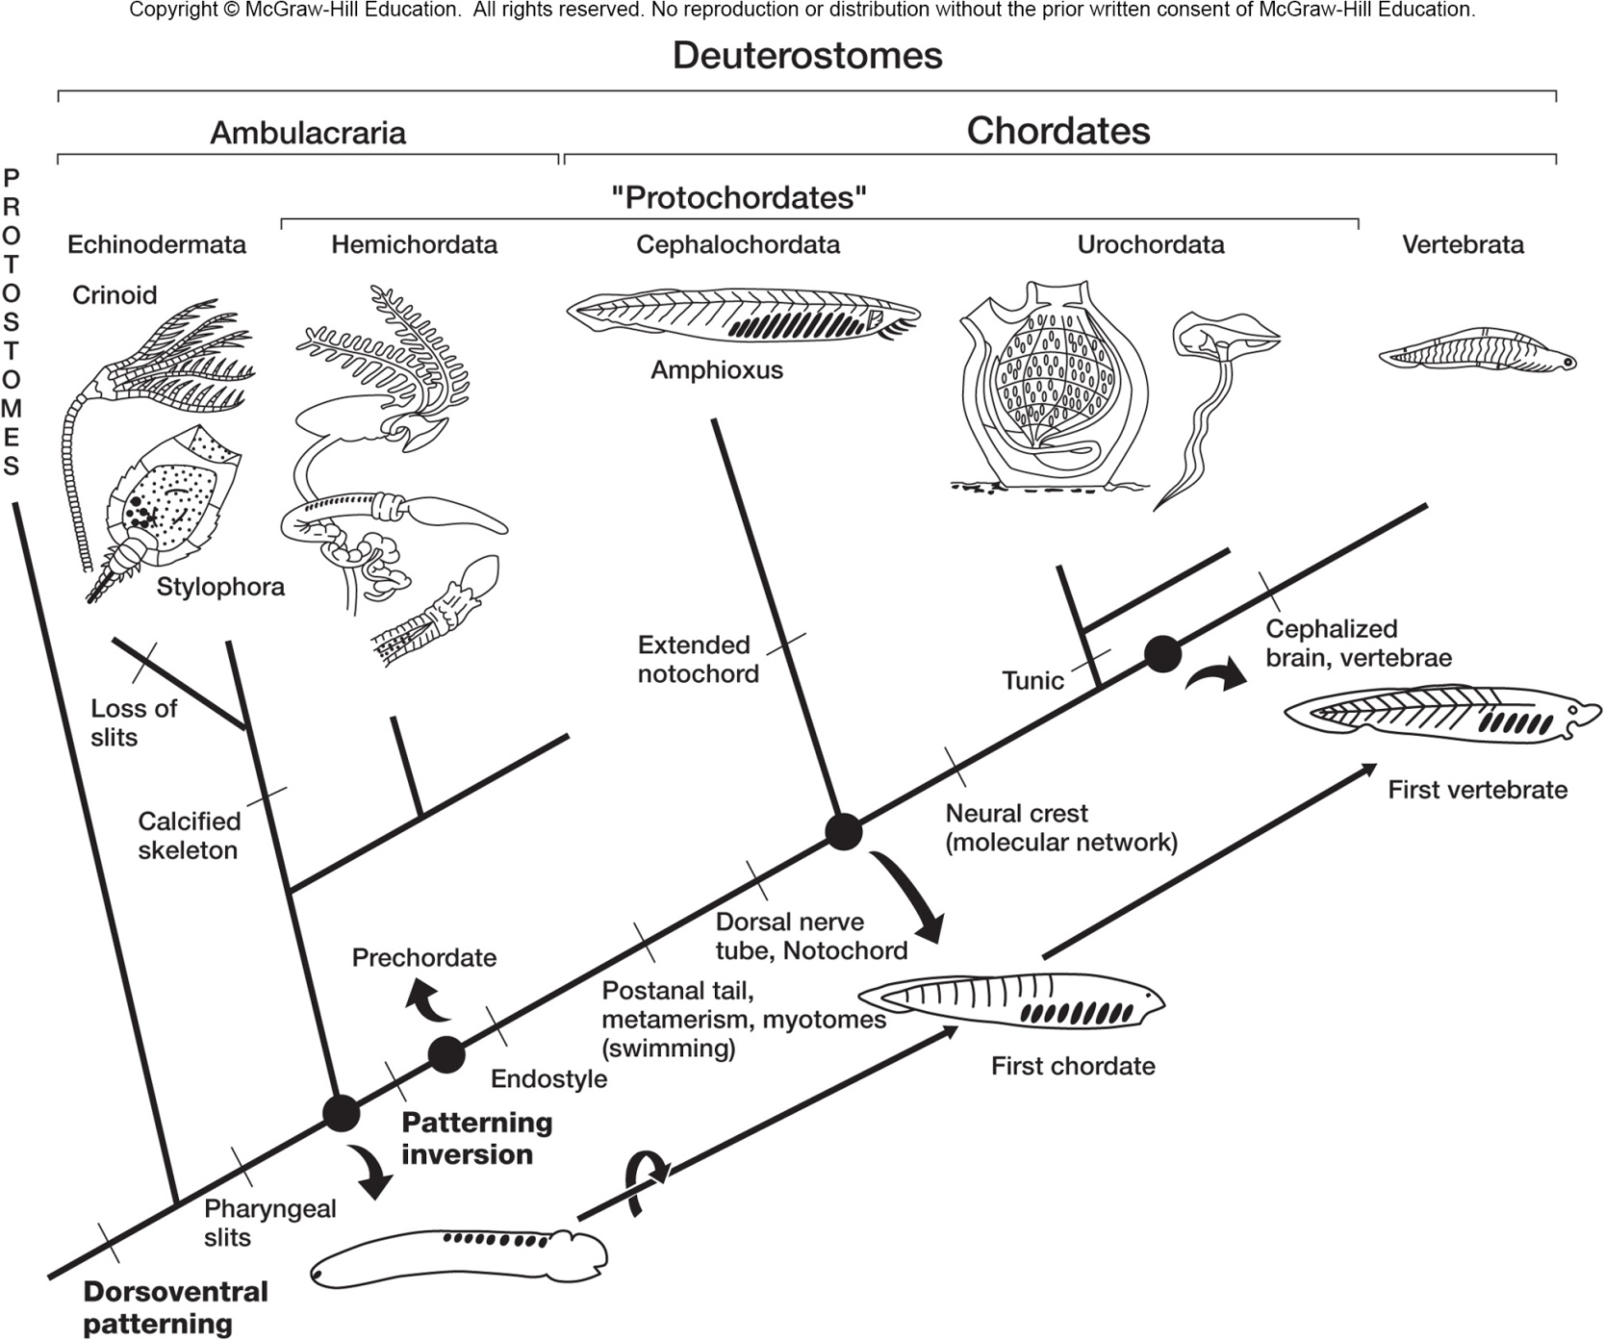
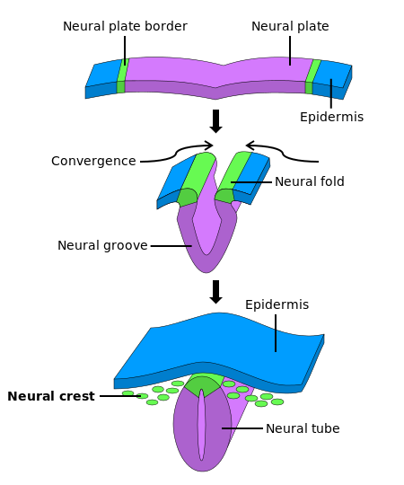
Neural Crest Cells?

Slide 9
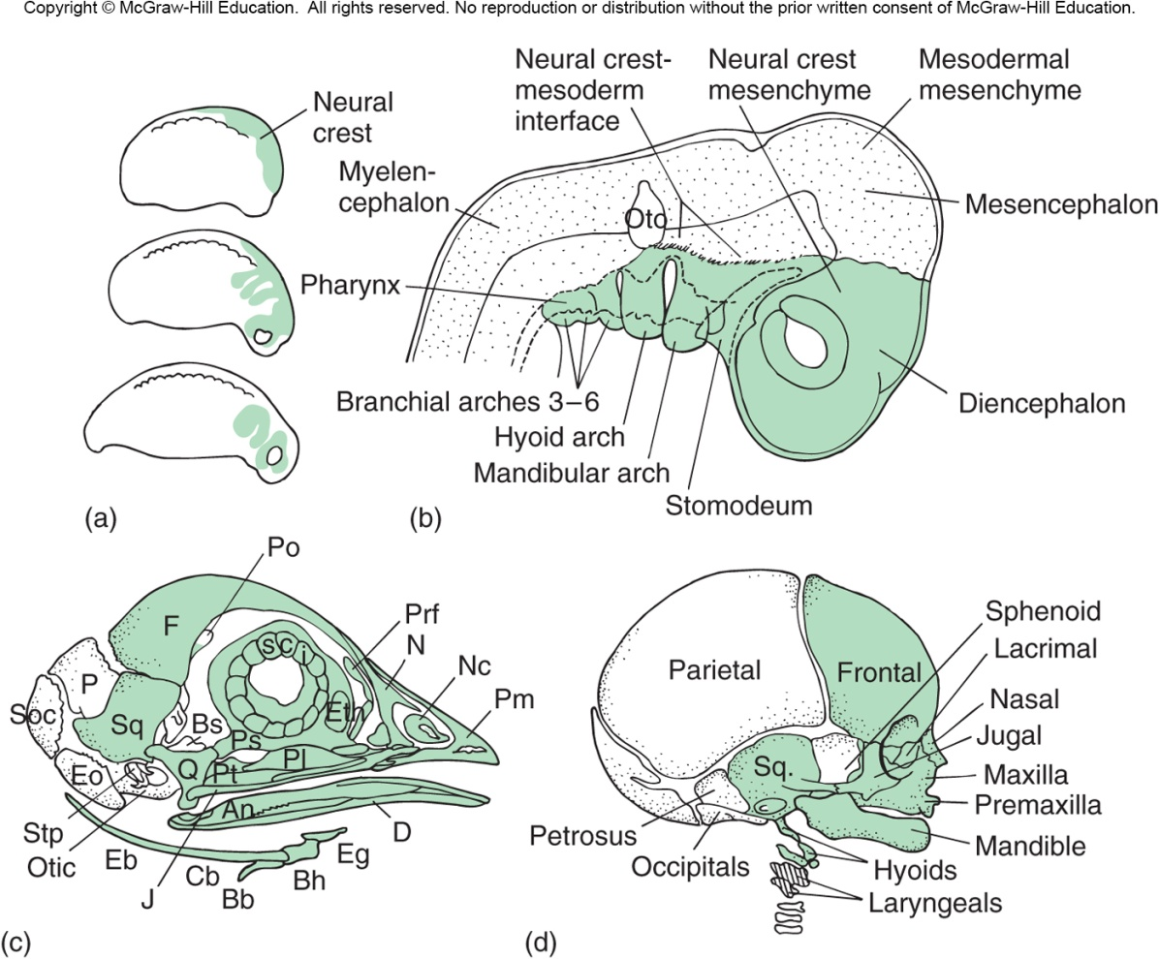
Neural Crest Cells in Cranium

Slide 10
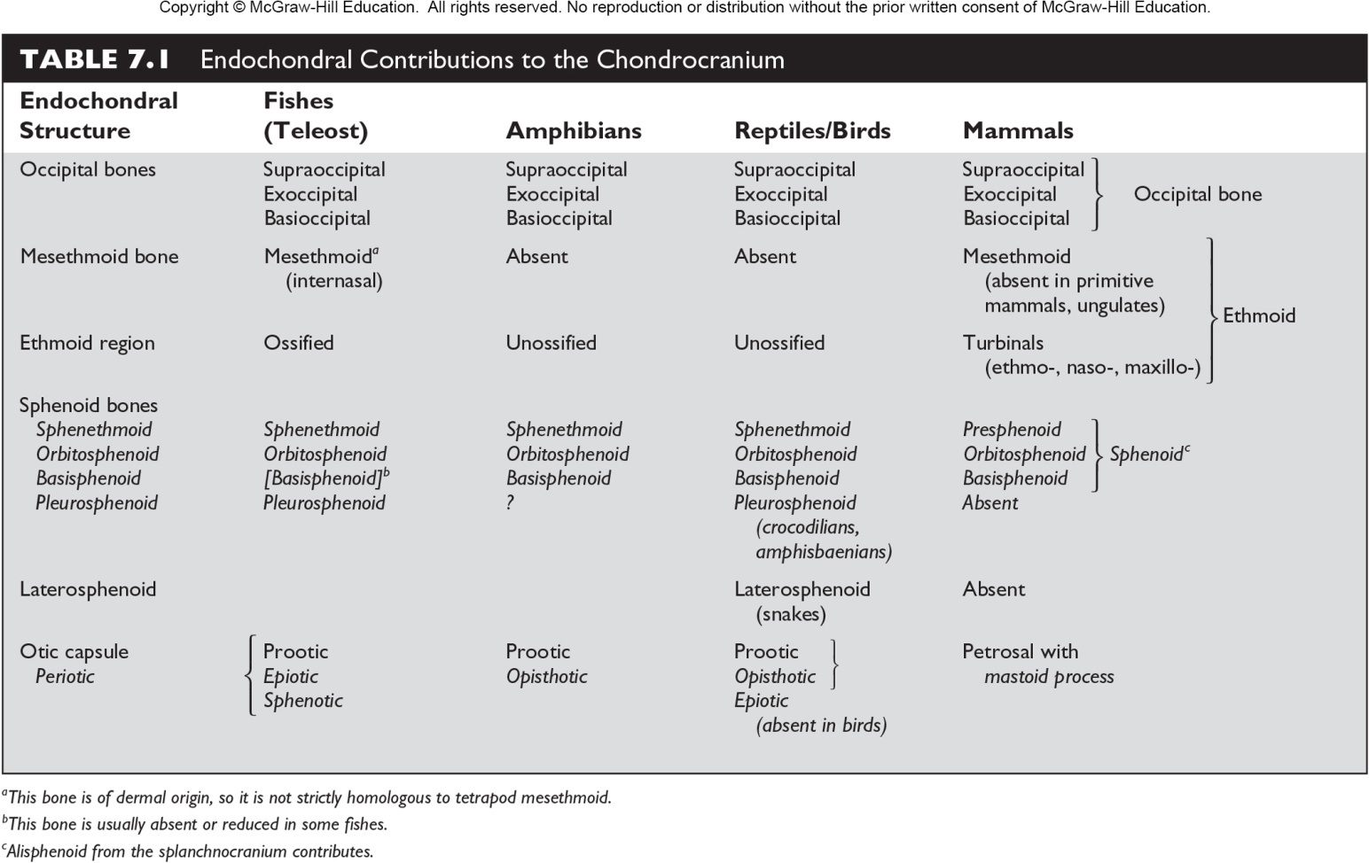

Slide 11
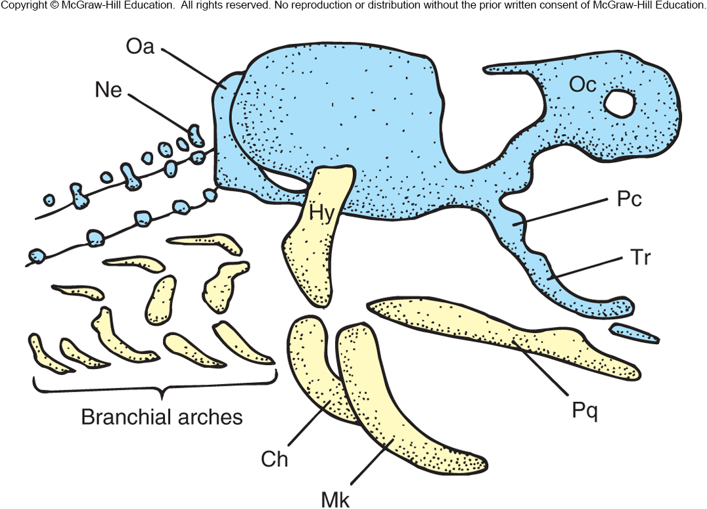
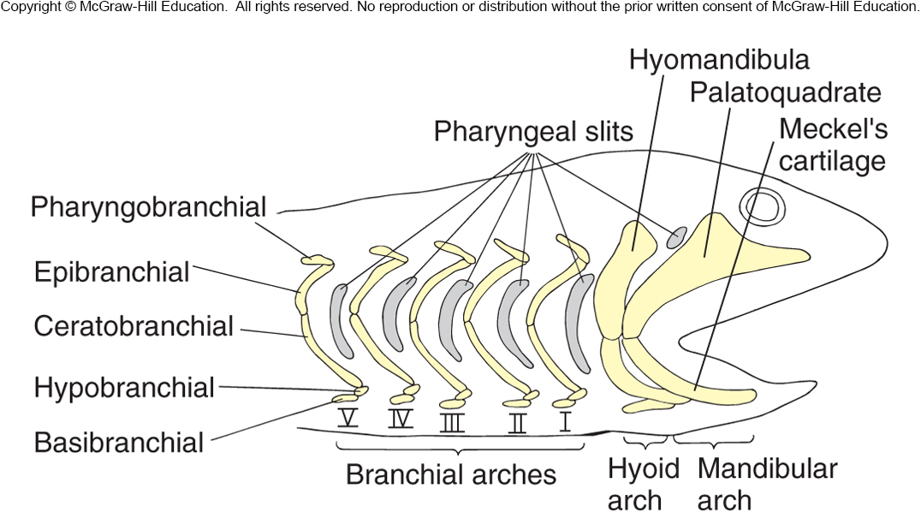
Splanochnocranium – Neural Crest Cells
Jaws from Branchial Arches
Embryology of Sharks
Spiracle (first reduced ‘gill silt’ of sharks)
Nerve and blood vessel distribution
Musculature similarities

Slide 12
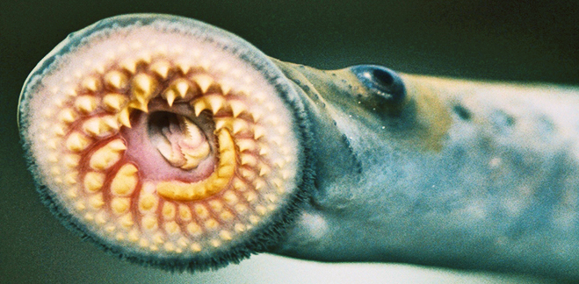
Origin of Jaws
Serial Theory
Composite Theory

Slide 13
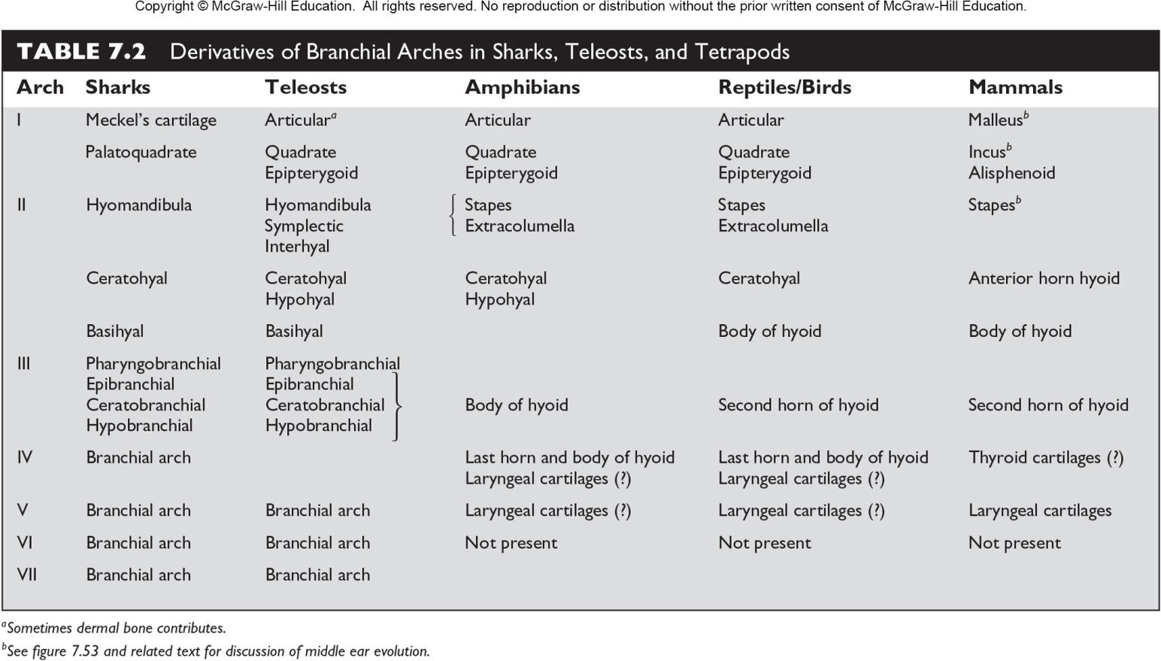

Slide 14
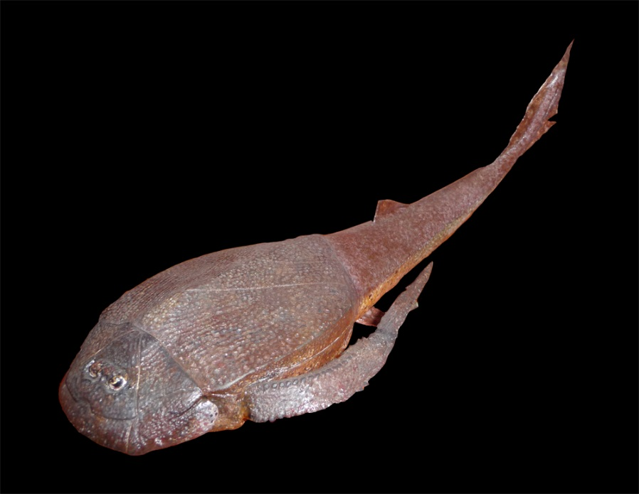
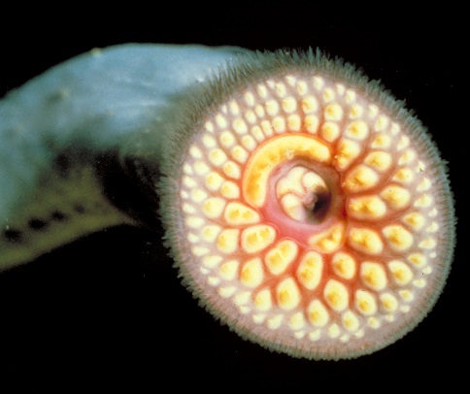
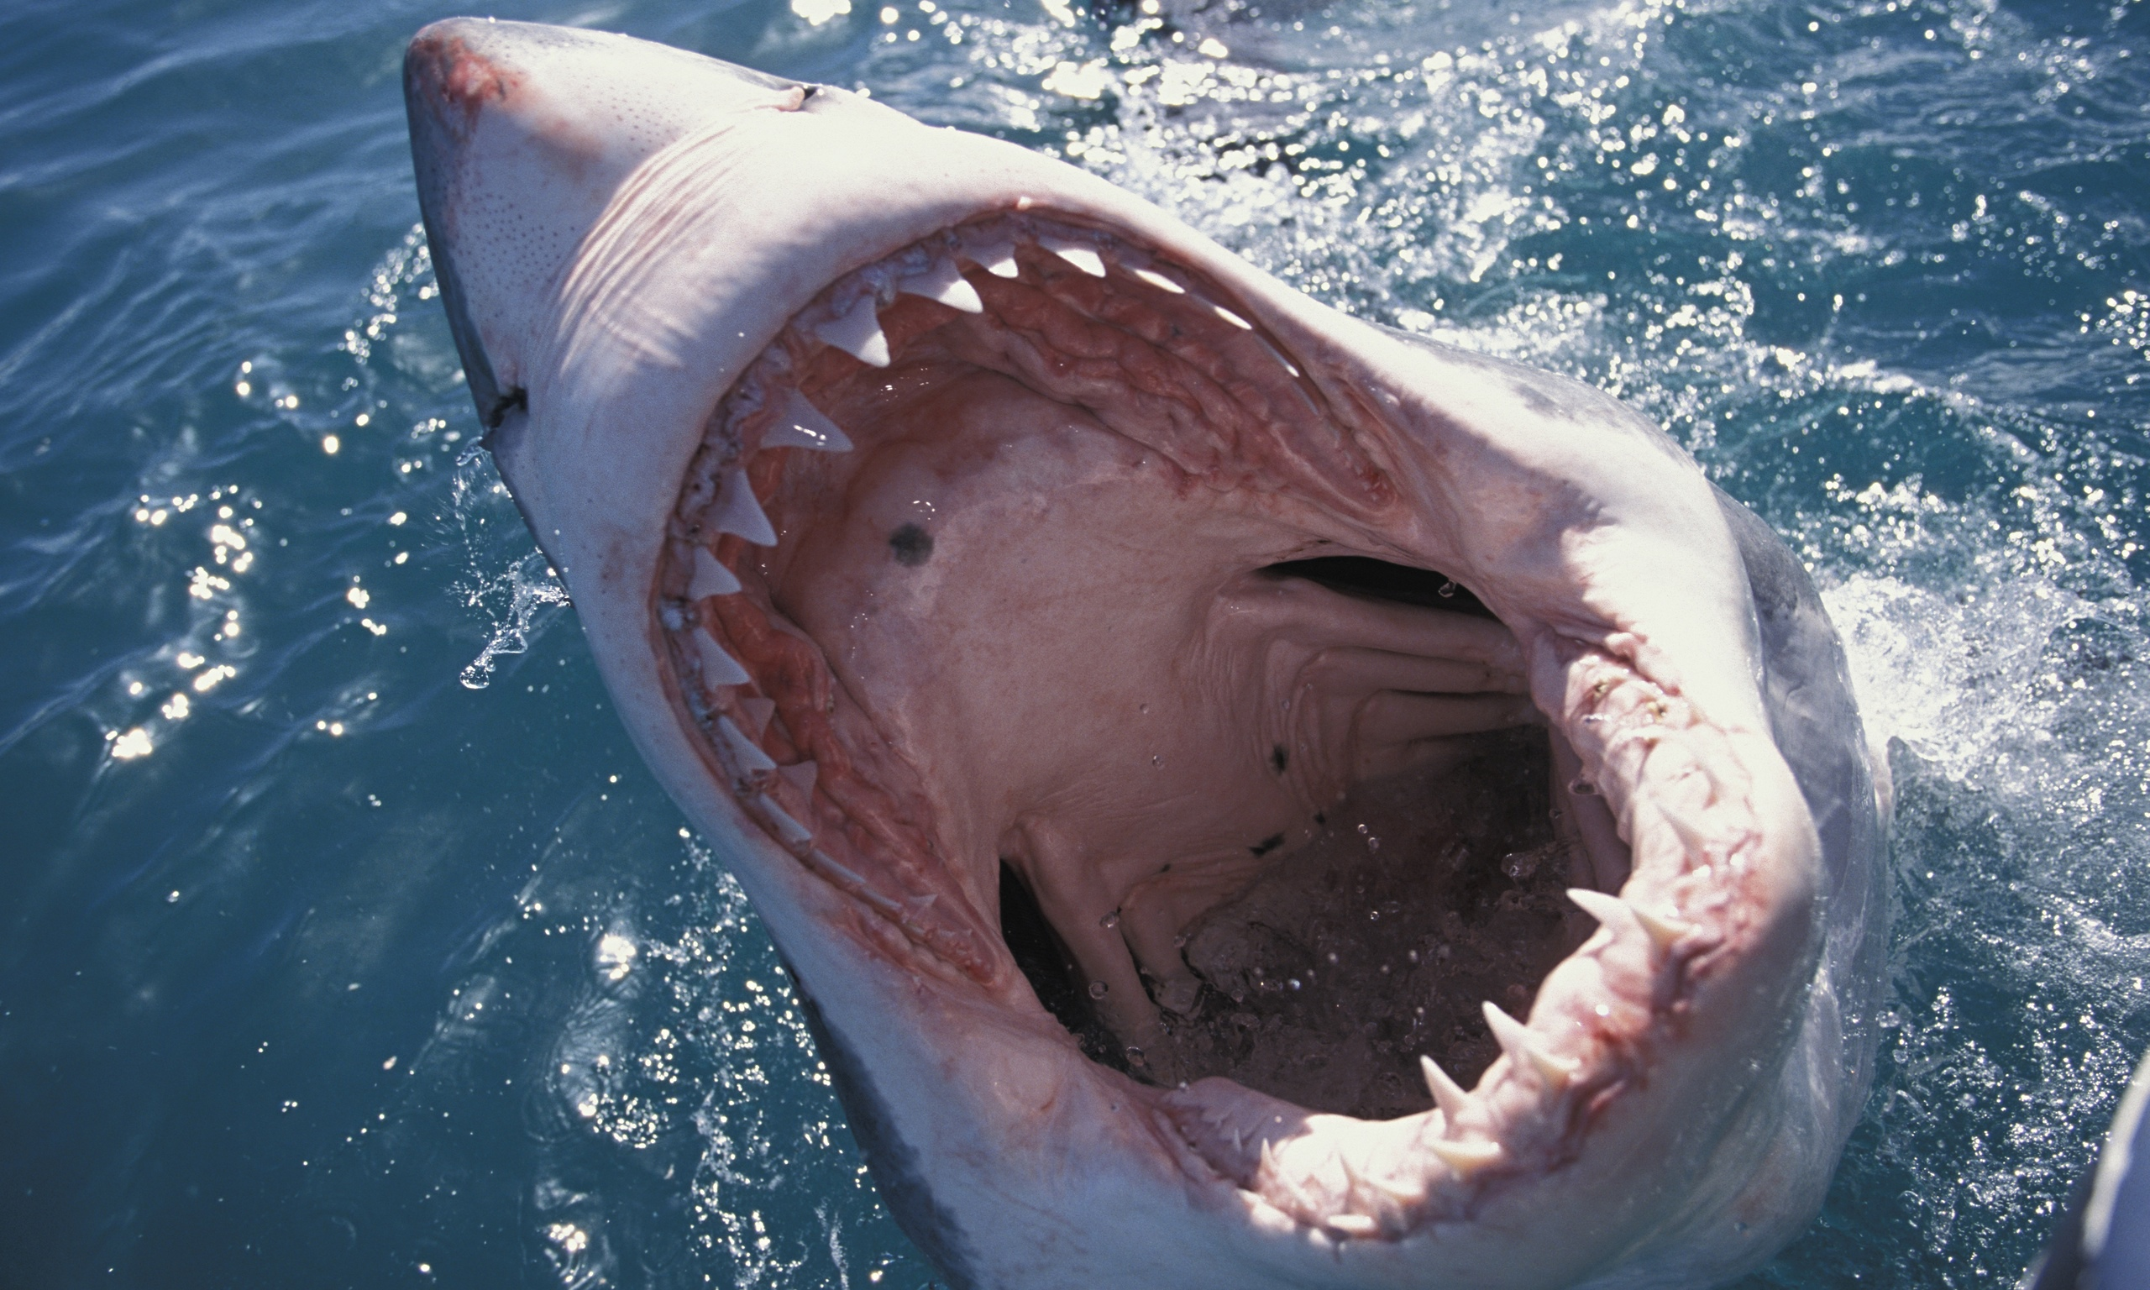
So we have jaws. Now what?
Suspensorium –Attachment types
No arch directly attaches to the skull
Mandibular arch itself is suspended from the skull - alone
Two primary articulations
Anteriorly Palatoquadrate to skull
Posteriorly by part of the hyoid

Slide 15
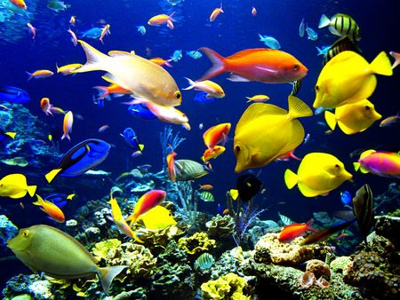
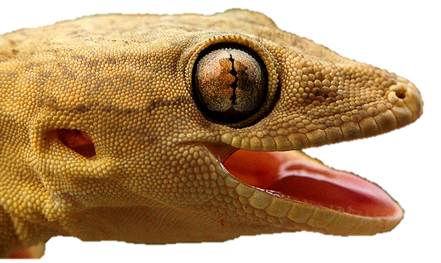
Hyomandibula primary articulation
Attached though quadrate – posterior of palatoquadrate
Hyomandibular is now the stapes
Hyoid Apparatus is formed from rest of Hyoid Arch

Slide 16
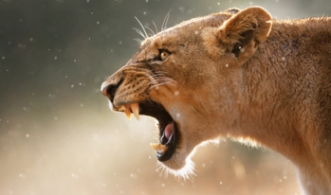
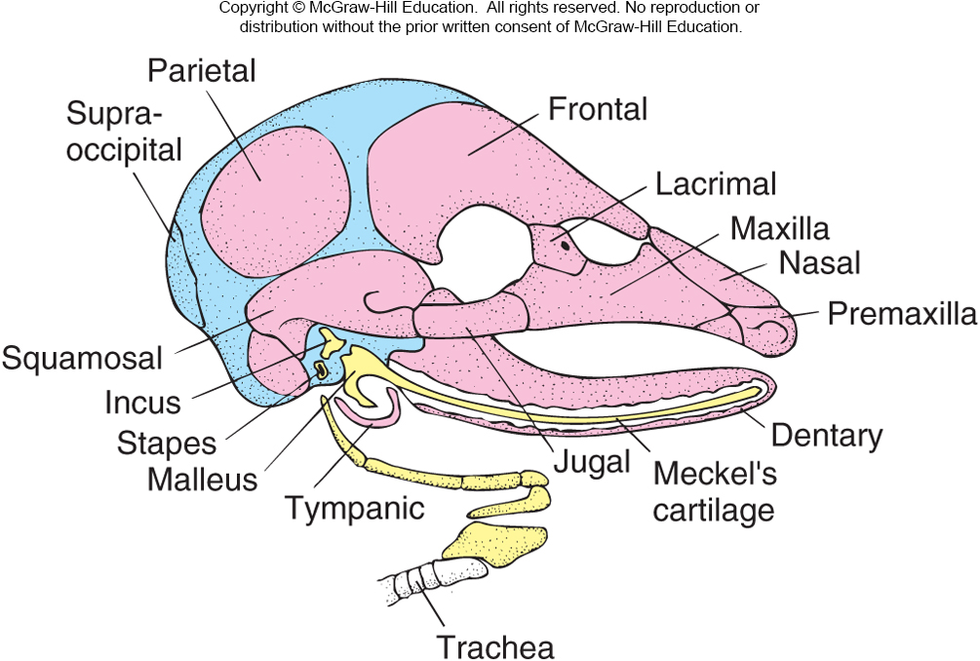
Entire upper jaw is incorporated into the braincase
Lower jaw suspended from Squamosal part of temporal

Slide 17
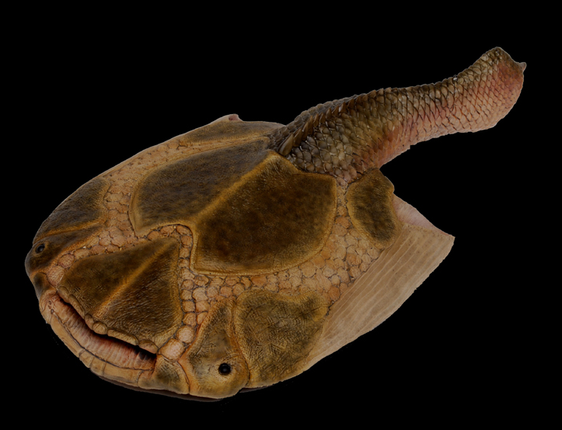
Dermatocranium
Completes Braincase
Lines Mouth
Encases Splanchonocranium
Teeth most often on these bones

Slide 18
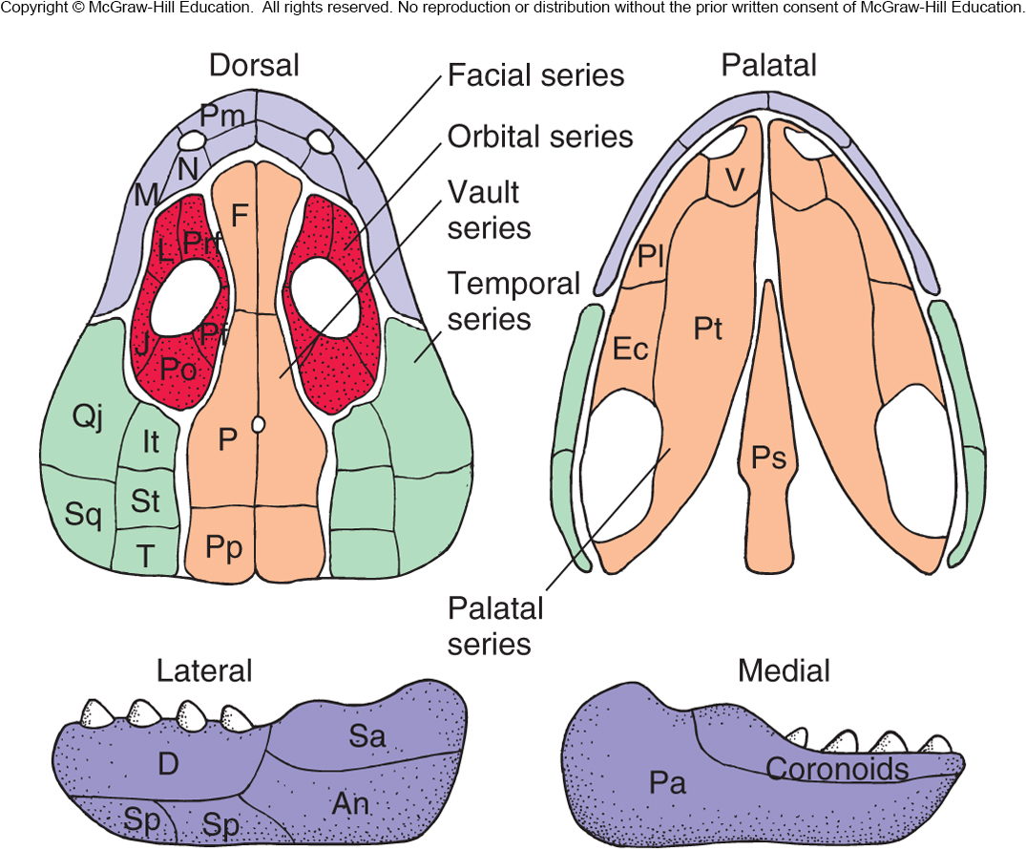
Dermal Bone Series

Slide 19
Skull Overview/Review
Braincase
Jaws
Hyoid

Slide 20
Cranial Kinesis
Mammals, amphibians – modern, turtles, and crocodiles
Everything else – fishes, most reptiles, birds, and therapsid mammals ancestors

Slide 21
