Slide 1
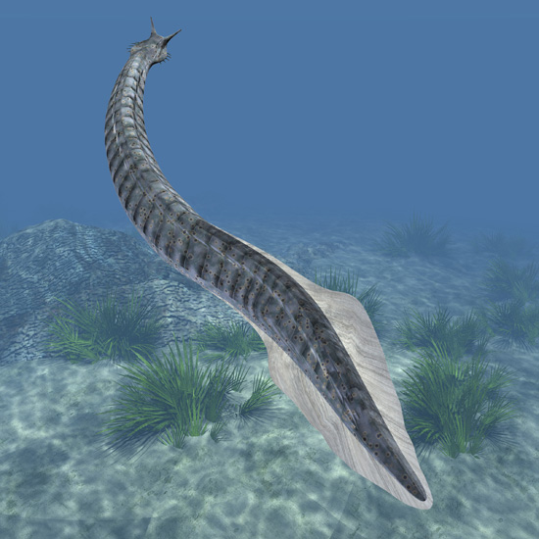
Origin of Chordates
BIOL 495 – Chapter Two

Slide 2
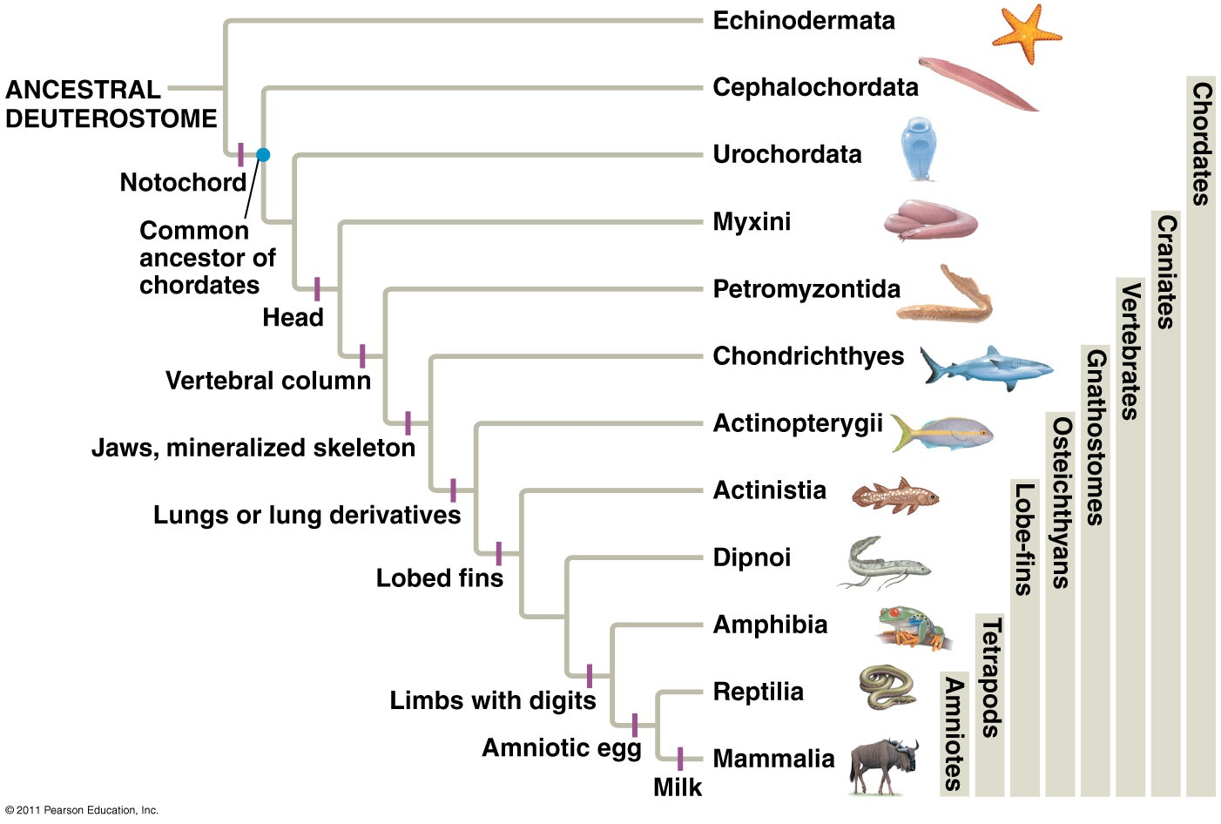
Comparative
Vertebrate
Anatomy

Slide 3
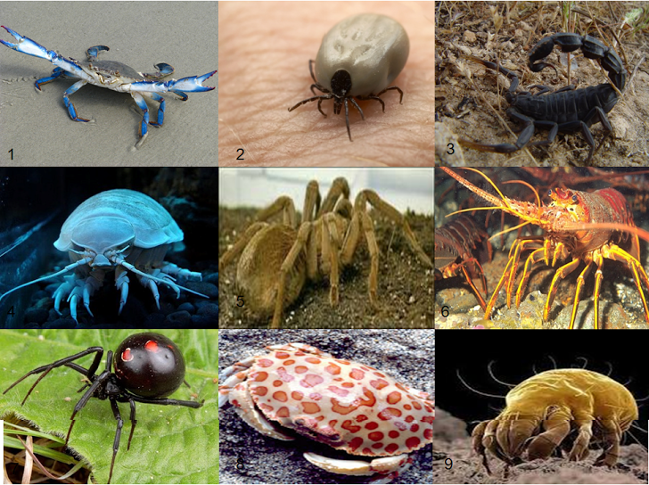
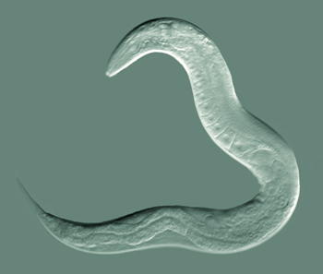
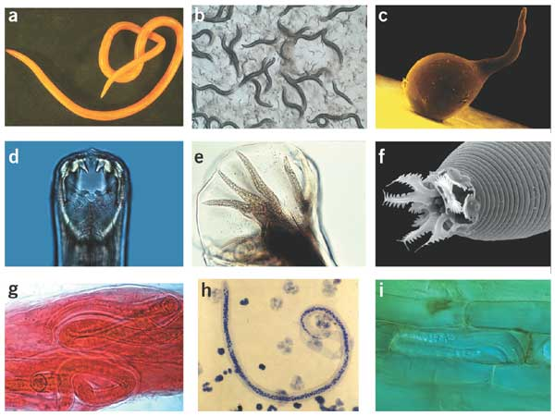
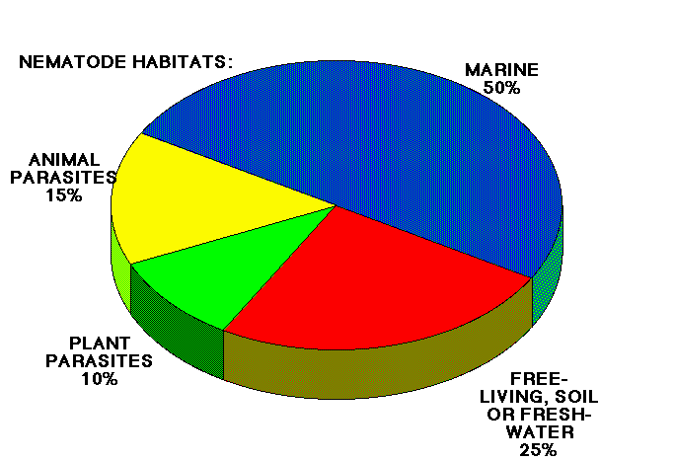
Abundance of Phyla
#1 – Arthropoda
#2 – Nematoda

Slide 4
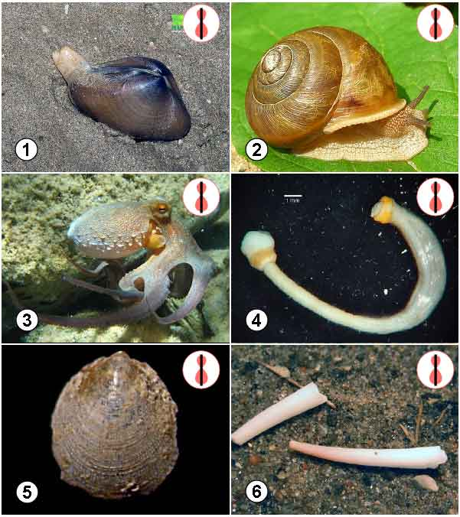
#3 – Mollusca
#4 – Chordata

Slide 5
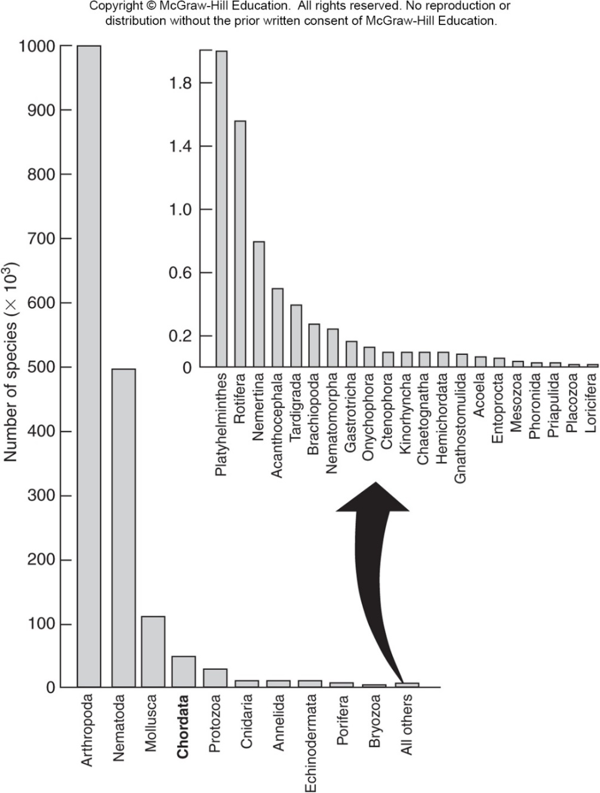
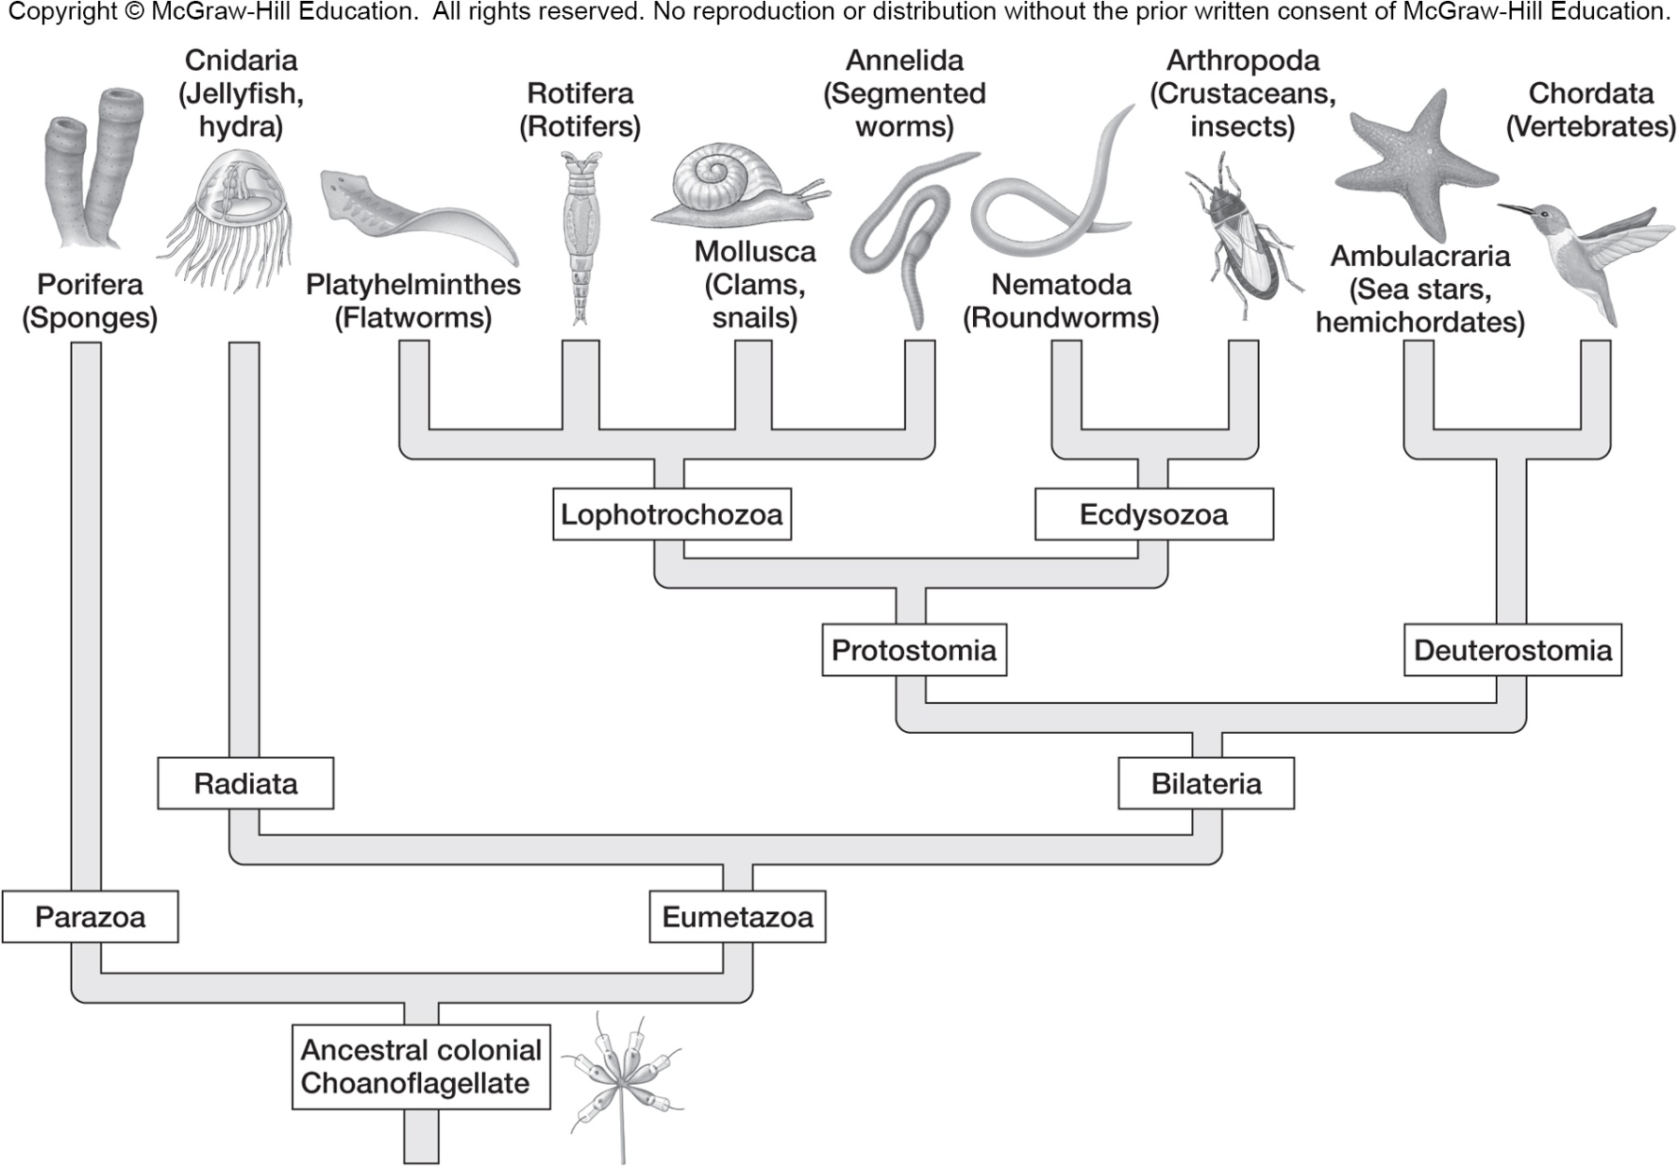
Relative abundance of species in phyla

Slide 6
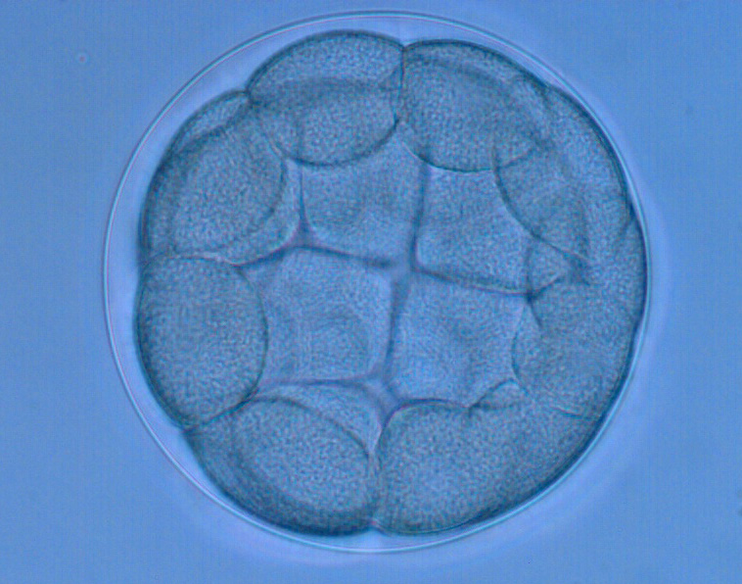
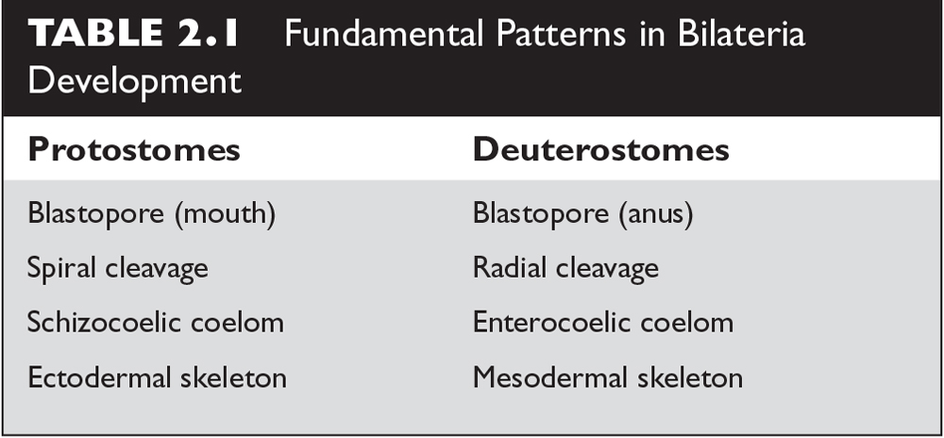
Protostomes vs Deuterostomes
Protostome Deutersotome
Cleavage
Coelom
origin
Blastopore
fate

Slide 7
Chordate Features
Notochord*
Pharyngeal Slits
Endostyle or Thyroid Gland*
Dorsal Hollow Nerve Cord*
Postanal Tail*
Notes:
Chalk board!

Slide 8
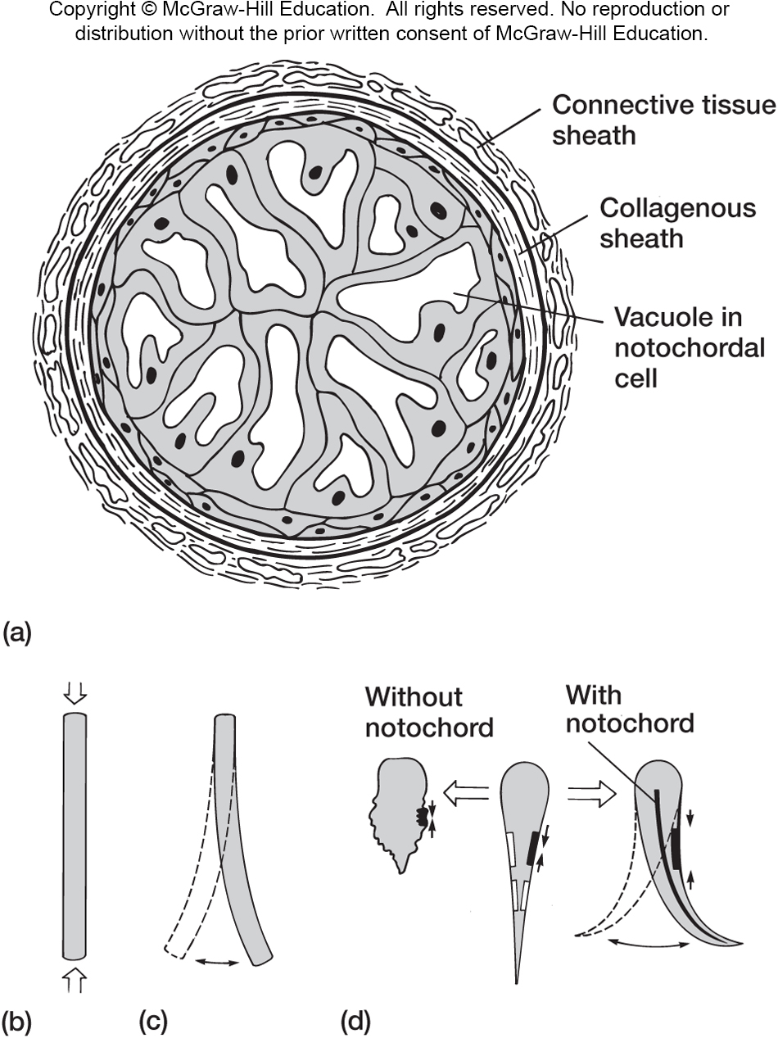
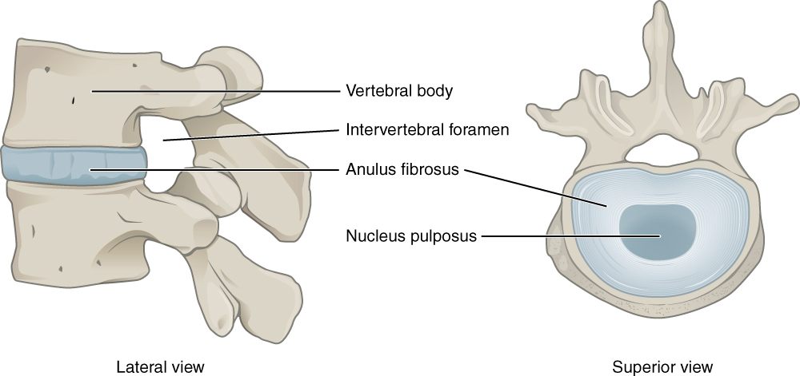
Notochord

Slide 9
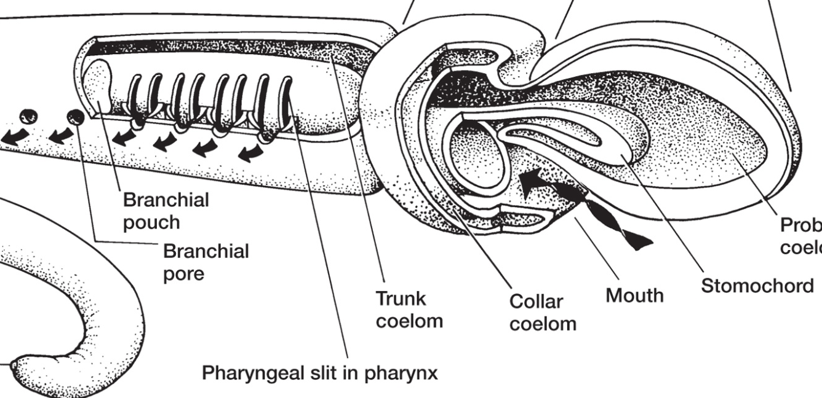
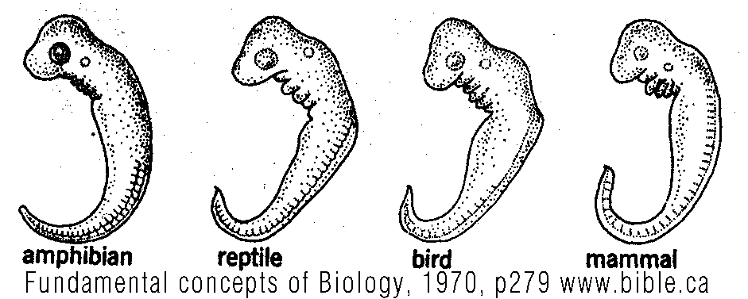
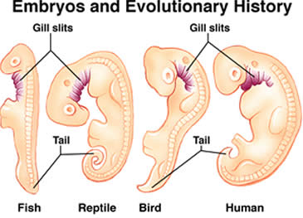
Pharyngeal Slits
NOT really ‘gill slits’
Pharynx – part of digestive track immediately posterior to mouth

Slide 10
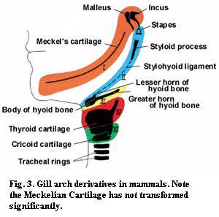

Slide 11
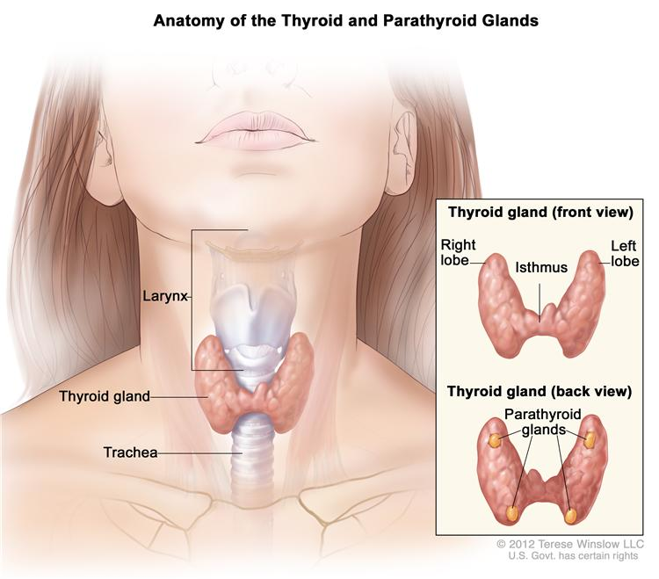
Endostyle or Thyroid Gland
Endostyle – part of the filter feeding apparatus
Thyroid gland – hormone producing endocrine gland
Evidence for Homology:
Arise embryological from the same tissue (floor of the pharynx)
Are involve with iodine metabolism
Endostyle → Thyroid Gland in Lampreys

Slide 12
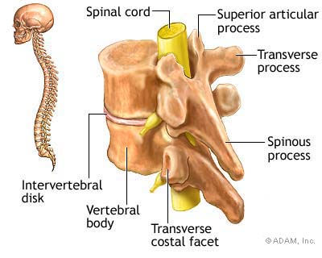
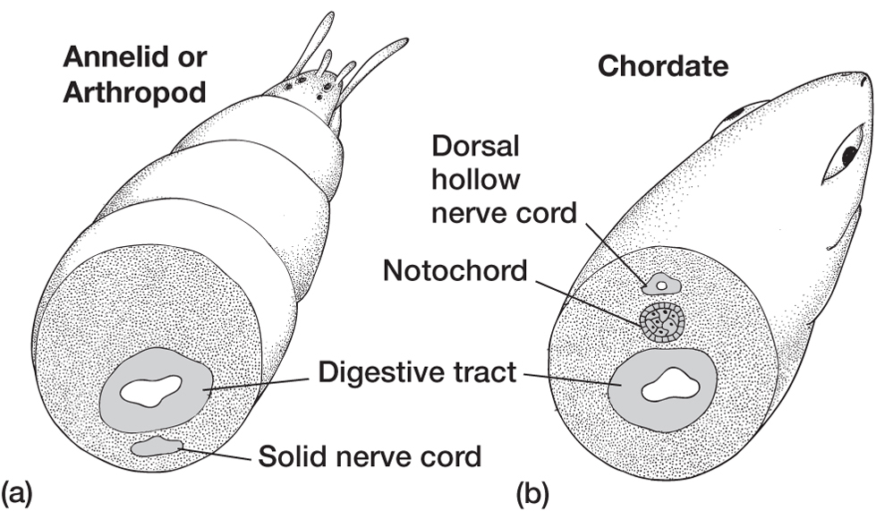
Dorsal Hollow Nerve Chord

Slide 13
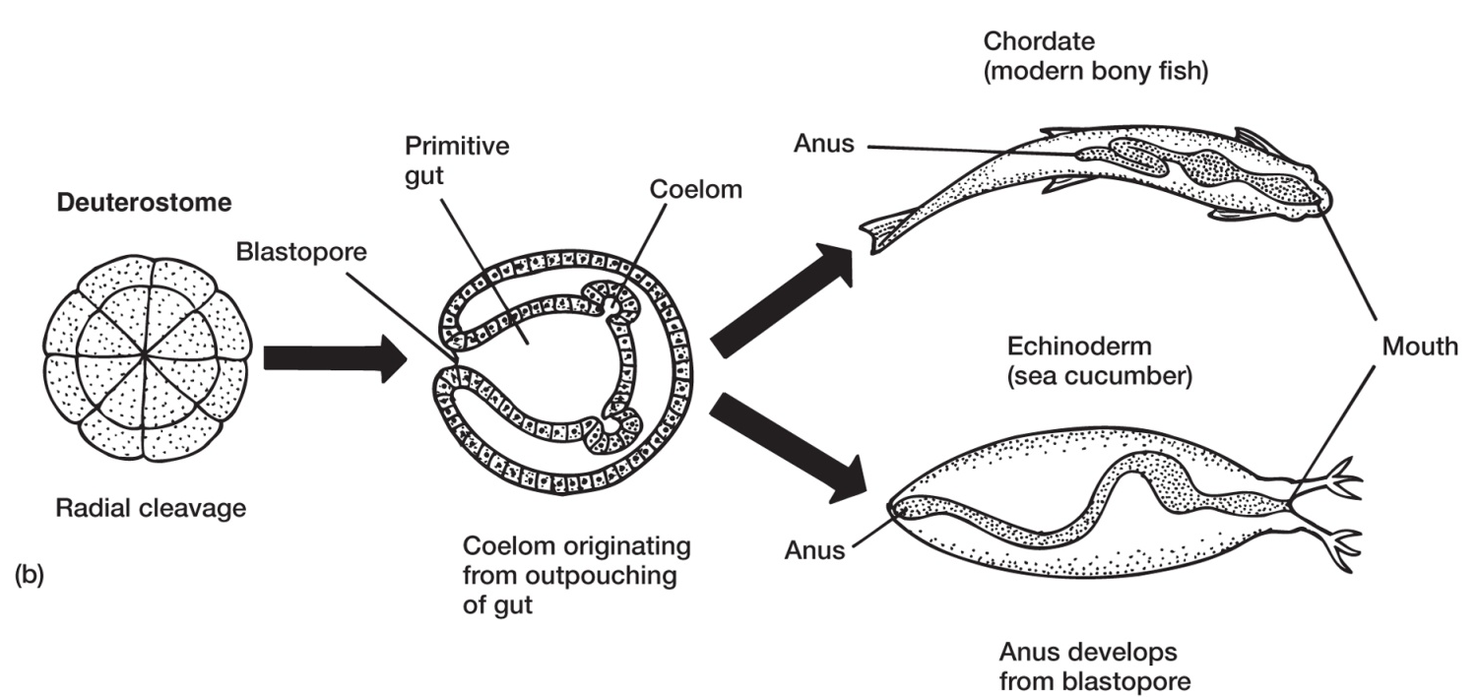
Postanal Tail

Slide 14
“Protochordates”
‘grouped’ mainly by primitive features
pelagic larva
benthic adults (many sessile)
Myomeres
Segmented blocks of muscle – outer body wall

Slide 15
Hemichordata – Acorn Worms

Slide 16
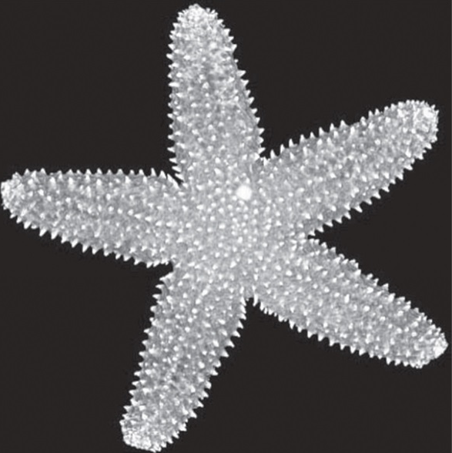
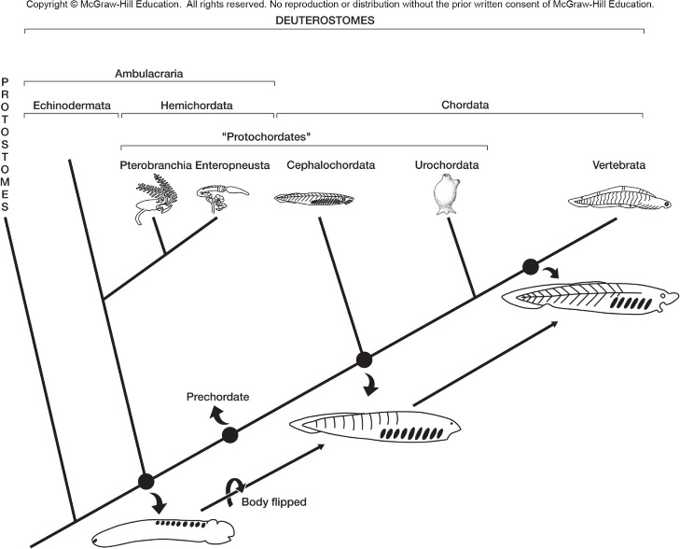
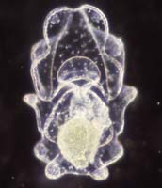
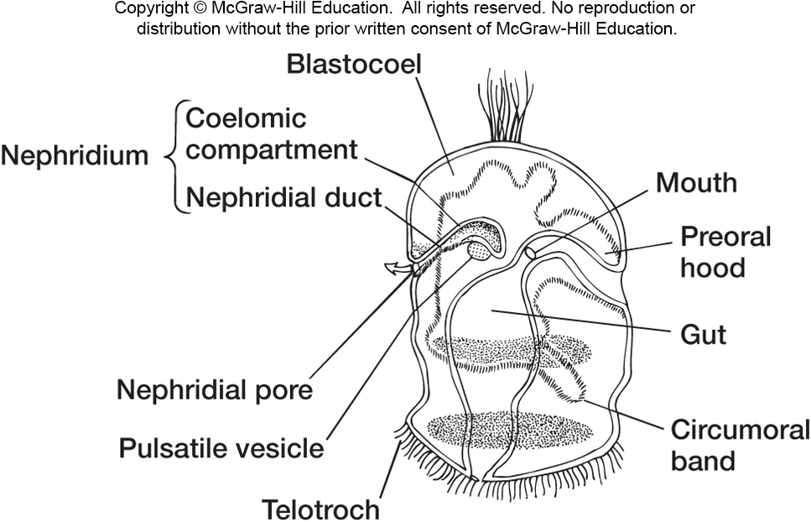
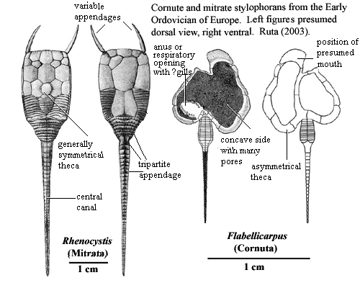
Hemichordata – Relationships?
Hemichordata Larva
Echinoderm Larva

Slide 18
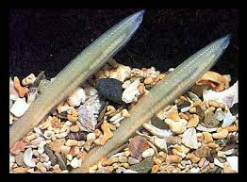
Cephalochordata – Amphioxus
No anterior swelling of dorsal nerve cord
Midgut cecum’s evolutionary fate?
Liver or pancreas perhaps
Notes:
Anatomy, diff from acorn worms!
Diff from us? High light stuff that will be diff from tunicates
Ecology – world wide, all over, live buried. Filter feeders.

Slide 19
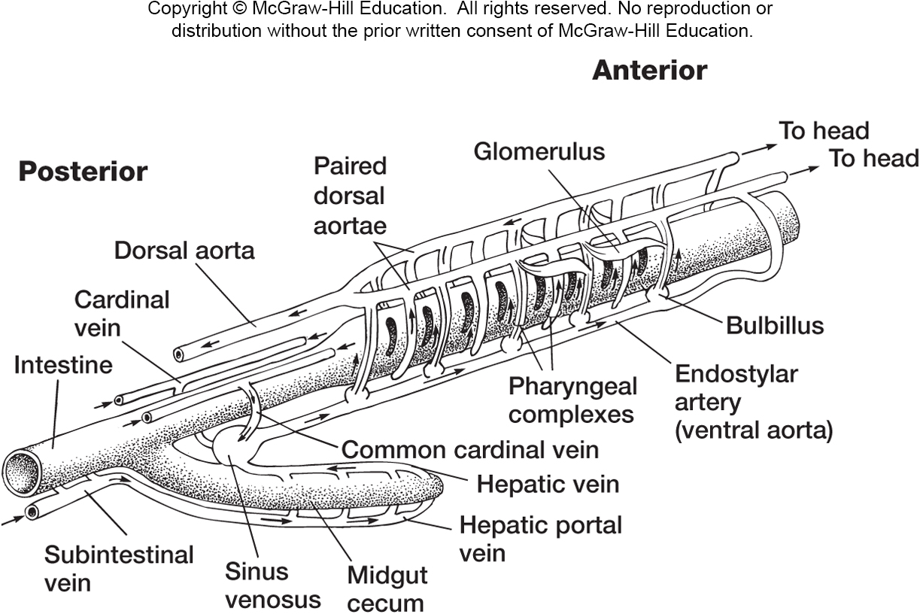
Blood is colorless plasma
Same general circulation pattern as vertebrates: blood flows anteriorly into the ventral aorta, up to the dorsal aorta, posteriorly in the dorsal aorta.
No ebb and flow pattern, even though they lack a heart

Slide 21
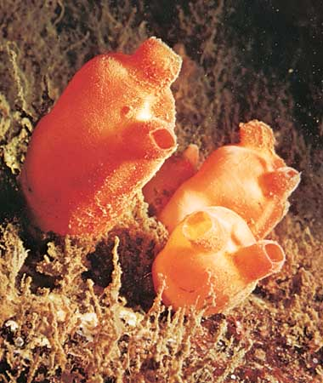
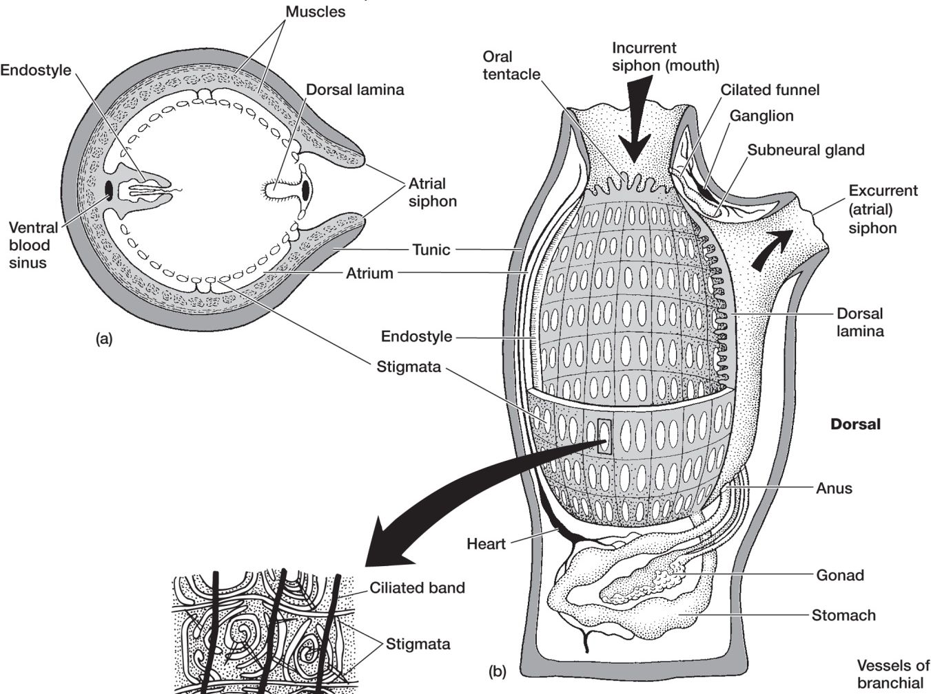
Urochordata – Tunicates/Sea Squirts
Notes:
Ecology as well

Slide 22
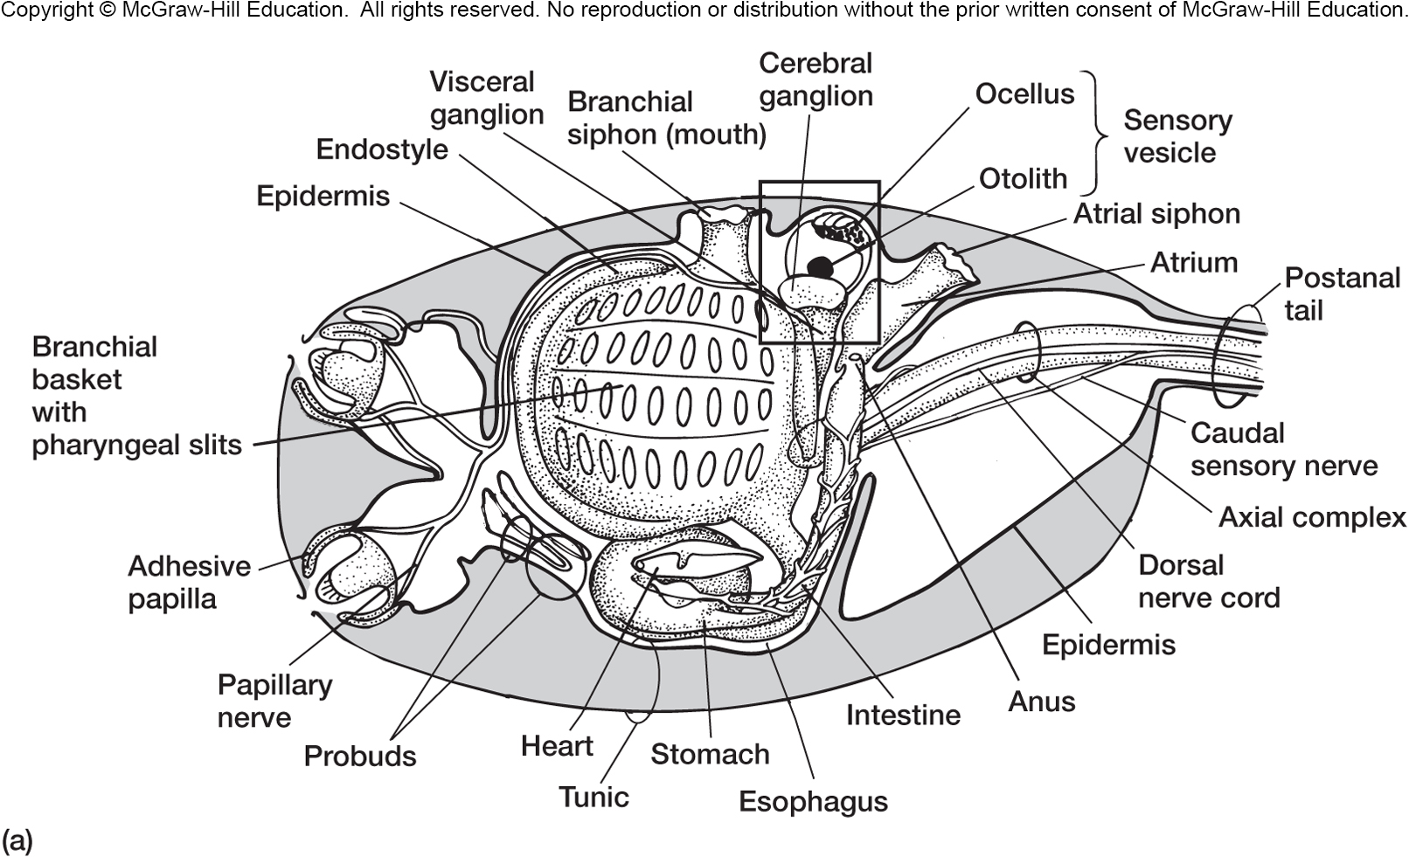

Slide 23
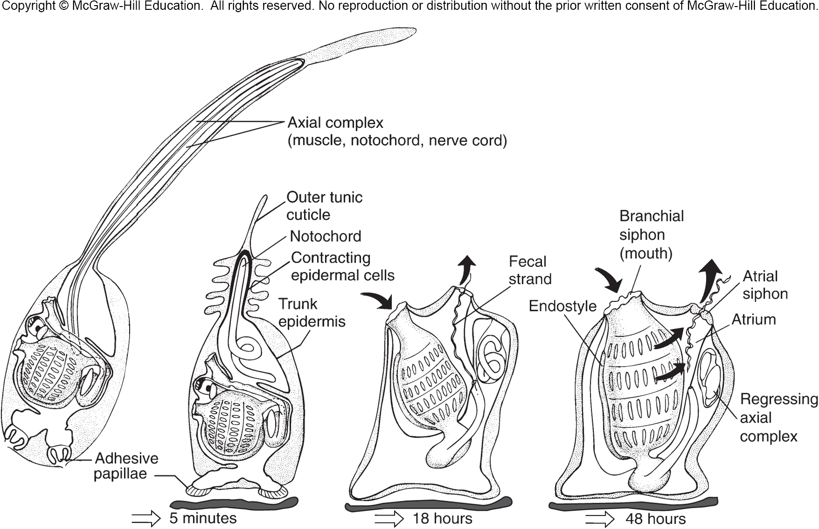

Slide 24
Has identifiable heart and rudimentary ‘brain’

Slide 25
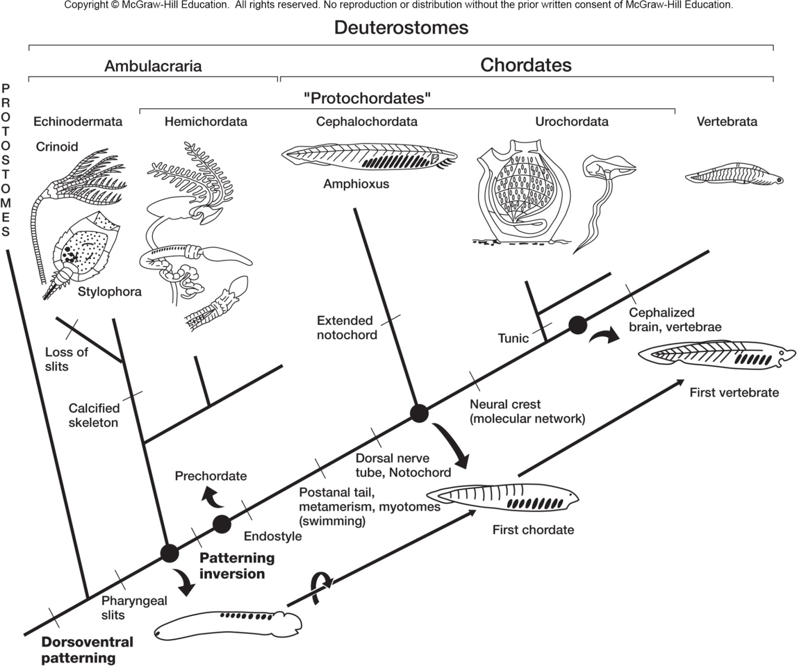

Slide 26
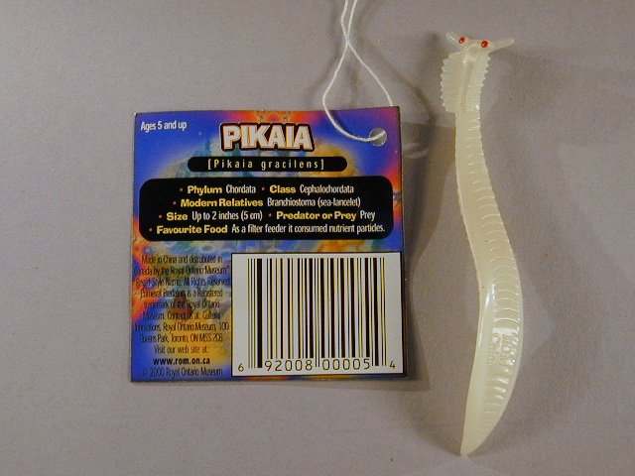
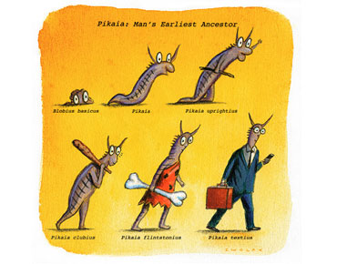
Chordate Origins?
Pikaia ~ 530 million years old

Slide 27
Chordate Origins, Echinoderma grade ancestor?
Hemichordata Larva
Echinoderm Larva
Pedomorphosis

Slide 28
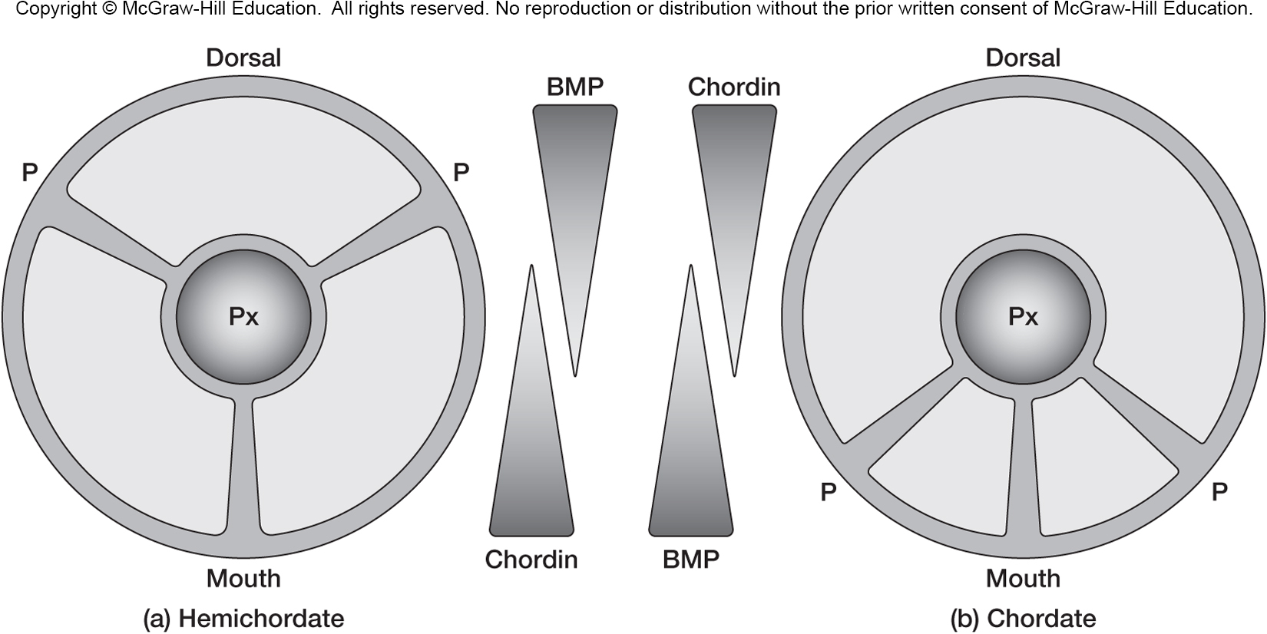
Another wrinkle: Inverted body plan

