Slide 1
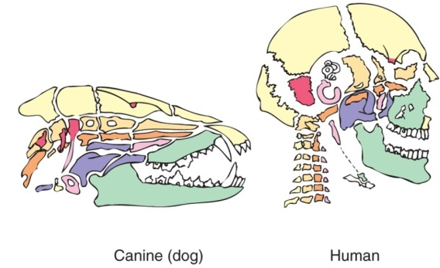
Introduction: What is Comparative Anatomy?
BIOL 495 – Chapter one

Slide 2
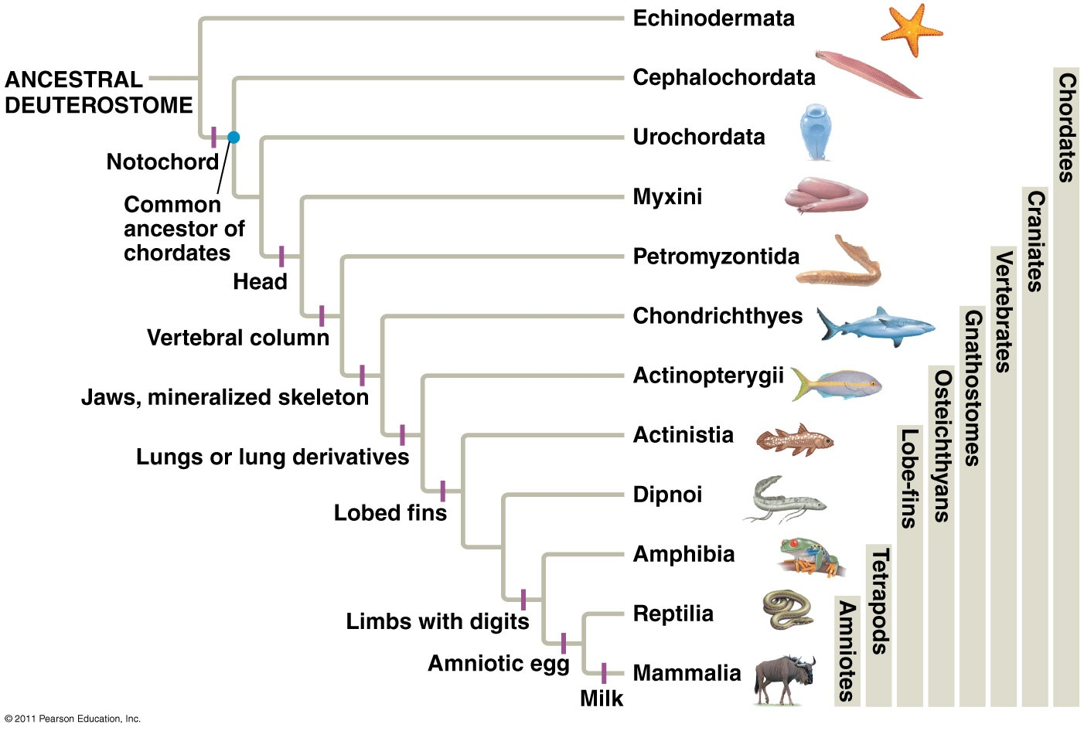
Comparative
Vertebrate
Anatomy

Slide 3
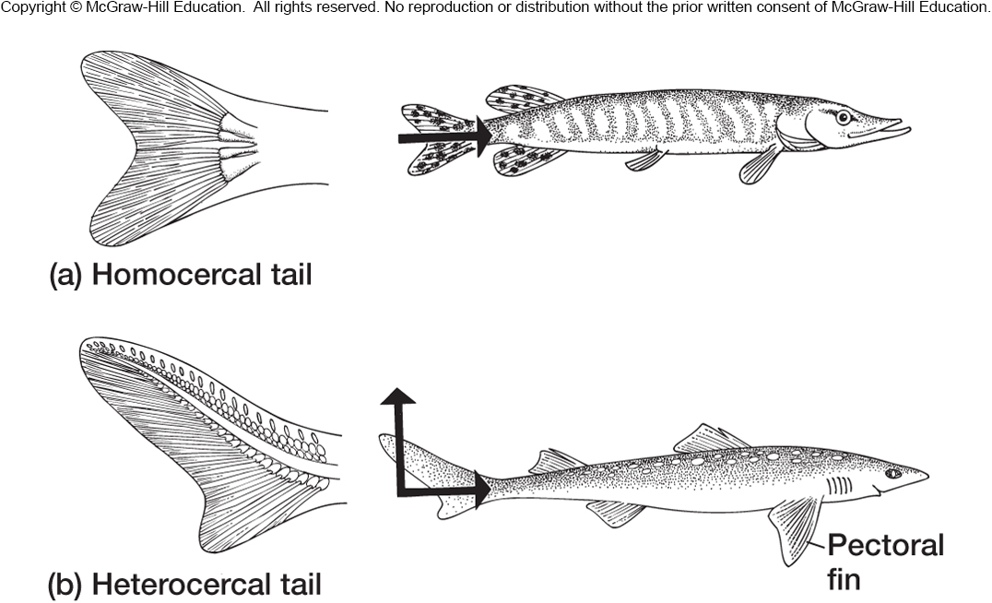

The Comparative Anatomy Toolkit
Functional Morphology
Form and Function are inseparably intertwined
Notes:
Zero in on one thing. Work it out. Can draw comparasens!

Slide 4

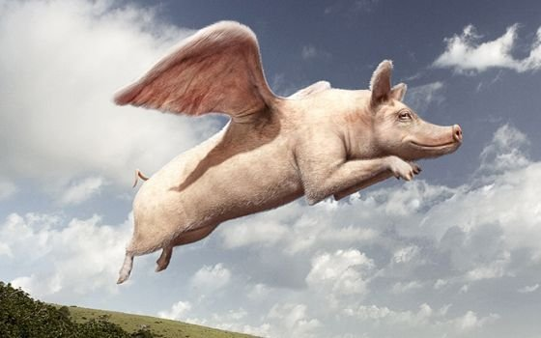
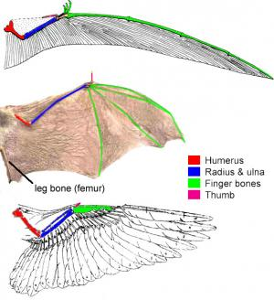
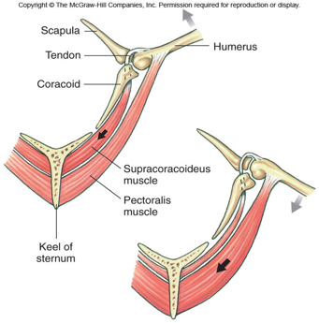
Form and Function

Slide 5
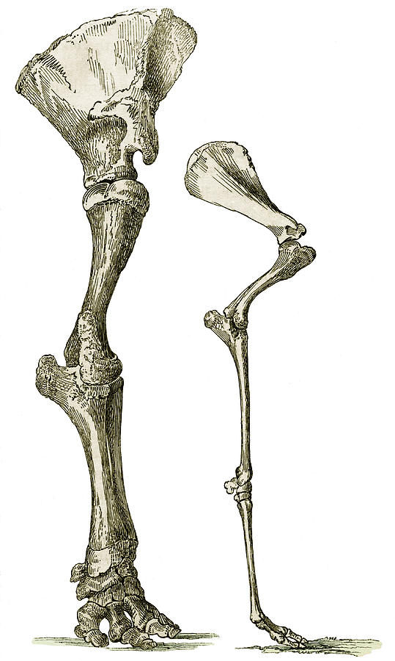
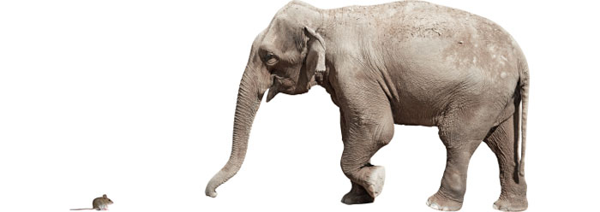
Why a mouse is not like an elephant

Slide 6
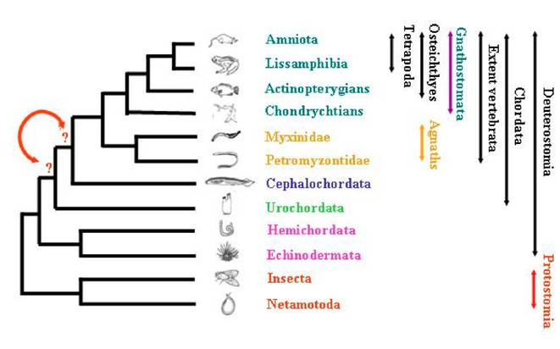
Reconstructing Evolution

Slide 7
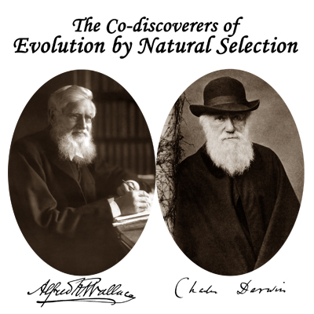
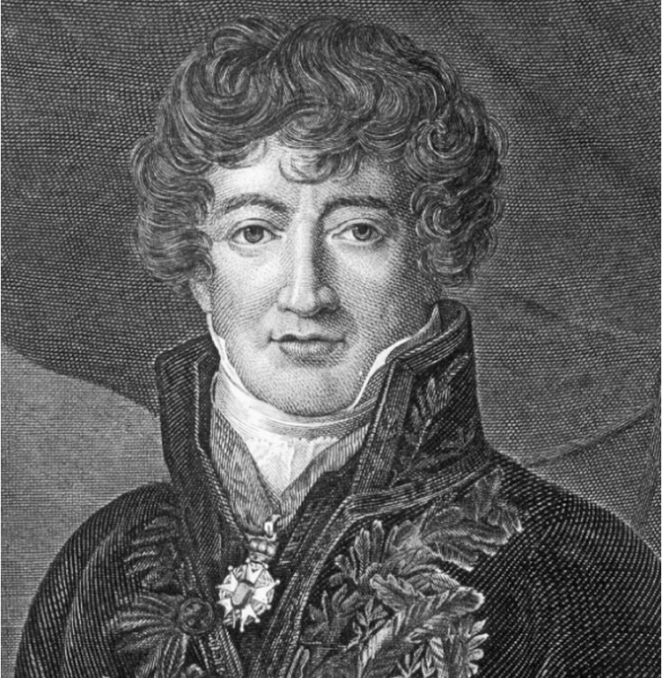
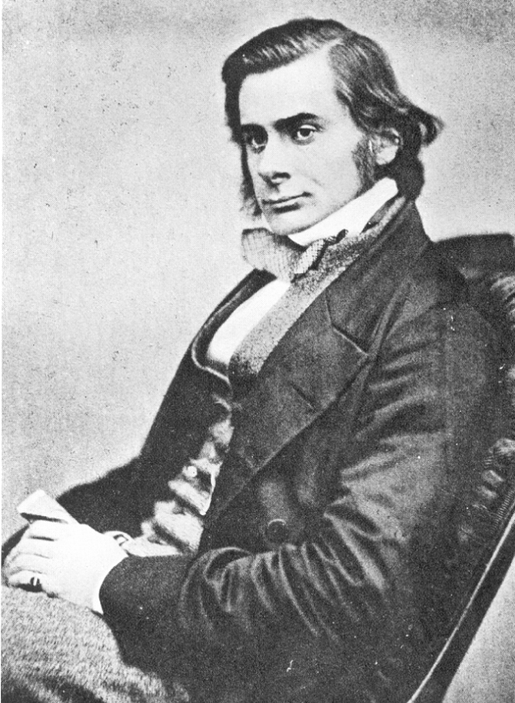
Comparative Anatomy and Evolution
Georges Cuvier
Huxley

Slide 8
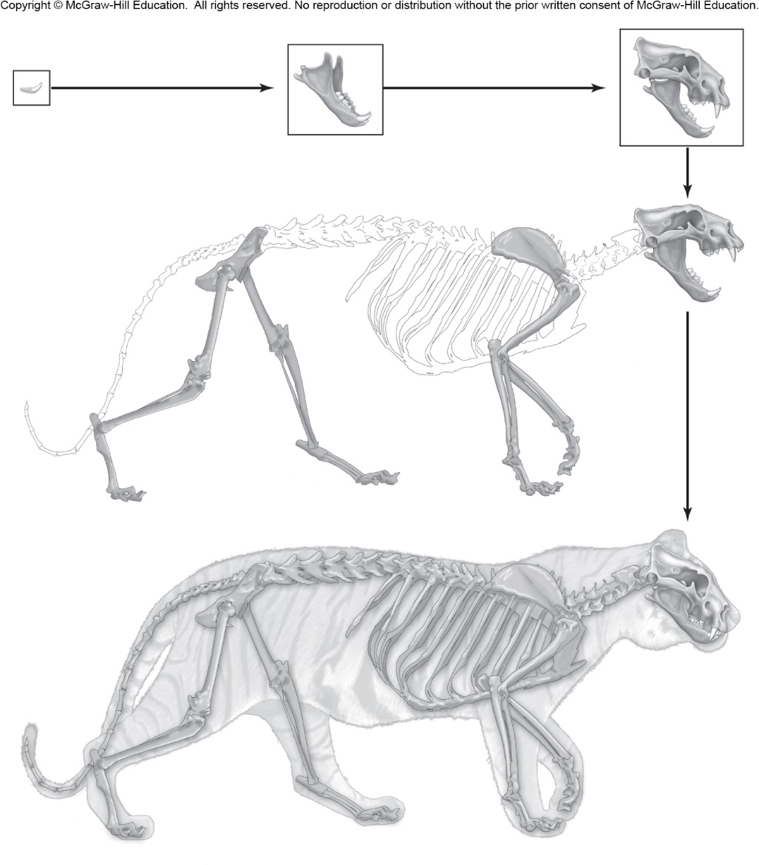
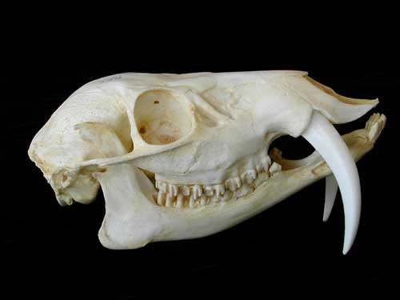
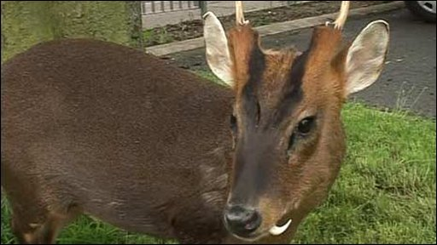
Cuvier’s Rejection of Evolution

Slide 9
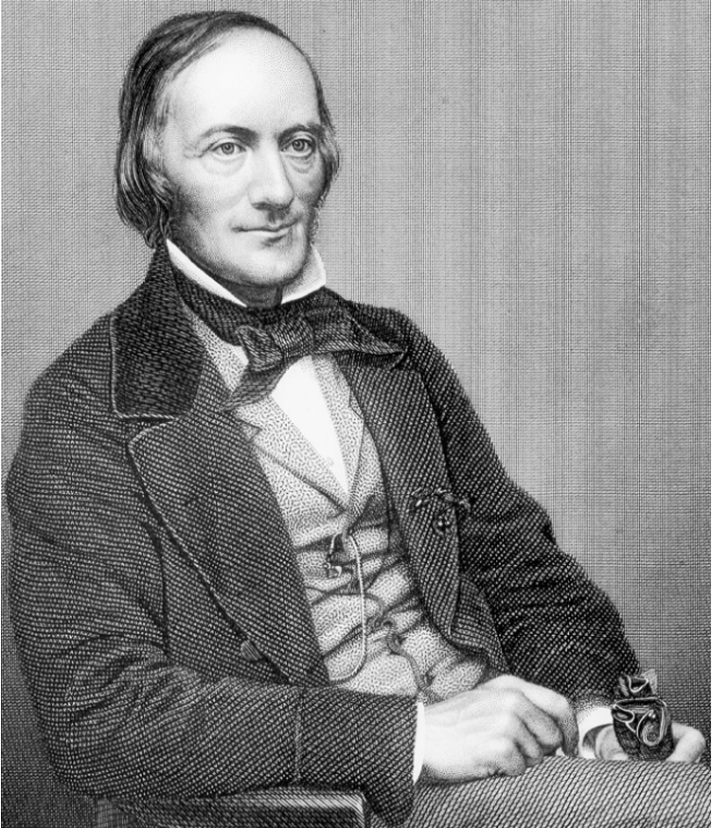
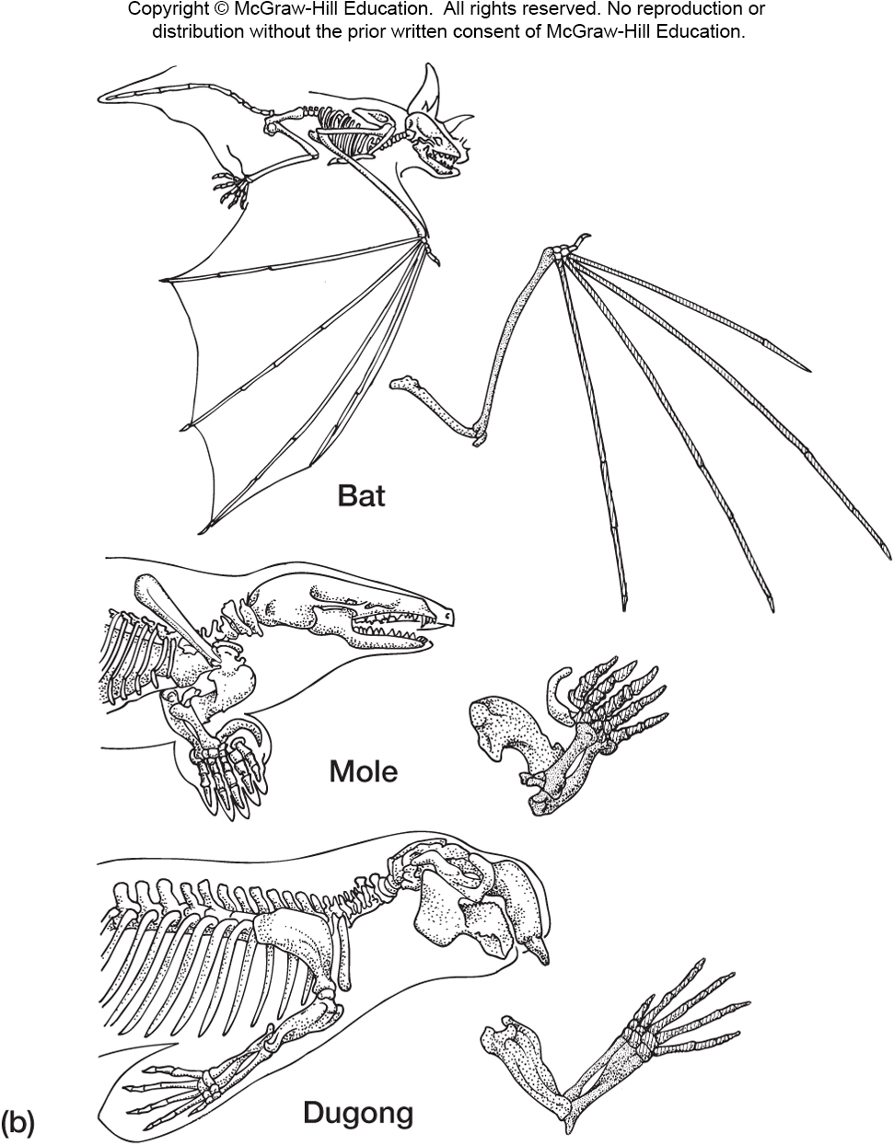
Richard Owen … archetypes

Slide 10
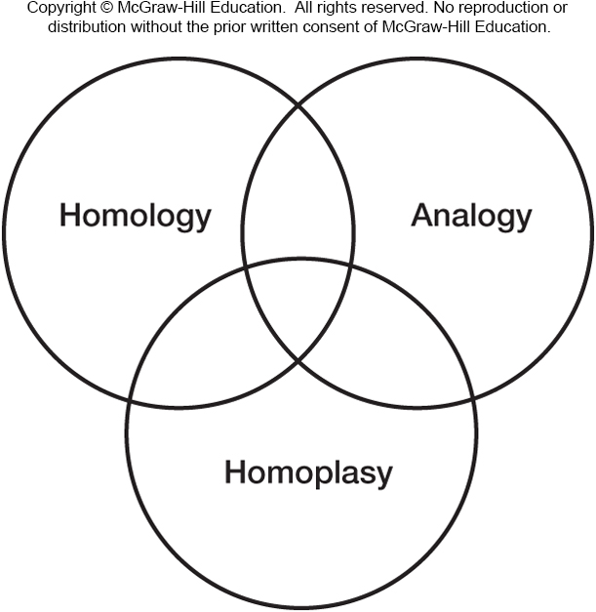
Morphological Concepts
Homology – Shared common ancestry
Analogy – Similar function, maybe appreance
Homoplasy – Similar appearance, not shared ancestry

Slide 11
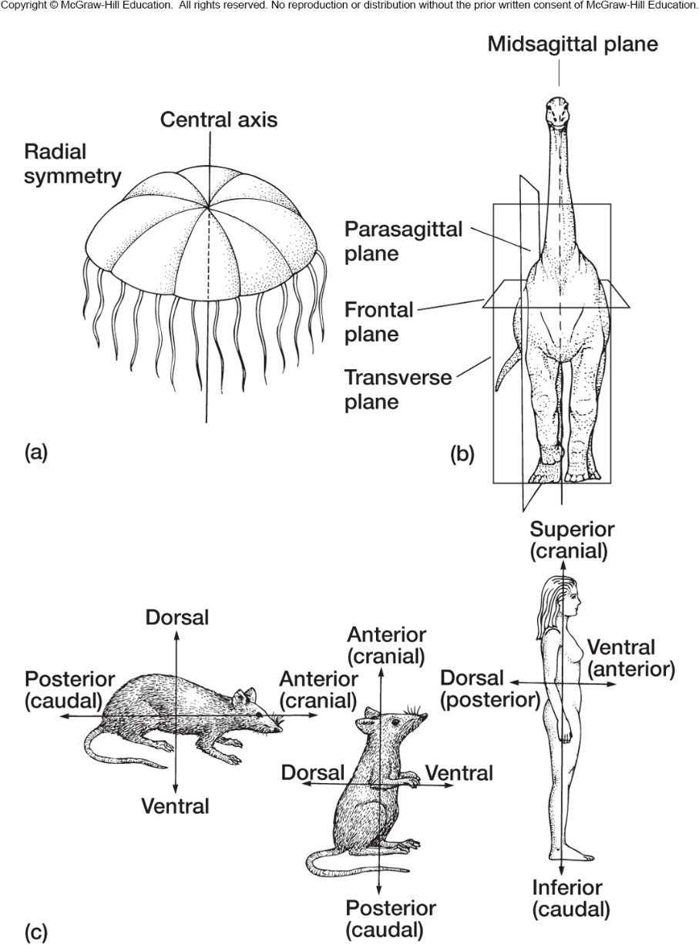
Anatomical Terms
Planes
Symmetry
Bilateral Symmetry

Slide 12
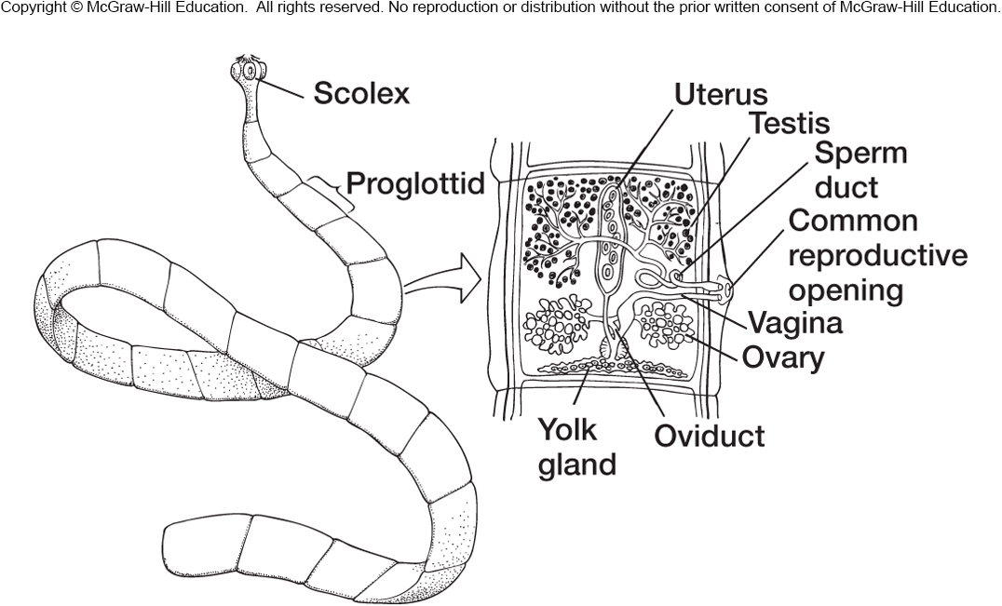
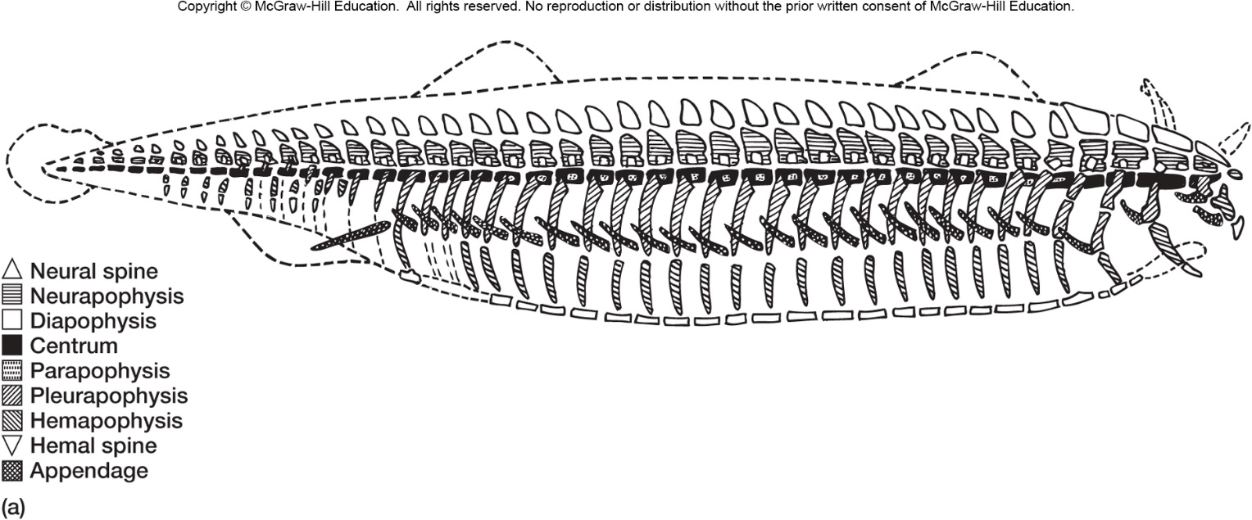
Segmentation

Slide 13
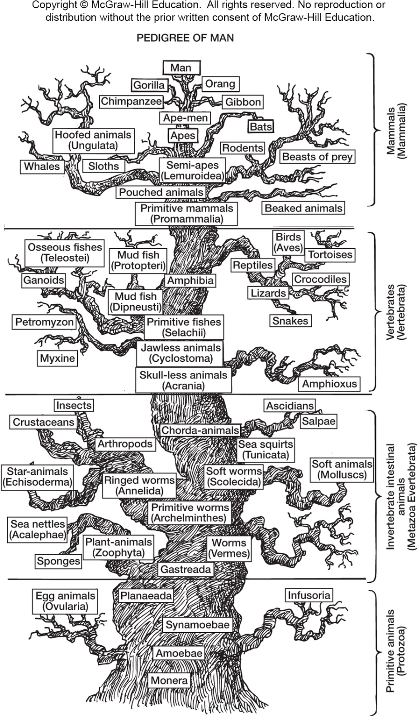
Phylogenetic Terms
Monophyletic group
Paraphyletic group
Synapomorphy
Plesiomorphy
Clade vs Grade

Slide 14
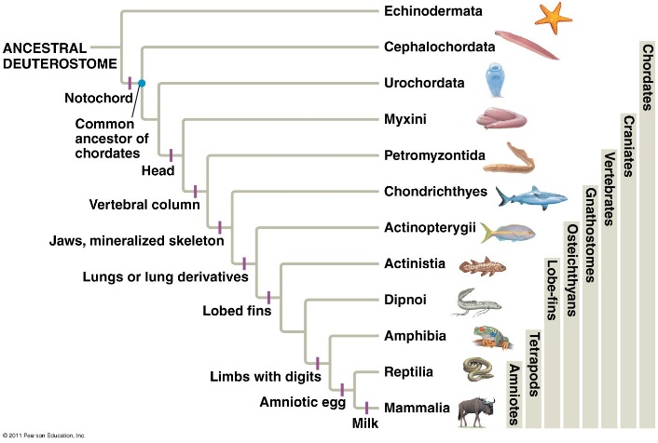
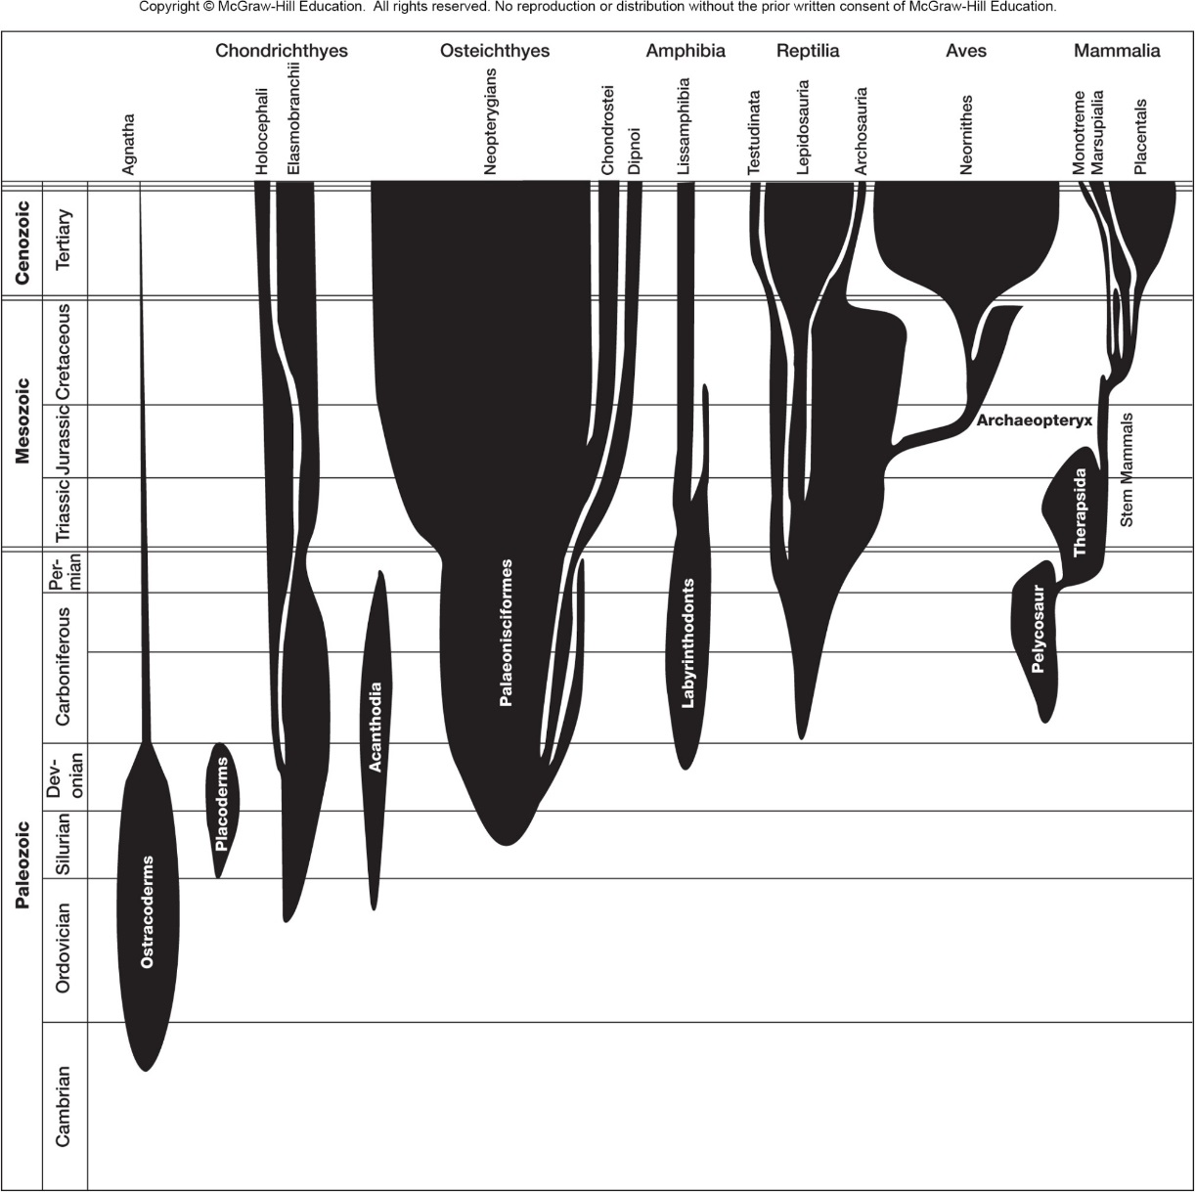
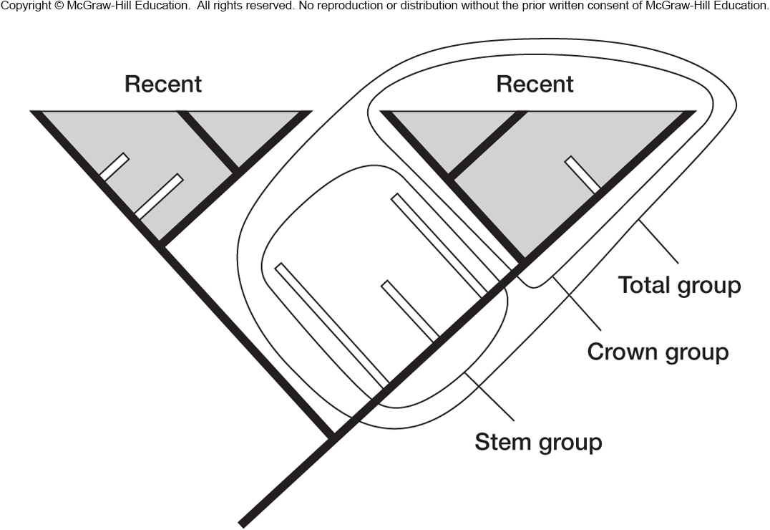
Paleontology (adds more terms!)

Slide 15
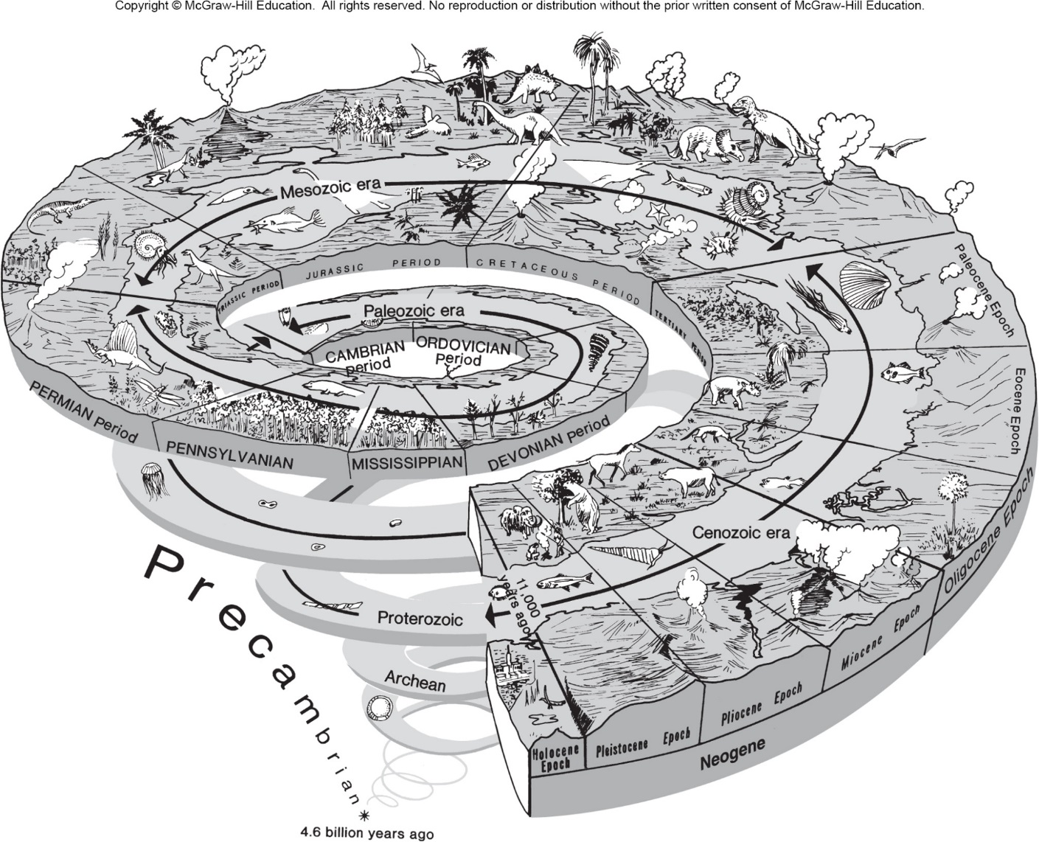
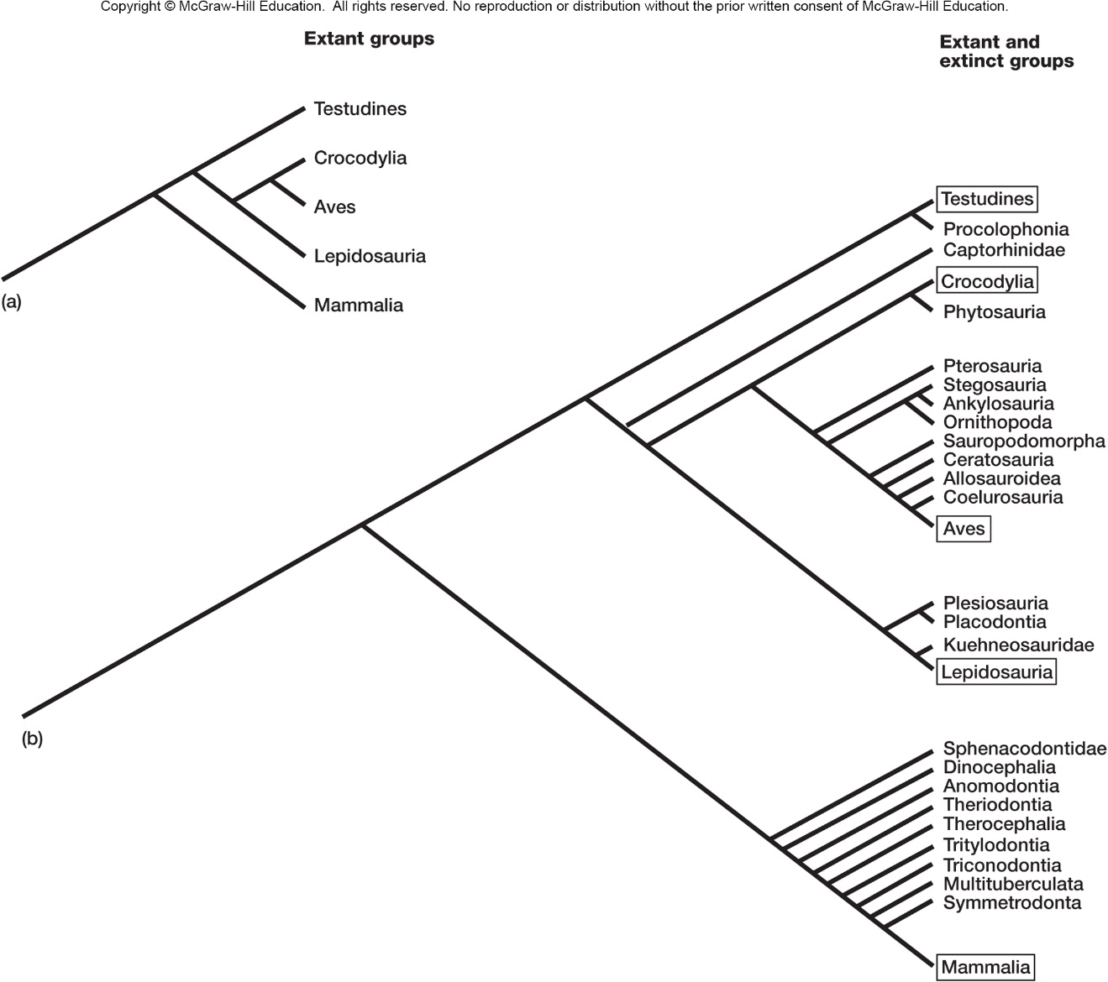

Slide 16
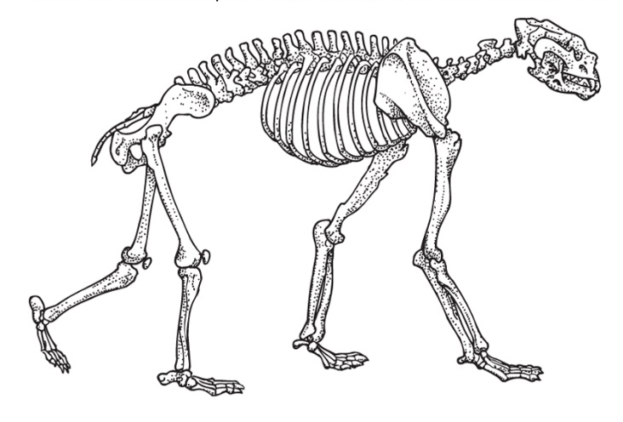
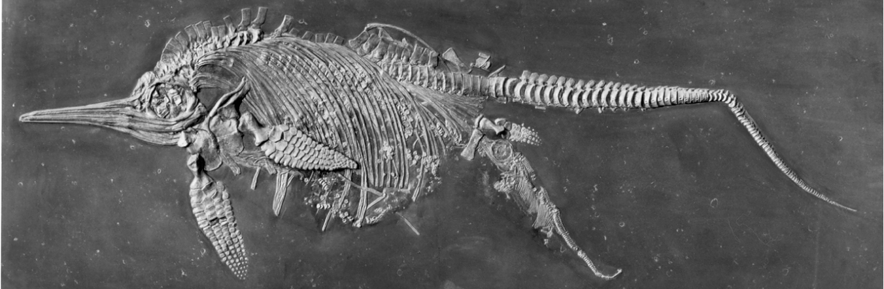

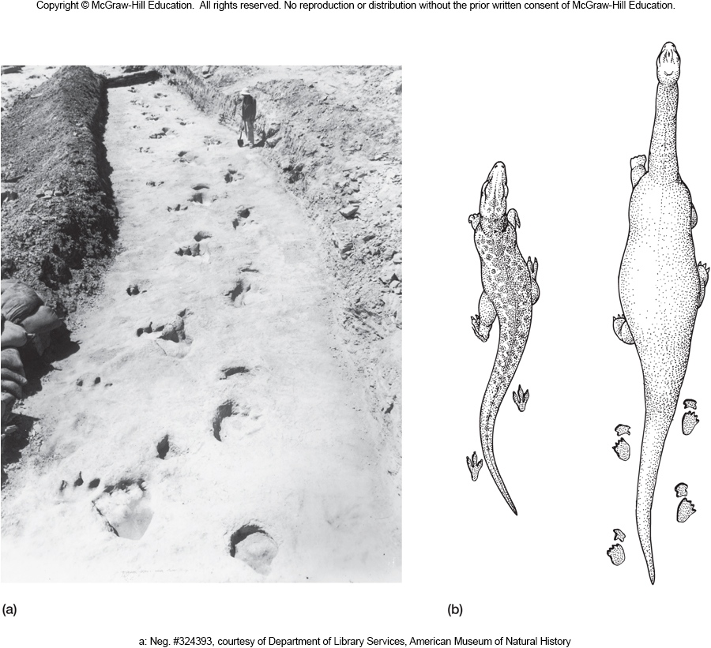

Slide 17
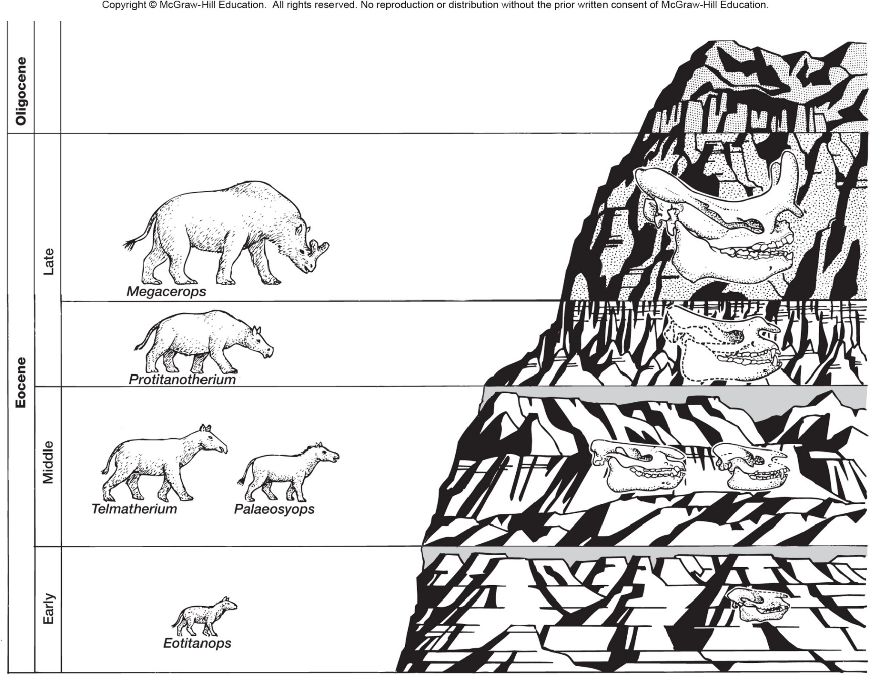

Slide 18
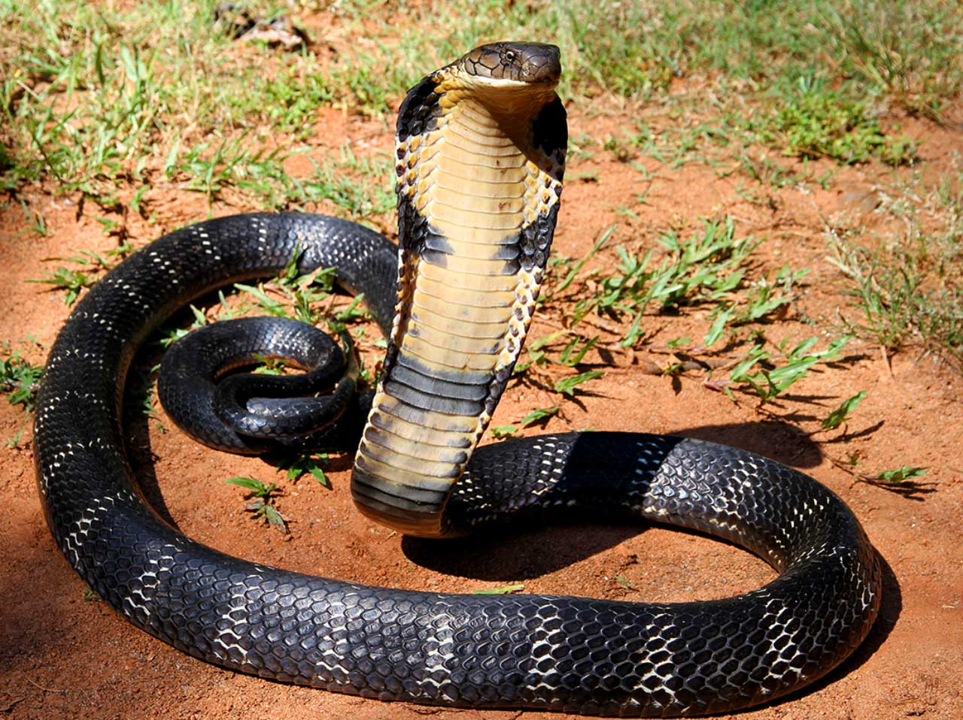
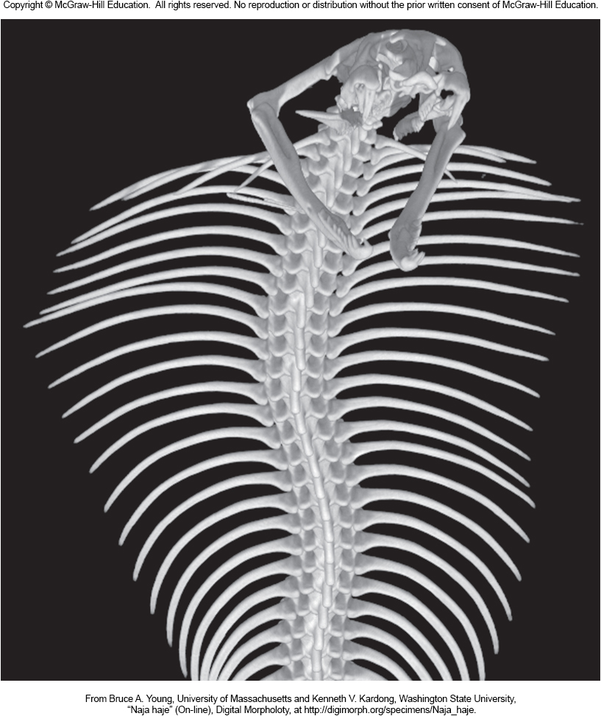
Understanding Modern Animals Physiologies

Slide 19
