Slide 1
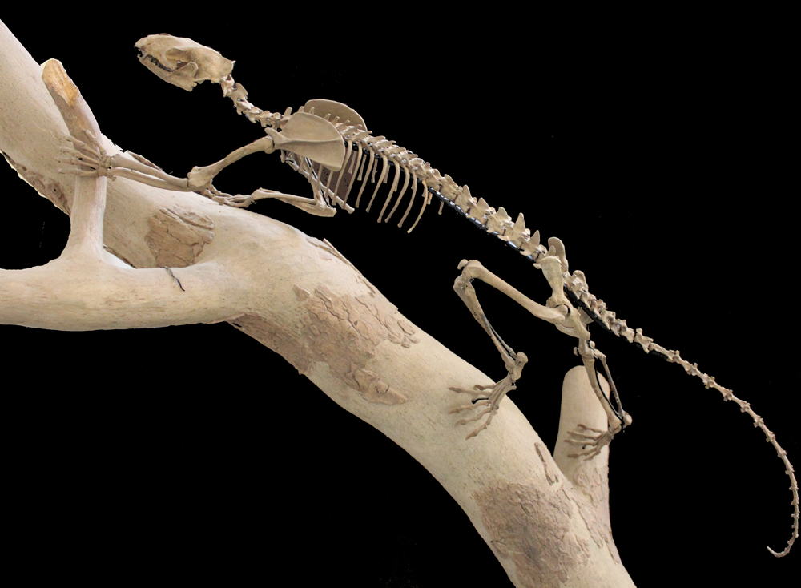
Evolutionary History and Paleobiology of Carnivorous Mammals
Michelle Spaulding, PhD
NSF Postdoctoral Fellow
Carnegie Museum of Natural History
Notes:
REPLACE VULP
----- Meeting Notes (1/19/12 15:08) -----
blow up the animal*, kill cm, add logos instead NSF CMNH
*retake image, its kinda blergh.

Slide 2
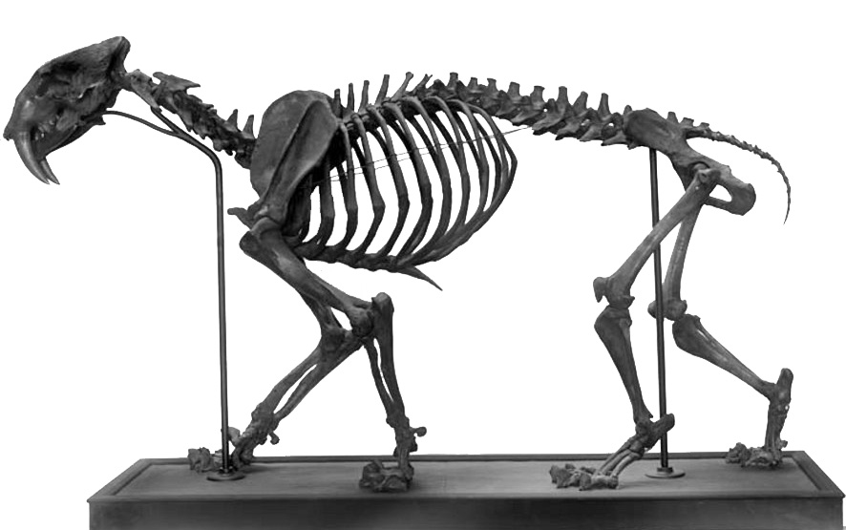
Paleontology
Notes:
Questions ! Not just fossil. Need to look at living to understand the past. Present is the key to the past.
CROP IMAGE KILL SCALE BAR. New taxon of
cimolestid
mammal
Eocene
Green Rive
r Fm
Blend bio and geo.
----- Meeting Notes (1/19/12 15:08) -----
scripted 1st copule of sentances

Slide 3
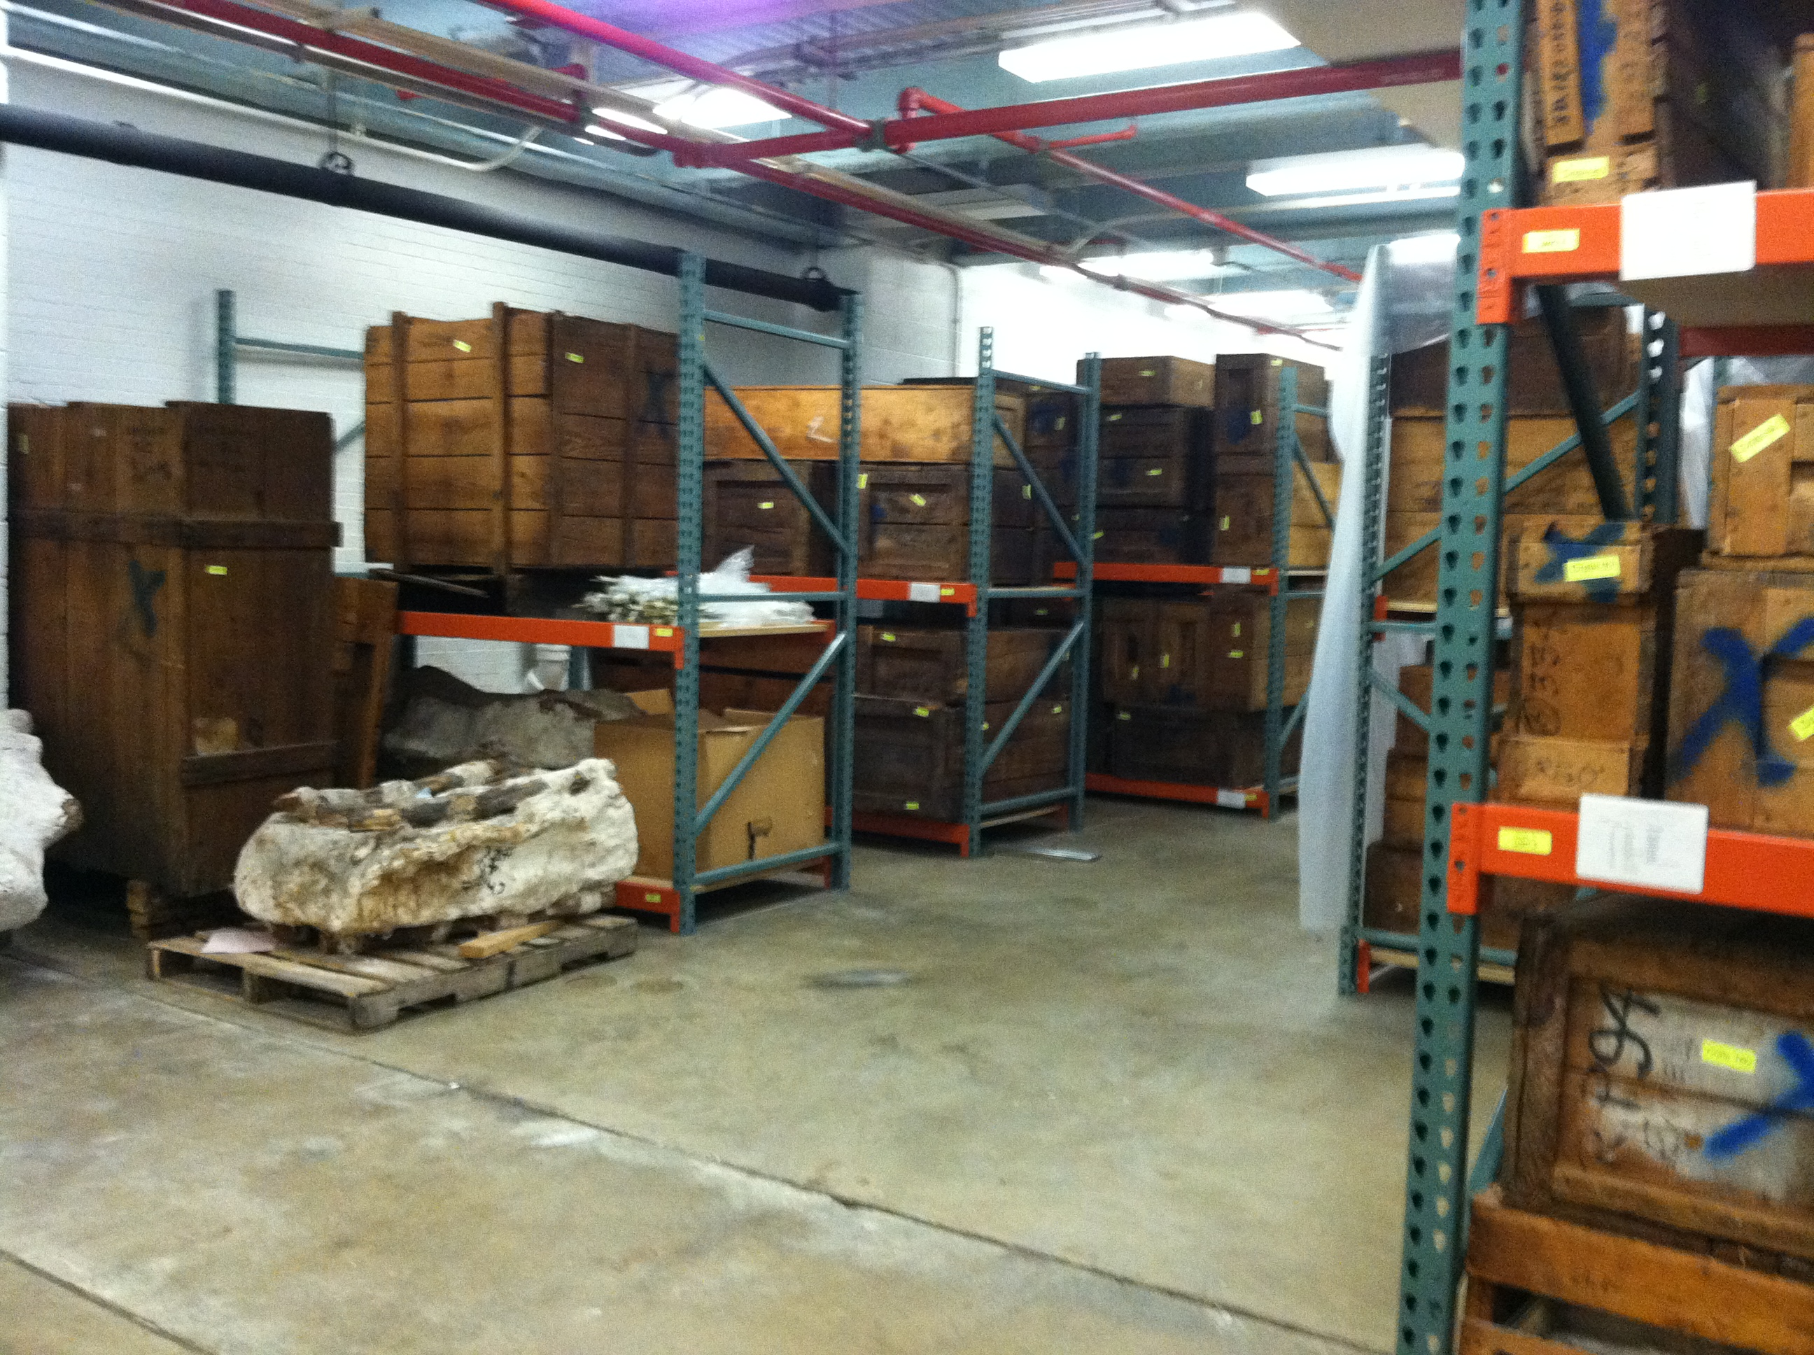
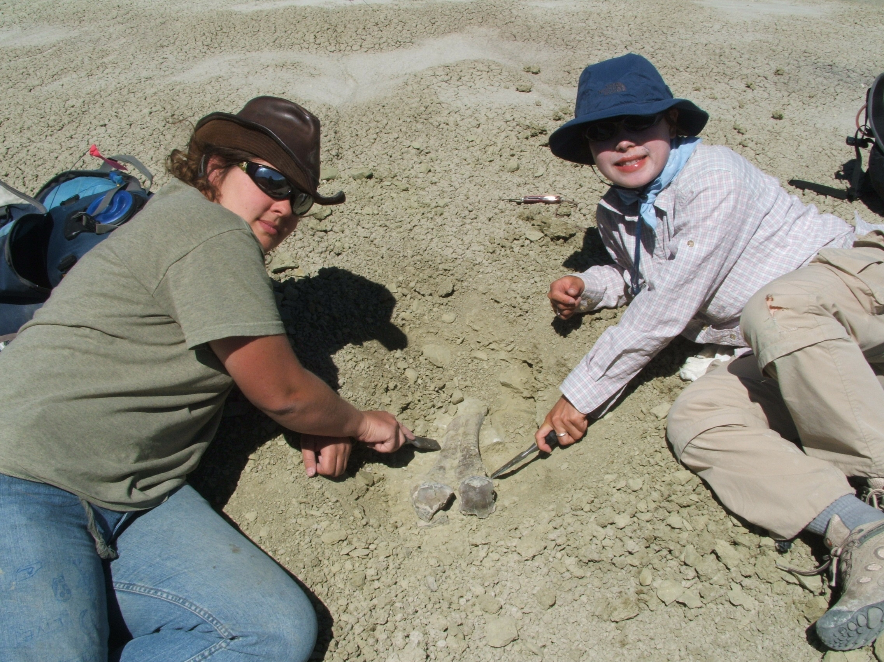
Field Work

Slide 4
Overview
Phylogeny – Carnivoramorpha
Function – Prehensility
Future Plans
Notes:
----- Meeting Notes (1/19/12 15:08) -----
mention coooper

Slide 5
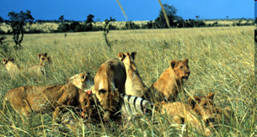
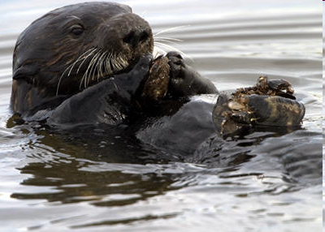
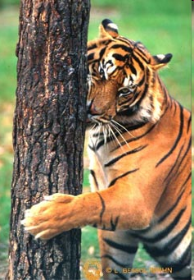
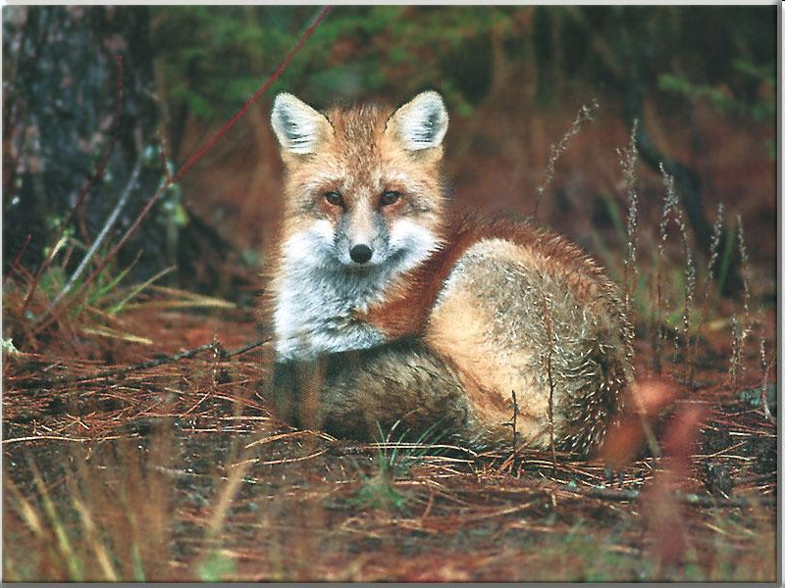
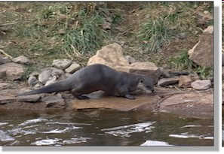
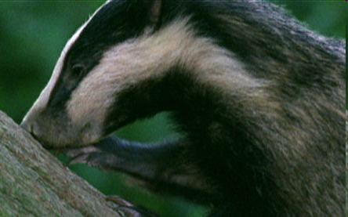
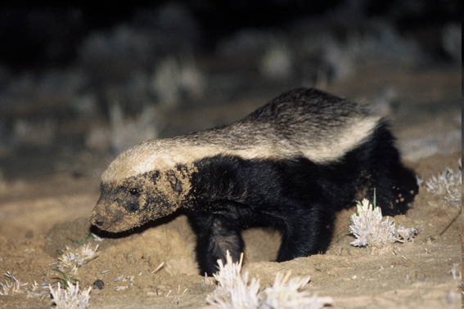
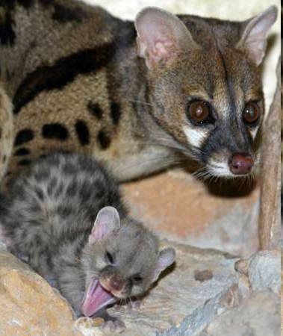
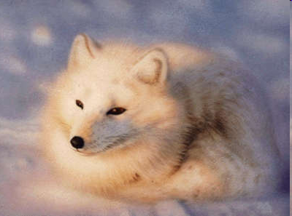
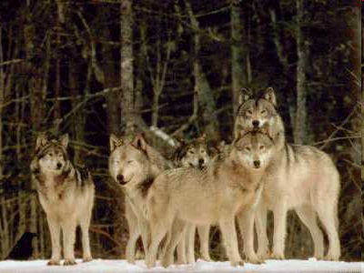
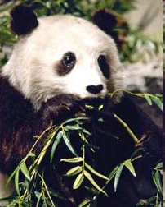
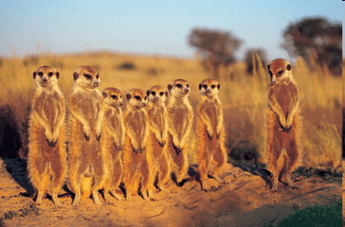
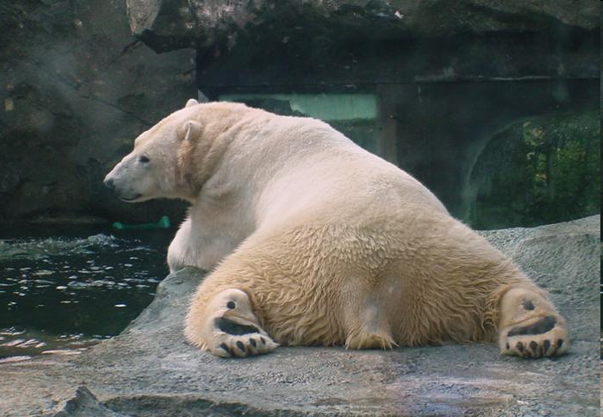
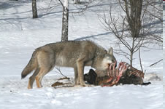
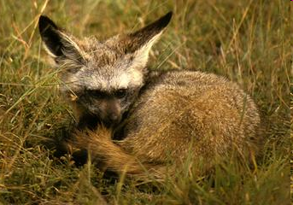
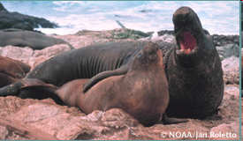
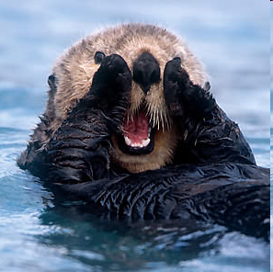
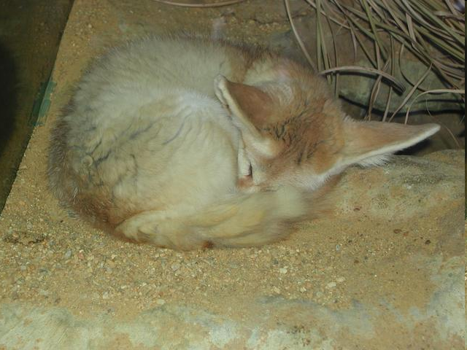
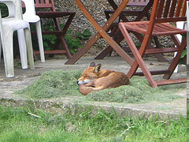
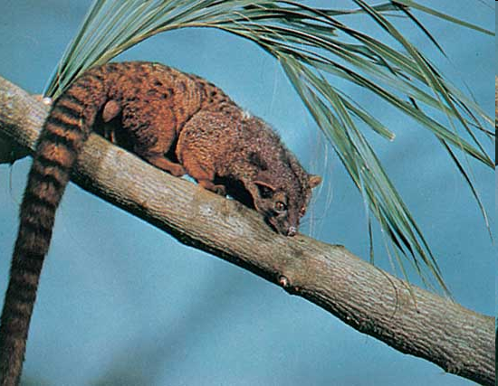
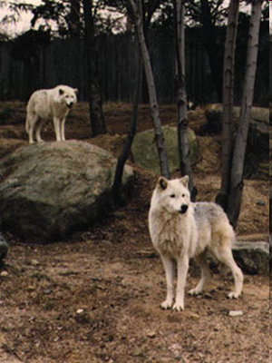
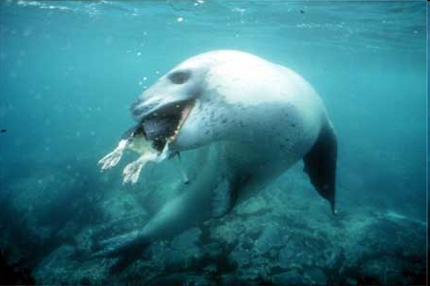
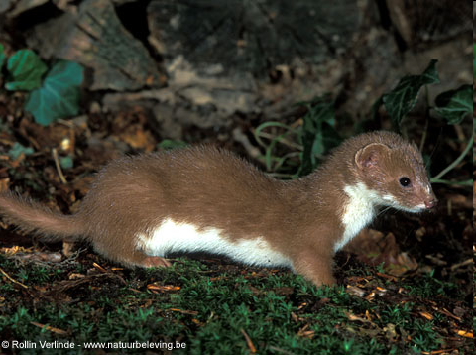
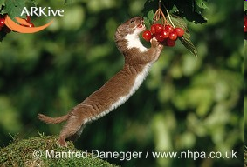
Phylogeny
What is Carnivora?
Fossil Relatives of Carnivora
Phylogenetic Relationships of Fossil Taxa
Locomotor and Diet Evolution
Notes:
Revise this. Keep it though the talk possibly in the corner.

Slide 6
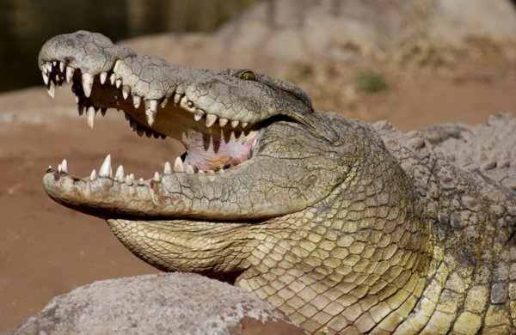
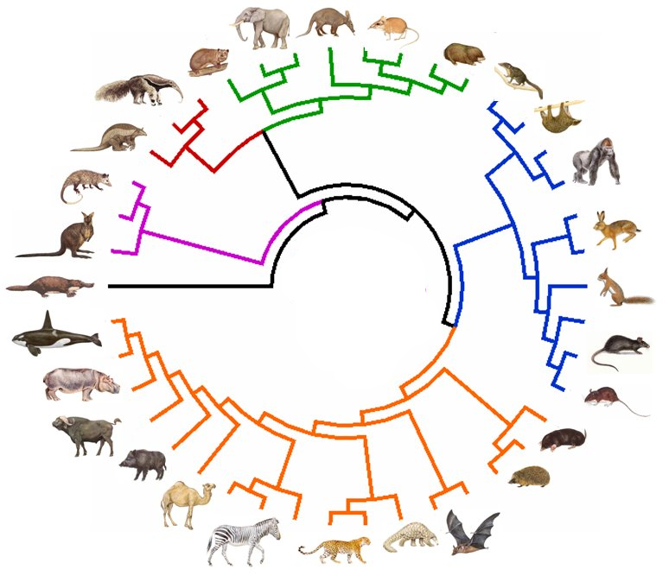
carnivores (meat eaters)
Carnivora (carnivoran)
Notes:
Molecular phylogeny – springer PUT TITLE IN – Extant Mammal Phylogeny

Slide 7
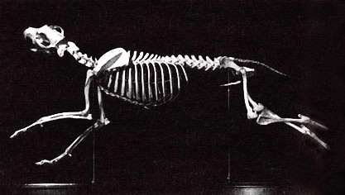
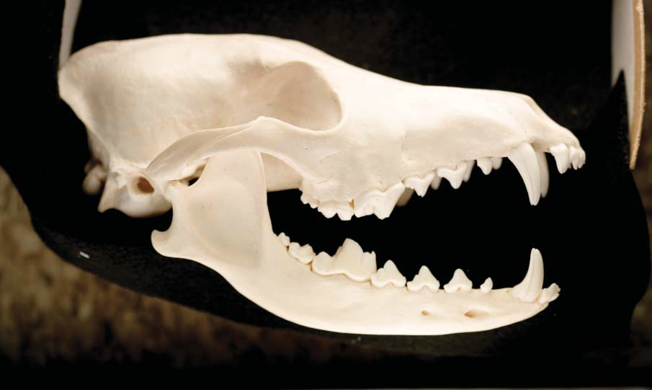
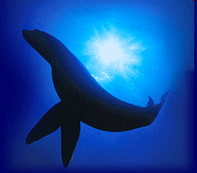
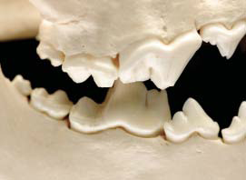
Carnivora
Carnivora
Notes:
All living have/are charaterized by: carnassial dentition
One order convergeting so many others.
Molecular and moprhology. Generalized but still informative.

Slide 8
Size
Notes:
Speed. SLOOOOOOOOOOOW down.

Slide 10
Habitat

Slide 11
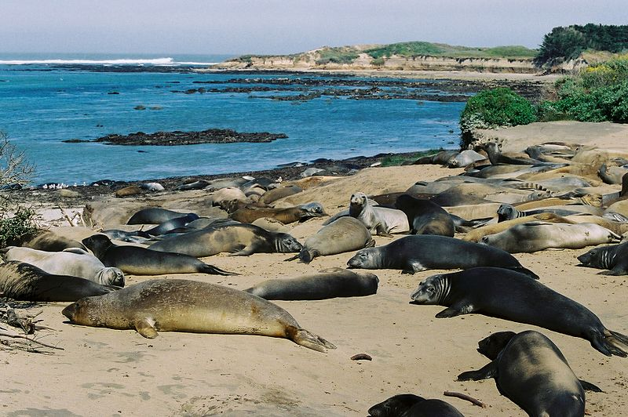
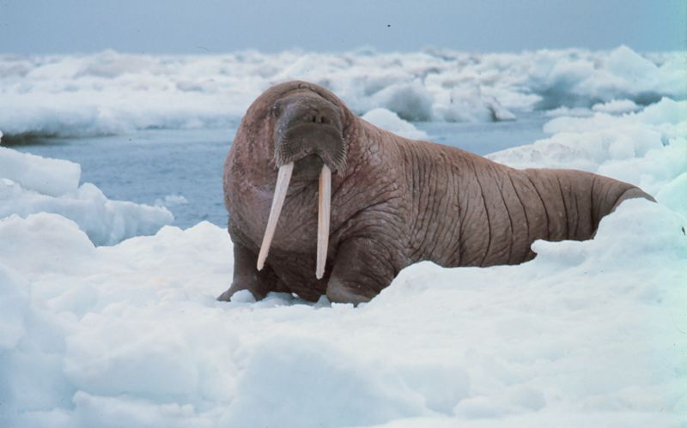
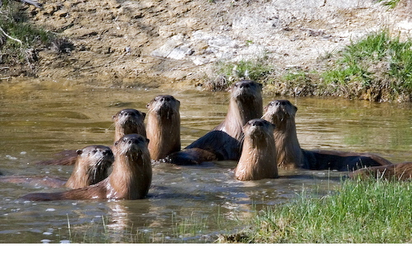
Habitat

Slide 12
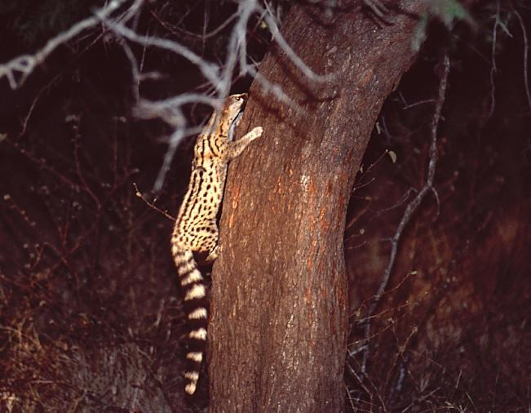
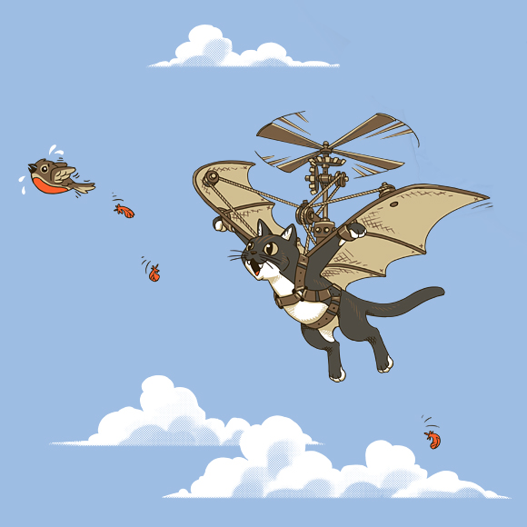
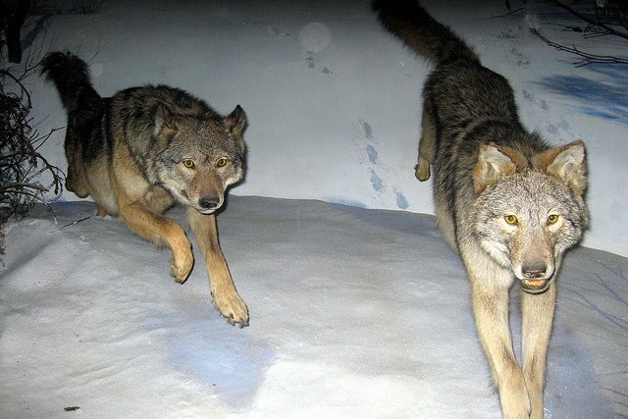
Locomotion

Slide 13
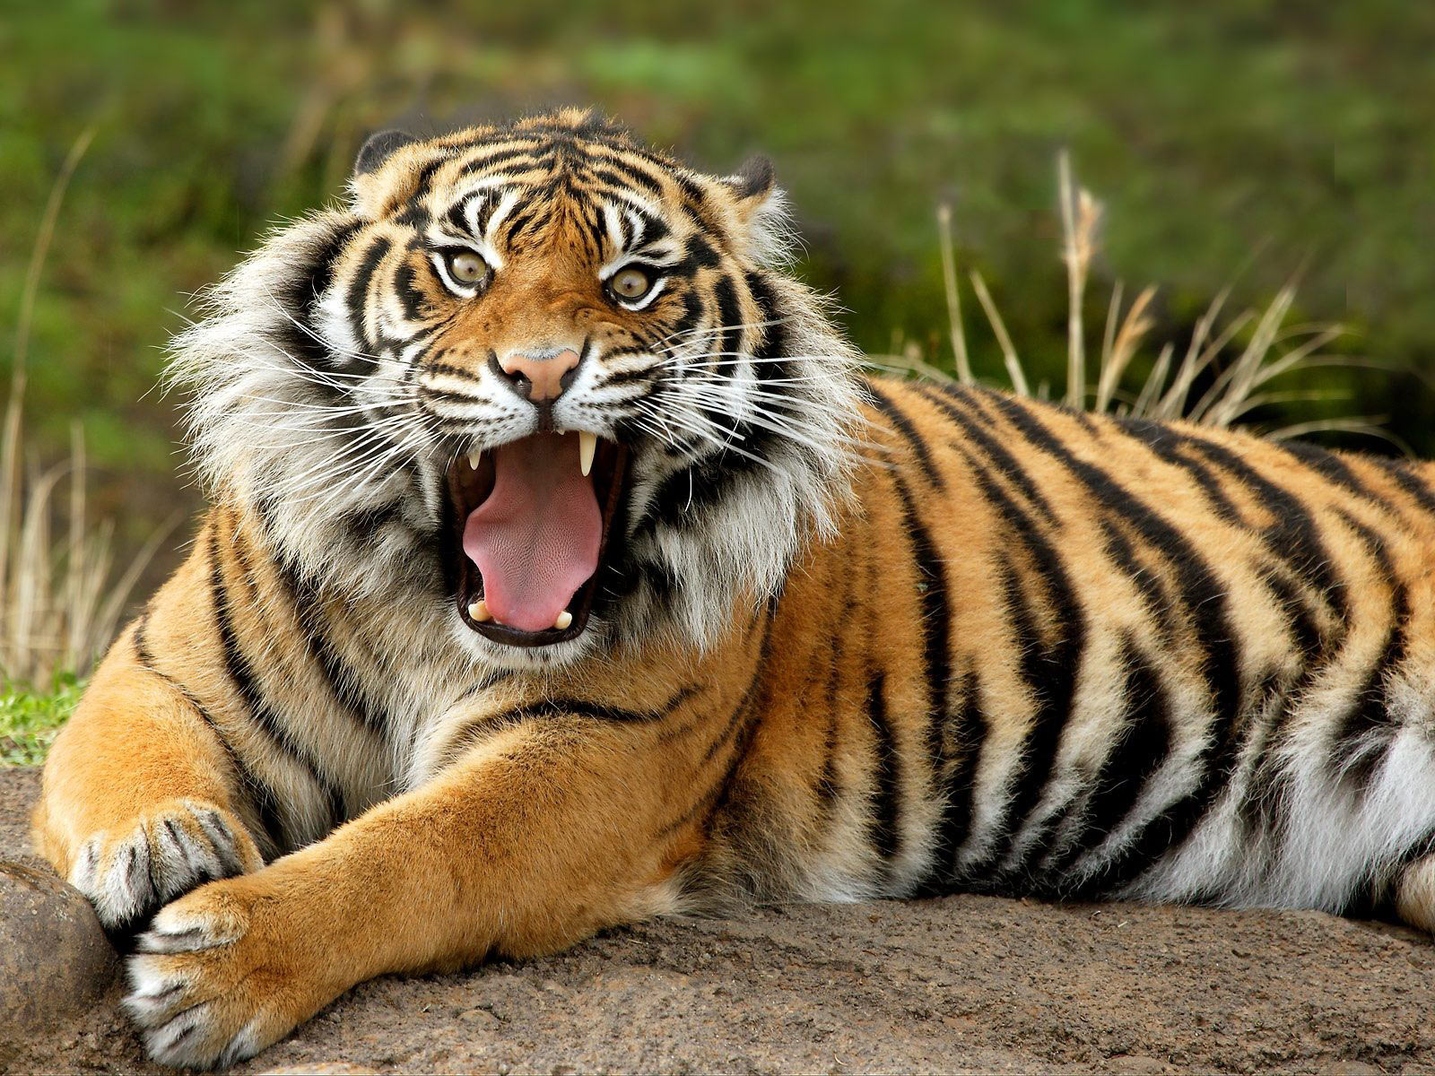
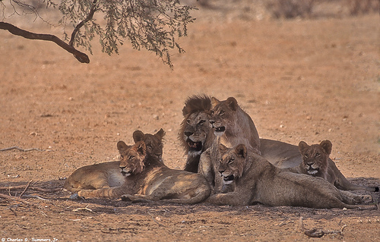
Social Structures

Slide 14
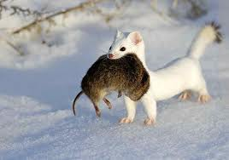
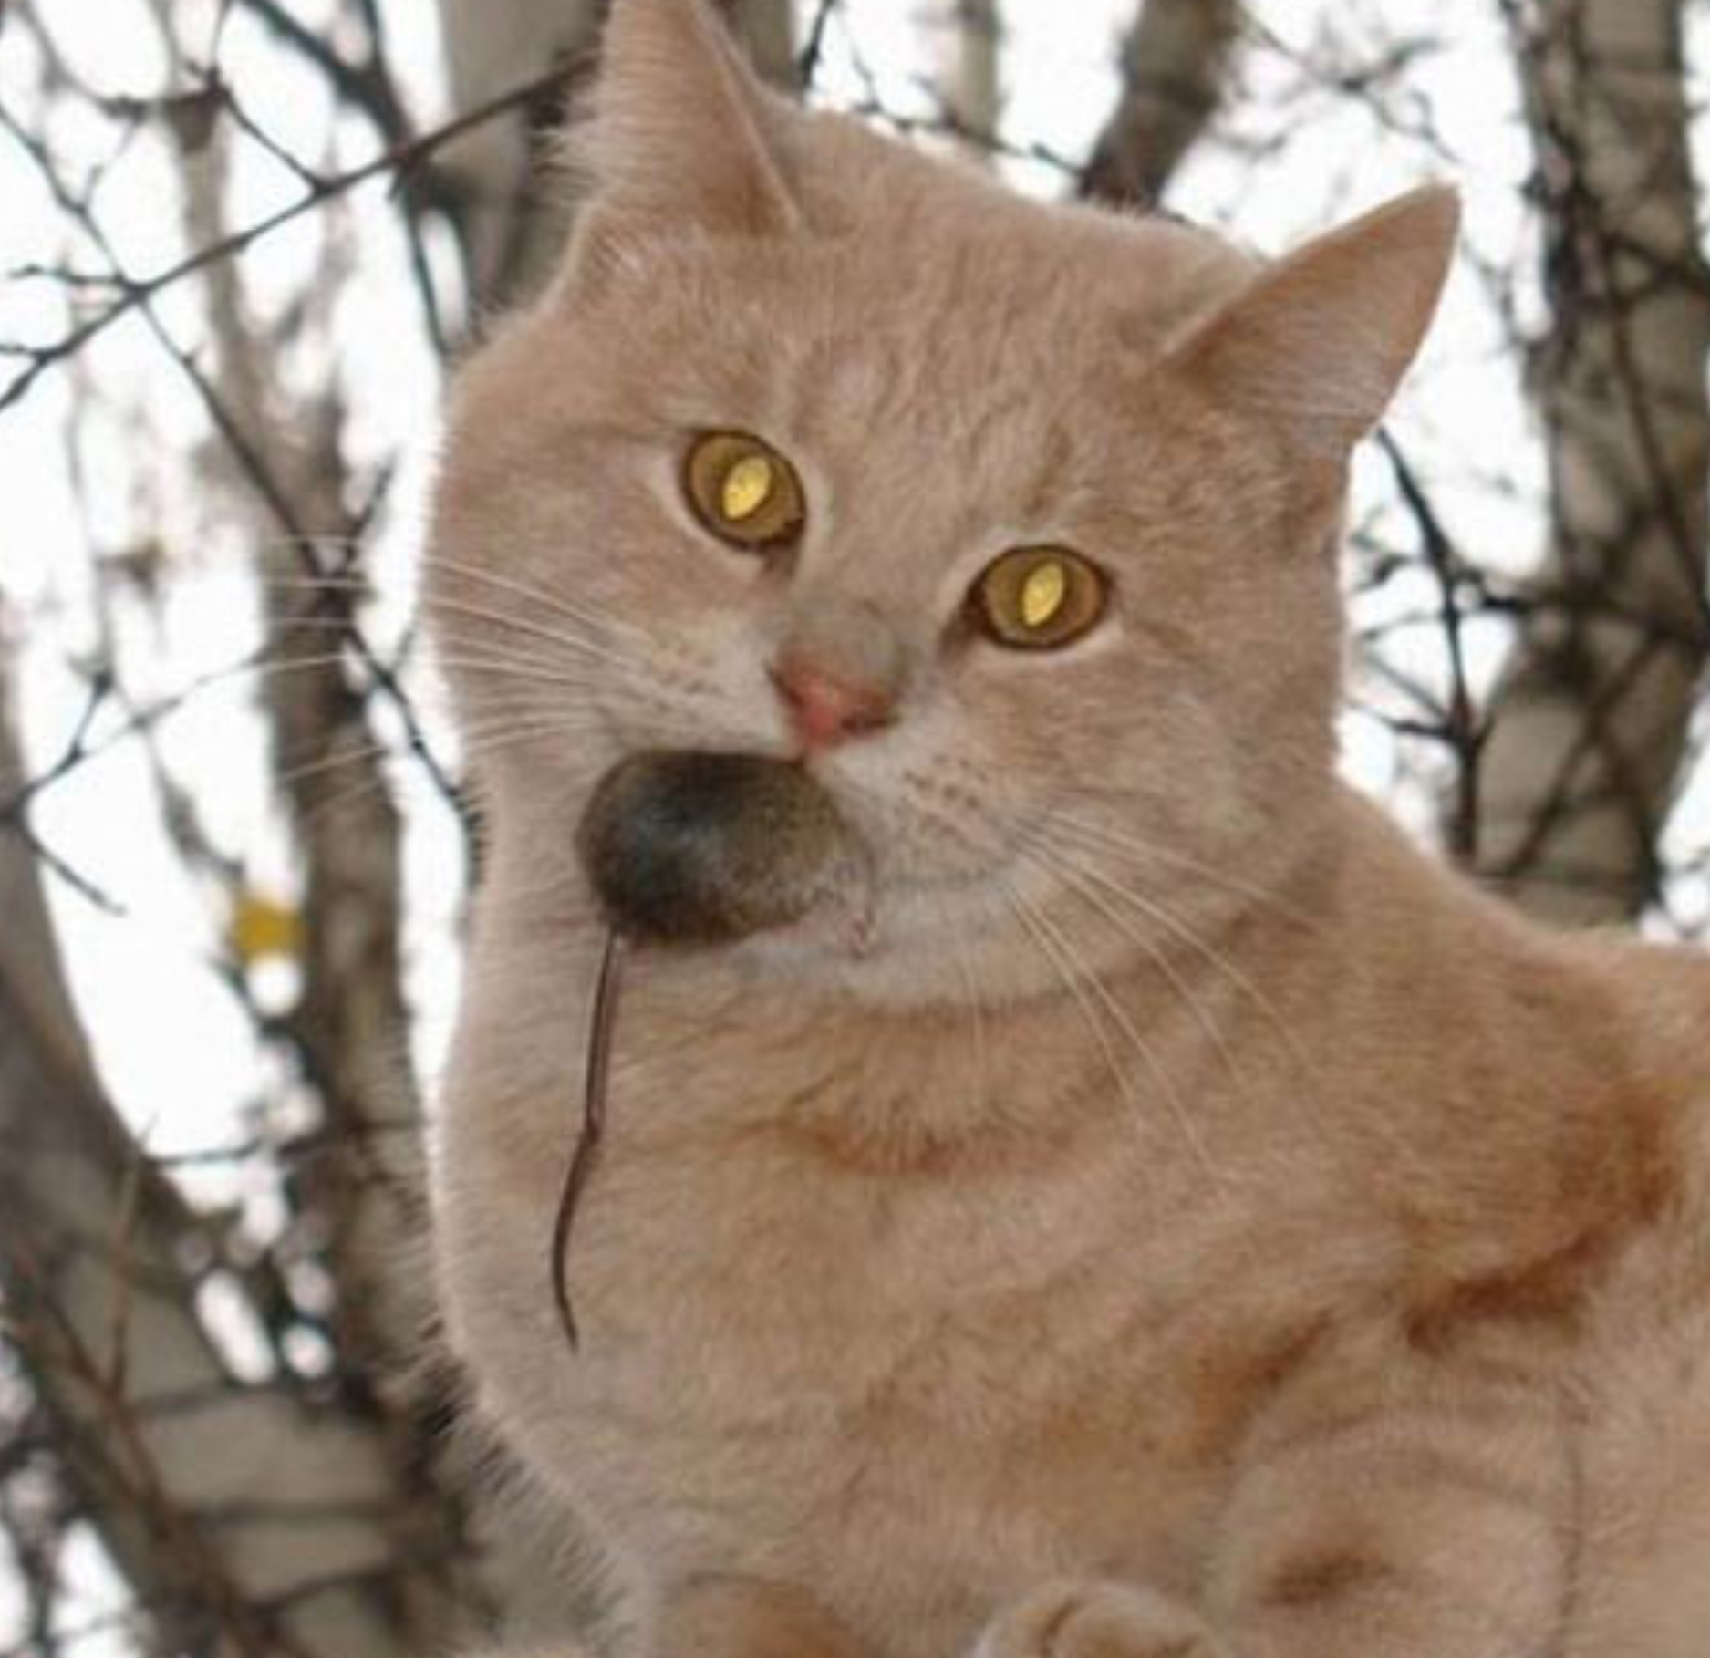
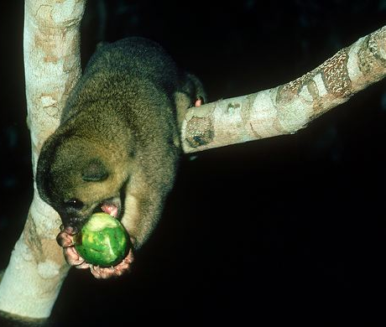
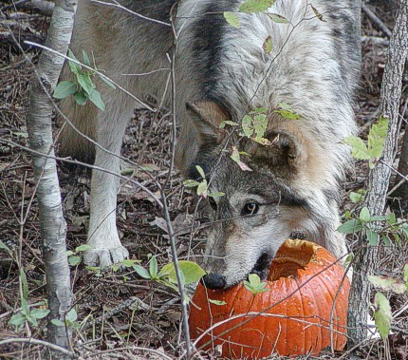
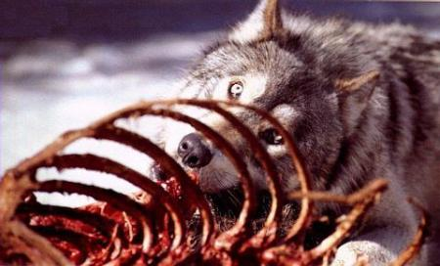
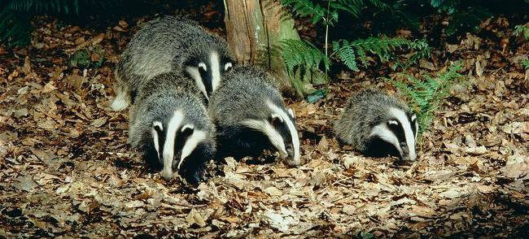
Diet

Slide 15
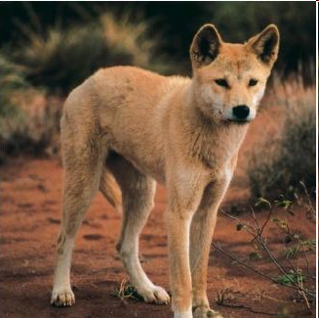
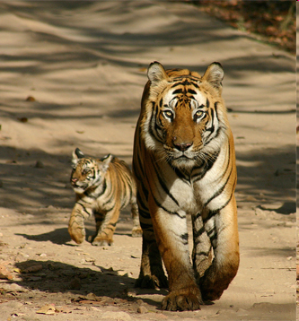
An Early Dichotomy
Caniformia
Feliformia
“Dog like”
Carnivora
“Cat like”

Slide 16

Caniformia
Feliformia
Caniformia
Canidae
Dogs, coyotes, wolves, foxes, jackals, etc.
Notes:
Increase red why get so dark!!!

Slide 17


Caniformia
Feliformia
Caniformia
Ursidae
Bears, including the giant panda

Slide 18


Caniformia
Feliformia
Caniformia
Pinnipedia
Seals, Sea Lions, and Walruses

Slide 19


Caniformia
Feliformia
Caniformia
Ailuridae
Ailurus - Red Panda

Slide 20


Caniformia
Feliformia
Caniformia
Mephitidae
Skunks and stink badgers

Slide 21


Caniformia
Feliformia
Caniformia
Procyonidae
Raccoons and relatives (Cacomistle and Coatis)

Slide 22



Caniformia
Feliformia
Caniformia
Mustelidae
Badgers, otters, weasels, wolverines, and martins.

Slide 23
Caniformia
Feliformia
Caniformia

Slide 24
Feliformia
Caniformia
Feliformia
Nandiniidae
Nandinia - African Palm Civet

Slide 25
Feliformia
Caniformia
Feliformia
Felidae
Cats – big and small

Slide 26



Feliformia
Caniformia
Viverridae
Feliformia
Civets, genets, and linsangs

Slide 27


Feliformia
Caniformia
Feliformia
Hyaenidae
Hyenas and the aardwolf

Slide 28


Feliformia
Caniformia
Feliformia
Herpestidae
Mongooses – including meerkats

Slide 29

Feliformia
Caniformia
Feliformia
Eupleridae
Malagasy carnivorans

Slide 30
Feliformia
Caniformia
Feliformia

Slide 31
Carnivora = all extant species
and hundreds of fossil species!
Feliformia
Caniformia
Notes:
Animate? If I am good for time… which I doubt!!!! Mention fossil groups? Floating amphicyon and a nimravidea? (yes!)

Slide 32
Beyond Carnivora?
Fossil Record
Feliformia
Caniformia
Carnivora
(~43 Ma)
Carnivoramorpha (~63 Ma)

Slide 33



Paleocene – Eocene World
~65-56 mya
56-34mya
Notes:
Z-curve its own slide.

Slide 34


Isotope Based Inferences
δ¹⁸O
WARMER
COOLER
PALEOCENE
EOCENE
OLIGOCENE
MIOCENE
P/P
Notes:
ASK WIBLE ABOUT

Slide 35



Historically divided into two groups
Viverravidae
Notes:
COLOR TAXON NAMES.

Slide 36




Historically divided into two groups
Miacidae
Vulpavus
Notes:
NEW IMAGE.

Slide 37
Uncertain Relationships of
Basal Carnivoramorphans
Miacidae
Viverravidae
????
Feliformia
Caniformia
????
Miacidae
Viverravidae
Carnivora
(~43 Ma)
Carnivoramorpha (~63 Ma)

Slide 38
Current Hypothesis
Spaulding et al., 2010: Palaeontology
53 (4): 815-832
“Miacidae”
Caniformia
Feliformia
Viverravidae
Carnivora (~43 mya)
Carnivoraformes (~55 mya)
Carnivoramorpha (~63 mya)
Other Placental Mammals
Notes:
Here mention Miacidae is bad! Won’t use anymore. Basal carnivoraformies.
So miacidae is pretty damn important!!! And getting them in the right order is espically important!
So we need a lot! …. So how many do we have?

Slide 39

Basal Carnivoramorpha
“Miacis” uintensis, AMNH 1964

Slide 40


Basal Carnivoramorpha
“Miacis” uintensis, AMNH 1964
Spaulding and Flynn, 2009
Journal of Vertebrate Paleontology

Slide 41



Basal Carnivoramorpha
Dawsonicyon isami, DMNH 19585
Spaulding et. al, 2010 - Palaeontology

Slide 42
Current Hypothesis
Spaulding et al., 2010: Palaeontology
53 (4): 815-832
“Miacidae”
Caniformia
Feliformia
Viverravidae
Carnivora (~43 mya)
Carnivoraformes (~55 mya)
Carnivoramorpha (~63 mya)
Other Placental Mammals
Notes:
Here mention Miacidae is bad! Won’t use anymore. Basal carnivoraformies.
So miacidae is pretty damn important!!! And getting them in the right order is espically important!
So we need a lot! …. So how many do we have?

Slide 43

Ambiguous Relationships
Notes:
LAAAABEEEEEL – LIE MAKE NIMRAVIDS RED.
KILL ERRENT PURPLE.

Slide 44





Postcranial Data
Notes:
Names? Less unintensis dimming, can vanish totally.

Slide 45

Expansion of the Matrix: additional postcranial data

Slide 46




Expanded Character Sampling
+ 3 cranial
243
+ 24 dental
99
Cranial
+ 117 postcranial
Postcranial
Dental
Postcranial
Notes:
REDO ARROWS ASK VEGA

Slide 47
Prior Taxon Sampling
Viverravidae
3 gen., 5 sp.
Basal Carnivoraformes
6 gen., 8 sp.
Miacis parvivorus
Miacis slyvestris
Oodectes herpestoides
Procynodictis vulpiceps
Quercygale angustidens
Tapocyon robustus
Vulpavus ovatus
Vulpavus profectus
Didymictis vancleveae
Protictis schaffi
Viverravus acutus
Viverravus minutus
Viverravus gracilis

Slide 48
Current Taxon Sampling
Viverravidae
3 gen., 8 sp.
Basal Carnivoraformes
10 gen., 19 sp.
Dawsonicyon isami
Miacis exiguus
Miacis medius
Miacis parvivorus
Miacis petilus
Miacis slyvestris
Miacis uintensis
Miacis washakius
Oodectes herpestoides
Palaearctonyx meadi
PM 58053
Procynodictis vulpiceps
Quercygale angustidens
Tapocyon robustus
Uintacyon vorax
Vassocyon promicrodon
Vulpavus ovatus
Vulpavus profectus
Vulpavus palustris
Didymictis protenus
Didymictis vancleveae
Protictis schaffi
Viverravus acutus
Viverravus minutus
Viverravus gracilis
Viverravus sicarius
Viverravus sp. nov.

Slide 49



Addition of Fragmentary Specimens
Miacis exiguus
60/243 characters scored
> 25%
Miacis medius
69/243 characters scored
>30%
Palearctonyx
34/243 characters scored
> 15%
Notes:
% # coding, palarotonyx in too.
Label age and provi.

Slide 50

Analysis
243 characters
60 taxa
  8 Viverravidae (3 genera)
  19 basal Carnivoraformes (10 genera, 8 ‘Miacis’)
Parsimony analysis in TNT
  New Technology Search
    Find a shortest topology 100 times
  Traditional search with TBR branch swapping
    Upon trees generated in the previous search

Slide 51

Results
Carnivora
Feliformia
Caniformia
Matrix size
243 Characters
60 Taxa
CI: .236 RI: .590 RC: .140
3 trees of length 1252
Notes:
REDO ASK VEGA

Slide 52

Non-Crown Carnivoramorpha
Viverravidae
Carnivoraformes
Notes:
REDO ASK VEGA NIMS PURPLE

Slide 53
Vulpavus
Notes:
MAKE BETTER>

Slide 54


Evolution of Locomotion
Blue - Arboreal
Red - Terrestrial
Black - Ambiguous
Spaulding and Flynn, 2009
Notes:
REDO.

Slide 55






Indicators of Locomotion
Arboreal
Terrestrial
Notes:
Label bones and arrows
----- Meeting Notes (1/19/12 15:08) -----
show skeleton and then pop out image - connect just knee to image. AB TER.

Slide 56









Evolution of Locomotion
Blue - Arboreal
Red - Terrestrial
Black - Unknown/Ambiguous
Notes:
----- Meeting Notes (1/13/12 12:31) -----
change word color to be blue or red
make black different - at least outline in white.

Slide 57




Diet
Viverravus
Vulpavus
Notes:
----- Meeting Notes (1/19/12 15:08) -----
foward, up down. meat herb.

Slide 58

Diet
Notes:
REDO ASK VEGA

Slide 59



Paleoenvironment
PALEOCENE
EOCENE
OLIGOCENE
Notes:
Change background – more differenty. 0 REDO ASK VEGA
DRAW CURVE ON . IN WHITE.
Animals are not in a vacuum. Tempuratures imply vegitation, cooling at the end of the eocene brought about loss of forests…. With that vulpauvs line, - highly arboreally adapted. Diversivication of further basal carnivoramorpha with cooler temps/ less closed forests.
----- Meeting Notes (1/19/12 15:08) -----
change font make bigger. super impose the find image of dried. use charles knight. make the yellow also red.

Slide 60



Eocene of North America
Notes:
Map of it
Then show fossils
Including long tail
Zoom in!

Slide 61







Green River Fossils

Slide 62

Cimolestid –
Extinct group of Placental Mammals
Notes:
----- Meeting Notes (1/19/12 15:08) -----
crop fossil so it gets bigger. get the good lighting image.
kill xray

Slide 63










Function – Prehensile Tails
Occurrence
Tail Terminology
Identification of Correlated Features
Test Case – Fossil Mammal
Notes:
Less transparent again
----- Meeting Notes (1/19/12 15:44) -----
add habitat paleo here implications.

Slide 64


Prehensile

Slide 65
Minimum 8 acquisitions
in 6 orders
Notes:
Put title on again. For the first time.
----- Meeting Notes (1/19/12 15:44) -----
8 apperances not events.

Slide 66

Previous Work
Primates
Carnivorans

Slide 67

Tail Terminology
3 regions of the tail
Proximal region
From 1st vertebra to transitional
Transitional region
After transitional to longest vertebra
Distal region
After longest vertebra
Notes:
Michelle- what marks the BEGINNING of the “transitional” vertebrae????? I presume it is the reduction or loss of transverse processes, or something similar-- whatever it is, list it on this slide

Slide 68

Transitional Vertebra
Proximal
Transitional
Notes:
----- Meeting Notes (1/19/12 15:44) -----
prehenile long x short y

Slide 69

Independent Bony Indicators
Long tail compared to body
Long proximal section
Short transitional section
Well developed transverse processes
Increase in robusticity
Notes:
Mention sacral stuff

Slide 70




Testing

Slide 71

Tail Length
Percentage of body length
Blue – Prehensile Red – Non Prehensile
Notes:
Put LEGEND.

Slide 72
Relative Section Lengths
Proximal
Transitional
Notes:
MAKE A DIAGRAM.

Slide 73
Relative Section Lengths
Proximal
Transitional
Notes:
MAKE A DIAGRAM.

Slide 74

Differences in Section Lengths, When Compared to Body Length
Carnivorans
Primates
Marsupials
Blue – Prehensile Red – Non Prehensile
Notes:
CUT OUT REDS.

Slide 75


Development of Transverse Processes
Notes:
PHOTO VERTS

Slide 76

Robusticity of Distal Tail Vertebrae
Robust
Ici
ty
Percent of tail length
Blue – Prehensile Red – Non Prehensile
Notes:
Legend, box around end of the tail.

Slide 77
Independent Bony Indicators
Long tail compared to body
Long proximal section
Short transitional section
Well developed transverse processes
Increase in robusticity

Slide 78


Tail Length
Section Lengths

Slide 79

Robusticity of distal tail vertebrae
Robust
Ici
ty
Percent of tail length
Notes:
Thicken black line. Outline in blue. Box again.

Slide 80
Its Prehensile!
Increase in robusticity
Long proximal section compared to transitional
Well developed distal transverse processes
51 tail vertebrae!

Slide 81
Paleoenvironment
PALEOCENE
EOCENE
OLIGOCENE
Notes:
Change background – more differenty. 0 REDO ASK VEGA
DRAW CURVE ON . IN WHITE.
Animals are not in a vacuum. Tempuratures imply vegitation, cooling at the end of the eocene brought about loss of forests…. With that vulpauvs line, - highly arboreally adapted. Diversivication of further basal carnivoramorpha with cooler temps/ less closed forests.
----- Meeting Notes (1/19/12 15:08) -----
change font make bigger. super impose the find image of dried. use charles knight. make the yellow also red.

Slide 82
Extant examples of prehensility found in closed canopy forests

Slide 83
Conclusions
Relationships among basal Carnivoramorpha resolved to an unprecedented degree
A method presented for reconstructing ancestral conditions
Basal group develops arboreality and omnivory correlating with expanding Eocene forests
Notes:
Fade them out

Slide 84
Conclusions
Suite of features for identifying prehensility in fossils developed
Prehensility demonstrated in the first cimolestid with significant postcranial material
Implications for canopy cover of early Eocene forests

Slide 85

Moving Forward –
Increased Sampling
Viverriscus omnivorus
Beard and Dawson, 2009
Notes:
Caption.

Slide 86




Moving Forward –
Locomotor Evolution
Notes:
----- Meeting Notes (1/19/12 15:49) -----
kill right 2 put in pinnipedseseseses

Slide 87


Moving Forward - CT Data

Slide 88


Moving Forward -“Total Evidence”
Molecules and Morphology
Spaulding et. al, 2009 PLoS ONE
Notes:
NEW VULP.

Slide 89

Moving Forward - Assembling the Tree of Life: Mammals
5000+ Morphological
Characters
Notes:
----- Meeting Notes (1/19/12 15:44) -----
# of institutions and PIs

Slide 90





Moving Forward - Field Work
Notes:
Friar’s formation EE uintan, mission valley formation, LE u, santiago formation E U-LU, Mission vallye L U, Sespe Formation LU-O

Slide 91


Acknowledgments
Access to collections and specimens: Carnegie Museum of Natural History - Dr. Zhe-xi Lou, Alan Tabrum, and Amy C. Henrici; San Diego Natural History Museum - Dr.Thomas Demere and Kesler A.Randall; Yale Peabody Museum - Daniel Brinkman; Center for Functional Anatomy and Evolution at the Johns Hopkins University School of Medicine - Dr. Ken D. Rose andArlene Daniel; The Field Museum of Natural History - Dr. Lance Grande and William F.Simpson; The University of Texas, at Austin - Dr. Timothy Rowe and Dr. Lyn Murray. AMNH: Ivy Rutzky, Carl Mehling, Dr. Chris Norris, Ruth O’Leary, Judy Galkin, and Susan Bell. Eileen Westwig, Darrin Lunde, Neil Duncan, Catherine Doyle-Capitman, and Dr. Robert Voss, Ana Barcel, Jeanne Kelly, Amy Davidson, Dr. Robert Evander, Justy Alicea, Edward Pedersen, Lorraine Meeker, and Chester Tarka.
Discussions: Andres Giallombardo, Alan Turner, Steve Brussatte, Sterling Nesbitt, Doug Boyer, Ken Rose, Ornella Bertand,Ni Xijun, AtoL members, my advisor John Flynn and the rest of my committee.
Funding: Columbia University and the National Science Foundation, NSF Graduate student fellowship and two awards to J. Flynn

Slide 92

QUESTIONS?

