Slide 1
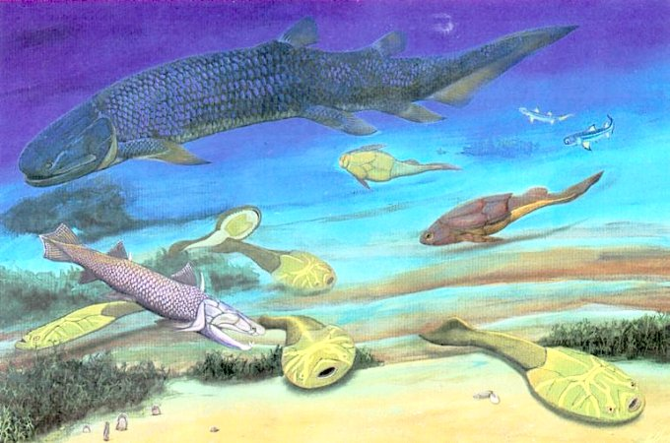
The Vertebrate Story, Part one
BIOL 495 – Chapter Three

Slide 2
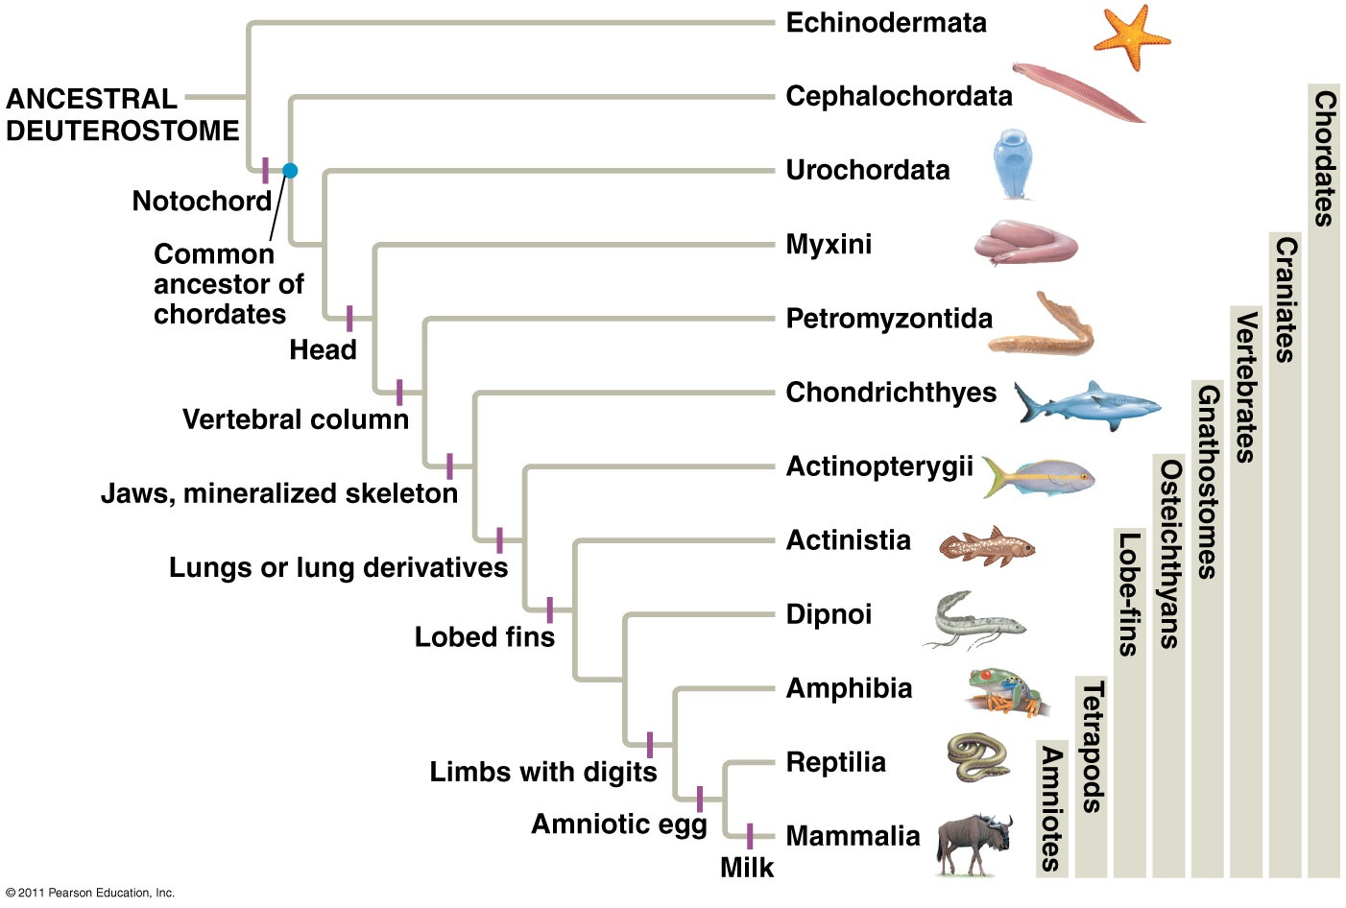

Slide 3
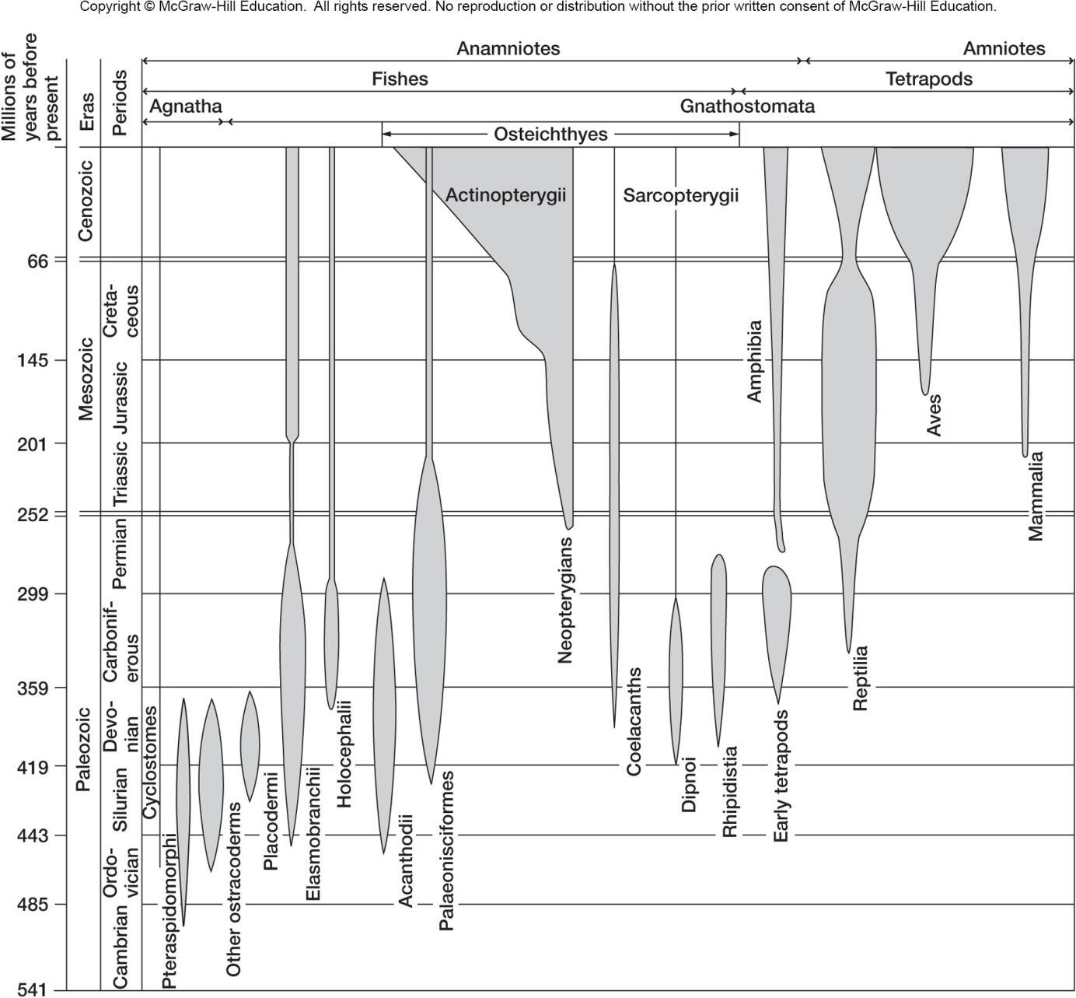

Slide 4
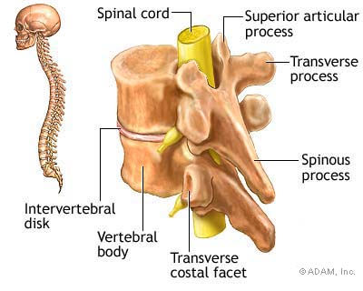
Vertebrate Innovations
Vertebral Column
Cranium

Slide 5
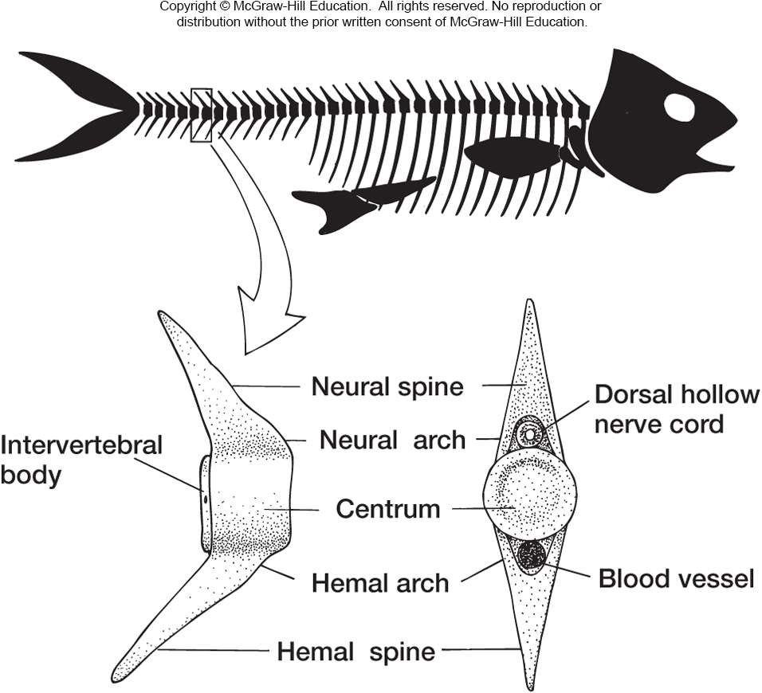
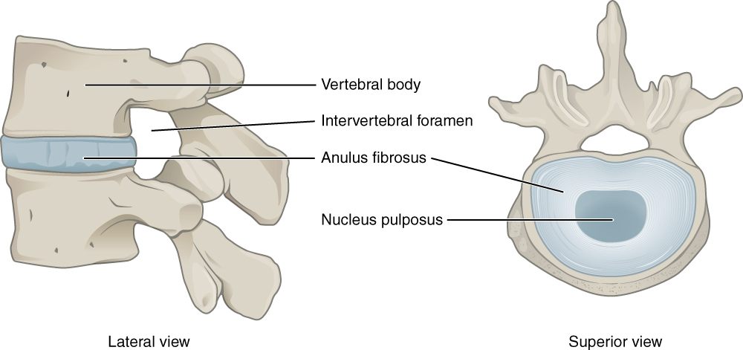
Vertebral Column

Slide 6
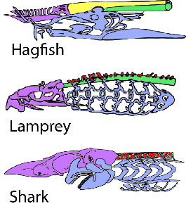
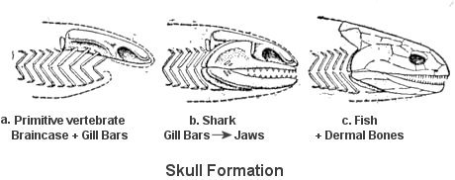
Cranium

Slide 7
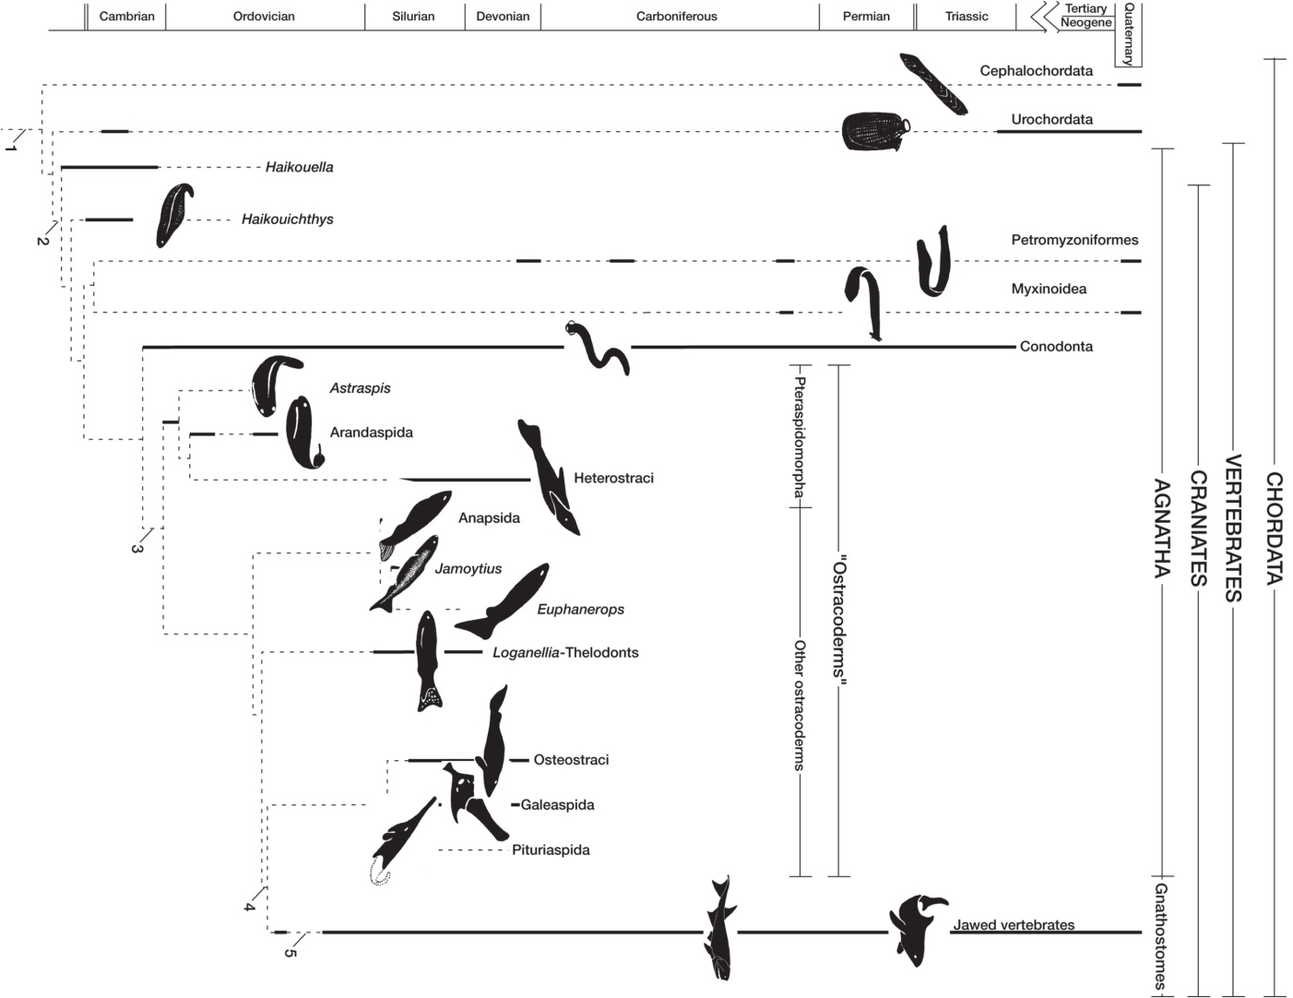
Vertebrate Phylogeny

Slide 8
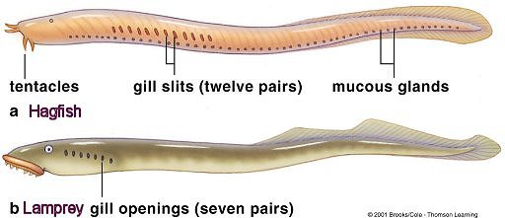
Jawless fishes - Living

Slide 9
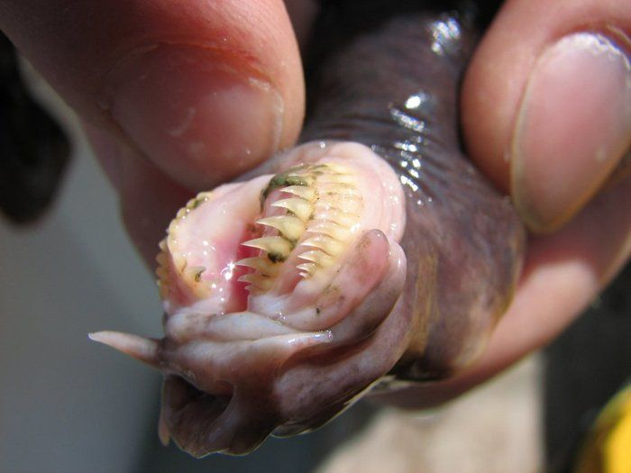
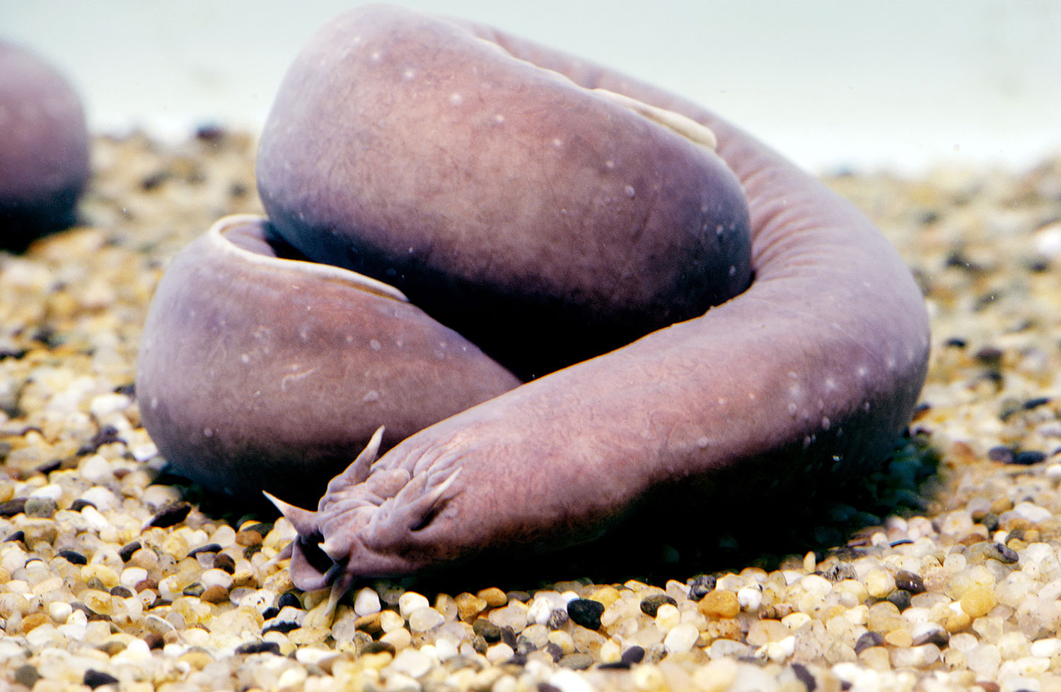
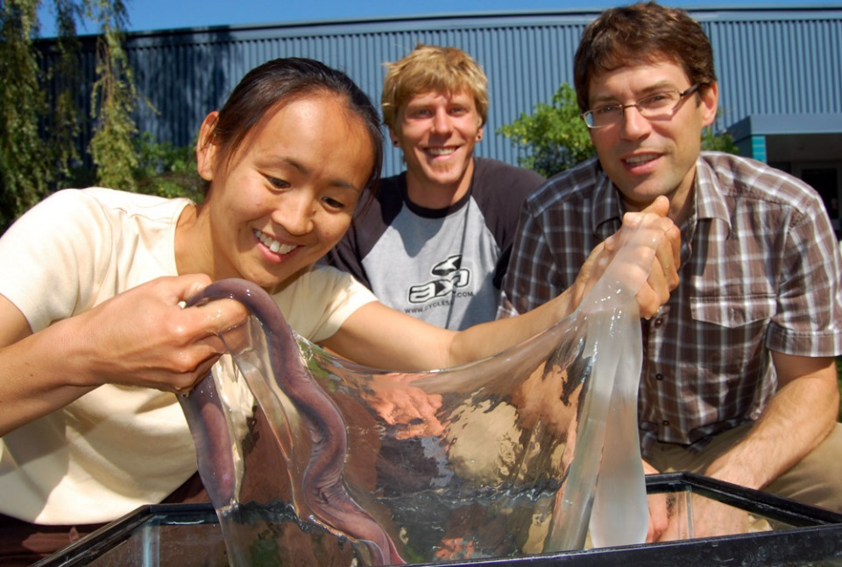
Hagfish – Myxinoidea
77 Species!
Notes:
Deep sea mud burrowing. All salt water. Body same comp as salt water. Not herms really, if eggs

Slide 10
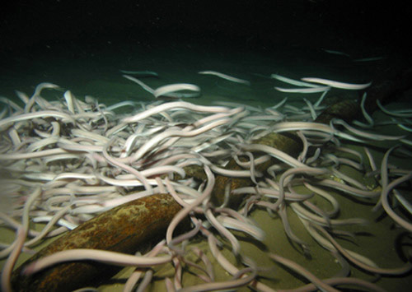
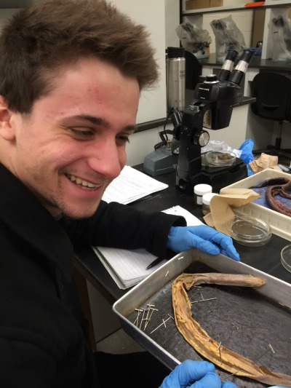

Slide 11
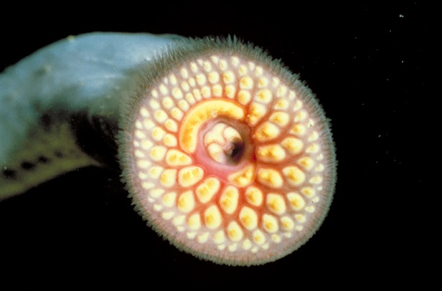
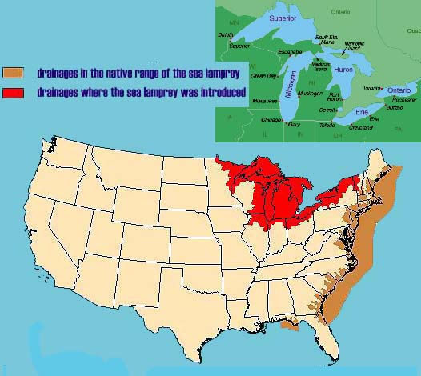
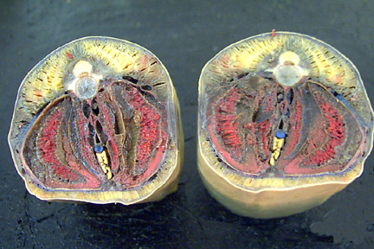
Lamprey - Petromyzoniformes
39 Species

Slide 12
Cyclostomes = Lamprey + Hagfish

Slide 13
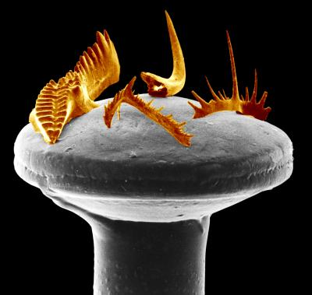
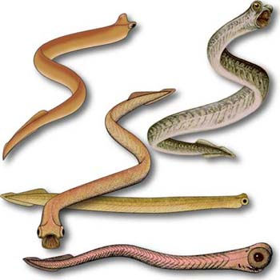
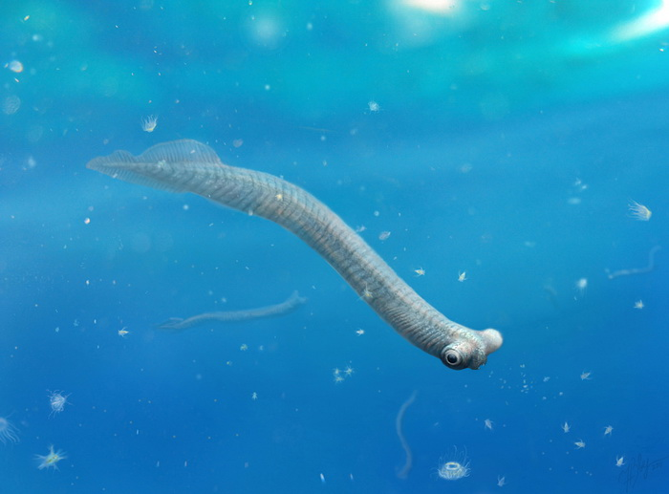
Fossil Agnathans - Conodonts
Cambrian to End Triassic ~ 500 to 200 Ma
Myomeres, notochord, postanal tail, dorsal nerve cord, pharyngeal slits
Mineralized dental tissues – cellular bone

Slide 14
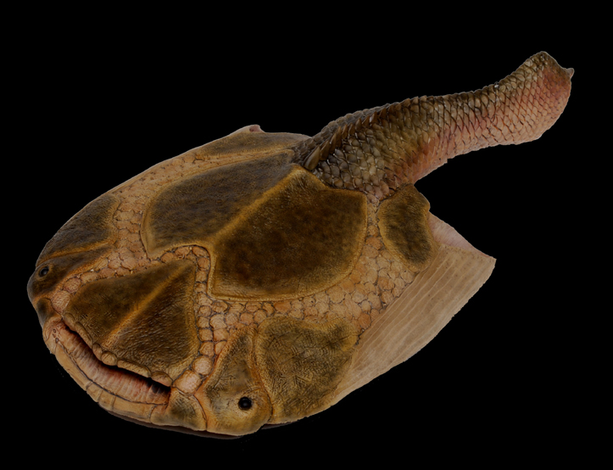
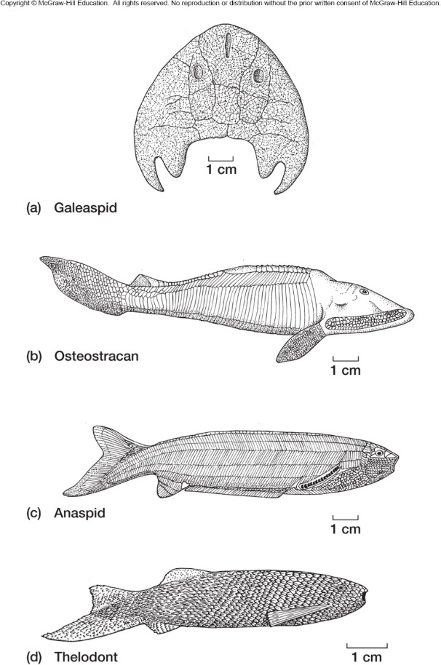
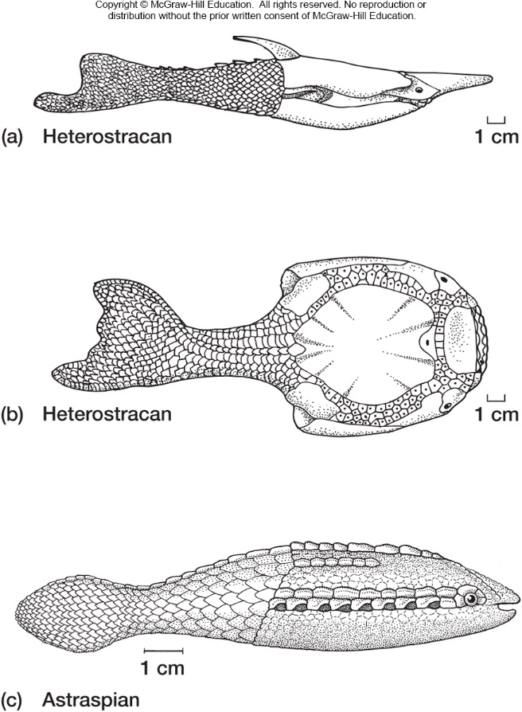
Fossil Agnathans - Ostracoderms
Ordovician to End Devonian ~ 470 to 370 Ma

Slide 15
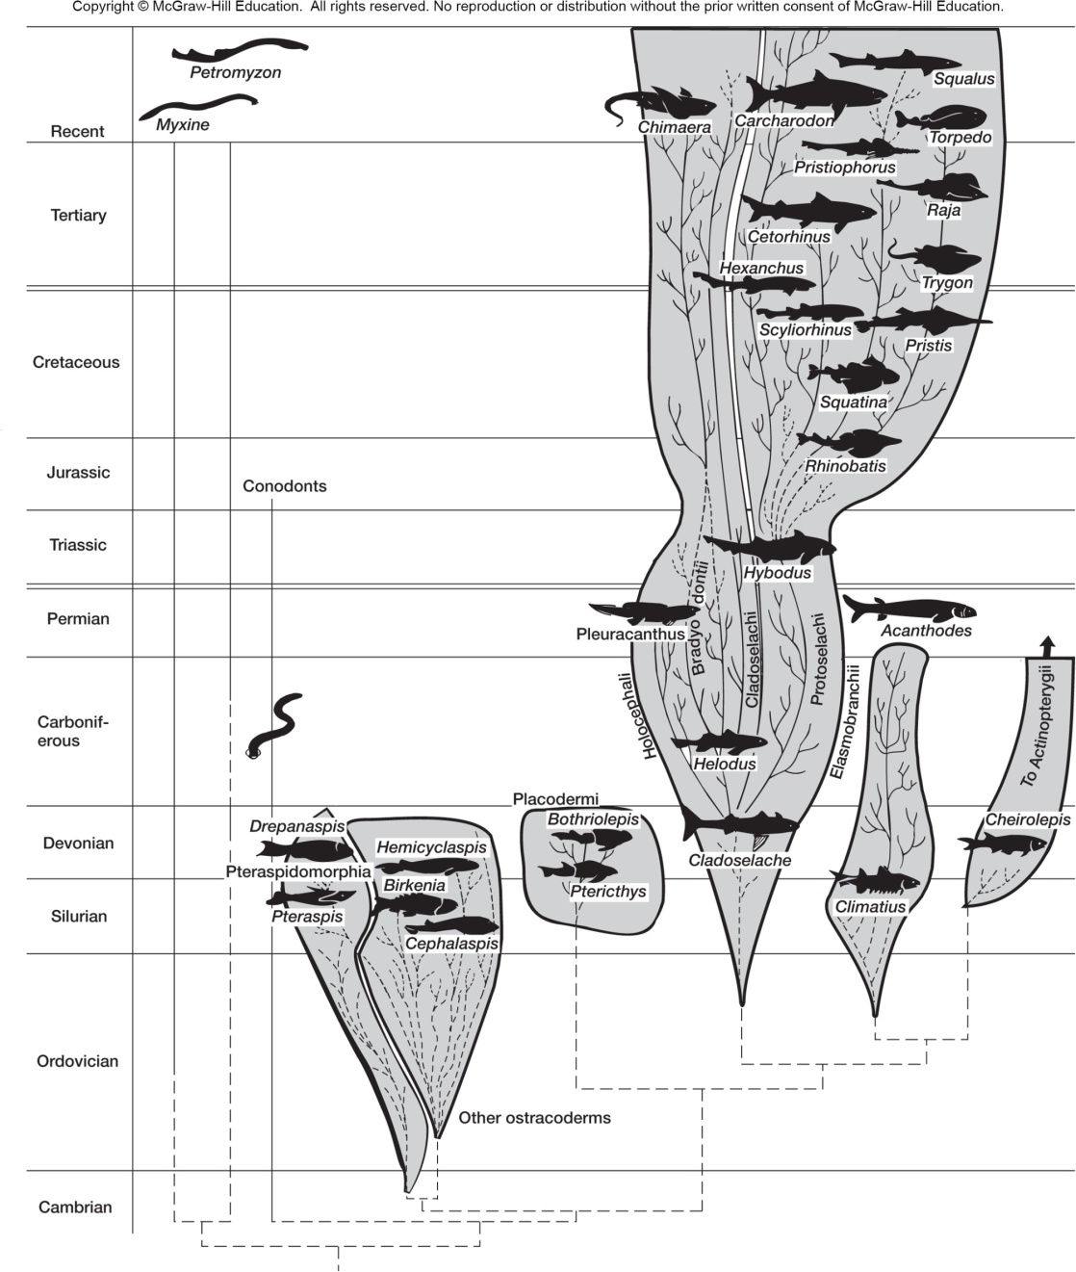
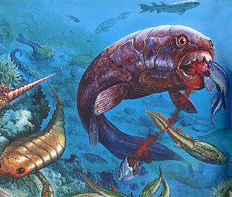

Slide 16
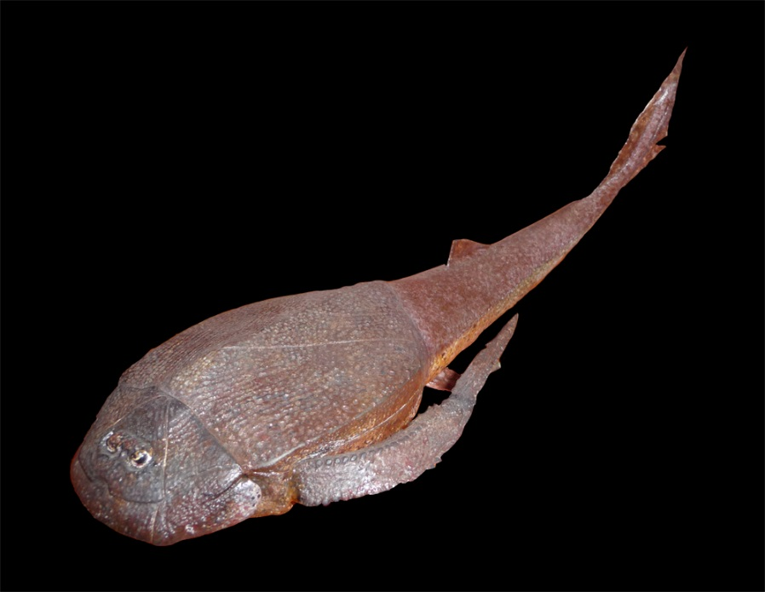
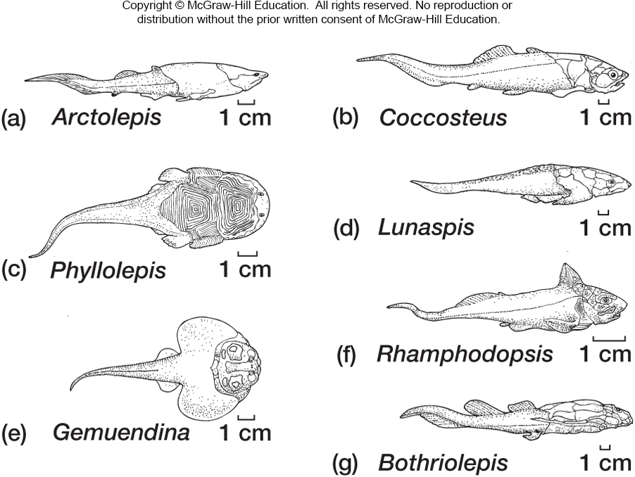
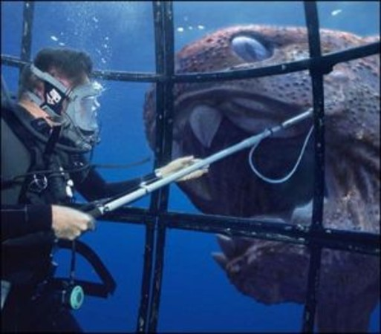
Placoderms – True Jaws Appear Silurian to Devonian ~ 440 to 370 MA

Slide 17
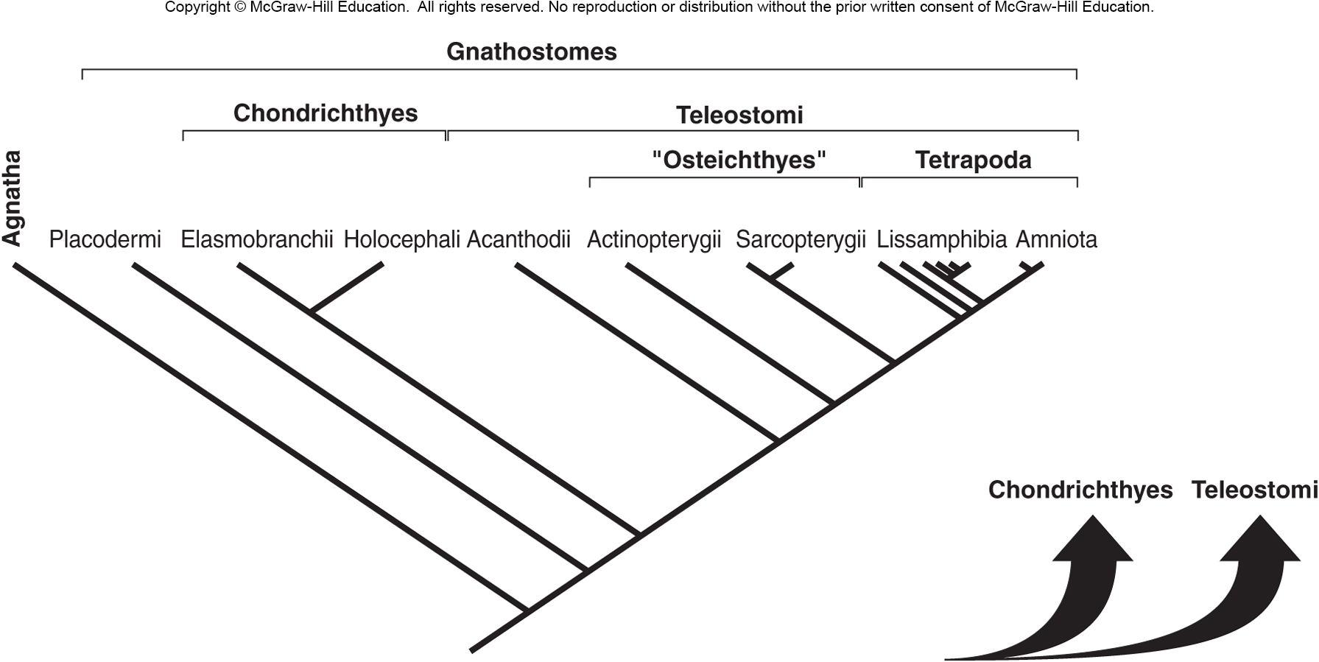
Placoderms replaced by sharks?
Notes:
Most make it!!! Poor placo

Slide 18
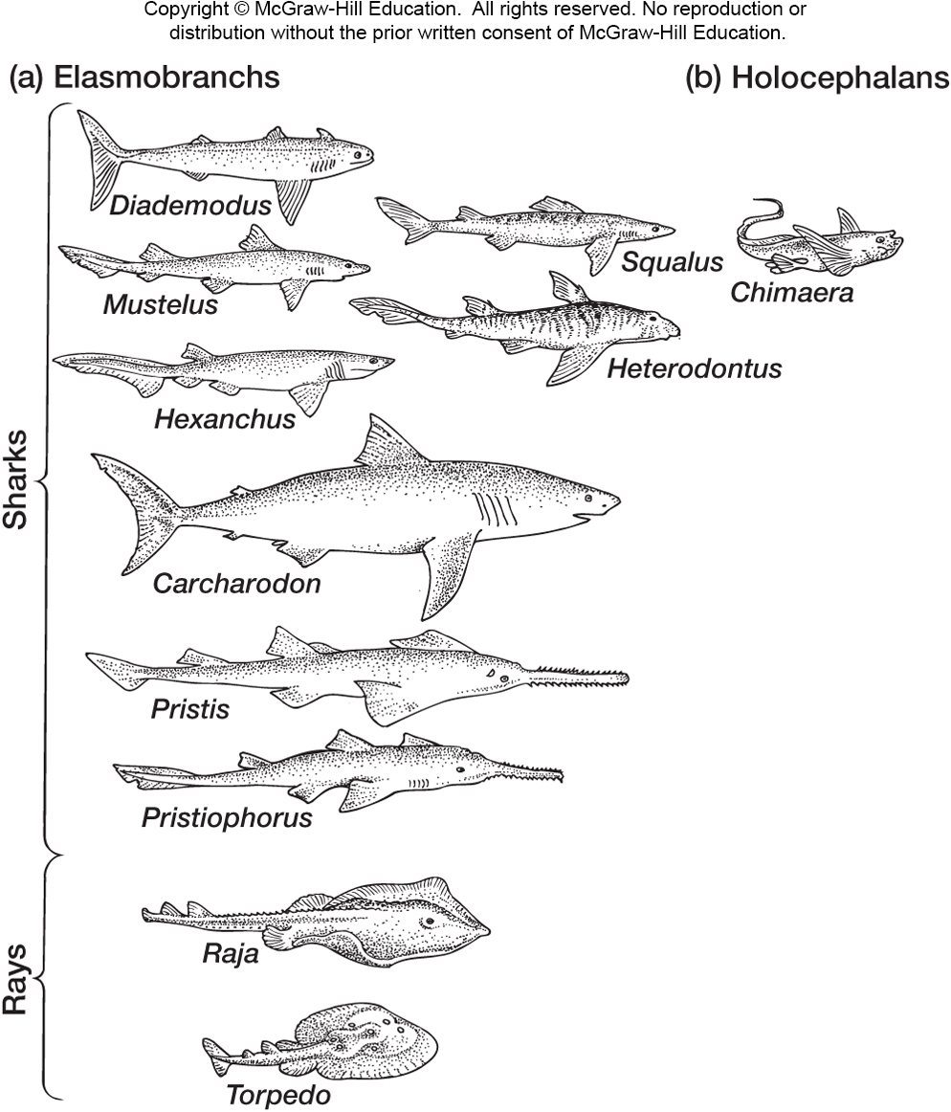
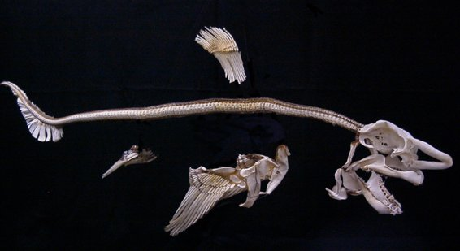
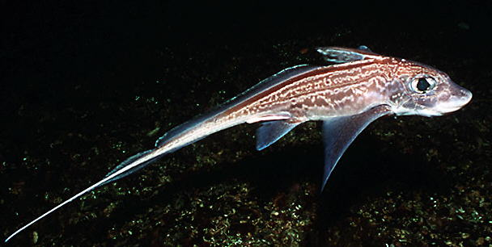
Chondrichthyes – Elasmobranchii & Holocephali ~ 460 Ma – Silurian
‘Cartilage Fish’

Slide 19
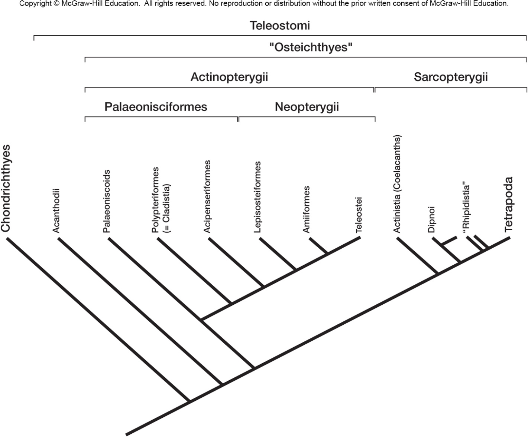
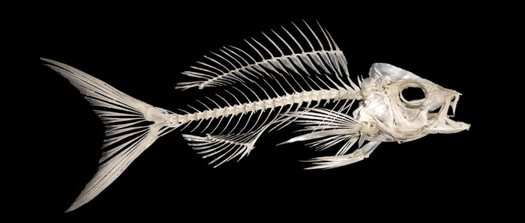
Osteichthyes – ‘Bony Fish’ ~ 460 Ma – Silurian

Slide 20
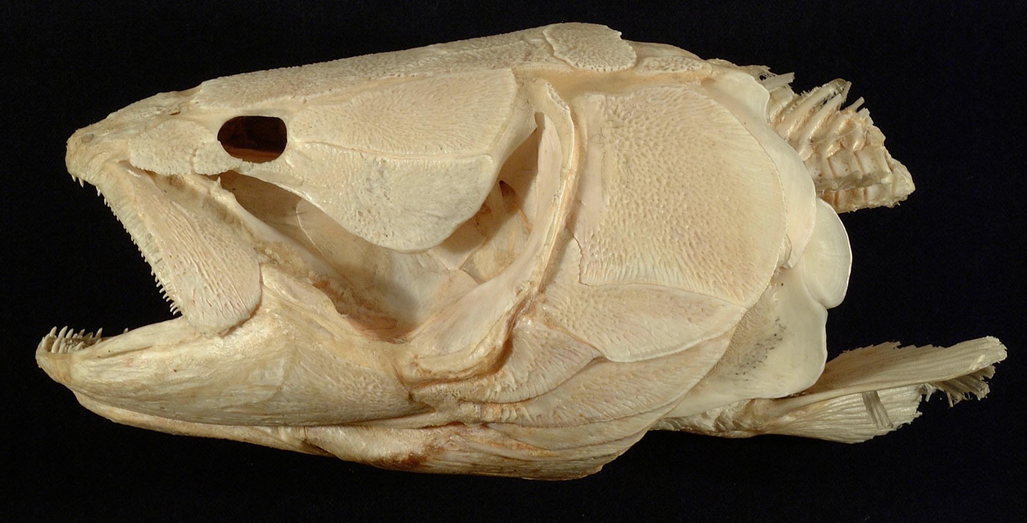
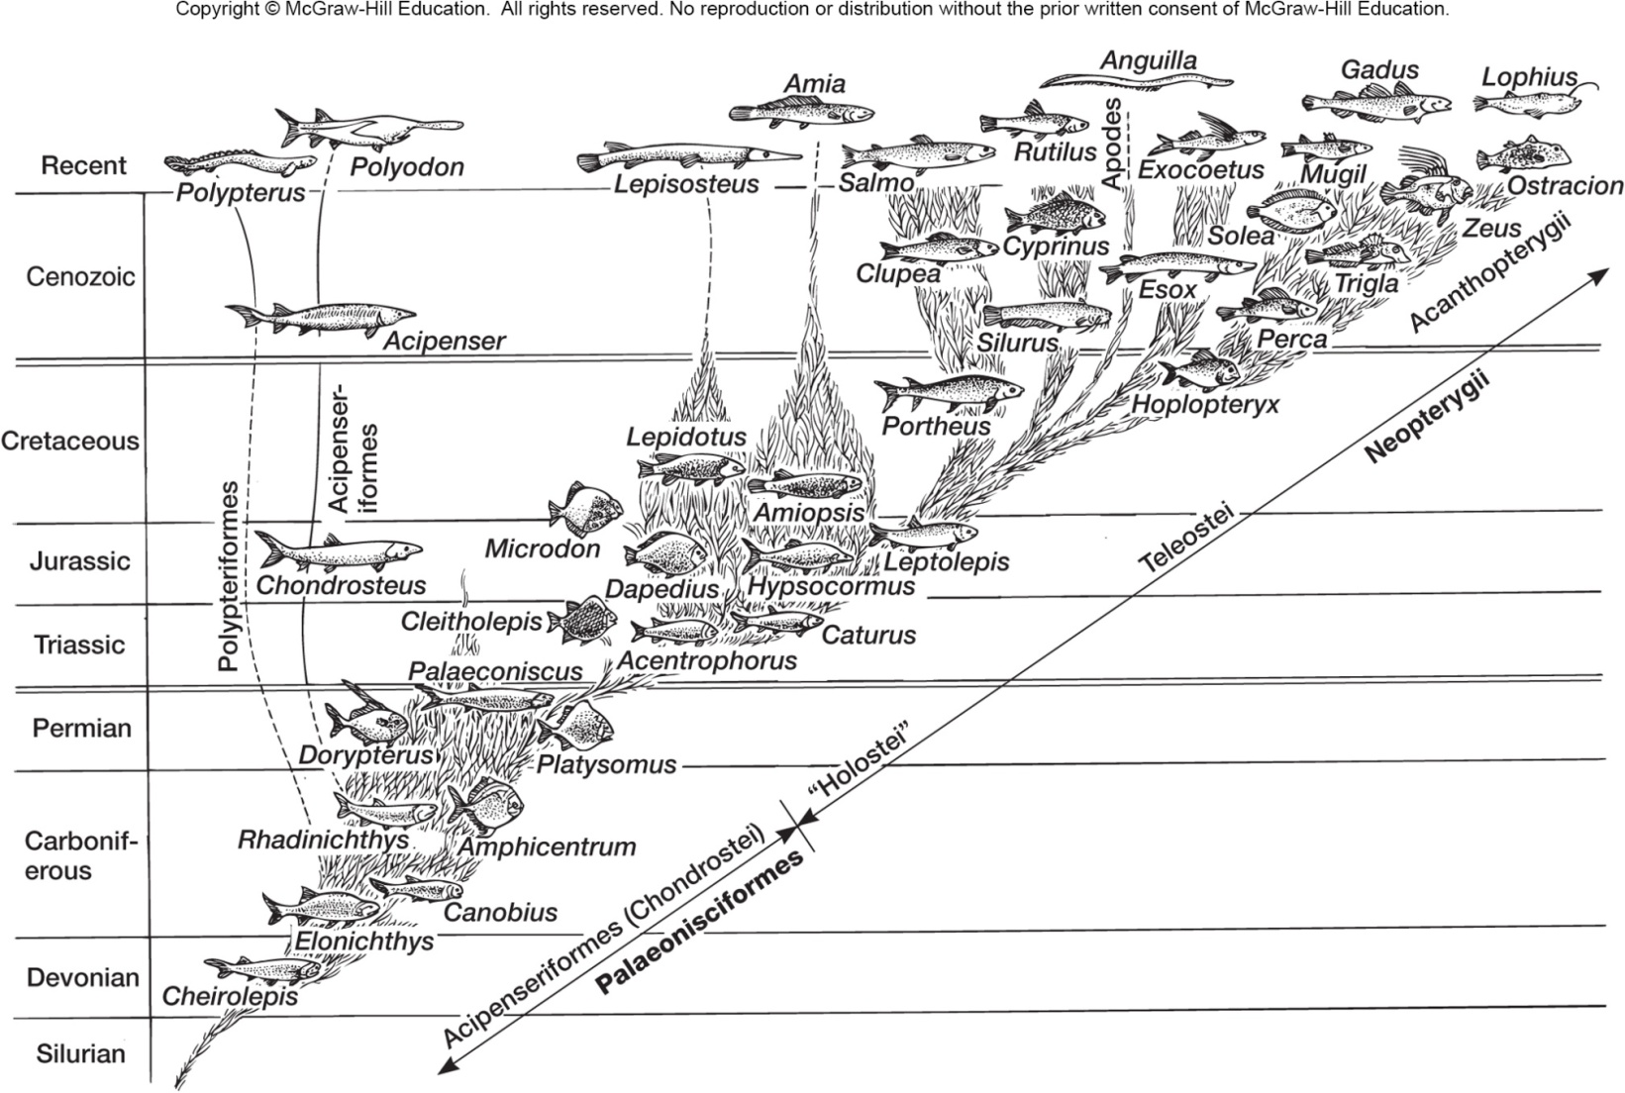
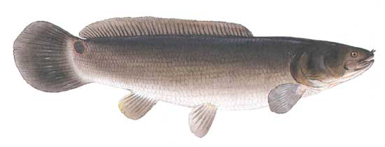
Actinopterygii the Ray Finned Fishes
Bowfin – Amia
A primitive Actinopterygiian

Slide 21
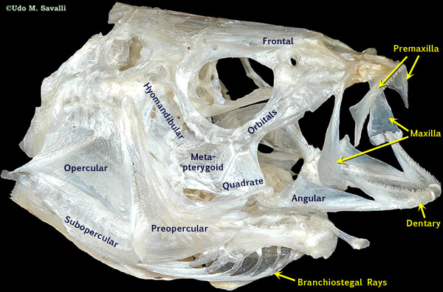
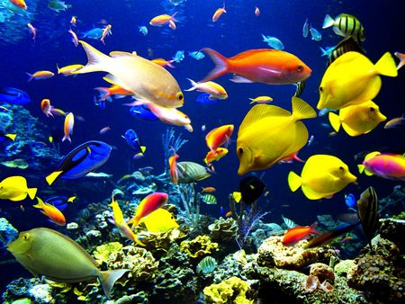
Teleostei – over 25,000 living species
Perch Skull

Slide 22
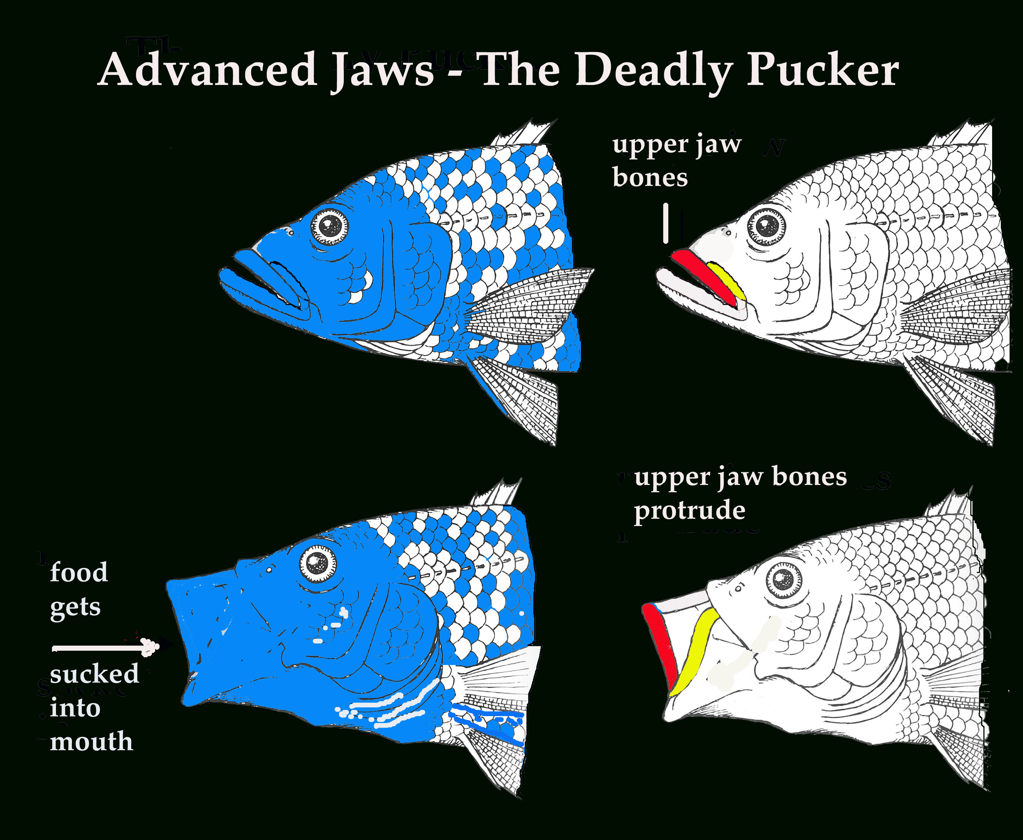
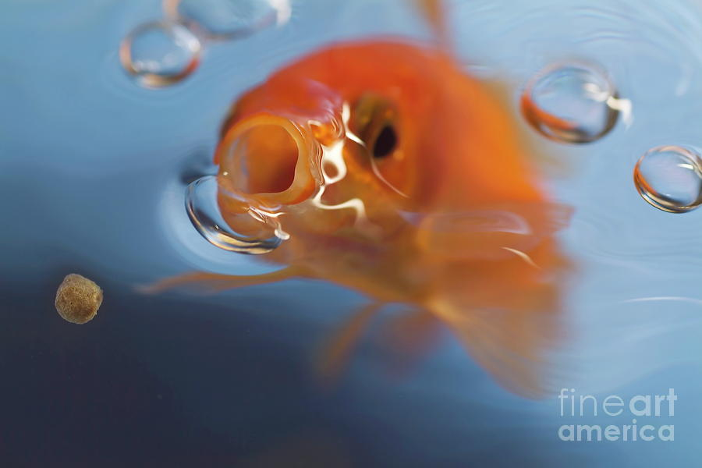

Slide 24
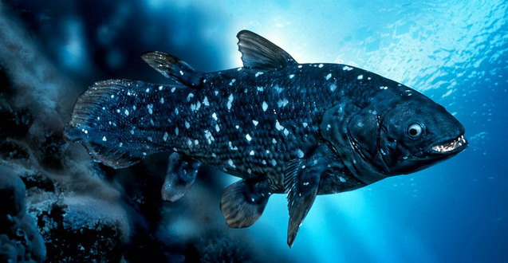
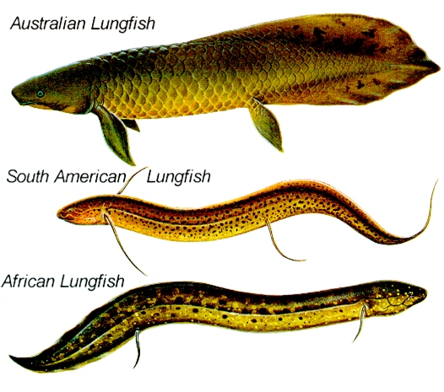
Sarcopterygii – Lobe Finned Fish

Slide 25
